Slide 1
Responding to the main MAP Review
Closeout Recommendation:
“A revised R&D plan addressing the issues described earlier must be submitted by November 30, 2010.”
The timescale constrains the scope of what is being requested.
During the same period, (i) the FY11 budget & the corresponding plan are being established , and (ii) the tools to enable MAP to manage the FY11 budget and rapidly assess schedule implications resulting from changes to the plan are also being established.
To mitigate the risk of “screwing up” whilst making these updates, we plan to proceed in a 2 step process:
  Update the MAP proposal to respond to the recommendations without changing what is assumed for the Year 2 resources (Year 1 was FY10), and submit the revised proposal by Nov. 30th.
  After Nov. 30th (when we have the tools we need), revise the plan to account for the this-year budget reality (we will have to do this every year anyway).
STEVE GEER
MAP TB 1st Nov, 2010
<number>

Slide 2
Game Plan
L1 Managers have been asked to make a first pass, in consultation with their L2 teams, at updating the MAP R&D plans to respond to the review recommendations.
Working discussions on the updated plans will take place this week.
Integrate the pieces into a coherent plan next week.
Present/discuss/finalize the updated plan in a TB meeting, to be scheduled. Thursday Nov. 18th ?
Aim to finalize the updated MAP proposal document before Thanksgiving (which is 25th Nov.).
STEVE GEER
MAP TB 1st Nov, 2010
<number>

Slide 3
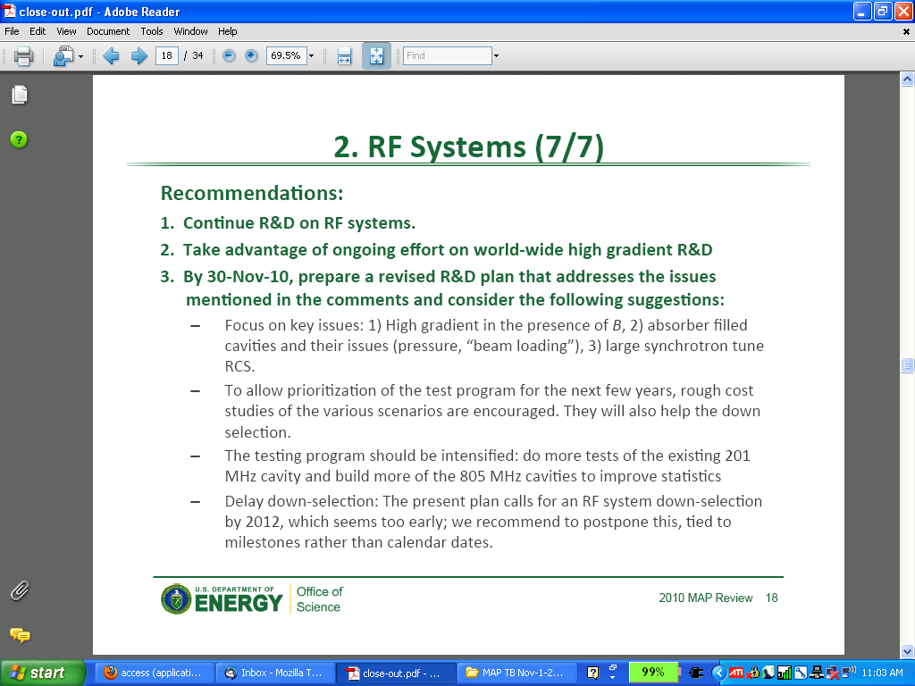
RF Systems Recommendations
STEVE GEER
MAP TB 1st Nov, 2010
<number>

Slide 4
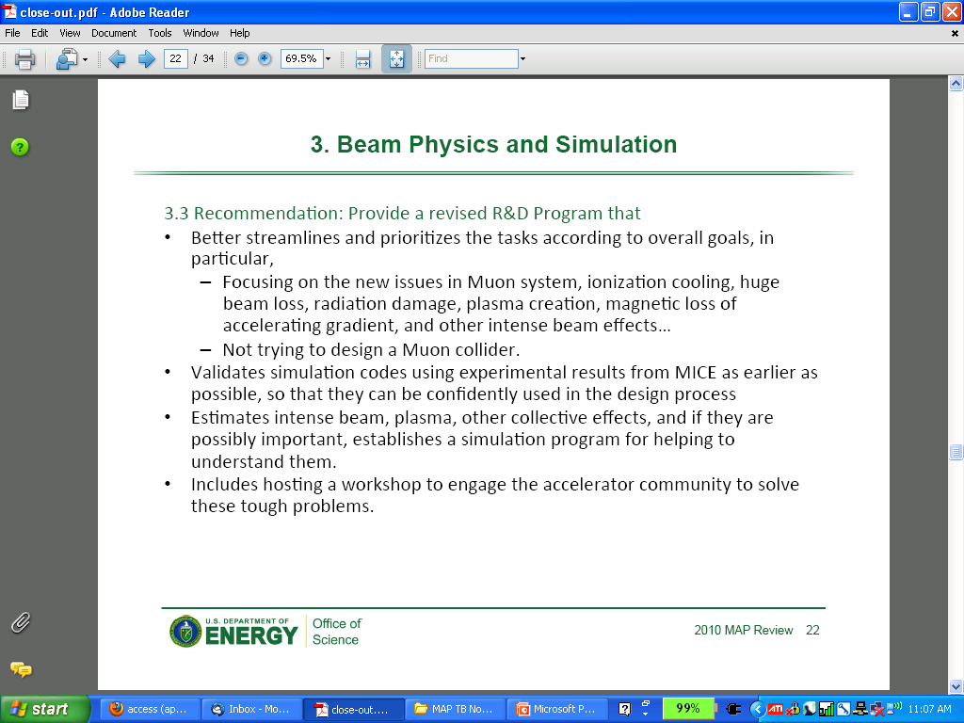
Beam Physics and Simulation Recommendations
STEVE GEER
MAP TB 1st Nov, 2010
<number>

Slide 5
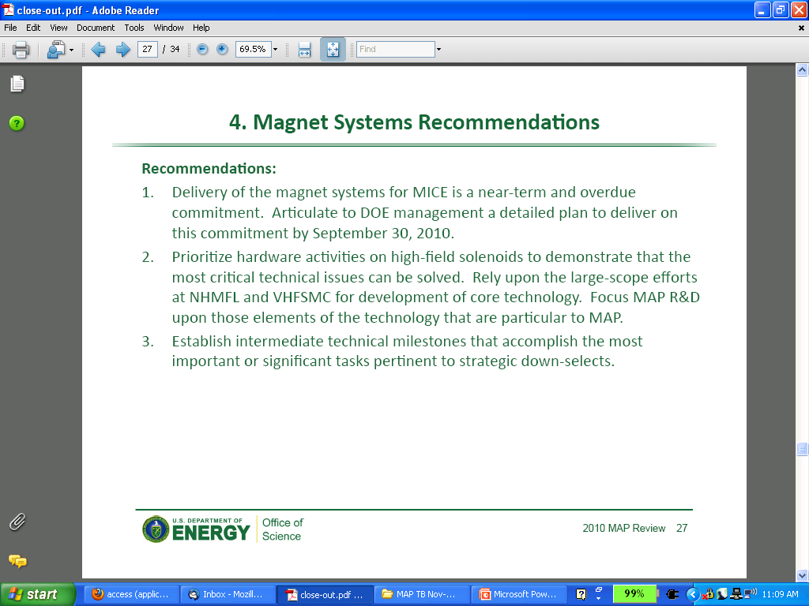
Magnet Systems Recommendations
STEVE GEER
MAP TB 1st Nov, 2010
<number>

