Slide 1
Muon Collider Design Workshop
December 1 - 3, 2009, BNL
Targetry Simulations
Roman Samulyak
AMS Department, Stony Brook University
and
Computational Science Center
Brookhaven National Laboratory
Collaborators:
Wurigen Bo, Xiaolin Li
Shuqiang Wang, Joung Doung Kim

Slide 2
Talk Overview
Main Objectives
Simulation of liquid mercury jet target for Neutrino Factory / Muon Collider and comparison with MERIT experiment
Status of the incompressible FronTier code
2009/12/1
2
Notes:
2

Slide 3

Motivation of the Present Study of the Mercury Target
Understanding of the hydrodynamic response of the mercury target and explanation of all details of MERIT data is necessary for the future target design
Using improved 3D FrontTier capabilities, perform new series of full 3D simulations of the mercury target with resolved all relevant physics processes
Perform full benchmark of simulations with MERIT data and fine-tune FronTier models
After the benchmark, FronTier can be used for reliable predictions of future targets.

Slide 4
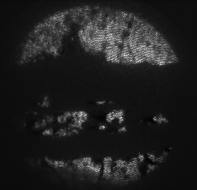
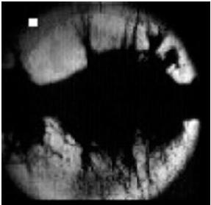
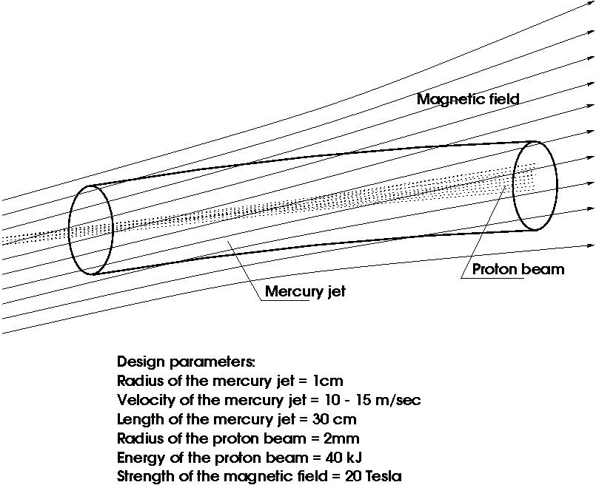
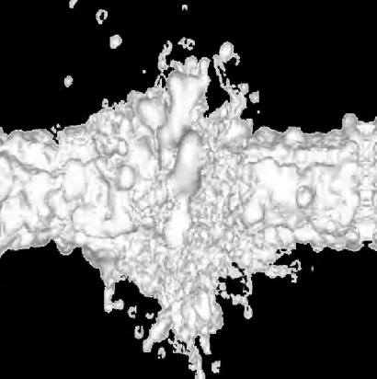
Mercury Jet Target for Neutrino Factory / Muon Collider
Distortion of the mercury jet as it enters the solenoid
Interaction of the mercury jet with proton pulses
  Studies of surface instabilities, jet breakup, and cavitation
  MHD forces reduce both jet expansion, instabilities, and cavitation
Dump of the used mercury jet in the reservoir
Jet disruptions
Top: experiment
Bottom: simulation
Target schematic

Slide 5
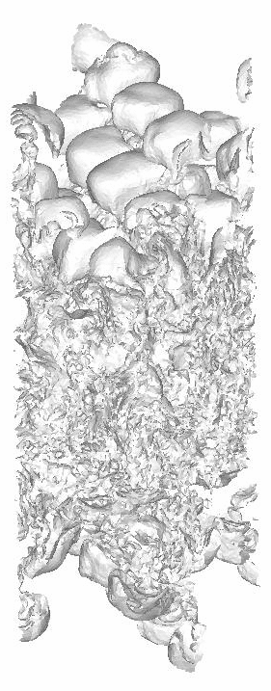
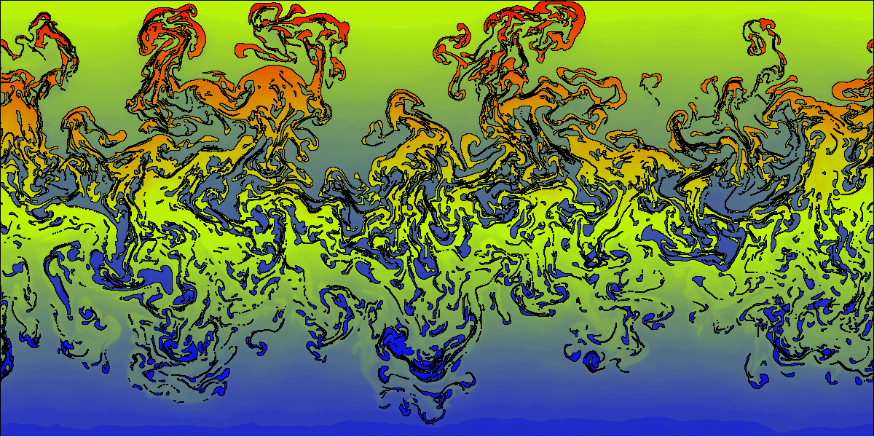
The FronTier Code
FronTier is a parallel 3D multiphysics code based on front tracking
Being developed within DOE SciDAC program
Physics models include
  Compressible and incompressible fluid dynamics, MHD
  Flows in porous media
  Phase transitions and turbulence models
Turbulent fluid mixing.
Left: 2D
Right: 3D (fragment of the interface)

Slide 6
Simulations of the mercury jet interaction with proton pulses

Slide 7
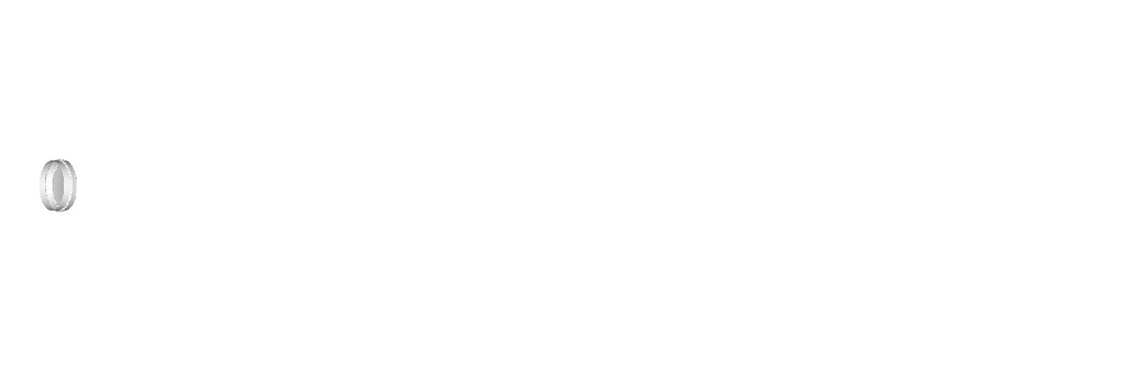
3D Simuation of Jet Ejection from a Nozzle.
High Speed Jet Cavitation, Breakup and Atomization
We evaluated the influence of the initial jet turbulence on jet disruption due to the interaction with the proton pulse
Initial turbulence is negligible compared to proton pulse induced instabilities
As a result, most of runs are done with idealized initial jet

Slide 8
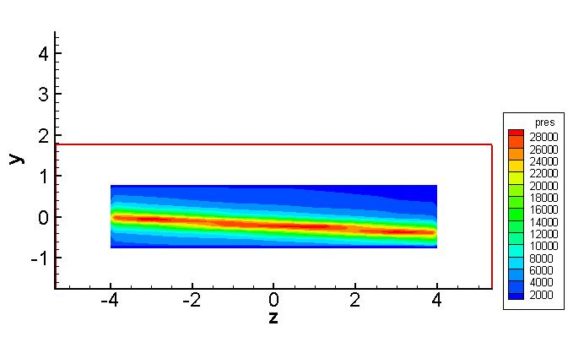
Simulation setup for proton-jet interaction
Elliptic jet: Major radius = 0.8cm
Minor radius = 0.3cm
Striganov’s Energy deposition calculation for 14Gev, 10T proton beam is used. The peak pressure is 12,050 bar.
Initial pressure distribution

Slide 9
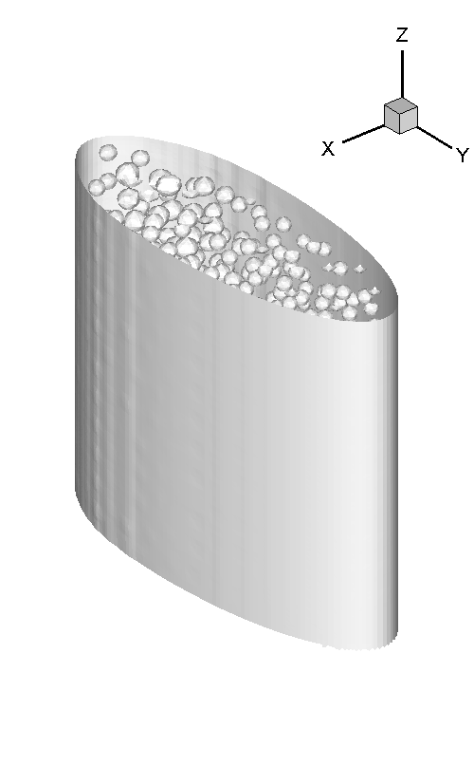
Evolution of the jet surface and cavitation bubbles for B=5T

Slide 10
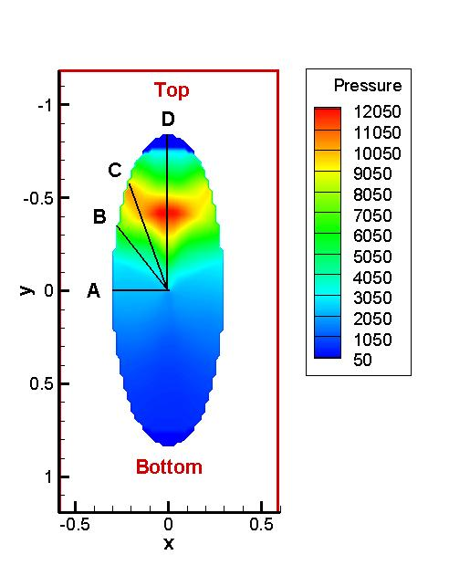
Positions for the filament length calculation
To obtain the expansion velocity along the jet surface, we evaluate the expansion length in 4 typical positions.

Slide 11
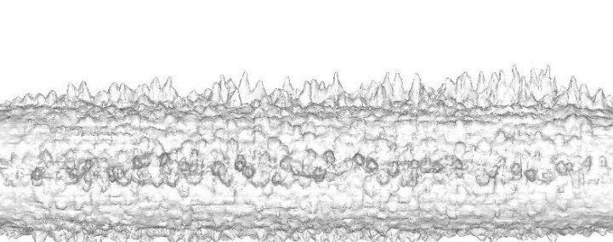
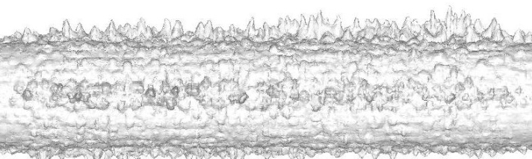
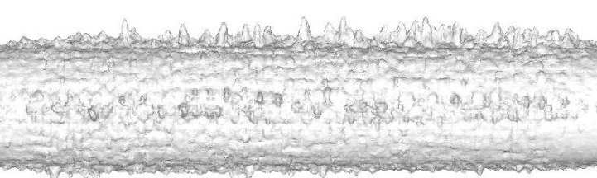
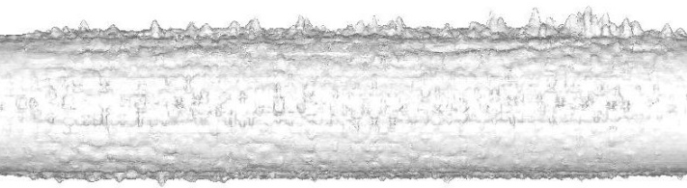
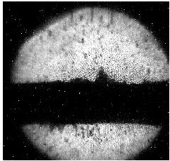
MHD Stabilizing Effect
Right: From top to bottom, the jet surface at 150 microsecond under longitudinal magnetic field.
Both the interior velocity and the surface velocity of the jet are decreasing with the increasing magnetic field.
The MHD stabilizing effect is weaker than in the corresponding 2D simulations where circular current exists in filaments.
0T
5T
10T
15T
Image from the experiment, B=10T

Slide 12
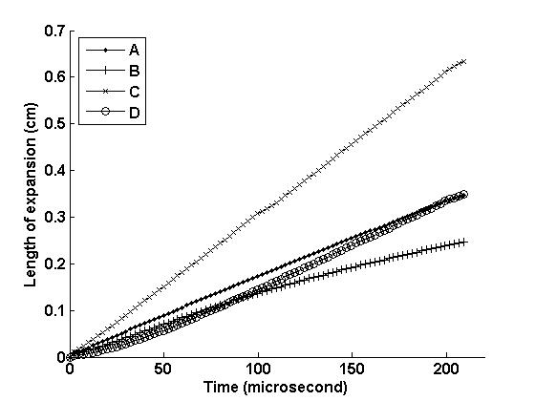
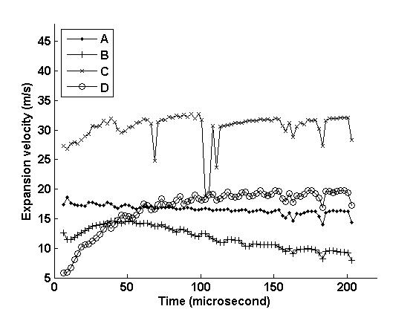
No magnetic field

Slide 13
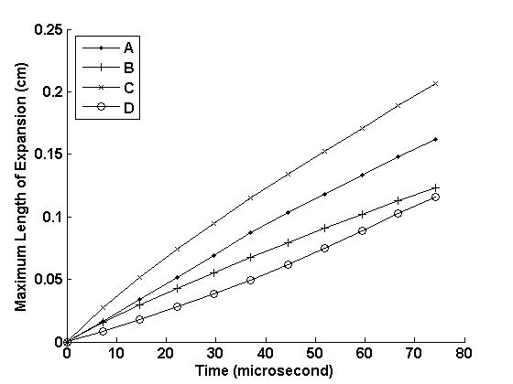
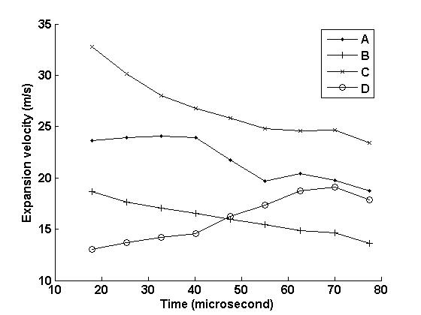
B=5T

Slide 14
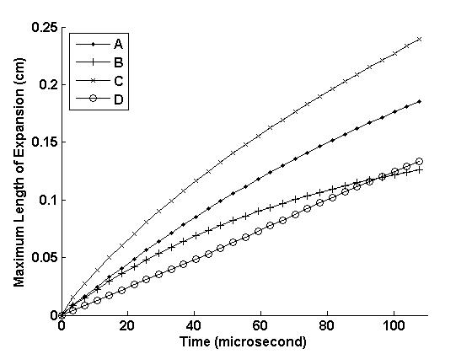
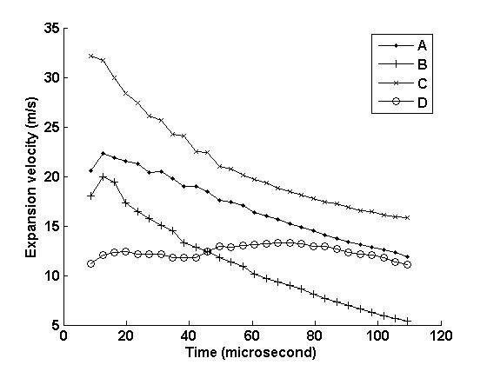
B=10T

Slide 15
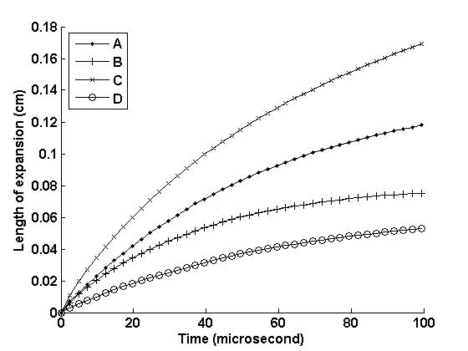
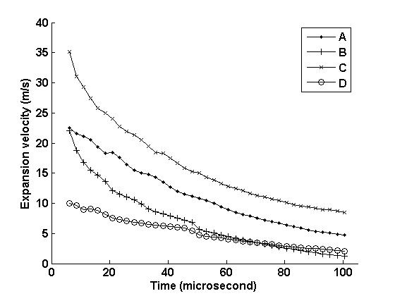
B=15T

Slide 16
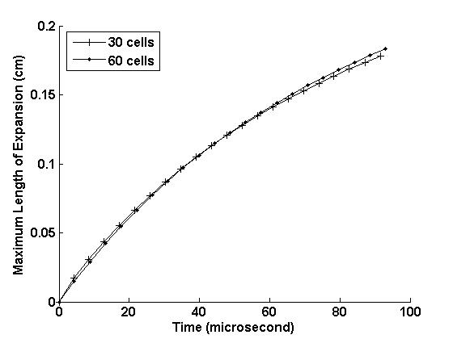
Mesh refinement
Maximum length of expansion for B=15T under mesh refinement.

Slide 17
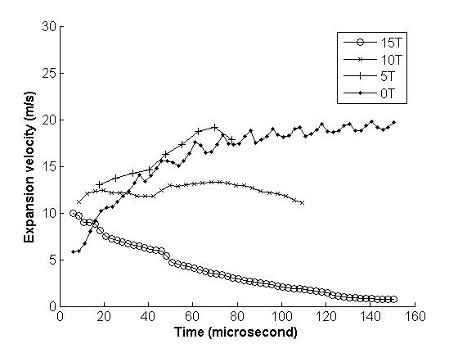
The velocity of filaments in the major axis of the ellipse for different magnetic fields.

Slide 18
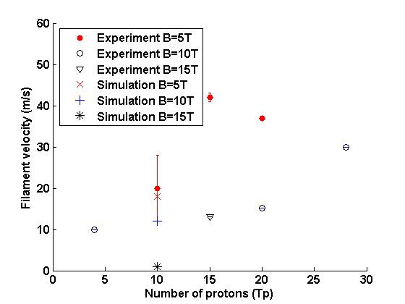
The velocity of filaments in the major axis of the ellipse for different
magnetic fields: comparison of experiments and simulations

Slide 19
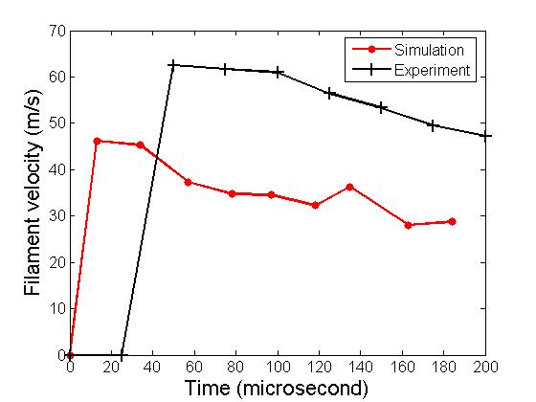
Delay in the formation of filaments
Large (~25 microsecond) delay in the formation of filaments was not observed in simulations.
Currently the nature of this delay is not understood.

Slide 20
Simulations of the mercury jet entrance into the magnetic field

Slide 21
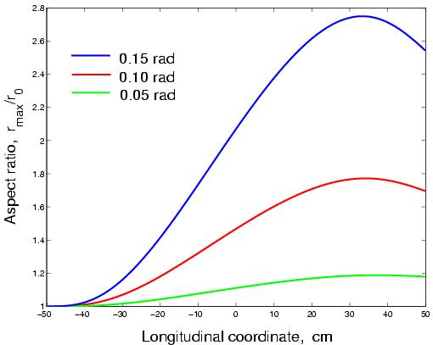
Distortion of the jet entering 15 T solenoid
B = 15 T
V0 = 25 m/s
Top: Aspect ration of the jet entering 15 T solenoid

Slide 22
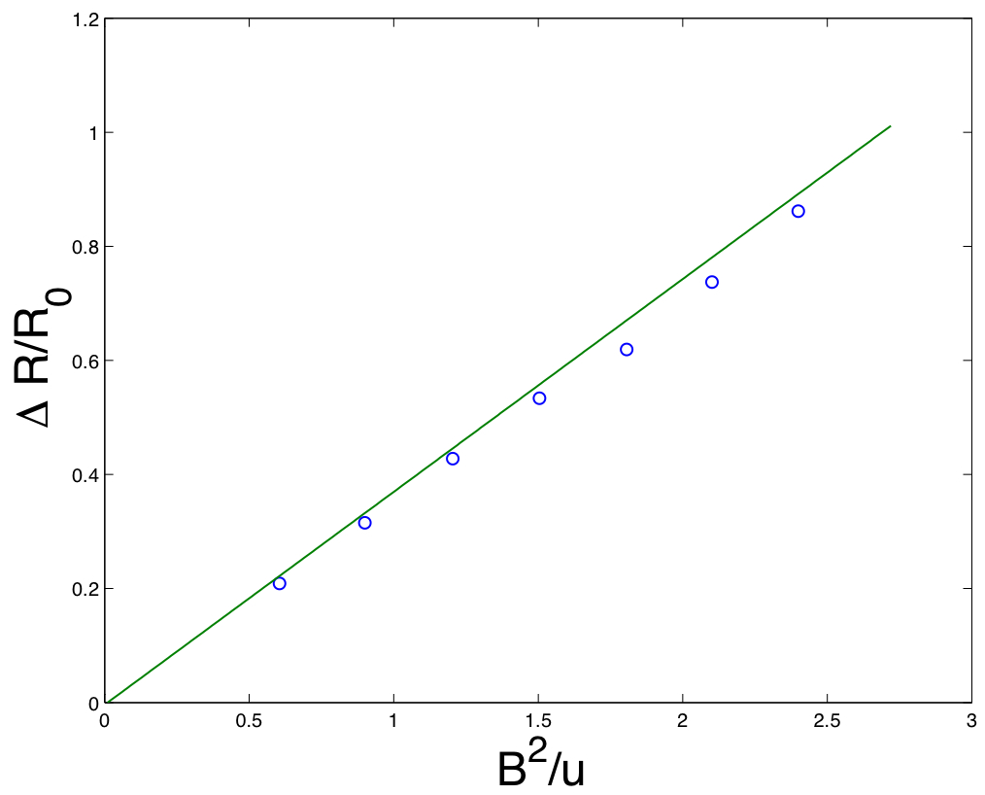
Comparison with the theory and other experiments (Oshima et al)
Obtained an excellent agreement with theory and experiments (Oshima at al) on the jet distortion
MERIT target simulations by FronTier agreed well with HyperMAG simulations (Neal Morley)
R. Samulyak et. al, Journal of Computational Physics, 226 (2007), 1532 - 1549.

Slide 23
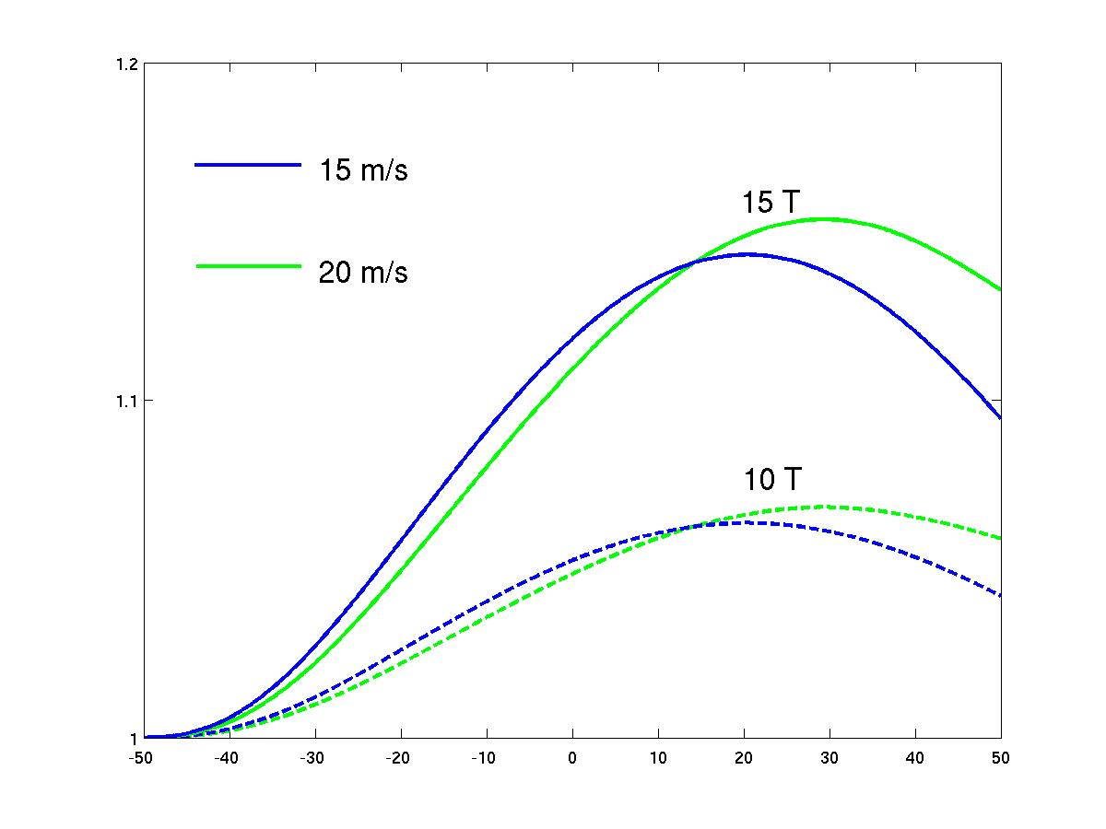
Predicted jet distortion in three view ports (MERIT experiment)
vp1 vp2 vp3
Our simulations underestimeted the jet distortion. Some other factors need to be resolved

Slide 24
Motivation for the development of
Incompressible FronTier code
Many problems related to the mercury target design require incompressible hydro / MHD code for multiphase / free surface flows
Entrance of the mercury jet in magnetic field
Mercury jet dump
These problems require physical simulation time of hundreds of milliseconds
Typical time step for a compressible code is
Grid size / fastest wave speed (sound speed) ~ 1.e-4 milliseconds
Millions of time steps with 3D compressible code is not feasible
Running compressible code with reduced sound speed introduced errors

Slide 25

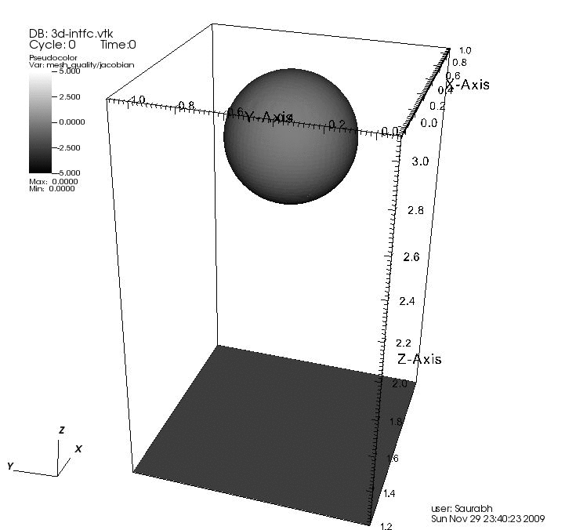
Incompressible FronTier code
Developed incompressible hydrodynamics code based on front tracking and the immersed boundary method for the projection equation

Slide 26
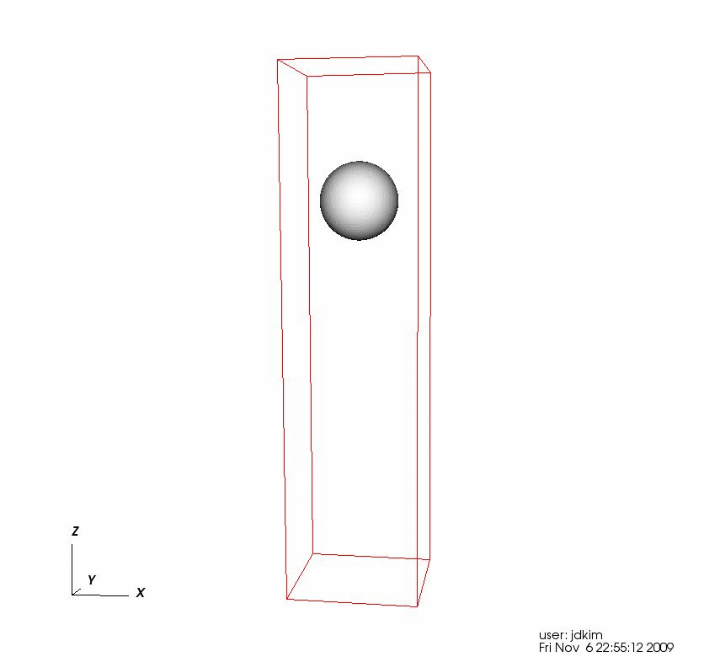

Incompressible FronTier code (cont.)

Slide 27
Limitations
The immersed boundary numerical approximation for the pressure equation within the projection method imposes limitations on the density jump across the interface ( x 10)
This is not acceptable for the target simulations (the density of the ambient gas would have to be ~1.3 g/cc )

Slide 28
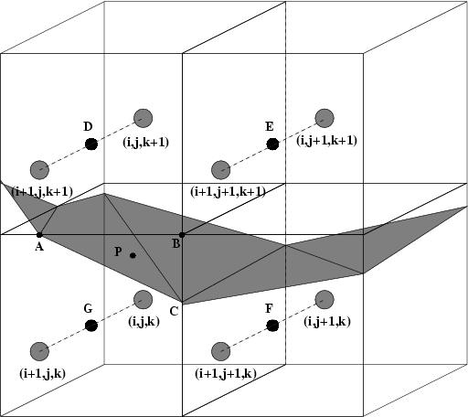
Resolution of limitations
Embedded boundary discretization has been developed for elliptic and parabolic equations and implemented in FronTier-MHD code
The method is currently being implemented in the incompressible FronTier code
  It will remove restrictions of the density discontinuity

Slide 29
Conclusions and Future Plan
New robust algorithm for topological change of 3D surface, 3D bubble insertion method coupling with the MHD code enabled large scale 3D simulations with complex geometry.
Performed simulations of mercury jets interacting with magnetic fields
Observed good agreement with experiments on the filament velocity
The delay of the filament formation was not observed in simulations.
Need to clarify the physics of the observed delay of the jet disruption
Further study of the jet entrance in the magnetic field will be performed and the contribution of several factors (velocity profile, turbulence etc) will be tested
Comprehensive benchmark with MERIT experiments
Simulations of mercury target at higher beam intensities
Simulations of the mercury dump process with new incompressible code
Studies relevant to other target concepts (waterfall etc.)

