Slide 1
Introduction to Optical Stochastic Cooling and the Bates Linear Accelerator Center at MIT
Robert P. Redwine
Director, Bates Linear Accelerator Center

Slide 2
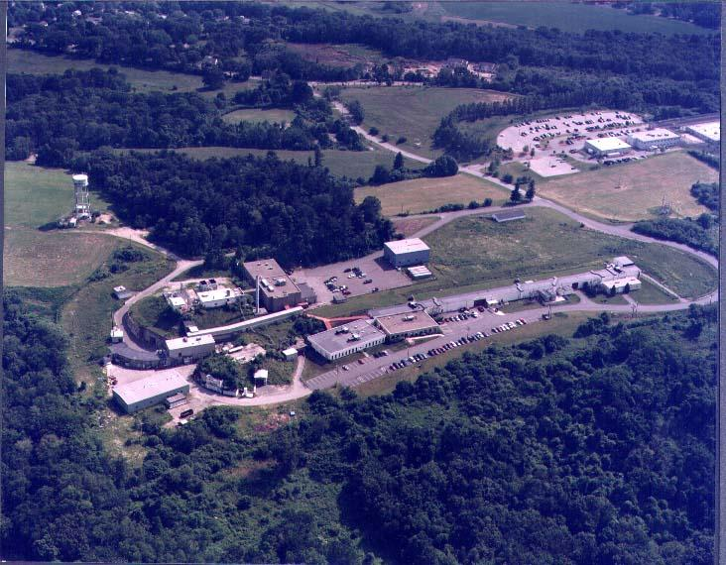
MIT Bates Linear Accelerator Center

Slide 3
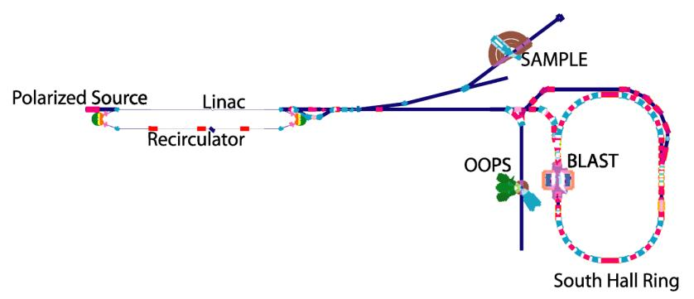
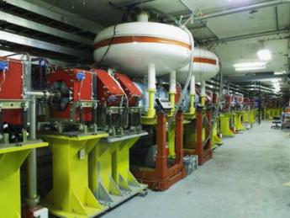
History
500 MeV linear electron accelerator with recirculator, polarized electron source and storage ring
Recirculator nearly doubles energy to 1 GeV
Storage ring can stack pulses from the accelerator to at least 225 mA; beam stores for 25-30 minutes
Beam polarization is kept longitudinal at target with a Siberian Snake
Ran nuclear physics experiments for 31 years, under a cooperative agreement with US DOE
Siberian Snake

Slide 4
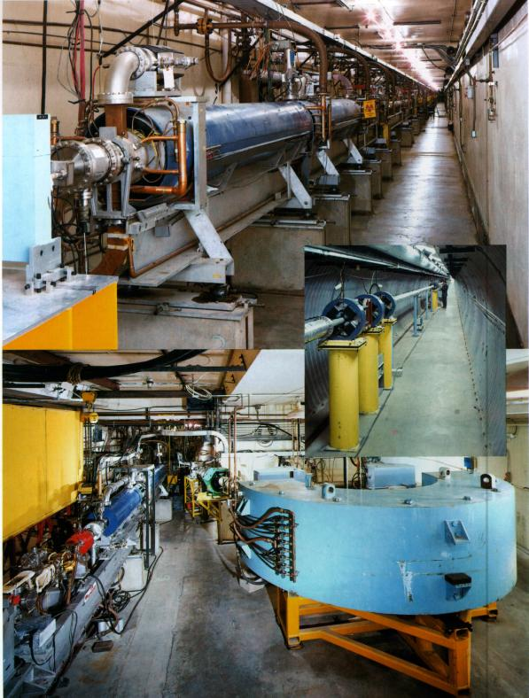
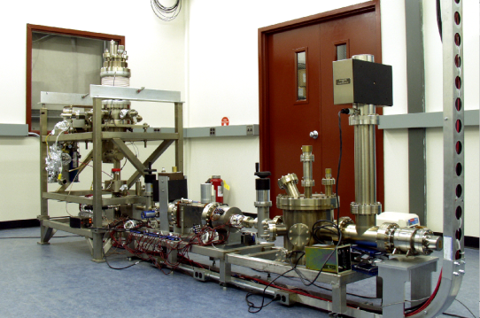
Present
MIT now owns the site and facilities
Bates is a multi-purpose laboratory
20+ physicists, engineers and technicians on-site

Slide 5
Optical Stochastic Cooling
Optical Stochastic Cooling (OSC) is potentially important for several applications, including a muon collider.
The MIT/Bates lab represents an almost ideal opportunity for a demonstration of OSC.
NP and HEP at DOE are evaluating a proposal from Bates to test OSC.
Dennis Kovar would like to hear directly from the muon collider community about the importance of pursuing OSC.

Slide 6
Optical Stochastic Cooling of a 100 GeV Muon Beam
(A. Zholents & M. Zolotorev)
Christoph Tschalär
Bates Linear Accelerator Center
Massachusetts Institute of Technology

Slide 7
Goal:
Cool a beam of 10⁹ muons at 100 GeV in ≤ 4ms (muon life-time = 2.2 ms)
Transverse:
Longitudinal:
Total 6-dimensional emittance reduction = 4·10¹⁰

Slide 8
OSC Cooling Section
N S N S N
Charged particle beam delayed
by magnetic bypass
Light pulse delayed and amplified
Particle receives longitudinal kick from own amplified light pulse in 2nd undulator
Particle in first undulator emits coherent light pulse of length Nλ

Slide 9
OSC Formalism
Phase shift
Mean shift
Mean cooling per transition:
N_{s} = number of muons whose light signals overlap

Slide 10
Maximize α_{L,T}
Optimize G:
incoherent heating = ½ coherent cooling
for
Optimize phase shift
→
Dual challenge: make N_{s} very small, G very large

Slide 11
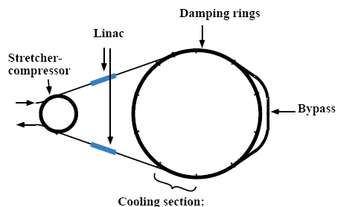
Conceptual Solution (Zholents & Zolotorev)
Three
C=1100m
Stretch incoming beam bunch from 0.2m to 100m length
Compress δ_{av} from 10⁻³ to 2·10⁻⁶
→ reduces N_{s} to
→

Slide 12
Initial and Final Beam Parameters in the Cooling Ring
initial final change
2·10⁻⁴ 2.5·10⁻⁶ 1/80
1·10⁻⁴ 1.2·10⁻⁶ 1/80
2·10⁻⁶ 2·10⁻⁹ 1/1000
8·10⁻¹¹ 1.8·10⁻²¹ 1/4·10¹⁰

Slide 13
Initial and Final Lattice Parameters for Optimal Cooling at 0.8 μm Optical Wavelength
initial final change
100 ~1000 ~10
4·10⁻⁴ 3.3·10⁻² 83
-0.1 -30 300
-0.025 -25 1000

Slide 14
Technical Challenges
Cooler Lattice
Very large dispersion
Very large and rapid change of cooling section time-of-flight parameters:
→ use 3 parallel cooler rings for initial, middle, and final cooling phase
→ reduce time-of-flight parameter changes to ~6 and dispersion change to ~2 in each ring
Cool both x and y dimension of the beam
→ attach bypass to cooler ring to rotate transverse beam plane by 90⁰ periodically

Slide 15
Light Amplifier
Optimized gain factor
at the beginning of the cooling cycle, decreasing exponentially to 2·10⁻¹¹ at the end, requires an average amplifier output power of
for each of the 10 cooling sections.
→ Use fast Optical Parametric Amplifier (OPA) developed by MIT group (F. Kärtner). Expected power levels of 1 kW reachable with intensive development in 5-10 years

Slide 16
Conclusion
OSC for muon beams of 10⁹ particles is conceptually feasible
Requires development of cooler lattices with large dispersions and rapidly varying time-of-flight characteristics
Requires development of kW-level OPA in the 1μm wavelength region
Requires experimental test of OSC to prove feasibility and develop basic tools and diagnostics

Slide 17

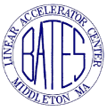
Optical Stochastic Cooling for a 2 TeVx2TeV Muon Collider &
OSC Experiment at the MIT-Bates South Hall Ring
F. Wang
MIT-Bates Linear Accelerator Center
Comparison of muon collider designs: “conventional” vs. “OSC”
OSC experiment at Bates: motivation, plan

Slide 18
Comparison of 2TeV x 2TeV muon collider design
 | Units | 1996 report (Table 13.5) | HEPAP P5 R.B.Palmer, March,2008 | OSC A.Zholents et al. PRST-AB 2001
Beam energy | TeV | 2x2 | 2x2 | 2x2
Ring Circumference | km | 8.08 | 8.08 | 8.08
Muons/bunch |  | 2x10¹² | 2x10¹² | 4.5x10⁸
No. of bunches for each sign |  | 2 | 2 | 2
β* at IP | μm | 3000 | 3000 | 10
Bunch length σ_{z} | μm | 3000 | 3000 | 10
Norm. muon trans. Emittance γε_{x,y} | π mm mrad | 50 | 25 | 0.003
Norm. muon Long. Emittance γσ_{b}σ_{E} | π μm | 114000 | 72000 | 189
rms Momentum spread | % | 0.2 | 0.12 | 0.1
Repetition Rate (μ production) | Hz | 15 | 6 | 200
Luminosity lifetime | No. turns | 900 | 900 | 350
Luminosity (original listed) | cm⁻²S⁻¹ | 1x10³⁵ | 4x10³⁴ | 1x10³⁵, ξ=0.15
Nominal, time average incl. HG |  | 6.2x10³⁴ | 4.8x10³⁴ | 4.8x10³⁴
Beam-beam limit, time average ξ=0.12 |  |  |  | 4.1x10³⁴ (6.4x10³⁴, ξ=0.15)

Slide 19
Nominal time-averaged luminosity:
Luminosity at beam-beam limit:

Slide 20
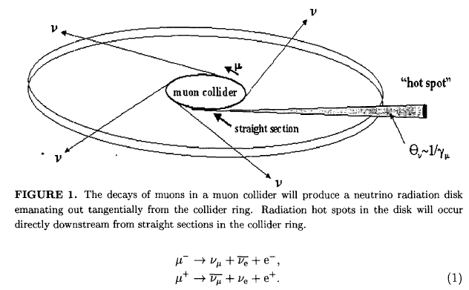
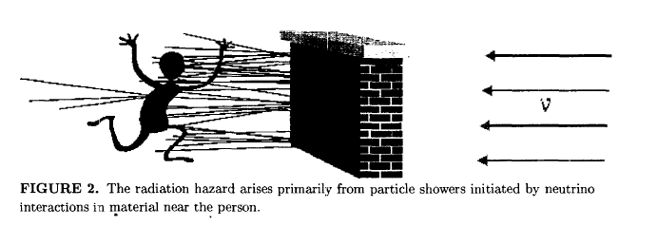
Neutrino Radiation Challenges
Bruce J. King, BNL-67408, CAP-281-Muon-00C, April 2000.

Slide 21
Neutrino-induced radiation dose
B.J. King, PAC 318, 1999
“Equilibrium approximation” for worst-case radiation calculations.
Unit of dose equivalent: 1 Sievert [Sv] =1 J/kg= 100 rem
The U.S. federal off site radiation limit: 1 mSv/year=100 mrem/year.
1% D_{fed} : 1 mrem/year

Slide 22
Comparison of 2TeV x 2TeV muon colliders (Continued)
 | Units | 1996 report (Table 13.5) | HEPAP P5 R.B.Palmer, March,2008 | OSC A.Zholents et al. PRST-AB 2001
Beam energy | TeV | 2x2 | 2x2 | 2x2
Ring Circumference | km | 8.08 | 8.08 | 8.08
Muons/bunch |  | 2x10¹² | 2x10¹² | 4.5x10⁸
No. of bunches for each sign |  | 2 | 2 | 2
Neutrino induced radiation*
Collider reference depth | m | 135 | 135 | 135
Keeps off site dose | mrem/year |  | < 1
Dave: Ave. rad. In plane | mrem | 0.04 | 0.01 | 3.2x10⁻⁵
Ld= ν beam distance to surface | km | 42 | 42 | 42
Straight section length for 10xDave. Rad. | m | 1.35 | 1.35 | 1.35
Dss:Dose from straight sections | mrem
Dss from 13.5m (~FODO ‘s) |  | 3.6 | 1.1 | 1.6x10⁻³
Dss from 268m straights** |  | 71 | 21 | 0.03
*B. J. King, PAC 99, p.318.
** No vertical wave field

Slide 23
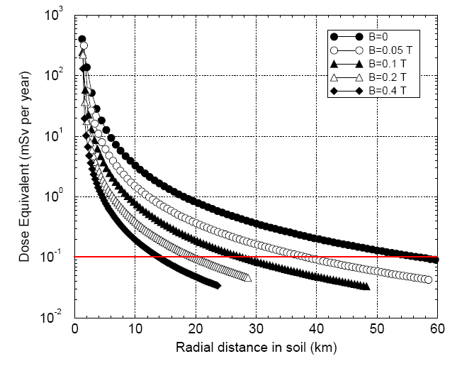
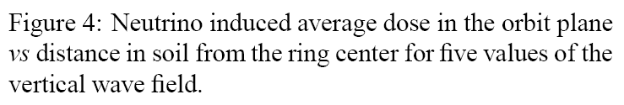
Shielding the Muon Collider Interaction Region
C.J. Johnstone and N.V.Mokhov, PAC 97, p.414

Slide 24
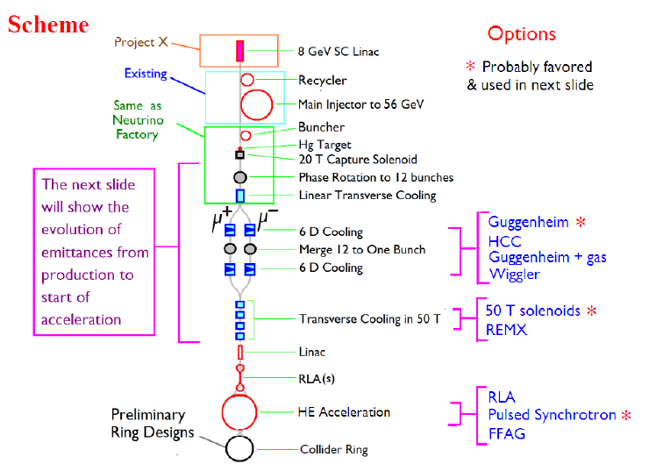

OSC in Muon Collider scheme
OSC
Cd=1100m
C=8088m

Slide 25
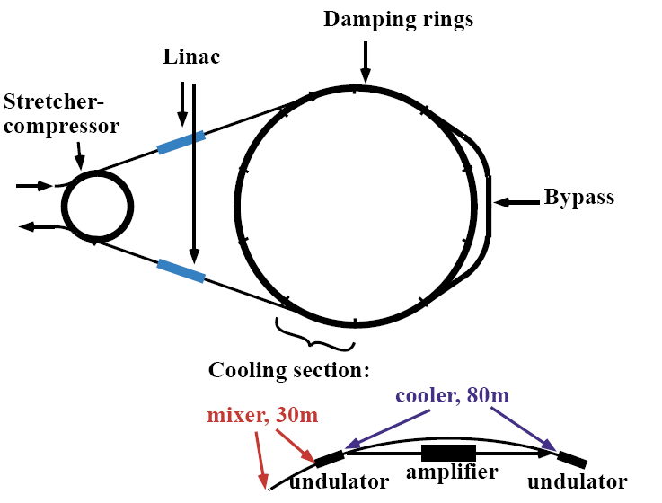
OSC scheme for each type of muon
Three
C=1100m

Slide 26
Summary of comparison
OSC feature: Cooling at ~100 GeV
Much smaller emittance:
each transverse plane: ~1/8000, longitudinal ~1/400
~4400 times fewer muons per beam, same luminosity
Advantages:
Dramatic reduction of off-site neutrino induced radiation hazard
50 times less proton beam pulse intensity
Background improvement in the detector
Disadvantages:
Increases the complexity of muon collider facility

Slide 27
OSC experiment at Bates
First Experimental Demonstration of Optical Stochastic Cooling
with the MIT-Bates South Hall Ring
W. Barletta, P. Demos, K. Dow, J. Hays-Wehle, E. Ihloff, J. Kelsey, B. McAllister, R. Milner,
R. Redwine (P.I.), S. Steadman, C. Tschalär, E. Tsentalovich, and F. Wang
Bates R&E/Accelerator Center and
Laboratory for Nuclear Science, MIT
F. Kärtner, J. Moses, and A. Siddiqui
Research Laboratory of Electronics, MIT
M. Babzien, M. Bai, M. Blaskiewicz, M. Brennan, W. Fischer,
V. Litvinenko, T. Roser and V. Yakimenko
Brookhaven National Laboratory
S.Y. Lee
Indiana University Cyclotron Facility
W. Wan, A. Zholents and M. Zolotorev
Lawrence Berkeley National Laboratory
Notes:
Bill Franklin leader of the OSC collaboration effort
Zholents and Zolotorev first worked out the formalism
S.Y. Lee saw the possibility of using the Bates facility
Chris Tschalaer worked through the formalism to determine the optimal experimental conditions using Bates SHR
James Hays-Wehle and Aleem Siddiqui are students

Slide 28
Motivation of experiment
OSC has never been demonstrated in practice.
The cost and time required for testing OSC in high-energy hadron machine or muon collider will be significant.
Experiment with e-beams is quick and cost-effective.
Why with Bates South Hall Ring
Bates SHR ring energy range is appropriate, machine lattice is very flexible.
There is a long straight section available for OSC insertion.
Bates facility is available for dedicated OSC testing.
Bates experiment goals
Proof-of-principle
OSC concept study: cooling mechanism, OSC & ring lattice integration, fast cooling test
Address key technical issues: optical amplifier, magnet bypass, diagnostics & control

Slide 29
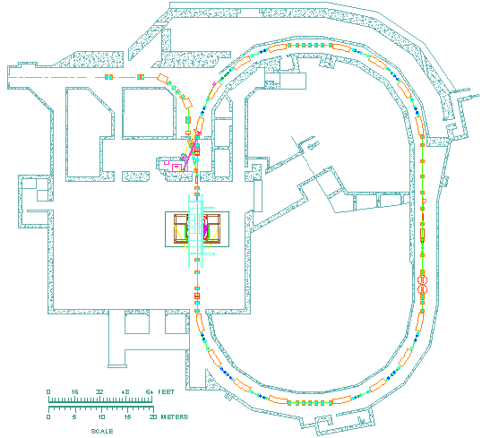
MIT-Bates South Hall Ring
Distinguish OSC from damping due to synchrotron radiation
  Low energy electrons
  Large dipole bend radius
Long straight sections desirable for OSC apparatus
South Hall Ring, e⁻ storage ring
  Full energy injection at 300 MeV
Dedicated use of South Hall Ring for first OSC demonstration
  Design tolerances consistent with existing technology
  Optimize for SHR environment
OSC
apparatus
C = 190.2 m
ρ = 9.14 m
Successful beam development
Run in April-May 2007
Notes:
Best place for such study is low-energy electron storage ring
Bates South Hall Ring well matched to needs of OSC demo
Show schematic layout of SHR
DC source, S band linac for acceleration to energies reaching 500 MeV, can be doubled ingle pass recirculator
Full energy injection of electrons in South Hall Ring for long-lived stored beam
Used mostly for precision experiments with internal polarized targets
Storage ring with Racetrack design 190 m circumference
2 long straight sections > 30 m
, OSC experiment to reside in east
Ample room for insertion of OSC, tunnels > 4 m in width
Formerly housed extraction line, may utilize existing X Line magnets, power supplies in chicane
Will add shielding in north arc for proximity to apparatus highly desirable for diagnostics, amplifier
Arcs contain 16 dipoles outfitted w/sync light ports (THz studies and OSC diagnostics)
Dipoles also advantageous for large radius of curvature
Radiation damping time long compared to electron rings of comparable energy

Slide 30
Bates Experiment Parameters
SHR | Natural | IBS effect
Beam energy (MeV) , RF: f(GHz)/ V (kV) | 300, 2.856/14
Electrons/bunch, bunch number, average current | 1×10⁸ , 12, 0.3mA
Chicane: L(m), bending angle (mrad)/ radius(m) | 5.55, 65 / 3.85
Inverse chicane matrix elements: R51, R52, R56 | 8.6×10-4, 2.52mm, -12mm
Undulator: L, period, λ | 2m, 20cm, 2μm
Lattice parameters at second undulator | β=3m, η=6m , η′=2
SR damping time τ_{x} (sec.) | 4.83
Beam emittance, ε_{x} (nm), 10% coupling | 47 | 96
Energy spread, rms bunch length | 8.5e-5, 5.1 mm | 1.67e-4, 9.8mm
Growth (damping) rates at equilibrium state:

Slide 31
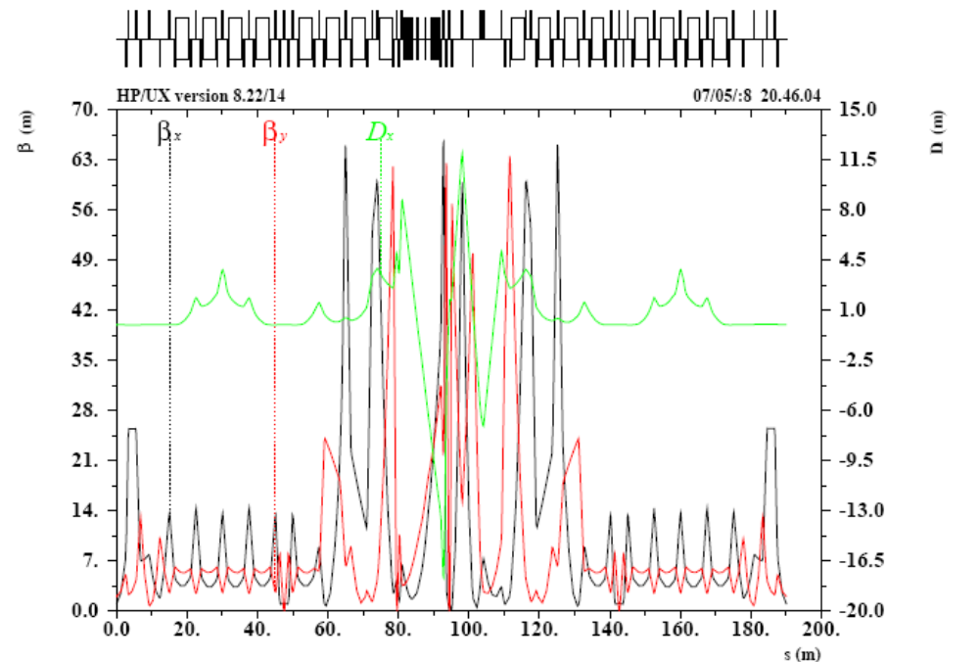
SHR Lattice for OSC Experiment
OSC Insertion

Slide 32
Bates OSC apparatus: Optical amplifier and layout
F. Kärtner, A. Siddiqui
50 ps, 1030 nm Laser
20 MHz, 20 W, 1 μJ
Undulator
Radiation
2 nJ
40 mW
Beam radius:
BaF₂ wedges
1mm
w = 0.5 mm
f = 12 cm
0.2 pJ
4 µW
f = 380 cm
2 mm
PPLN
n=2
f = 380 cm
270cm
103cm
24cm
103cm
270cm
Lenses and wedges, 1mm, n=1.5
Total optical delay is only 5.5 mm ~ 20 ps
PPLN: Periodically Poled Lithium Niobate
Notes:
32

Slide 33
Bates OSC apparatus: Small-angle bypass
Based on Optical Parametric Amplifier: total signal delay ~20ps only! Then we can choose small-angle chicane with path length increase of 20 ps ~ 6 mm.
4 parallel-edge benders and one (split) weak field lens. Choose ψ=65 mrad, ΔL=6mm.
Tolerances to conserve coherence are much relaxed for small-angle bypass.

Slide 34
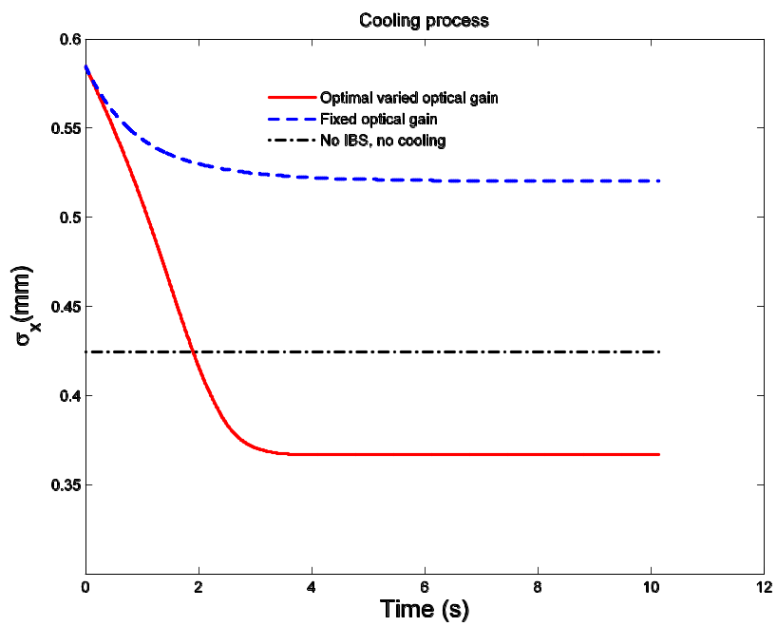
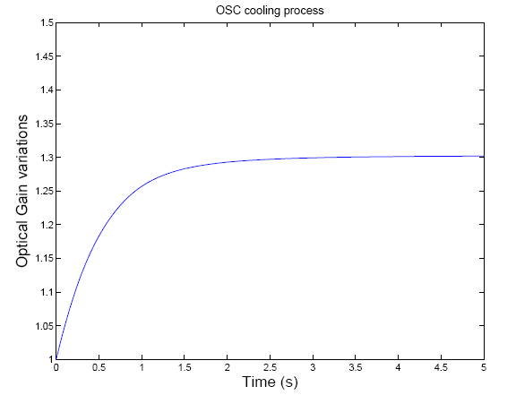
SHR OSC experiment numerical modeling:
σ_{x} and optical amplification
Observation of beam transverse size changes during cooling process
Optimal cooling achieved by adjusting optical amplification.

Slide 35
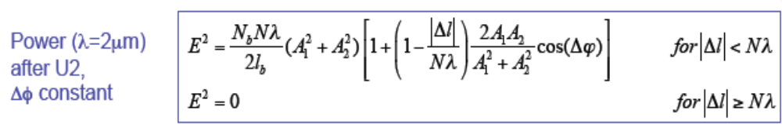
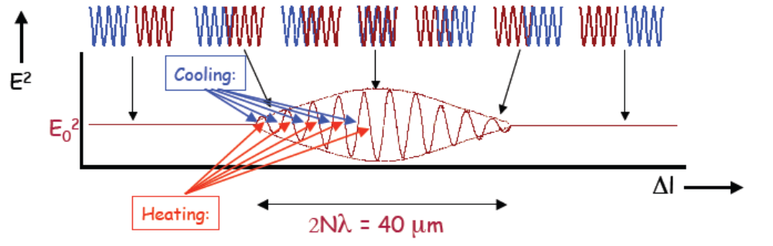
OSC Tuning Diagnostics
J. Hays-Wehle, W. Franklin
Interference signal is maximal when light amplitudes same (low gain alignment).
E² is maximal for Δf=0 (Δf=π/2 for OSC) use in feedback system.
Need analysis and bench test of phase feedback during high gain operation.
Correlate with beam size measurements (sync. light monitors, streak camera).

Slide 36
How technologies to support OSC are developing
High power laser amplifiers – rapid progress with DOD and industrial funding, expect 10X increase in average power in ~5 years
Sub-femtosecond timing – critical to future light sources for ultra-fast science; sub-fs capability over km distance expected ≤ 5 years
Superconducting wigglers – critical to and under development for future light sources; HTS magnets could play an important role

Slide 37
Summary of OSC experiment at Bates
Cooling of high energy hadron or muon beams holds major promise for increasing collision luminosity of hadron-hadron /electron-ion colliders, and for the realization of a multi-TeV muon collider.
OSC is a promising cooling technique which has never been demonstrated.
The proposed Bates experiment utilizes an existing and available accelerator complex.
The collaboration contains the necessary expertise to carry out the experiment and to subsequently deploy it at possible high energy colliders.
Technologies to support OSC for high energy colliders are developing.
DOE proposal is under review.

Slide 38
Additional slides

Slide 39
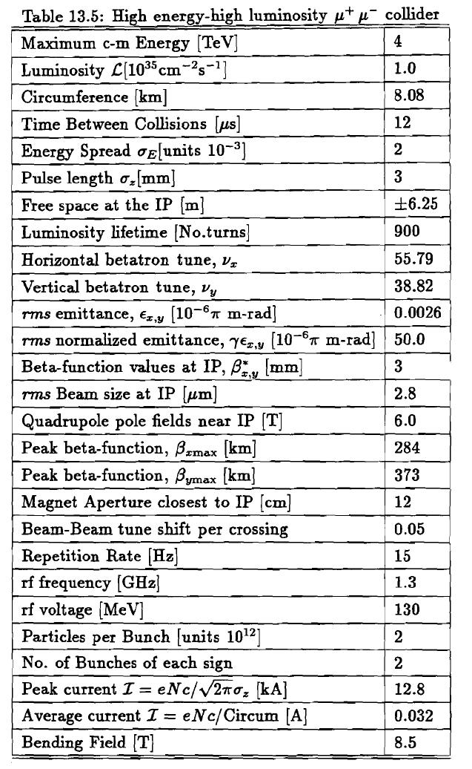
1996 design

Slide 40
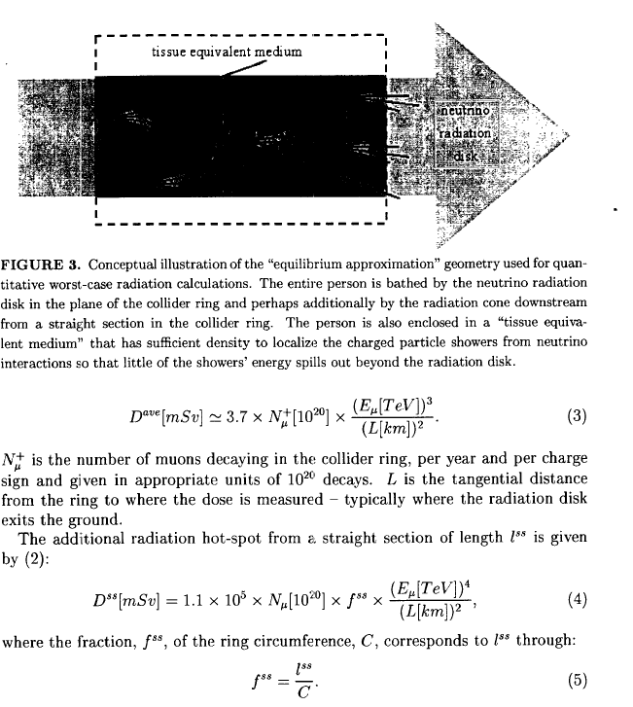

Slide 41
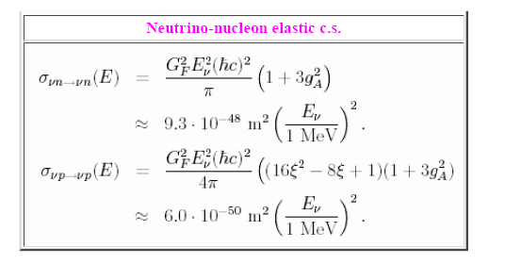
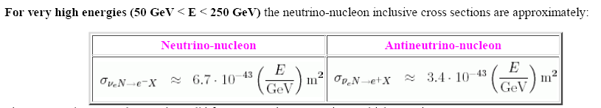
http://cupp.oulu.fi/neutrino/
Centre for Underground Physics in Pyhäsalmi (Finland),
CUPP project, University of Oulu

