Slide 1
RF System for an HCC
All the critical RF concepts have been suggested for SBIRs at one time or another by Milorad Popvic, Al Moretti, Mohammad Alsharo’a, and Mike Neubauer
Mike Neubauer
Muons, Inc.

Slide 2
Assumptions
Individual cavities are fed with RF for an HCC
  In general, the more the cavities per HCC period, the less the RF input power per cavity
  The coax feed into the cavity can use 50% of the length of a single cavity module or cell.
  Each cavity has its own RF source phase matched to its neighbors.
Magnet Coils fit around the outside diameter of the cavity wall.

Slide 3
Assumptions, continued
Ceramic loaded cavities will reduce the OD of the cavity.
  The drawings show ceramic loading of one style, but there are different ways to load the cavity.
Grids are an optimum choice for the use of high pressure gas in the HCC.
  They will be shown, but other choices can be made.
The RF system that is used to feed each individual module of the HCC is not shown.

Slide 4
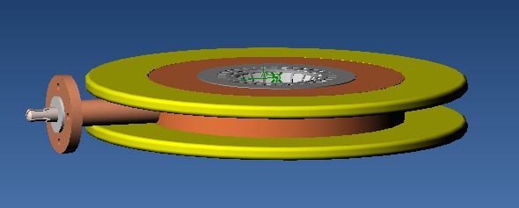
Cavity Module Concept
Single pill-box cavities are made that are aligned to create an HCC.
Each Cavity has it’s on set of magnet coils at 50% fill factor along the length of the cell
Grid Window
Magnet coils
Pill box cavity
Coaxial Feed

Slide 5
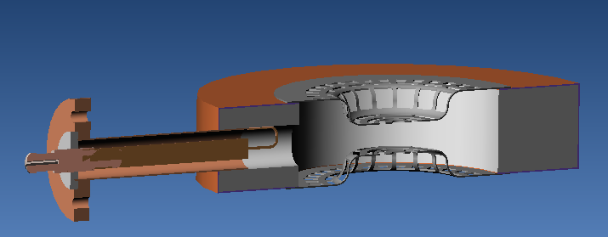
An Example of Cavity Detail
Formed Grid
Ceramic Filled Cavity
Plated Copper
Magnetic Coupling

Slide 6



Ez as a function of Radius for various ceramic loaded 325 MHz “pillbox” cells
Z_{shunt}= 6 54 100 MΩ/m

Slide 7
Input Power per Cell
(neglecting ceramic losses)
P_{in}(v/m)=[V(v/m)]²/Z_{shunt}(MΩ/m)
P_{in}=25²/Z for 25MV/m gradient
For copper at RT Z=54 MΩ/m for an “optimum” ceramic loaded cavity
  P_{in}=11.6 MW/m or 463 kw per cell
At 70K, Z ~4.5*Z_{RT} due to copper P_{loss}
  P_{in}=2.55 MW/m or 102 kw per cell

Slide 8
Ceramic Losses
For full ceramic
loaded cavity
Q=1/tanδ
Q_{70K}~20,000
Copper only
Q_{70K}~100,000

Slide 9
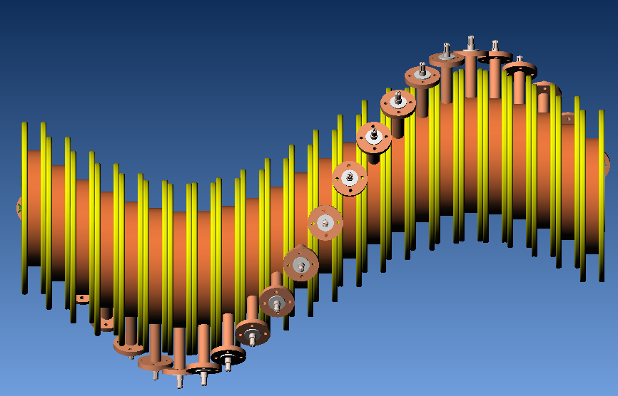
Complete HCC---Single Period

Slide 10
Cavity Detail
Ceramic Loaded Cavity reduces size
  Need to verify losses at operating temperature
  May need charge dissipative coating on surface seen by the beam (currently working on a related SBIR)
Copper Plated and Post-machined
  Removes the problem of packaging and voids between ceramic and metal
Flat moly grid anchored by ceramic ring solves distortion problems. (Puts grid in tension going down to 70K)
  Ceramic ring adds mechanical support
Coaxial Feed can be reduced in size
  Need to measure power capability in High Pressure Gas

Slide 11
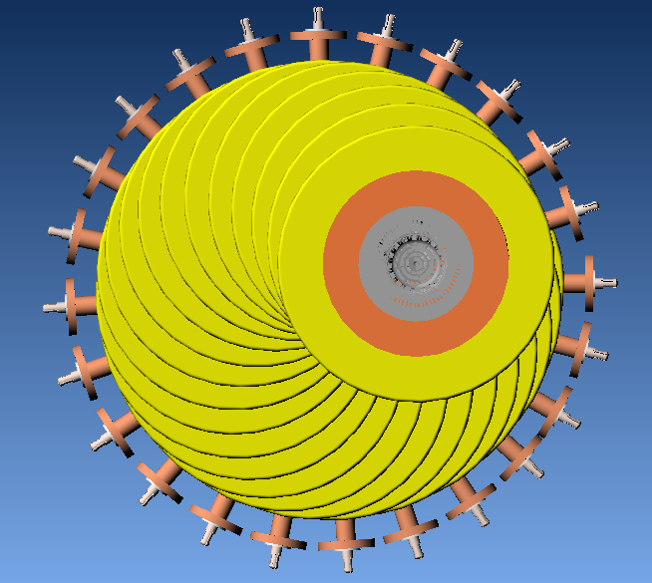
This is a 25 cavity per period
400 MHz design
Magnet Coil
Approximate Diameter at the coax flange is 40”
Pill box Cavity
Coax Feed per cavity

Slide 12
Summary
A conceptual design for putting RF through coils into an HCC is presented.
Engineering Design issues need to be resolved, and there do not seem to be any “impossible” constraints.
The most important aspect is: 50% of the cavity module is enough room for an RF coax feed.
All the critical RF concepts have been suggested for SBIRs at one time or another by Milorad, Moretti, Mohammad, and Neubauer.

