Slide 1
Field Emission in the
805 MHz Cavity
Update on the eSHIELD Phase I SBIR
Kevin Paul
Tech-X Corporation
Muon Collider Design Workshop / BNL / Dec 3, 2009
Notes:
1

Slide 2
Magnetic Insulation Primer
Introduced to achieve high voltages in transformers without arcing
  F. Winterberg, “Magnetically Insulated Transformer for Attaining Ultrahigh Voltages,” Rev. Sci. Instrum., vol. 41, p. 1756, December 1970.
  E. H. Hirsch, “The Concept of Magnetic Insulation,” Rev. Sci. Instrum., vol. 42, no. 9, p. 1371, 1971.
  F. Winterberg, “On the Concept of Magnetic Insulation,” Rev. Sci. Instrum., vol. 43, p. 814, May 1972.
  Field emitted electrons are confined to a region near the surface
  Magnetic field is parallel to high-voltage surface (high electric field)
  Thickness determined by Larmor radius
  Limited time for acceleration by the electric field (i.e., expect less energy deposition on surface)
Muon Collider Design Workshop / BNL / Dec 3, 2009
2
Notes:
2

Slide 3
The eSHIELD Phase I SBIR
“Magnetic Insulation and the Effects of External Magnetic Fields on RF Cavity Operation in Muon Accelerators”
Accurate field/secondary emission and heating models
  VORPAL (3D Electromagnetic/Electrostatic PIC)
  Mostly complete (needs temperature dependent secondary emission)
Simulations of emitted electron propagation in cavities
  In Progress (Discussed in this presentation!)
Coupled small-scale micro-physics simulations with large-scale macro-physics simulations
  Currently being studied in terms of non-uniform “mesh refinement”
  Early in development (i.e., we ignore space charge for now)
Prototype integrated numerical simulations of the magnetic insulation concept
  To be developed further in Phase II
Muon Collider Design Workshop / BNL / Dec 3, 2009
3
Notes:
3

Slide 4
Simulation Challenges
Material and emission modeling / “The Physics”
  Temperature-dependent field and secondary electron emission models are parameterized approximations (uncertainty)
  Material surfaces must be parameterized in terms of bulk properties
  Microscopic surface geometries are unknown and evolve in unknown ways
  Need to resolve the “small scale” (How “small” is uncertain!)
Multi-scale resolution issues
  Microscopic surface properties / asperities: ~10⁻⁶ m
  RF Cavities: ~0.1 m to ~1 m
  EM PIC time scale (in small-scale simulations): ~10⁻¹⁵ s
  RF Time Scales: ~10⁻⁹ s to 10⁻⁸ s
  Need “mesh refinement” (Hard in PIC!) – Ignoring space charge (for now)!
Muon Collider Design Workshop / BNL / Dec 3, 2009
4
Notes:
4

Slide 5
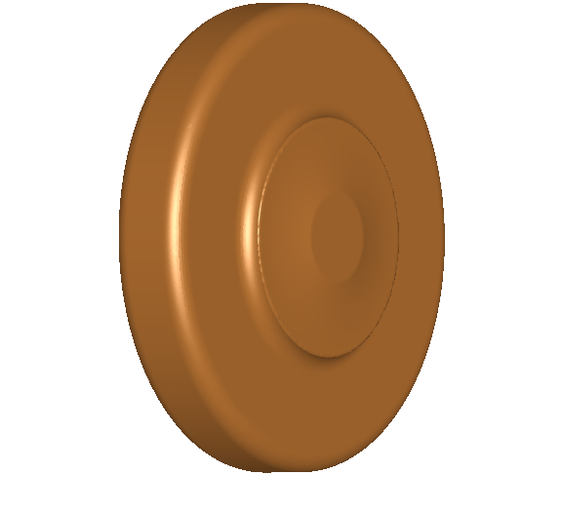
VORPAL Simulations of the
805 MHz “Button” Cavity
Full Diameter: 31.5 cm
Iris Diameter: 16 cm
Central Length: ~8 cm
Enclosed by windows (asymmetric)
y
x
z
Muon Collider Design Workshop / BNL / Dec 3, 2009
5
Notes:
5

Slide 6
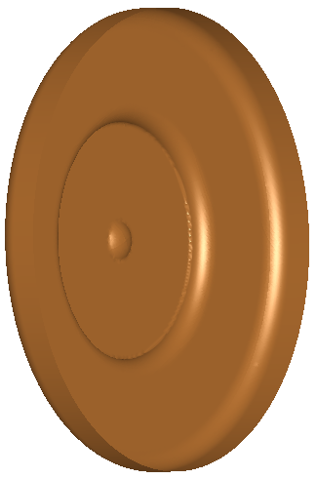
VORPAL Simulations of the
805 MHz “Button” Cavity
Full Diameter: 31.5 cm
Iris Diameter: 16 cm
Central Length: ~8 cm
Enclosed by windows (asymmetric)
Considered 3 points of emission:
  On axis (“button”)
  Off axis / On window (4 cm)
  Off axis / On iris (~8.5 cm)
Emission Spots: ~1 mm radius
Fowler-Nordheim (300 K)
Emits for only 1 RF cycle
Magnetic Fields considered:
  None
  “Parallel” (x-axis)
  “Perpendicular” (y-axis)
C
B
A
y
x
z
Muon Collider Design Workshop / BNL / Dec 3, 2009
6
Notes:
6

Slide 7
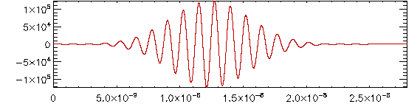
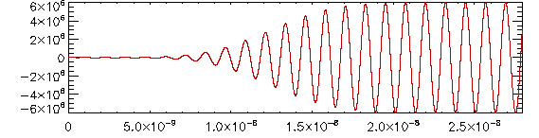
VORPAL Simulations of the
805 MHz “Button” Cavity
Emission!
Muon Collider Design Workshop / BNL / Dec 3, 2009
7
Notes:
7

Slide 8
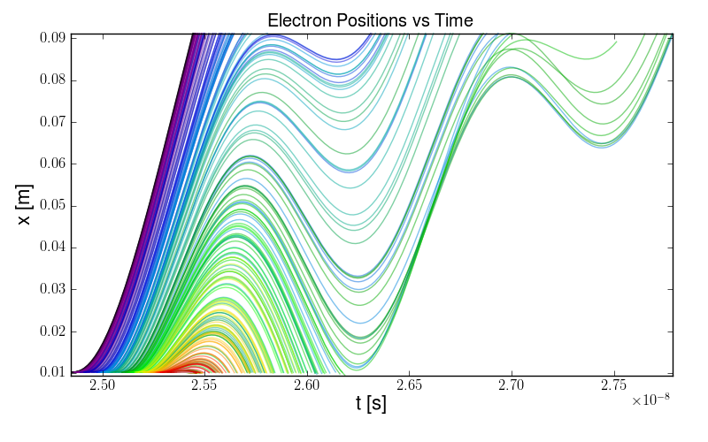
CASE A1: On-axis / B = 0
Muon Collider Design Workshop / BNL / Dec 3, 2009
8
Notes:
8

Slide 9
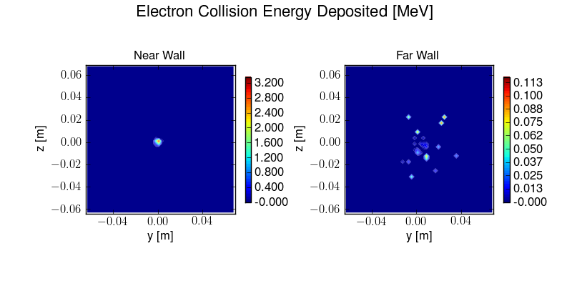
CASE A1: On-axis / B = 0
Total Energy:
7.2 MeV
0.85 MeV
Muon Collider Design Workshop / BNL / Dec 3, 2009
9
Notes:
9

Slide 10
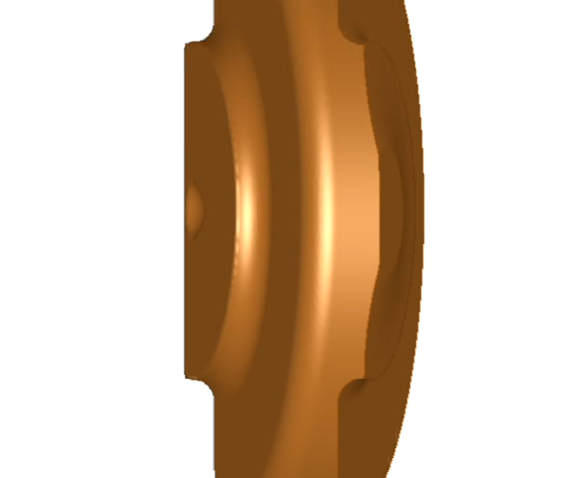
CASE A1: On-axis / B = 0
Muon Collider Design Workshop / BNL / Dec 3, 2009
10
Notes:
10

Slide 11
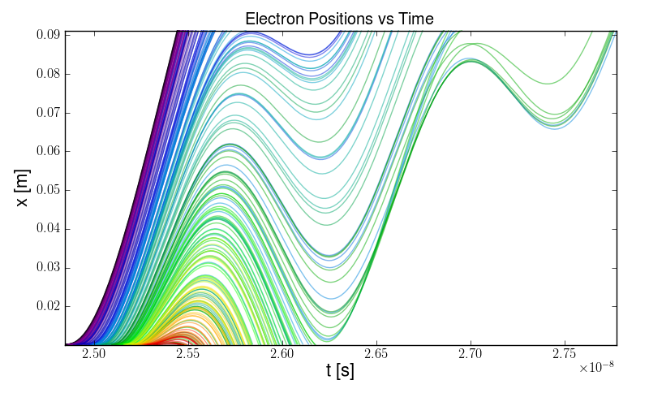
CASE A2: On-axis / B_{x} = 1 T
Muon Collider Design Workshop / BNL / Dec 3, 2009
11
Notes:
11

Slide 12
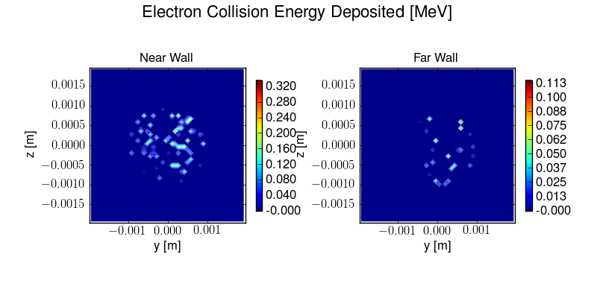
CASE A2: On-axis / B_{x} = 1 T
Total Energy:
7.2 MeV
0.86 MeV
Muon Collider Design Workshop / BNL / Dec 3, 2009
12
Notes:
12

Slide 13
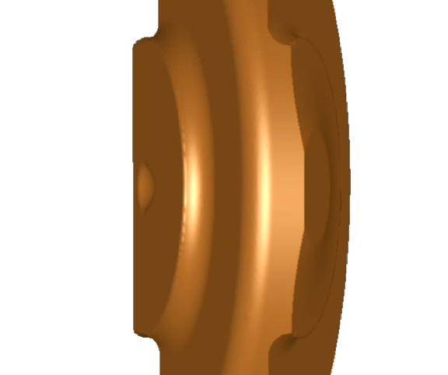
CASE A2: On-axis / B_{x} = 1 T
Muon Collider Design Workshop / BNL / Dec 3, 2009
13
Notes:
13

Slide 14
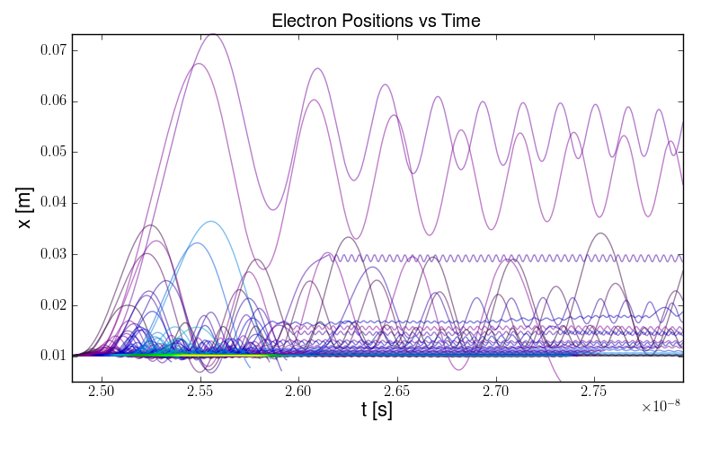
CASE A3: On-axis / B_{y} = 1 T
Muon Collider Design Workshop / BNL / Dec 3, 2009
14
Notes:
14

Slide 15
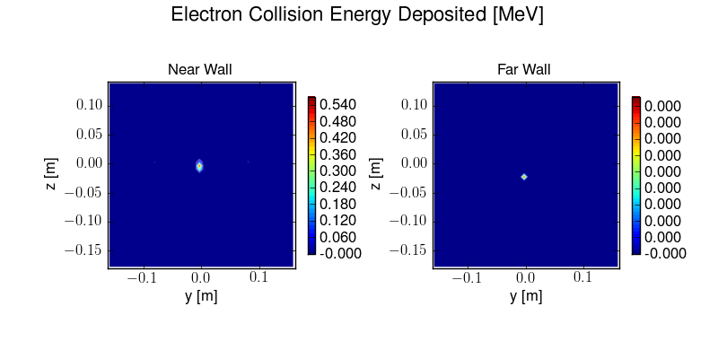
CASE A3: On-axis / B_{y} = 1 T
Total Energy:
0.96 MeV
0.48 eV
Muon Collider Design Workshop / BNL / Dec 3, 2009
15
Notes:
15

Slide 16
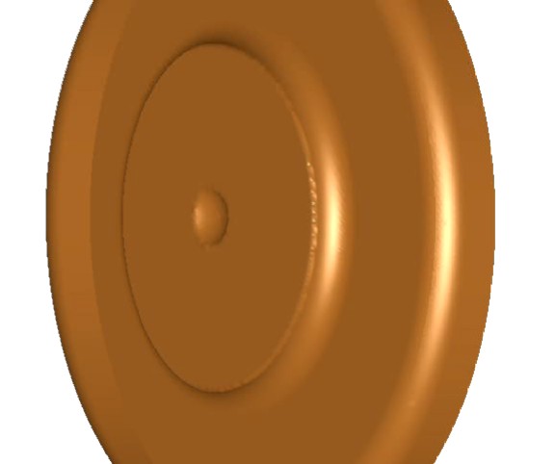
CASE A3: On-axis / B_{y} = 1 T
Muon Collider Design Workshop / BNL / Dec 3, 2009
16
Notes:
16

Slide 17
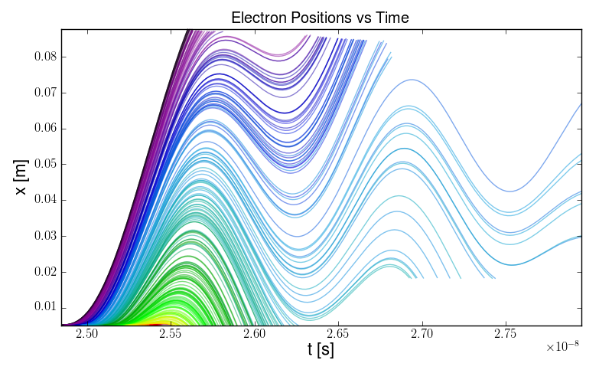
CASE B1: On-window / B = 0
Muon Collider Design Workshop / BNL / Dec 3, 2009
17
Notes:
17

Slide 18
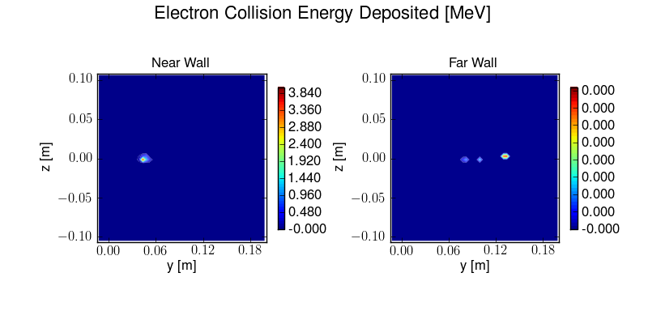
CASE B1: On-window / B = 0
Total Energy:
7.3 MeV
43 eV
Muon Collider Design Workshop / BNL / Dec 3, 2009
18
Notes:
18

Slide 19
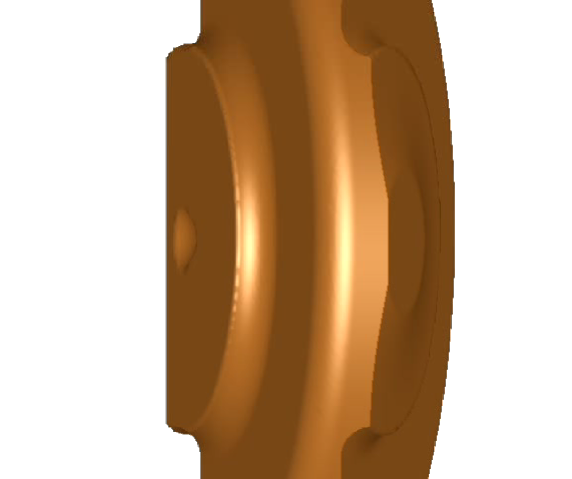
CASE B1: On-window / B = 0
Muon Collider Design Workshop / BNL / Dec 3, 2009
19
Notes:
19

Slide 20
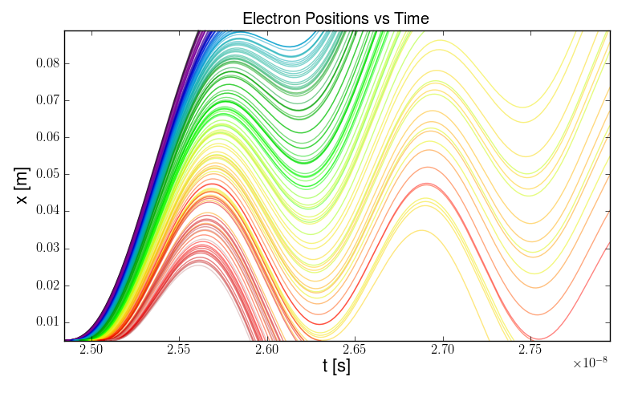
CASE B2: On-window / B_{x} = 1 T
SUSPICIOUS!
Muon Collider Design Workshop / BNL / Dec 3, 2009
20
Notes:
20

Slide 21
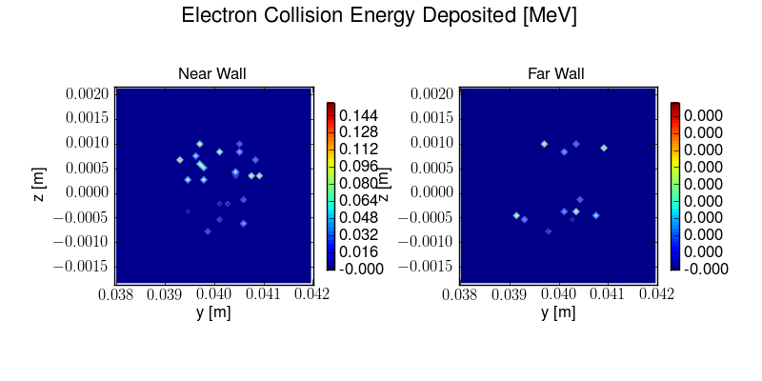
CASE B2: On-window / B_{x} = 1 T
Total Energy:
1.5 MeV
688 eV
Muon Collider Design Workshop / BNL / Dec 3, 2009
21
Notes:
21

Slide 22
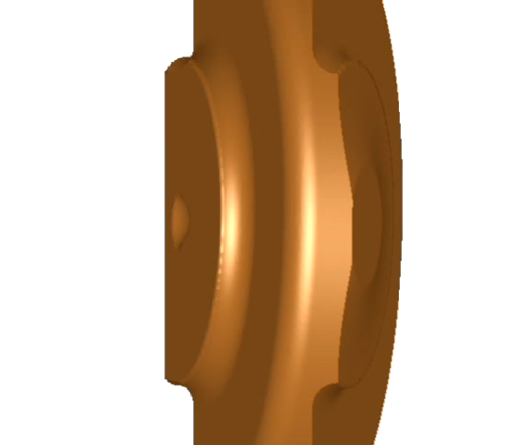
CASE B2: On-window / B_{x} = 1 T
Muon Collider Design Workshop / BNL / Dec 3, 2009
22
Notes:
22

Slide 23
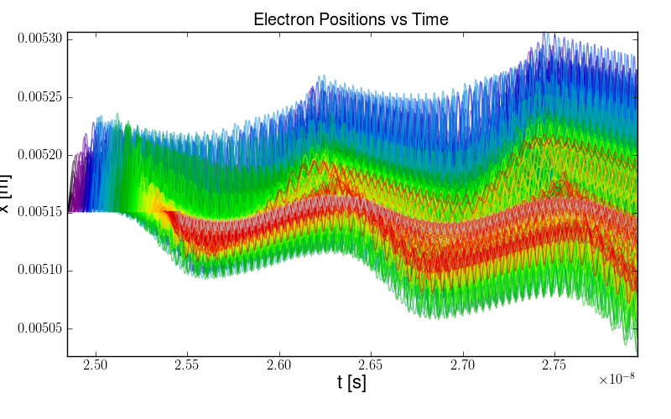
CASE B3: On-window / B_{y} = 1 T
Muon Collider Design Workshop / BNL / Dec 3, 2009
23
Notes:
23

Slide 24
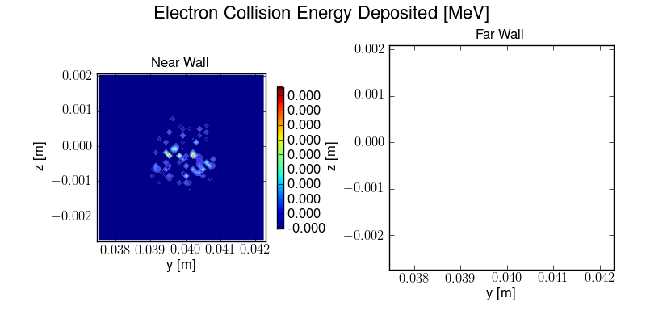
CASE B3: On-window / B_{y} = 1 T
NOTHING!
Total Energy:
6.2 keV
Muon Collider Design Workshop / BNL / Dec 3, 2009
24
Notes:
24

Slide 25
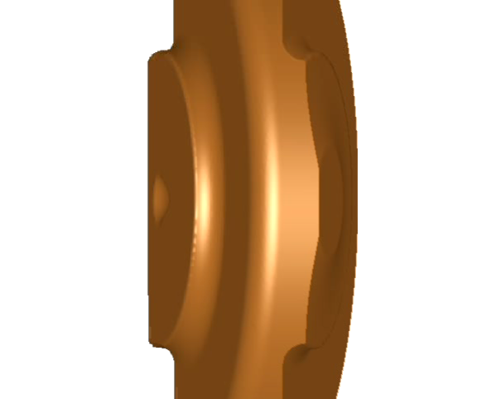
CASE B3: On-window / B_{y} = 1 T
Muon Collider Design Workshop / BNL / Dec 3, 2009
25
Notes:
25

Slide 26
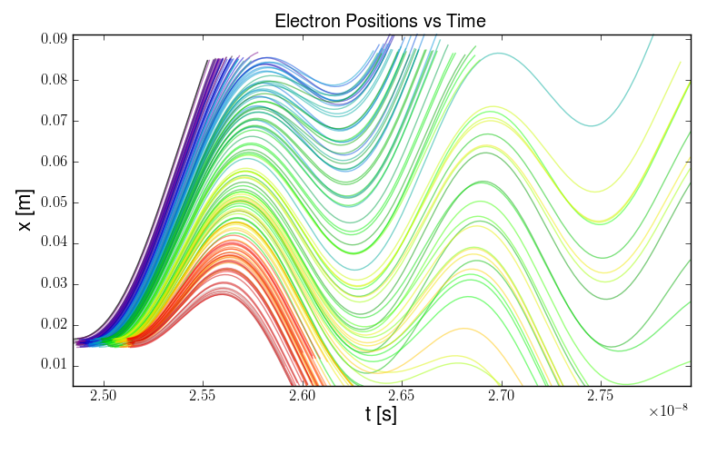
CASE C1: On-iris / B = 0
Muon Collider Design Workshop / BNL / Dec 3, 2009
26
Notes:
26

Slide 27

CASE C1: On-iris / B = 0
Total Energy:
13.8 MeV
43.5 keV
Muon Collider Design Workshop / BNL / Dec 3, 2009
27
Notes:
27

Slide 28
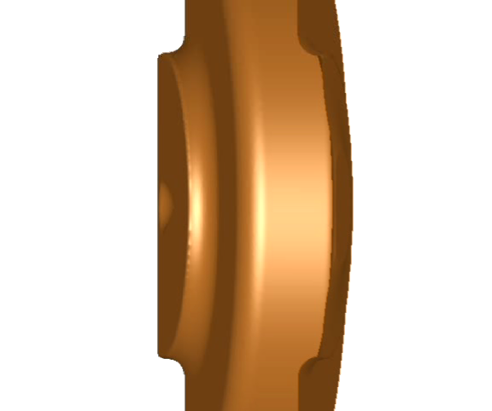
CASE C1: On-iris / B = 0
Muon Collider Design Workshop / BNL / Dec 3, 2009
28
Notes:
28

Slide 29
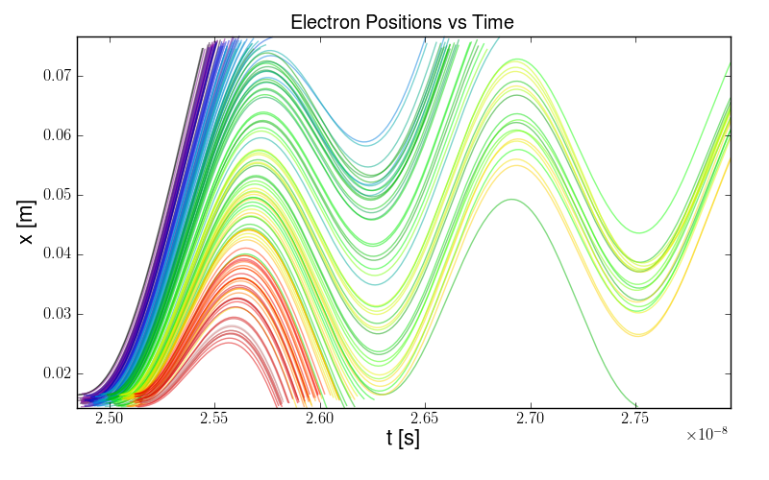
CASE C2: On-iris / B_{x} = 1 T
Muon Collider Design Workshop / BNL / Dec 3, 2009
29
Notes:
29

Slide 30
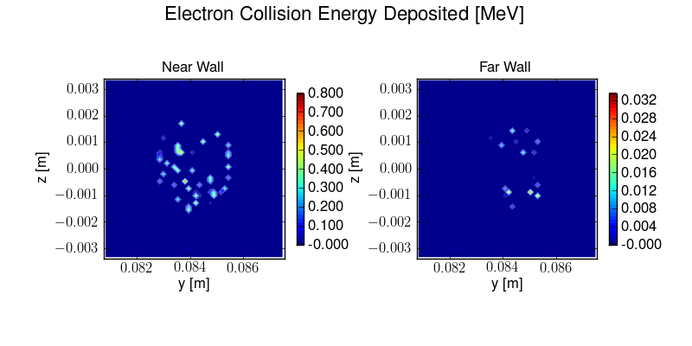
CASE C2: On-iris / B_{x} = 1 T
Total Energy:
13.8 MeV
175 keV
Muon Collider Design Workshop / BNL / Dec 3, 2009
30
Notes:
30

Slide 31
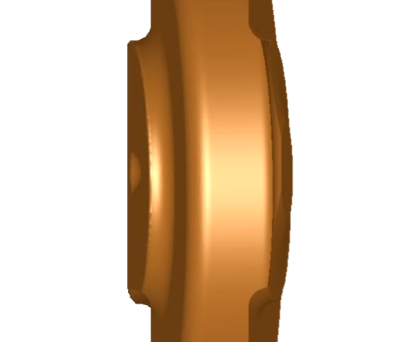
CASE C2: On-iris / B_{x} = 1 T
Muon Collider Design Workshop / BNL / Dec 3, 2009
31
Notes:
31

Slide 32
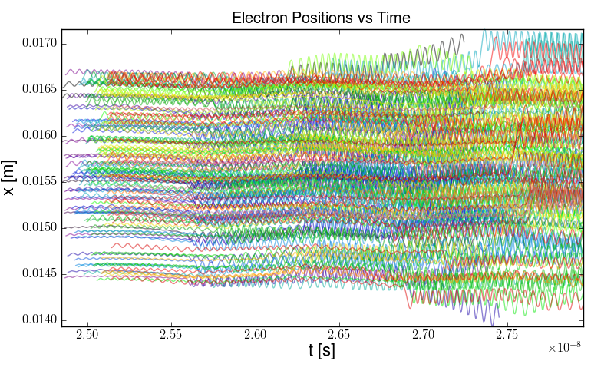
CASE C3: On-iris / B_{y} = 1 T
Muon Collider Design Workshop / BNL / Dec 3, 2009
32
Notes:
32

Slide 33
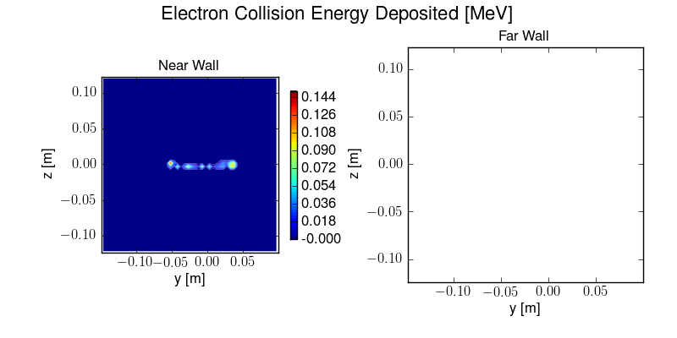
CASE C3: On-iris / B_{y} = 1 T
NOTHING!
Total Energy:
1.15 MeV
Muon Collider Design Workshop / BNL / Dec 3, 2009
33
Notes:
33

Slide 34
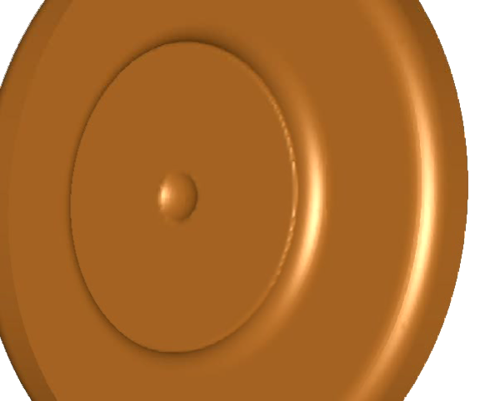
CASE C3: On-iris / B_{y} = 1 T
Muon Collider Design Workshop / BNL / Dec 3, 2009
34
Notes:
34

Slide 35
Conclusions & Future Work
Preliminary simulations of field emission in the 805 MHz cavity
  Not a thorough exploration of configuration space, but…
  Most of the energy deposited is on the “near” wall (very little on “far”)
  Suggest that “magnetic insulation” can reduce the energy deposited on the near wall by approximately an order of magnitude!
  Probably depends (greatly!) on the cavity field-strength, dimensions, etc.
Need to account for space charge
  Requires finer mesh
  Suggests non-uniform “mesh refinement” techniques (or risk prohibitively large simulations)
Need to include secondary electrons
  Multi-pactoring could be significant (amplification and resonance)
  Means simulating longer times (many RF cycles)
Need to investigate better data analysis techniques
Muon Collider Design Workshop / BNL / Dec 3, 2009
35
Notes:
35

