Slide 1
Muon acceleration by RLA
with the non-scaling FFAG
Dejan Trbojevic

Slide 2
RLA for Muons
Introduction:
  Present design of the muon RLA’s
Problems:
  Matching of the circular non-scaling FFAG to the straight linac.
  Time of flight adjustments for each pass.
Goals:
  Use the permanent magnets for the arcs – Halbach magnets.
  Try to make four or five times in muon energy by either a race track or dog-bone acceleration with a single arc (2.5-10 GeV or -60%< δp/p< +60%).
  Match the betatron and dispersion functions from the arc to the linac.
  Design a chicane to adjust the time of flight for different energy passes.

Slide 3
‘Racetrack’ vs ‘Dogbone’ RLA (both μ⁺ and μ⁻ species )
From Alex Bogacz presentation at the previous LEMC:
μ⁺
μ⁻
μ⁺
μ⁻
μ⁺
μ⁻
μ⁺
μ⁻
μ⁻
ΔE
μ⁺
μ⁺
μ⁻
better orbit separation at linac’s end ~ energy difference between consecutive passes (2ΔE)
allows both charges to traverse the Linac in the same direction (more uniform focusing profile
the droplets can be reduced in size according to the required energy
both charge signs can be made to follow a Figure-8 path (suppression of depolarization effects) Chuck Ankenbrandt
μ⁺
μ⁻
μ⁺
μ⁻
ΔE/2

Slide 4
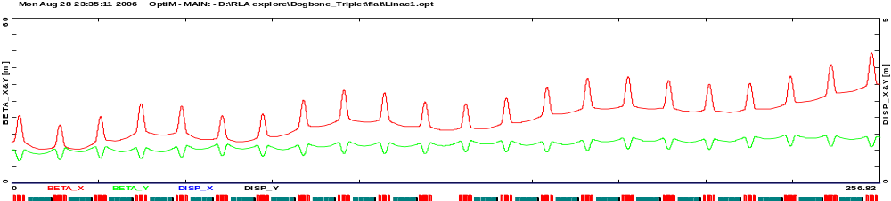
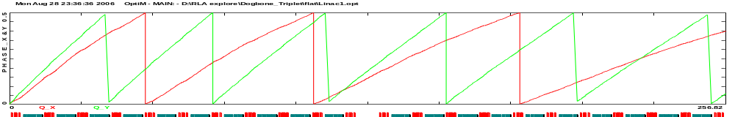
FODO vs Triplet focusing − ‘flat focusing' linac profile*
Bob Palmer*
From Alex Bogacz presentation at the previous LEMC:
Triplet
1-pass, 3-5 GeV
256.82 meters
phase adv. drops much faster in the horizontal plane

Slide 5
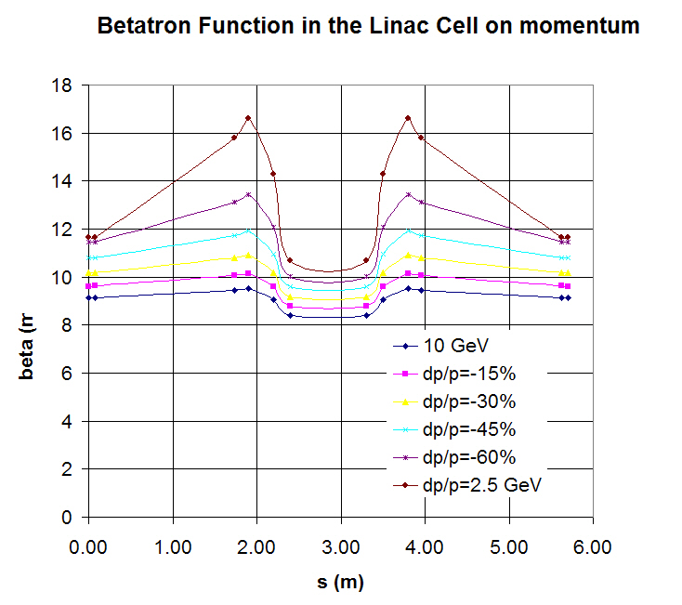
The linac – Betatron Function dependence on energy

Slide 6
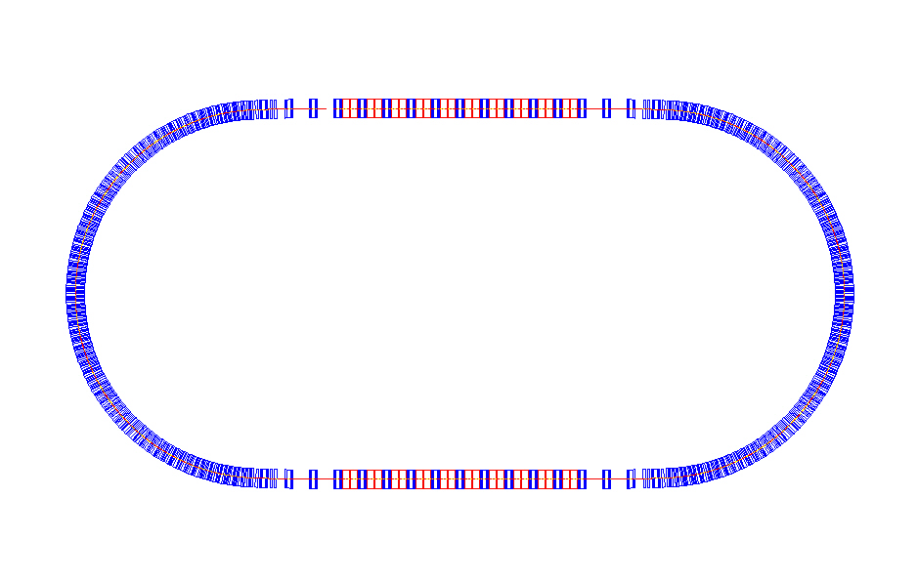
Multipass Linac - racetrack FFAG
20 Cavities
Chicane
Chicane
Non-scaling FFAG arc
Non-scaling FFAG arc
Chicane
20 Cavities
Chicane

Slide 7
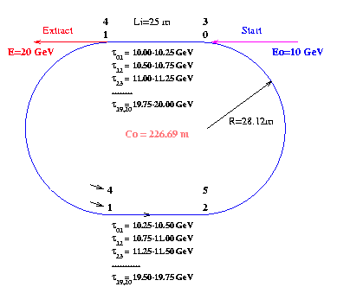
Muon Collider Review Meeting At BNL 2001

Slide 8
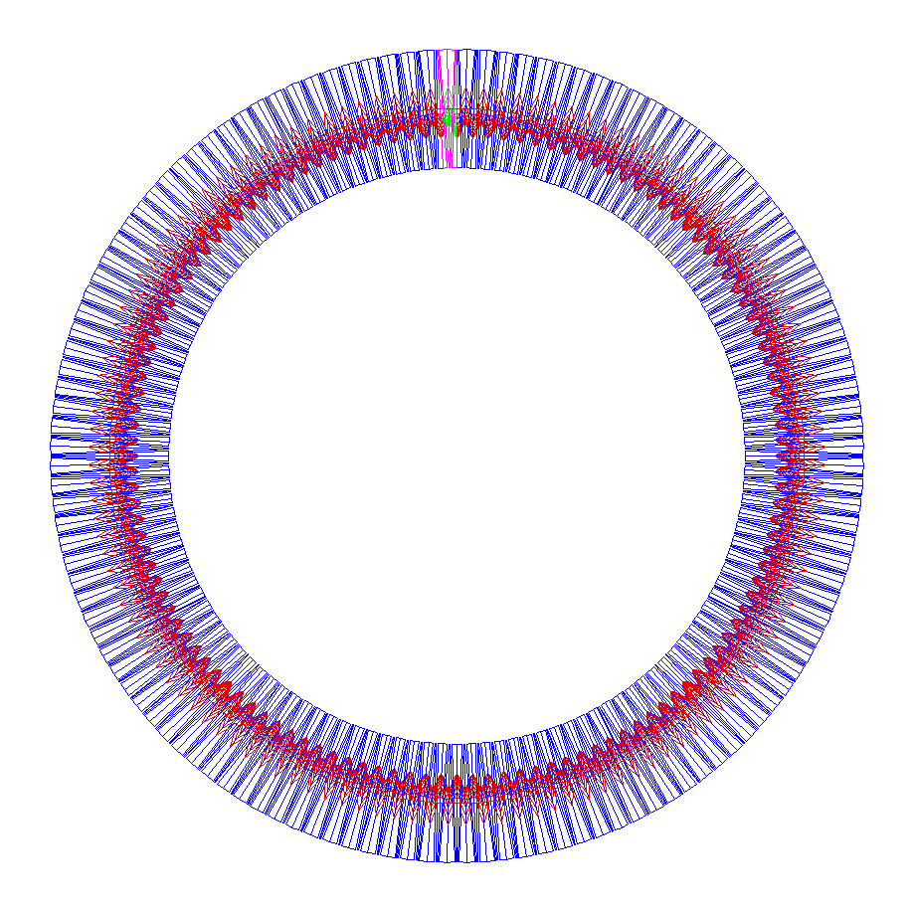
Design of the arcs with Halbach magnets
FODO cells for the 2.5 -> 10 GeV muons
N=170 cells
L=1.606 m
L_{BD}=0.73 m
L_{QF}=0.52 m
For the:
δp/p=+-60%
B_{BD}=2.5 T
GF=40.0 T/m
GD=-50.0 T/m
r=43.42 m
86.85 m

Slide 9
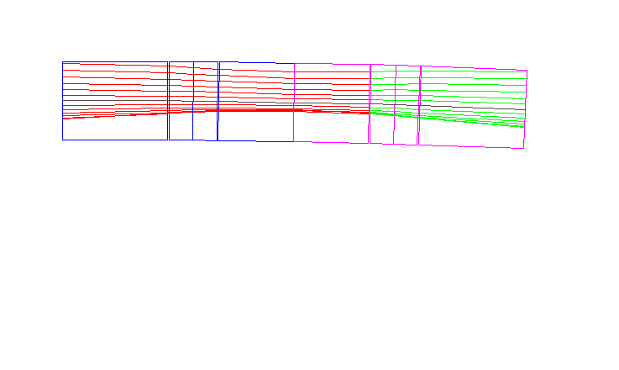
Arc cell with Halbach magnets
FODO cell for the δp/p=+-60 % -> 2.5 - 10 GeV
0.1675 m
0.1675 m
x _{max}=65.8 mm
x _{min}= -35.1 mm
0.73/2 m
52 mm
0.73/2 m
1.606 m

Slide 10
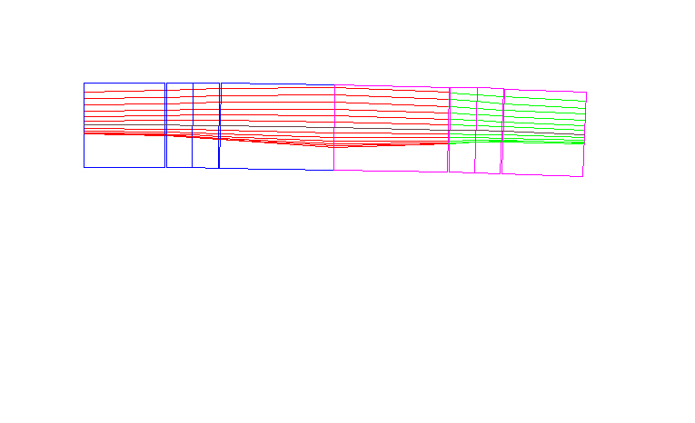
Arc cell with Halbach magnets
FODO cell for the δp/p=+-60 % -> 2.5 - 10 GeV
0.1675 m
0.1675 m
x _{max}=52.9 mm
x _{min}= -12.8 mm
52/2 mm
0.73 m
0.52/2 m
1.606 m

Slide 11
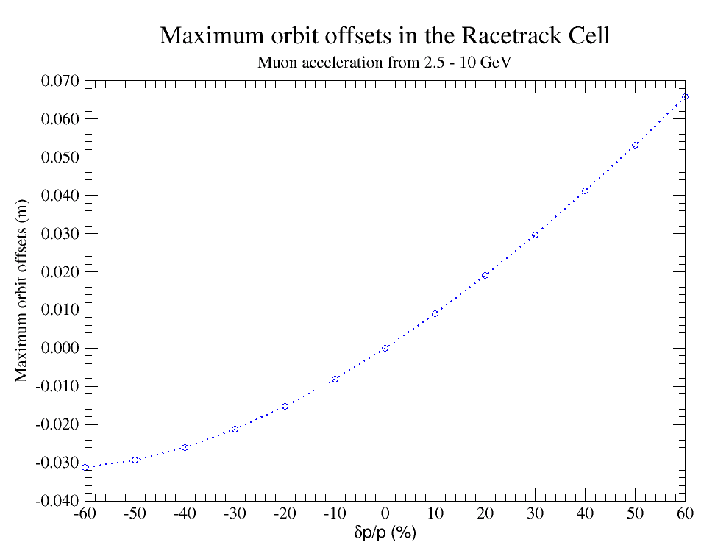
Arc cells for two different lattices
FODO cell for the δp/p=+-60 % -> 2.5 - 10 GeV

Slide 12
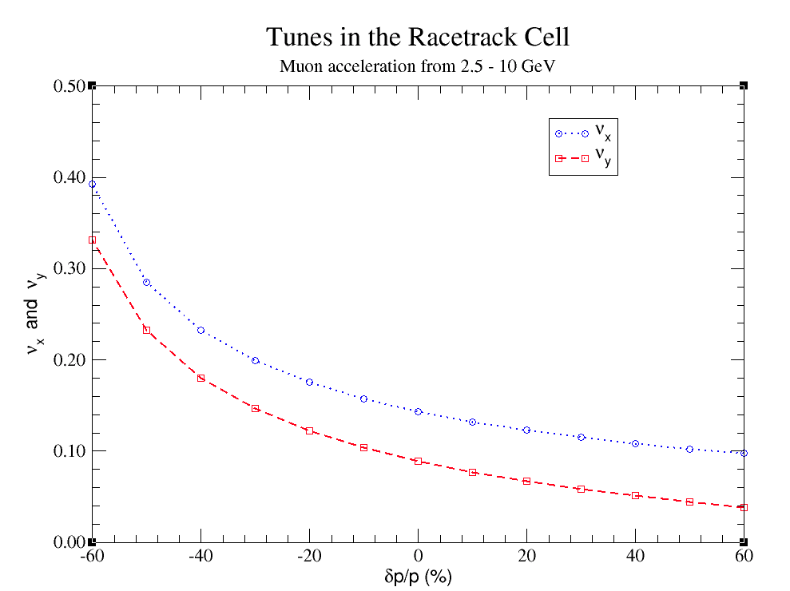

Slide 13
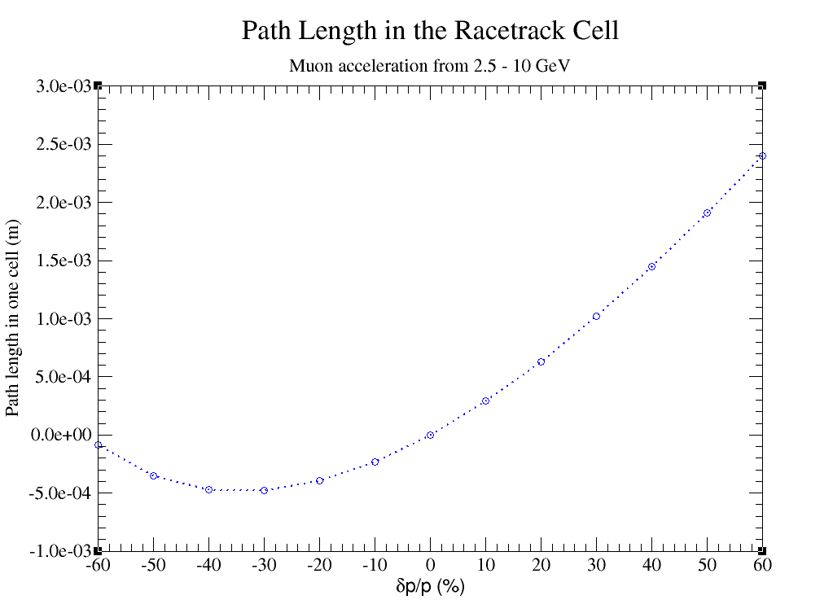
A total difference in the path length -
10 GeV and the minimum of the parabola
is Δl=0.2465 m

Slide 14
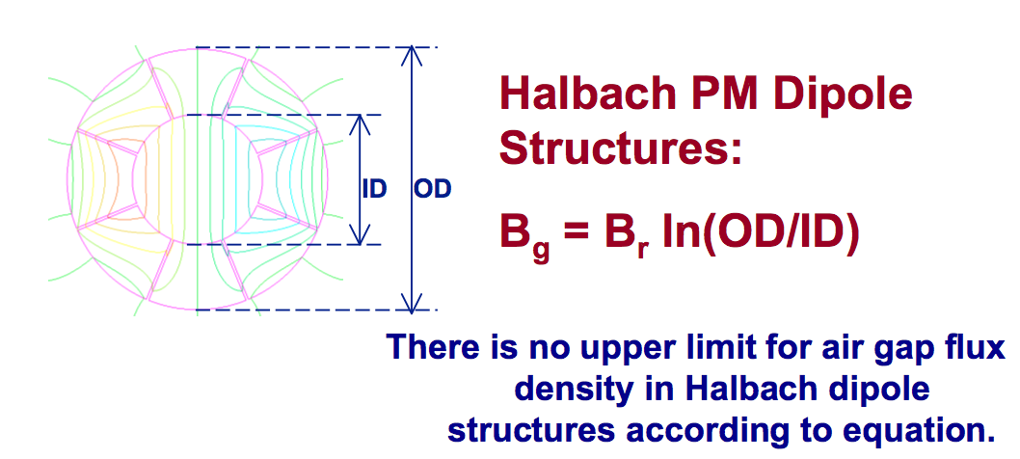
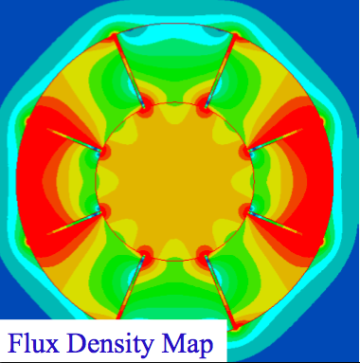
Halbach permanent magnet
But in reality it would be limited by:
The realistic size
The demagnetization effect

Slide 15
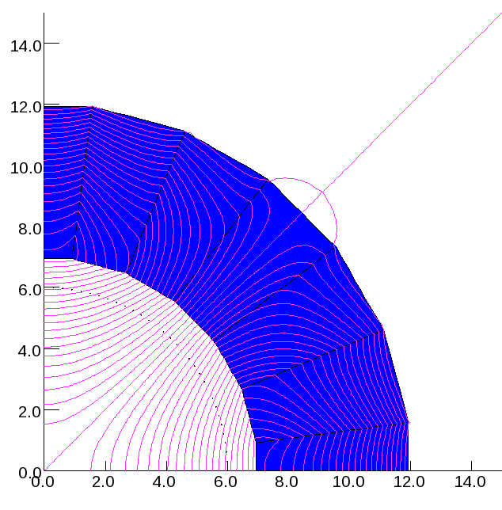
Permanent Magnet for the BNL additional triplets
(K. Halbach)
Material: NdFeB n5563
Br = 15000 G
Hc = -13000 Oe
(www.mceproducts.com)
Y (cm)
Field Quality @ R=6 cm
b2 = 10248.0 Gauss (17 T/m)
b6 = 44.3 Gauss (4.3E-3)
X (cm)

Slide 16
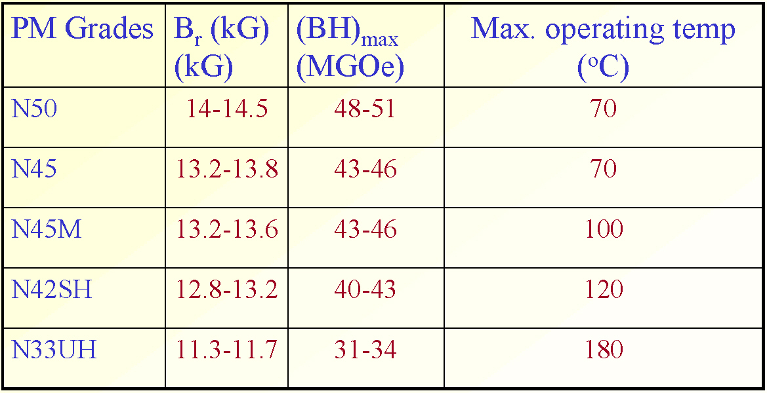
Halbach permanent magnets: available material
No-Fe-B Type Rare Earth Magnets:

Slide 17
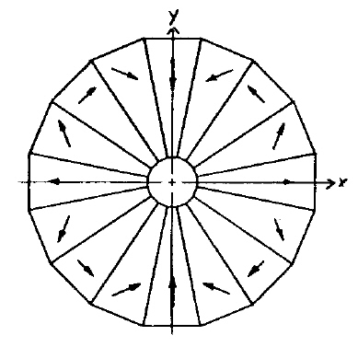
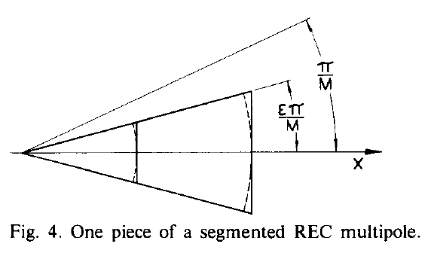
Halbach permanent magnets – pictures from the original publication:
B_{g}= B_{r} ln(OD/ID)
B_{r}=1.5 T
OD=85 cm
ID =14 cm
ln(OD/ID)=1.8
B_{g}=2.7 T
QL_{D} = 52 cm
BL = 16.75 cm
QL_{F} = 73 cm
G_{F} = 2.7 T/0.068 m = 40 T/m
G_{D}= -2.7 T/0.054 m=-50 T/m
14 cm
85 cm
Dejan Trbojevic BNL - Muon Collider Design Workshop Dec 1-3, 2009

Slide 18
Halbach permanent magnets
35 cm

Slide 19
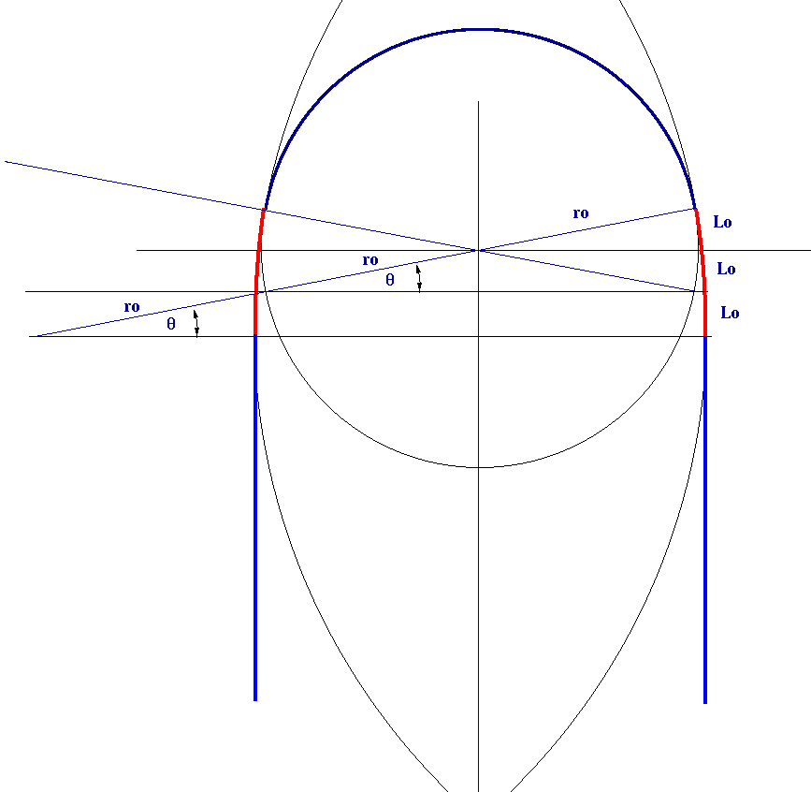
Matching cell – geometrical constraint - arc to linac
The matching cell length
is: L=3 * 1.605 m = 4.815 m

Slide 20
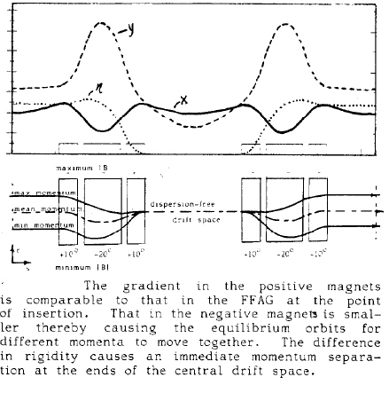
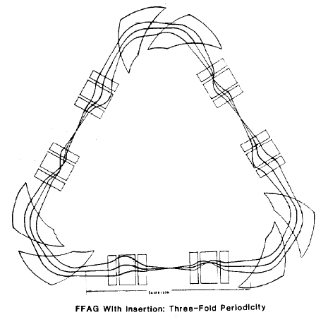
IEEE Transactions on Nuclear Science, Vol. NS-30, No. 4, August 1983

Slide 21
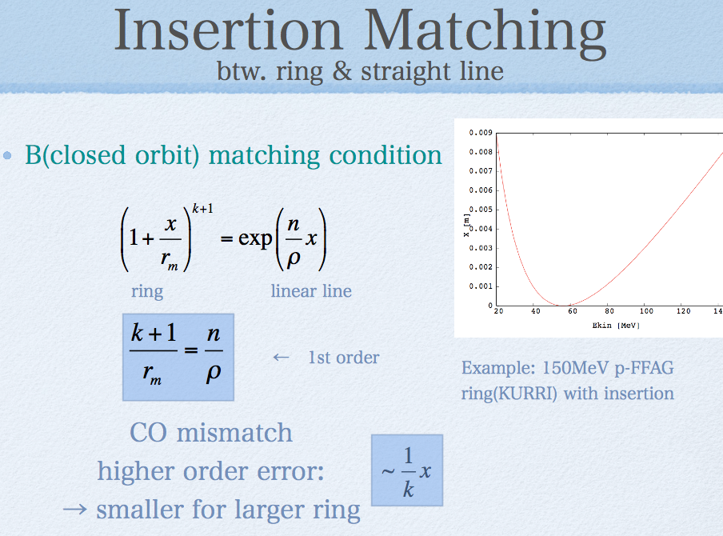
Yoshiharu Mori – Fermilab FFAG workshop:

Slide 22
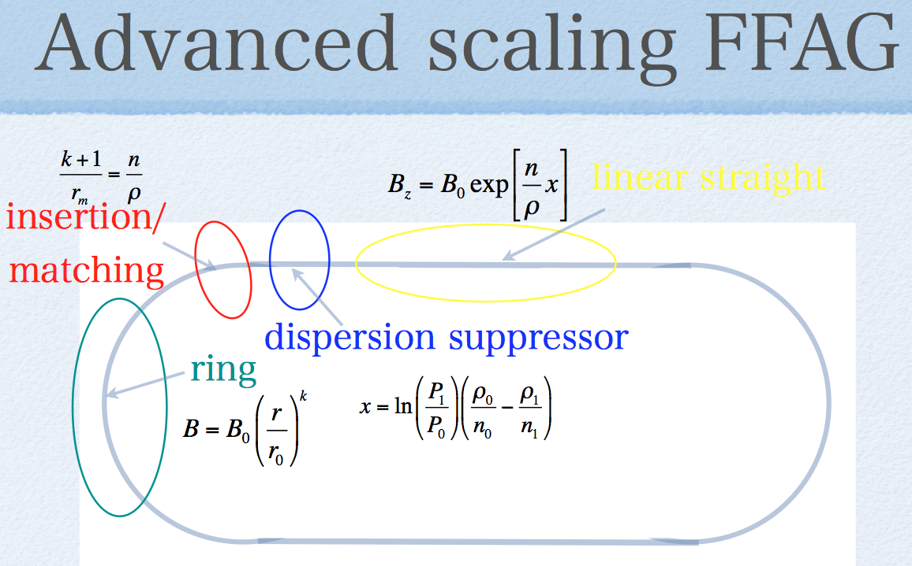
Yoshiharu Mori – Fermilab FFAG workshop:

Slide 23
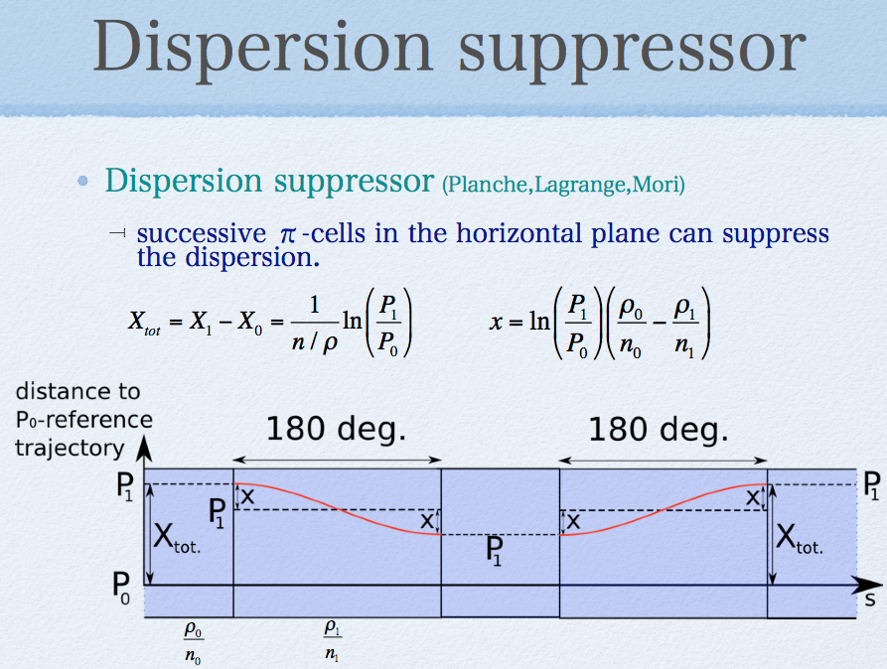
Yoshiharu Mori – Fermilab FFAG workshop:

Slide 24
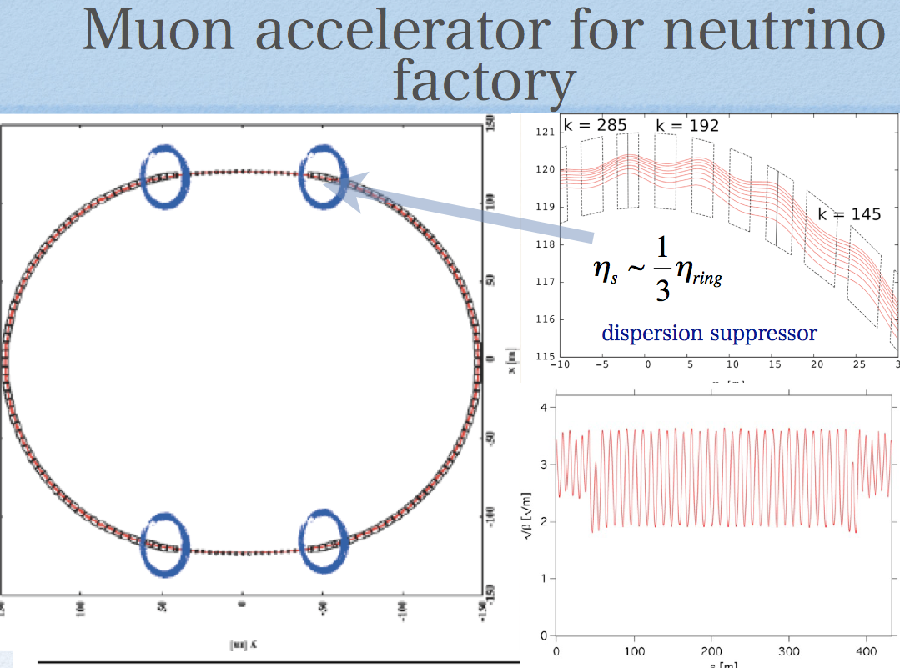
Yoshiharu Mori – Fermilab FFAG workshop:

Slide 25
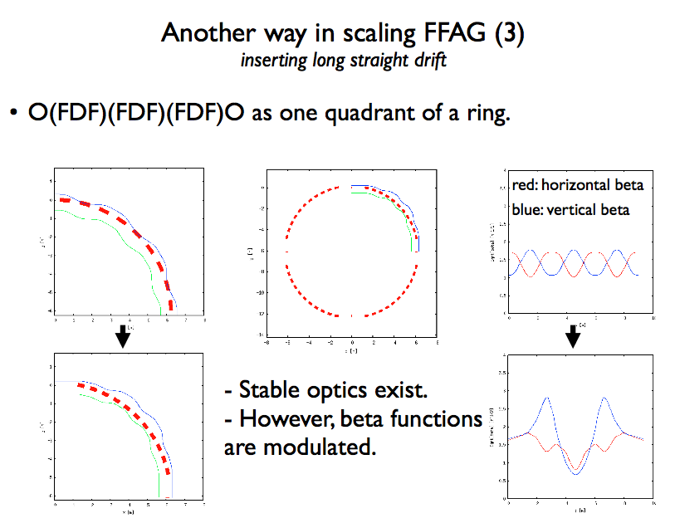
Shinji Machida – Fermilab FFAG workshop

Slide 26
New matching cell
Input parameters are:
x_{max} and x_{min} from the arc NS-FFAG
p_{max}, p_{o}, and p_{min}, D_{x}, β_{x}, β_{y},
Unknowns: B_{D} , B_{F} , Φ_{fo} , Φ_{do} , and l_{o}
ρ_{fmax}
φ_{fο}
ρ_{fo}
a_{max}
φ_{dο}
a_{min}
ρ_{fmin}
l_{o}
φ_{fο}
u_{max}
φ_{dο}
x_{max}
u_{min}
φ_{dο}
ρ_{dmin}
x_{min}
ρ_{do}
φ_{dο}
ρ_{dmax}
To be matched to the input
parameters of the linac: β_{x}, β_{y}, α_{x},α_{y}

Slide 27
Matching Cell - @ zero dispersion end
a_{max}
a_{min}
l_{o}
ρ_{dmin}
u_{max}
φ_{dmin}
ρ_{do}
u_{min}
φ_{dο}
ρ_{dmax}
φ_{dmax}

Slide 28
Matching Cell @ entrance
w
Φ_{fmax}
ρ_{fmax}
j
ρ_{fmax}
Φ_{fo}
a_{max}
ρ_{fo}
Φ_{fo}- Φ_{fmax}
a_{min}
Φ_{fmin}
Φ_{fo}- Φ_{fmax}= Φ_{do}- Φ_{dmax}
ρ_{fmin}
l_{o}
Φ_{fmin}- Φ_{fo}
u_{max}
Φ_{fmin}- Φ_{fo}= Φ_{dmin}- Φ_{do}
p_{min}
x_{max}
u_{min}
u_{max}=a_{max}+l_{o} tan(Φ_{fo}-Φ_{fmax})
p_{o}
x_{min}
u_{min}=a_{min}+l_{o} tan(Φ_{fmin}-Φ_{fo})
p_{max}

Slide 29





Mike Craddock’s approach:
ρ_{fmax}
D/2
φ_{fο}
x_{d+}=0
ρ_{fo}
X_{d+}
x_{d-}=0
φ_{dο}
X_{d-}
ρ_{fmin}
l_{o}
φ_{fο}
u_{max}
φ_{dο}
high p₊
x_{fp+}
u_{min}
φ_{dο}
ρ_{dmin}
x_{fp-}
ρ_{do}
p_{o}
φ_{dο}
low p₋
F/2
ρ_{dmax}

Slide 30
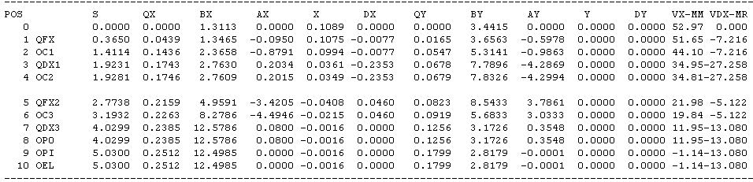
Matching to linac -> zero dispersion for each momentum
β_{x}
Dispersion
β_{y}
Orbit offsets

Slide 31
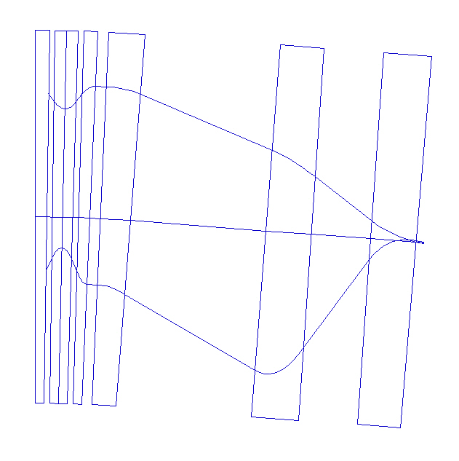
Matching to linac -> zero dispersion for each momentum
10 GeV
2.5 GeV

Slide 32
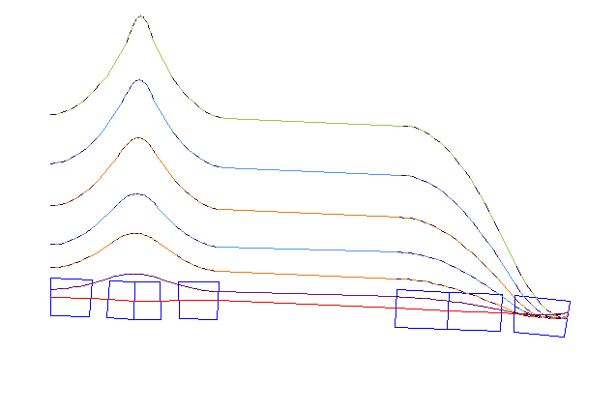
p>p_{cent} orbits matched to linac -> zero dispersion for each momentum
p=p_{max}
p=p_{cent}

Slide 33
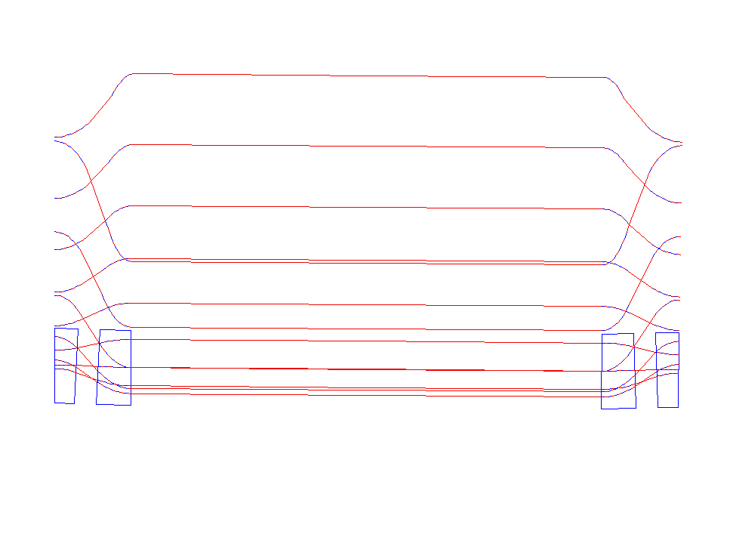
Matching cell to the non-scaling FFAG arcs

Slide 34
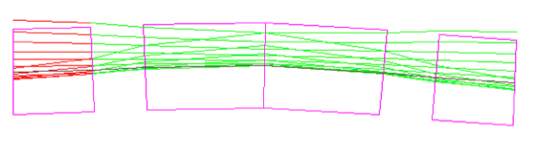
Matching cell to the non-scaling FFAG arcs

Slide 35
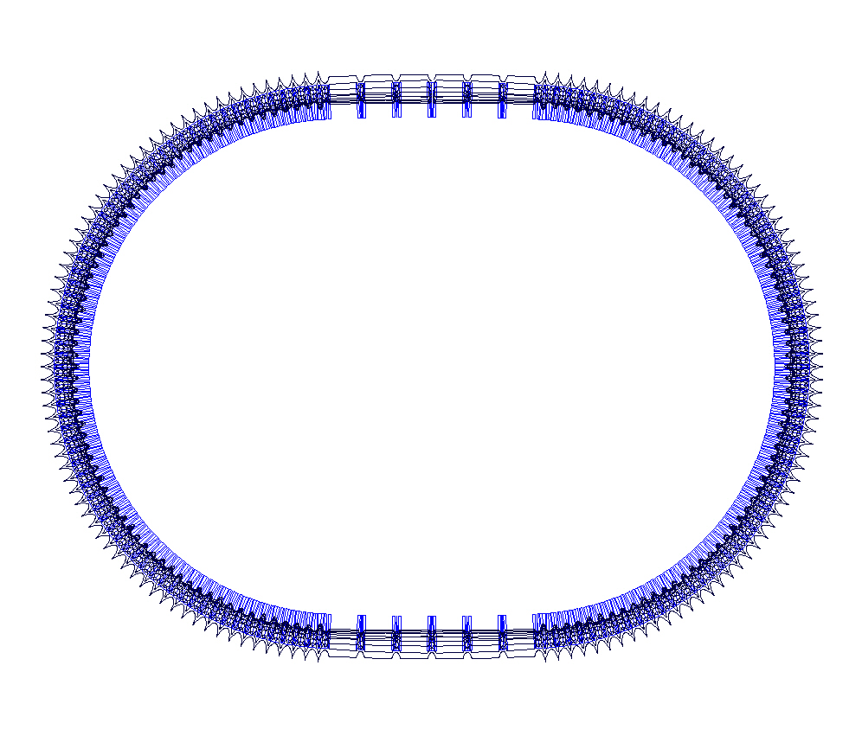
Non scaling FFA arcs with matching cells without linac
Orbits from 2.5 – 10 GeV
through the matching cells and arcs:

Slide 36
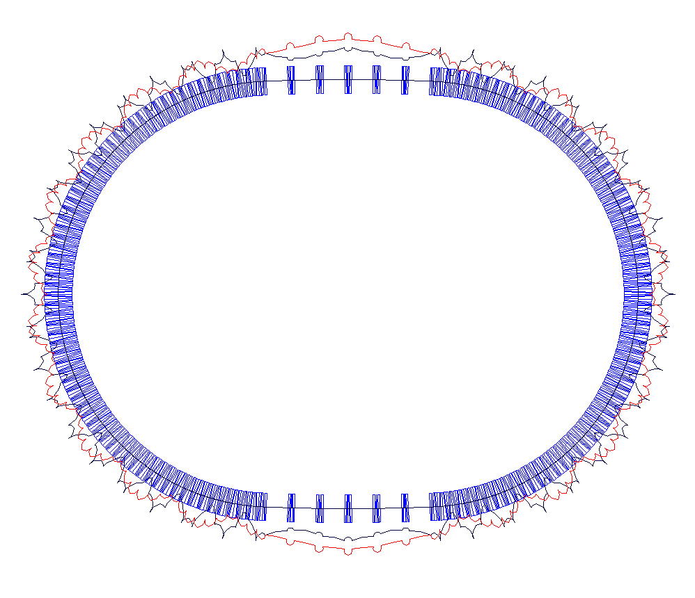
Non scaling FFA arcs with matching cells without linac
Betatron Functions from 2.5 – 10 GeV
through the matching cells and arcs:

Slide 37
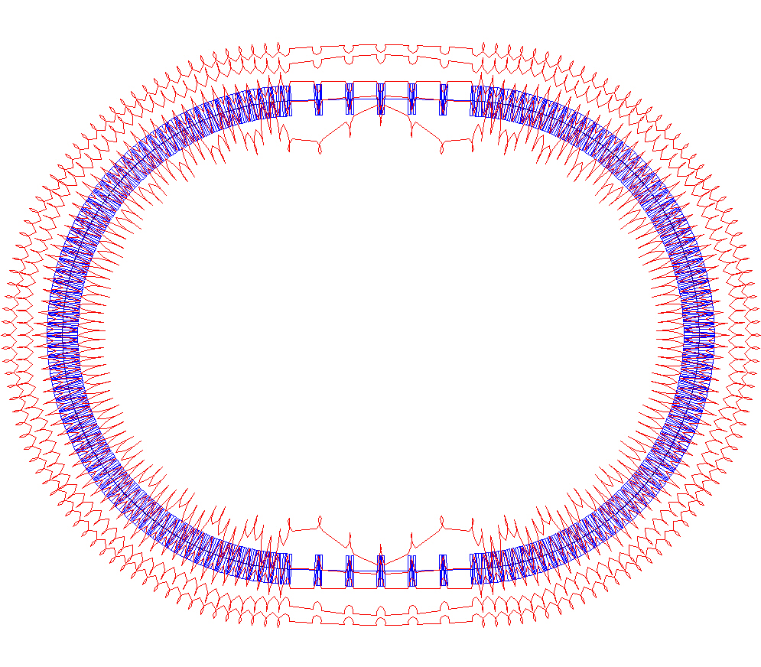
Non scaling FFA arcs with matching cells without linac
Dispersion from 2.5 – 10 GeV
through the matching cells and arcs:

Slide 38
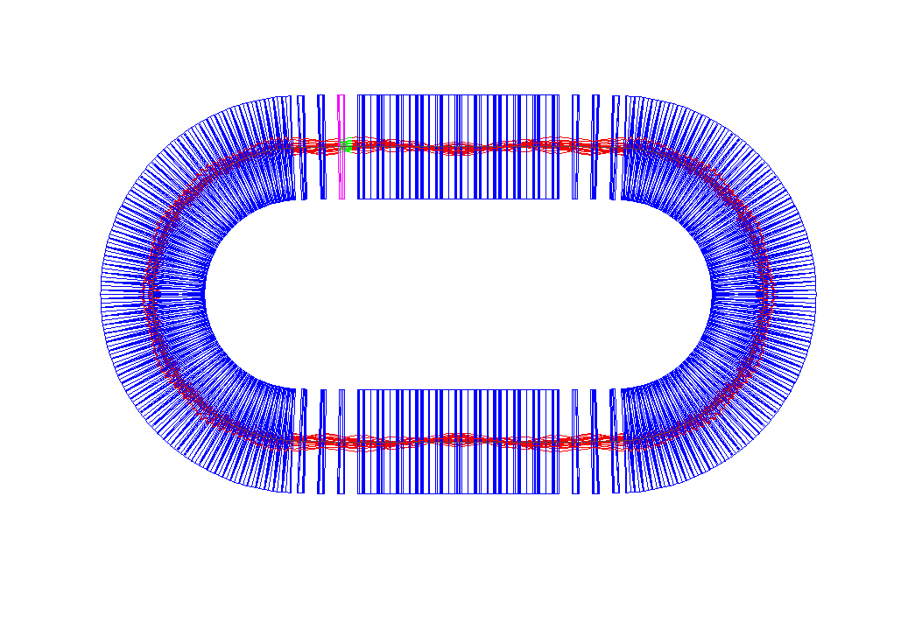
Matching cell with linac – arc to linac
Orbits magnified 100 times
From 2.5 GeV- 10GeV

Slide 39
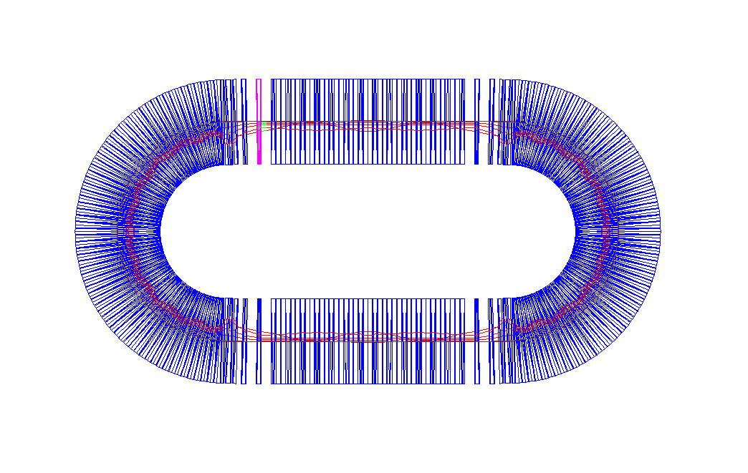
Multipass Linac with combined function triplets
Details of the orbits with
Chicanes:

Slide 40
Details of the chicane calculations:
−2θ
L
θ
L_{o} /L=cos θ
L_{o}

Slide 41
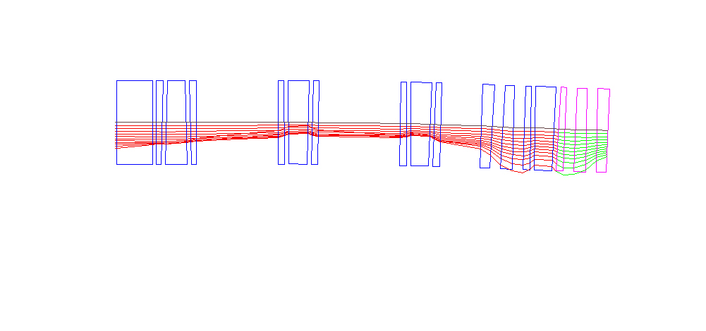
Details of the Chicane
CAVITY
TRIPLET

Slide 42
Summary:
A combination of the non-scaling FFAG with linac is possible.
Time of flight adjustments is necessary –maximum of 0.493 m delay.
The simulation of acceleration can be set-up by the PTC (Polymorphic Tracking Code).
Thanks to Muon Inc. for the support

Slide 43
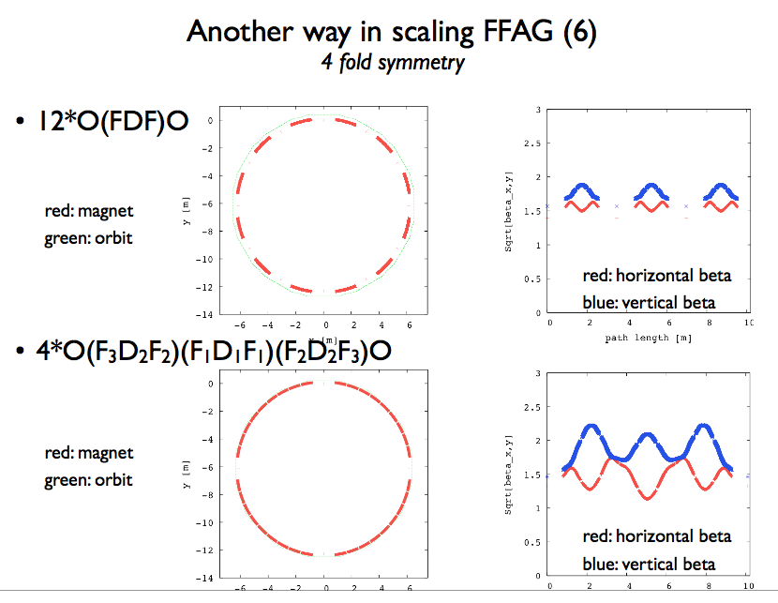
Shinji Machida – Fermilab FFAG workshop

Slide 44
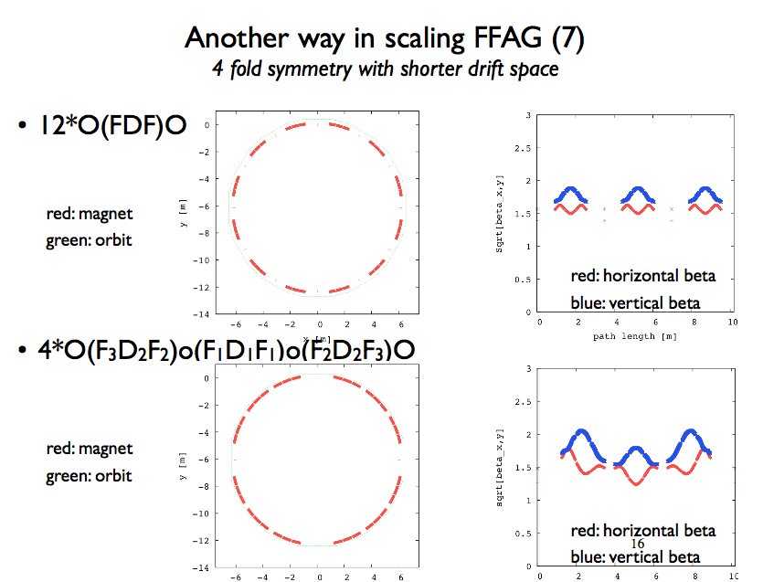
Shinji Machida – Fermilab FFAG workshop

Slide 45
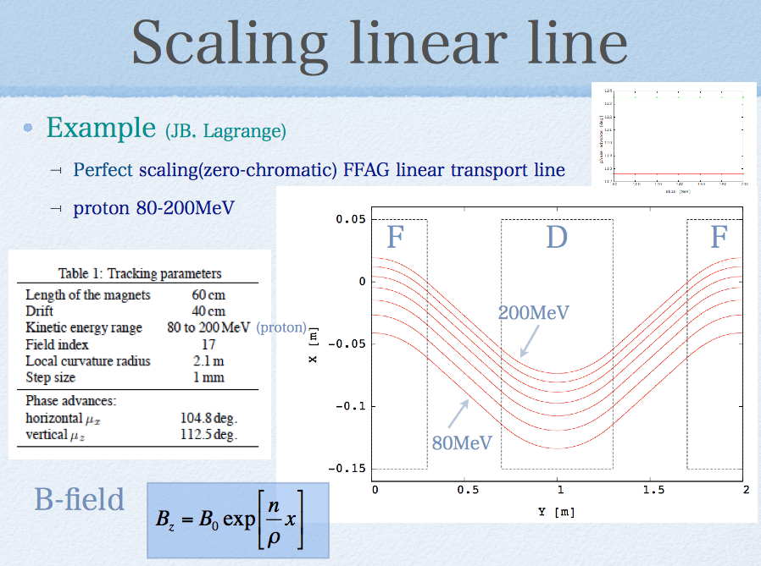
Yoshiharu Mori – Fermilab FFAG workshop:

Slide 46
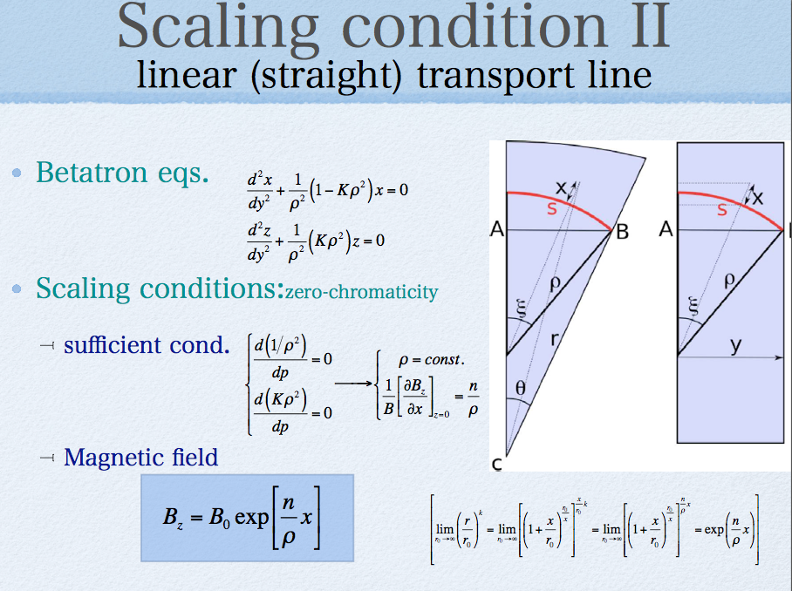

Slide 47
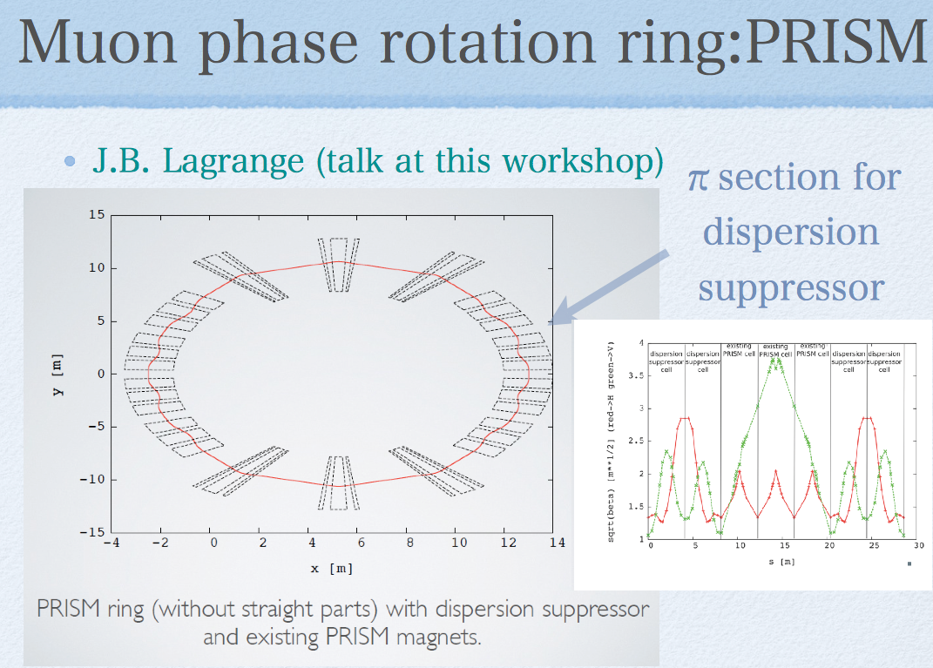
Yoshiharu Mori – Fermilab FFAG workshop:

