Slide 1
VHFSMC
Very High Field Superconducting Magnet Collaboration

Slide 2







The VHFSMC Collaboration

Slide 3
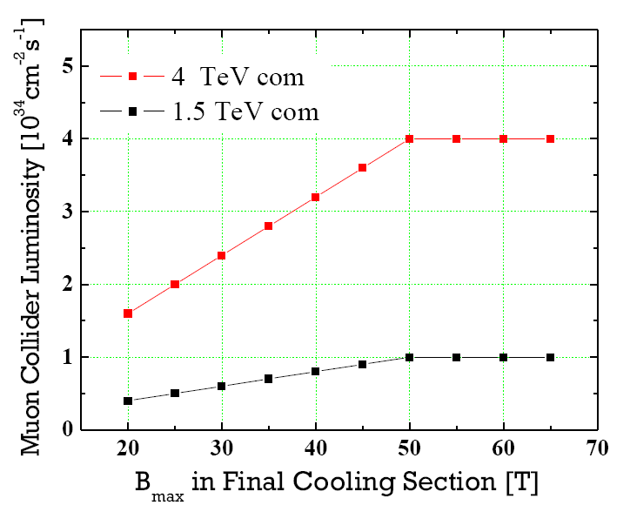
VHFSMC Goals
The primary goal is to develop the Technology of High Temperature Superconductors for use in magnets at fields beyond those available for Nb based conductors.
This supports the needs of the muon collider R&D as well as the NMR community (see National Academy COMAG report)
L ~ B solenoid
L ~ B in collider ring
HTS Conductors may be Rad Hard. (BNL & CERN reports)

Slide 4
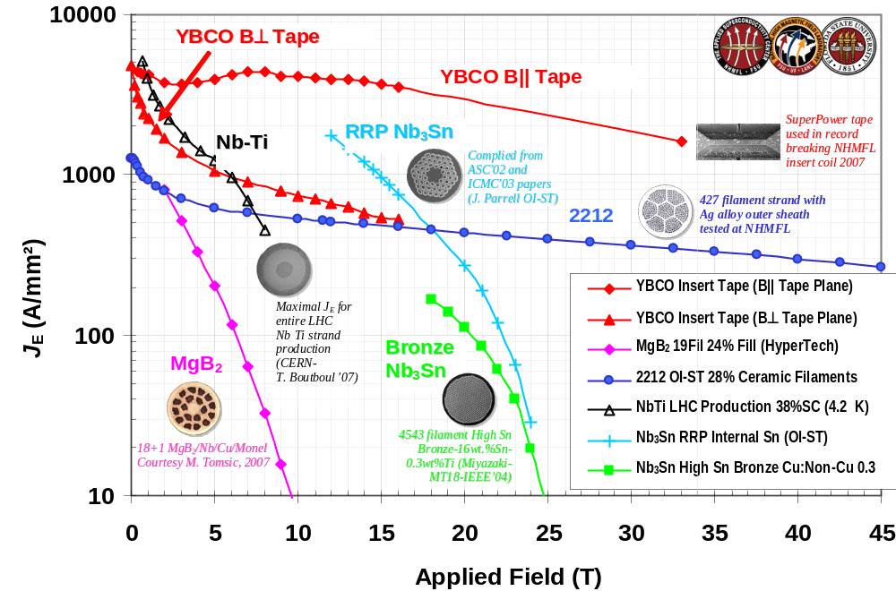
Quick Overview of Bi 2212
Why the excitement?

Slide 5
Goals and Tasks
    The immediate goal (2 years) is to understand if Bi 2212 is a suitable vehicle for this task. The work has been broken down into 6 tasks:
        Understand the material science of Bi 2212.
        Measure and understand the response of Bi 2212 to axial and transverse loads.
        Develop the cabling technology.
        Understand the stability and quench behavior of the conductor and coils.
        Test Bi 2212 in wind and react environment.
        Integrate Industry into collaborative R&D.

Slide 6
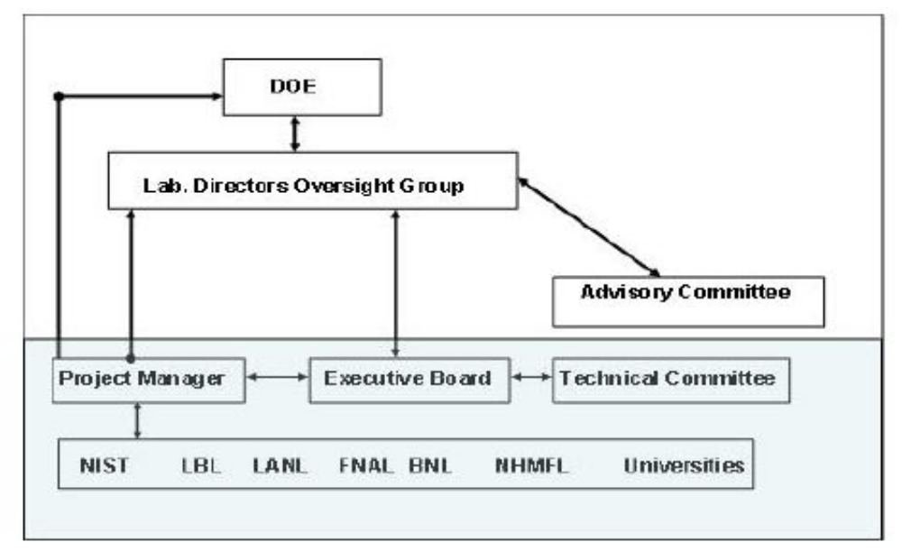
Organization of VHFSMC
Oversight Group:
Chair Greg. Boebinger, Director National High Magnetic Field Laboratory.
Steve Vigdor, Associate Director for Nuclear and Particle Physic BNL
Steve Holmes, Associate Director for Accelerators FNAL
J. Siegrist, Director Physics Division LBNL
Mike Kelley, Division Chief, Electromagnetics Division (ex officio) NIST
David Larbalestier NHMFL is Chairman of the Technical Committee.
Arup Gosh (BNL) is Project Manager

Slide 7
Status and Reasons Why
We have received word from the DOE that this effort will be funded at $4 M spread over two years. Further funding will depend on performance and the results we achieve.
This program was necessary for two reasons:
    The major support of HTS conductor development is from the power industry. Their interest is in the high J_{c} , low B, and high temperature (LN₂ or higher) conductor. Support is necessary for the special needs of HEP magnets which involve very high fields, need high current density and which can only be achieved at LHe temperatures with the HTS conductors.
    The use of the HTS material in HEP type magnets at very high fields will require both new theoretical understanding of the material as well as extending our technology for magnet construction.
This collaboration is much stronger than any one member:
  Industry where the conductor is fabricated.
  The National Labs where the magnet building technology is located.
  The material scientists in the universities who can help guide the improvement of the conductor.
Conductor
Magnets

Slide 8
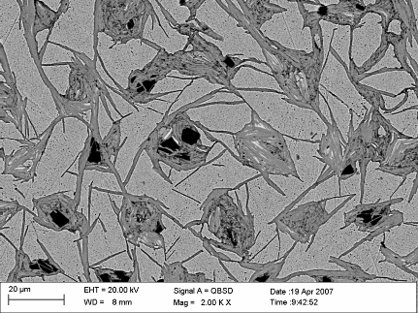
Collaboration Rich in Resources
Major thrust is understanding heat-treatment-microstructure-chemistry relationship to the J_{c} of the conductor. This work is taking place at NHMFL-LANL. Great facilities for exploring conductor physics
Cross section of 2212 taken at NHMFL. Very sophisticated instrumentation now available for studying the conductor. Hope to increase J_{c} by improving connectivity which depends on the heat treatment.

Slide 9
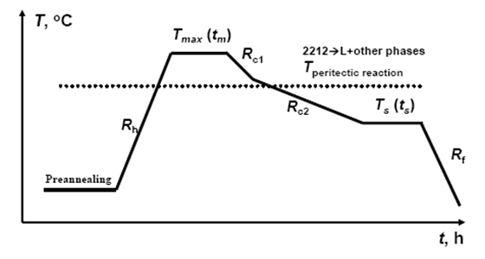
Some Challanges
Wind and react has delicate temperature profile.
A typical heat treatment profile for Bi-2212 wire reaction. This empirical reaction procedure typically has tight tolerances ±2°C on Tmax, different specifications on the heating and cooling rates Rx and secondary hold temperature and oxygen partial pressures. There is a huge need to understand what occurs during each step of the process so as to better optimize it. Quenching samples from multiple points in the process and correlating microstructure and superconducting properties is one important tool to be applied to this goal.
Good progress lately on understanding the requirements at NHMFL.

Slide 10
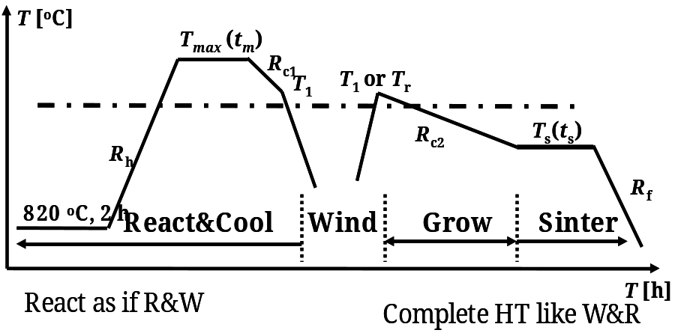
Some Challenges Continued
React and wind may be a solution
React-wind-sinter heat treatment protocol. Proposed by Justin Schwartz. The horizontal dashed line represents the peritectic melting temperature, though there is evidence that peritectic melting begins at a lower temperature during the second heat treatment than in the first. Has the advantage that the critical parts of the heat treatment are done on the cable NOT the magnet.

Slide 11
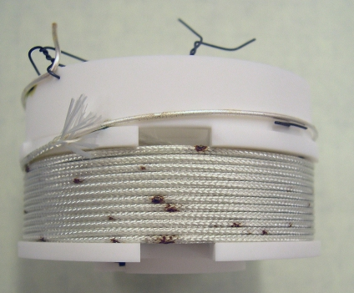
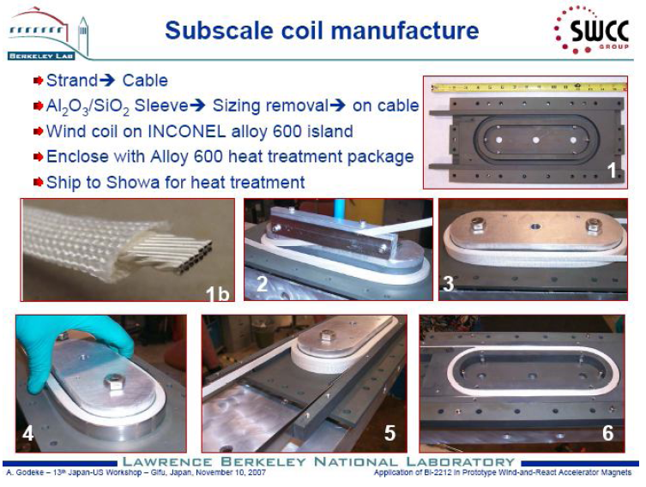
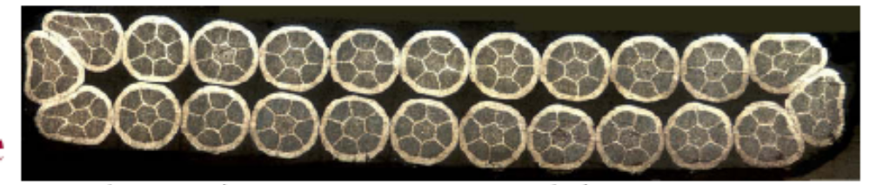
Test coils and cable can be fabricated
NHMFL test coil
LBL Test Coil
FNAL test cable. Test degradation of J_{c} in the cabling process

Slide 12
Status
Work plans and budgets are being prepared under the guidance of the Technical Committee. These must be prepared before any dispersal of funds. Negotiations are under with industry in order to get both their help to develop a better conductor as well as to arrange for a supply of conductor to feed the program outlined above.
Some funds will held back for use downstream in a manner that will be determined by our first results.
Since this program provides an important source of support for the MC program, we are proposing that we use as a guide the design of a 30 T magnet with a size suitable for muon cooling. This will provide the focus for identifying where the critical problems lie and assure that they are addressed.

Slide 13
A future need!
The goal of the program is to develop the technology to build magnets with B>30 T, hopefully on the time scale of 2 years. The program does not have funding to actually build a full scale magnet. This is a future need. A full scale test is crucial for verifying the work done by the VHFSMC.
Could be collaborative with other agencies of divisions.

