Slide 1


Project X Overview
mostly Steve Holmes ppt’s with my spin
&
CW 8 GeV Linac and Beam Structure
In collaboration with C. Ankenbrandt and R. Johnson
Milorad Popovic
FNAL

Slide 2
Project X: A multi-MW Proton Source at Fermilab
There are more than 50 slides, I will show only few
Steve Holmes
Lawrence Berkeley Laboratory
November 20, 2009

Slide 3
Strategic Context
P5 Recommendations
Energy Frontier
  “The panel recommends for the near future a broad accelerator and detector R&D program for lepton colliders that includes continued R&D on ILC …”
  “The panel also recommends R&D for alternative accelerator technologies, to permit an informed choice when the lepton collider energy is established.”
Intensity Frontier
  “The panel recommends an R&D program in the immediate future to design a multi-megawatt proton source at Fermilab and a neutrino beamline to DUSEL… “

Slide 4
Evolution of the Fermilab Accelerator Complex
Project X, a multi-MW Proton Source, is the linchpin of Fermilab’s strategy for future development of the accelerator complex.
Project X provides long term flexibility/opportunities post-2012
  Energy Frontier:
  Tevatron → ILC or Muon Collider
    Technology alignment
    Fermilab as host site for ILC or MC
  Intensity Frontier:
  NuMI→ NOνA→ LBNE/mu2e→ multi-MW Proton Source → NuFact
    Continuously evolving world leading program in neutrino physics and other beyond the standard model phenomena

Slide 5
Accelerator Requirements: Rare Processes
 | Proton Energy (kinetic) | Beam Power | Beam Timing
Rare Muon decays | 2-3 GeV | >500 kW | 1 kHz – 160 MHz
(g-2) measurement | 8 GeV | 20-50 kW | 30- 100 Hz
Rare Kaon decays | 2.6 – 4 GeV | >500 kW | 20 – 160 MHz (<50 psec pings)
Precision K⁰ studies | 2.6 – 3 GeV | > 100 μA (internal target) | 20 – 160 MHz (<50 psec pings)
Neutron and exotic nuclei EDMs | 1.5-2.5 GeV | >500 kW | > 100 Hz

Slide 6
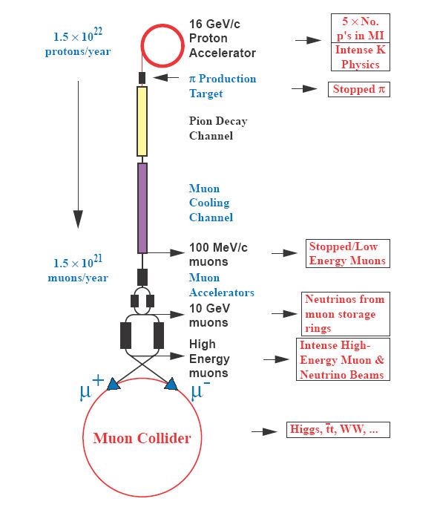
Joint PX/NF/MC Strategy
Project X shares many features with the proton driver required for a Neutrino Factory or Muon Collider
  NF and MC require ~4 MW @ 10± 5 GeV
    Requires upgrade of the Project X
    linac to 2-4 MW
    The ICD-1 includes such a concept:
    rep rate x8 (20 Hz)
  Primary issues are related to beam “format”
    NF wants proton beam on target
    consolidated in a few bunches,
    Muon Collider requires single bunch
  Project X linac is not capable of delivering
  this format
It is inevitable that a new ring(s) will be
required to produce the correct beam format for targeting.
8 GeV, 4 MW Linac

Slide 7
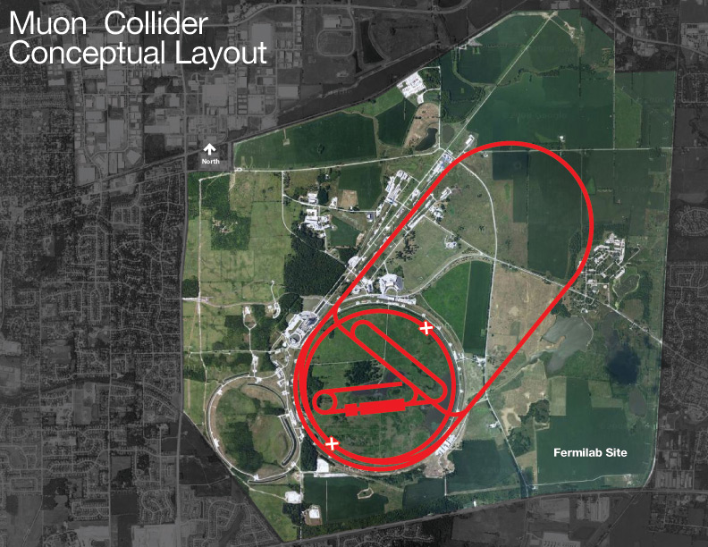
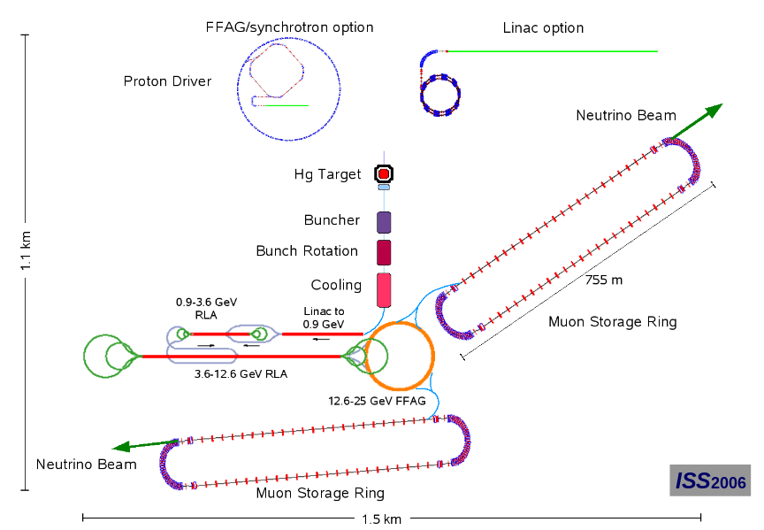
Joint PX/NF/MC Strategy
Natural evolutionary schemes through neutrino superbeams:
NOνA→ LBNE→ Neutrino Factory → Muon Collider
Close coordination with NFMCC, MCTF,
and IDS_NF

Slide 8
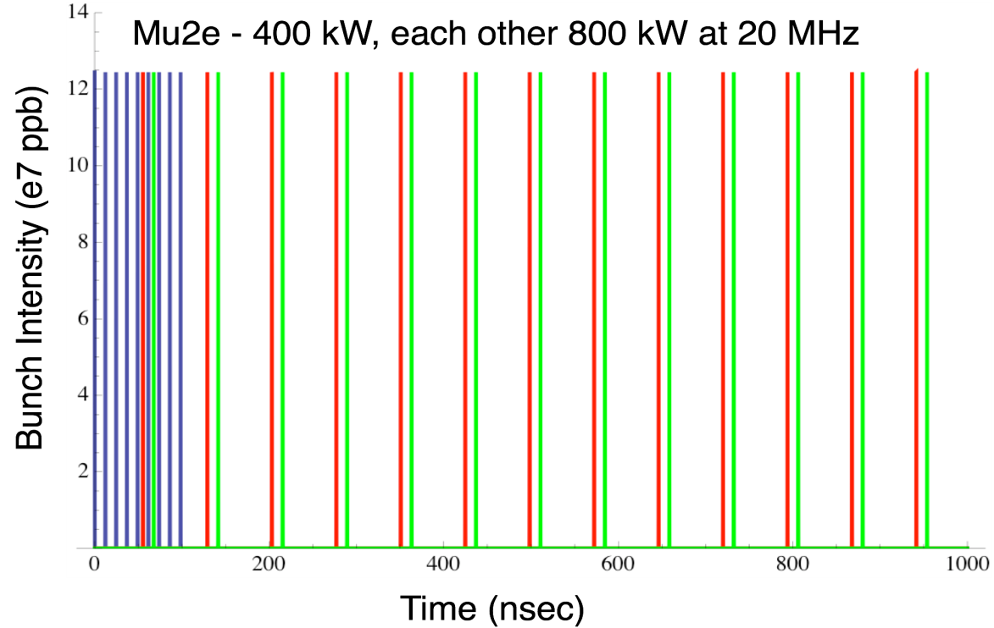
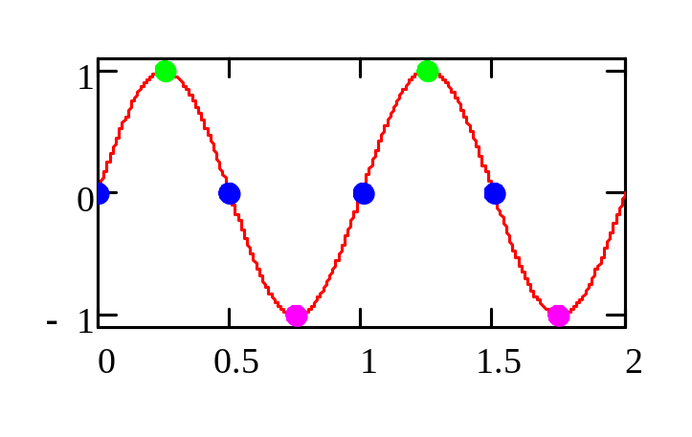
Initial Configuration-2
Operating Scenario
1 μsec period at 2 GeV
mu2e pulse (9e7) 162.5 MHz, 100 nsec 400 kW
Kaon pulse (9e7) 27 MHz 800 kW
Other pulse (9e7) 27 MHz 800 kW
Separation scheme

Slide 9
Summary
Project X is central to Fermilab’s strategy for future development of the accelerator complex:
  Energy Frontier: Aligned with ILC technology development; Fermilab as potential site for ILC or a Muon Collider
  Intensity Frontier: World leading program in neutrinos and rare processes; Fermilab as potential Neutrino Factory site
Initial configurations, and preliminary cost estimates, established
  >2 MW at 60-120 GeV, simultaneous with up to 2 MW for rare processes program
  Upgradable to 2-4 MW at 8 GeV
Integrated effort on Project X, ILC, and Muon Facilities
Project X could be constructed over the period ~2015 - 2019
Collaboration formed

Slide 10
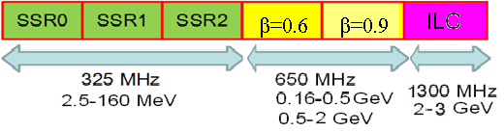
Possible scheme for 3 GeV CW Linac with 650 MHz cavity, option #4.
Parameters of the cavities and components.
Slava Yakovlev and Nikolai Solyak
01/06/2010

Slide 11
Part 2
CW 8 GeV Linac and Beam Structure
Milorad Popovic
FNAL

Slide 12
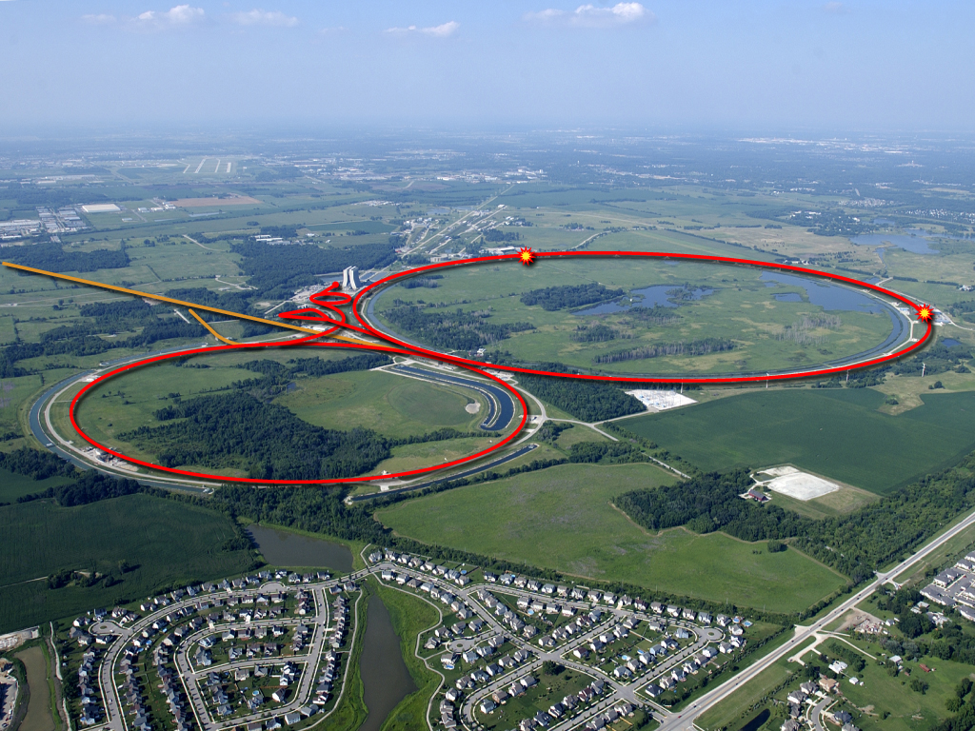
Fermilab in 2020
NuMI (NOvA)
8 GeV SC Linac
DUSEL
Recycler: 100-200 kW (8 GeV) for kaons, muons, …
Main Injector: >2 MW (60-120 GeV) for neutrinos

Slide 13
Transition at 2.x GeV to High Energy Linac
There is kink, about 3 degree, and warm transfer line
A Double-Bend Achromat!?( Dipole 2meter, 0.25T)
RF switching for 2.x GeV Experiments, Additional kick from middle quadrupole
Injection of H- to High Energy Linac, (may be line should be isochronous, Buncher?!)
Injection of Muons for NuFactory and Muon Collider

Slide 14


“High” Energy Linac
There is ~40m long warm section at 2.x GeV
Kink, ~3 degree between “Low” and “High” Energy Linacs
High Energy Linac directed ~toward DUSEL
Injection at MI10, 5GeV< Injection energy ≤ 8GeV
0.125mA < H- Current < 1mA
-5 Degree <Synchronous Phase < -2 Degree
9 Cell, 9 cavities per Cryo Module
FODO, quads outside
16MV/m < Eacc < 18MV/m

Slide 15
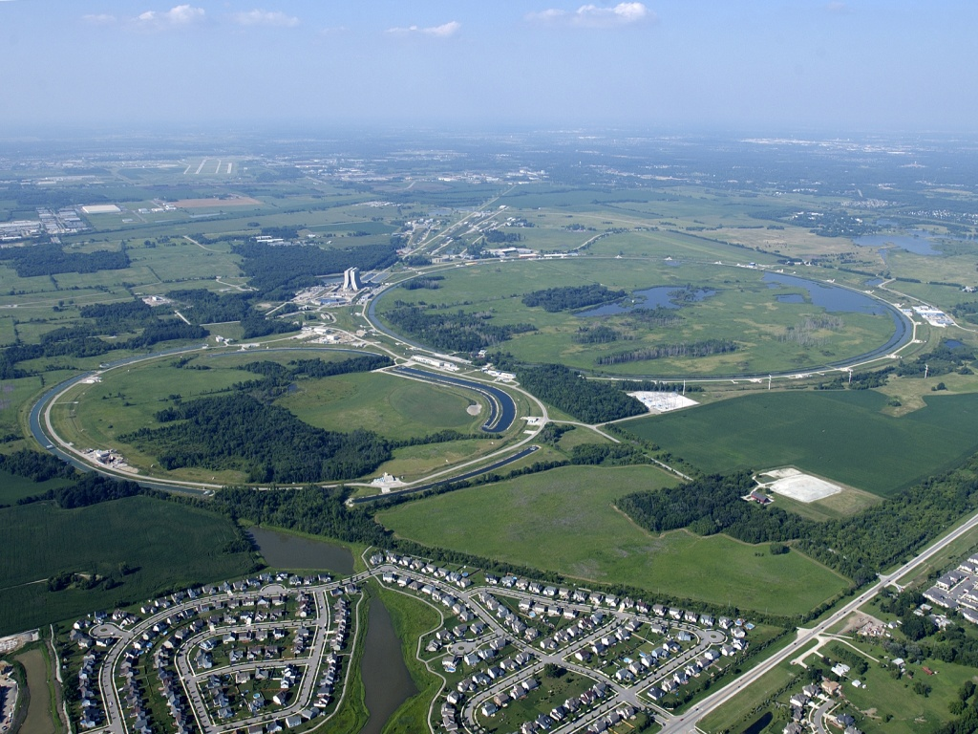
Fermilab in 2030
Low energy program (350-2000 kW)
NuMI (NOvA)
8 GeV neutrinos
DUSEL
8 GeV SC Linac
25 GeV NF
Recycler
Main Injector
Young-Kee Kim Fermilab Strategic Plan Slide 15
Notes:
15

Slide 16

μ
Muons, Inc.
Injection & Accumulation
H- Injection from CW Linac at ~ 8GeV is major problem
For 1mA and 4 MW beam Injection last for 500msec
For small accumulation ring, l~300m injection last for 5x10⁵ turns
Laser Stripping is still concept
What about pushing existing technology?

Slide 17
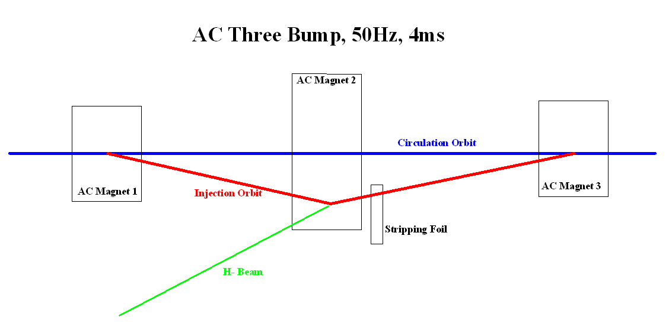
Injection & Accumulation
125uA current , 1MW@8GeV -> 7.8x10¹⁴ , Main Injector can take
1.5x10¹⁴ -> total injection time in Recycler ~200msec
To ease Injection, AC Dipole scheme is envisioned, (motivated by misunderstanding (by me) Chuck’s, Muons Inc, Resonant Foil concept )
Every 20msec, circulating beam spends 4 msec on foil with H- injected beam

Slide 18
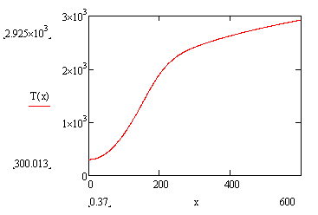
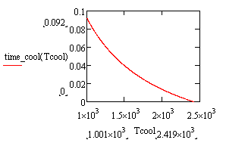
Simple Example-Toy Model
μ
Muons, Inc.
The Carbon foil is 200ugr/cm^2, beam spot is 0.3 cm radius, 1.5x10^14, 5Hz, Linac Current CW125uAmp, 430turns per injection, all particles hit foil at every passage.
For CW, <~1mA ,
long Injection -> T⁴ cooling is effective
low impact of injected beam

Slide 19
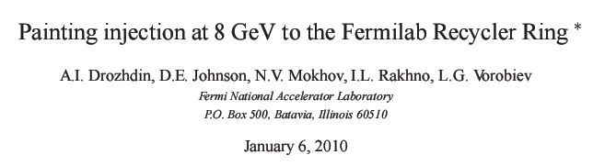
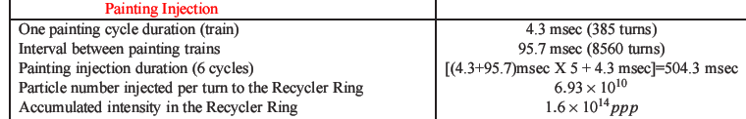
1mA CW (Boys, we are scooped)
μ
Muons, Inc.

Slide 20

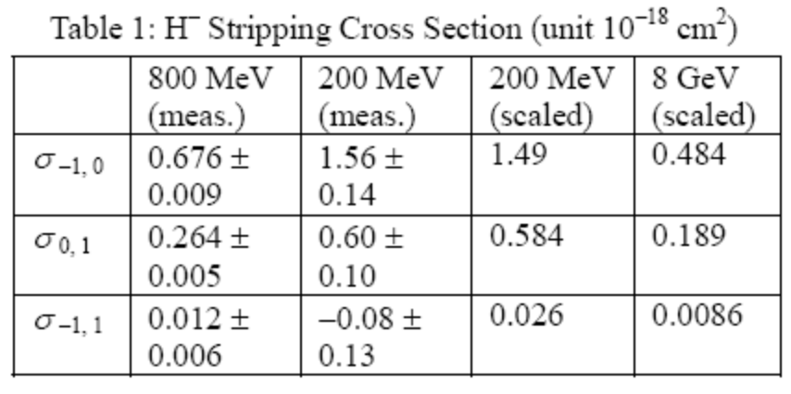
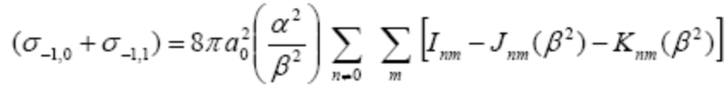
Stripping Foil Thickness, 8GeV H- Beam
μ
Muons, Inc.
ugr/cm^2

Slide 21
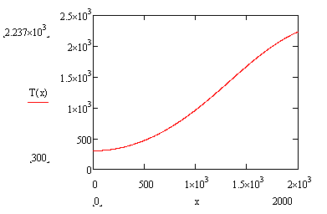
Painting by “Hand”
μ
Muons, Inc.
Foil
Closed Orbit

Slide 22
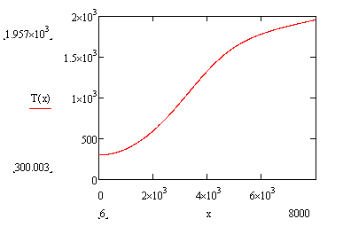
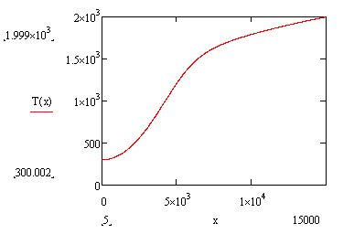
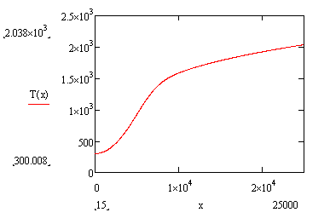
Example for 4 discrete injections <-> 50k turns
μ
Muons, Inc.
Foil
Closed Orbit
64
100

Slide 23
Excel Panting Parameters
μ
Muons, Inc.
Ekin | 8000 |  | Eps_x | 5.2764E-07
gamma | 9.528785 |  | Beta_x,Alfa | 175 | 1
beta | 0.994478 |  | Q_x | 2.917
E95No | 5.00E-06 |  | phy_x | 0
 |  |  | Eps_y | 5.2764E-07
T-revol | 1e-6 |  | Beta_y, Alfa_y | 50 | -1
 |  |  | Q_y | 3.927
 |  |  | phy_y | 0
 |  |  | x_off | 0.00E+00
 |  |  | y_off | 0.00E+00

Slide 24
Rotating Stripping Foils
μ
Muons, Inc.
Carbon Foil
Linac Beam
Circulating beam
Rotating Disk Holder
Like BeamWhacker

Slide 25
μ
Muons, Inc.
CW SRF H⁻ linac as a proton driver for muon colliders
and neutrino factories
Milorad Popovic^{1†}, Charles M. ankenbrandt²,
Rolland P. Johnson²
¹Fermilab, P.O. Box 500, Batavia, IL, 60510, USA
²Muons, Inc., 552 N. Batavia Ave., Batavia, IL, 60510, USA
We describe a Project-X proton driver based on a CW Superconducting RF Linac with final energy as high as 8 GeV. This machine would have the potential to produce multi-MW H⁻ beams to drive the Fermilab neutrino programs, rare kaon and muon decay experiments, muon cooling R&D programs, neutrino factories, and muon colliders. Keys to a CW machine to suit these uses include ways to generate the desired bunch trains and ways to accumulate many protons in an intermediate storage ring before they are bunched and directed to a target. Enhanced carbon foil techniques can allow accumulation of intense proton beams from a CW linac, which we propose to be extended from 3 GeV to as much as 8 GeV for the most efficient muon production for colliders and neutrino factories and to replace the Booster for improved Main Injector operation
___________________________
Supported in part by Fermilab Research Alliance, LLC under Contract
No. DE-AC02-07CH11359
† popovic@fnal.gov

