Slide 1


μ
Muons, Inc.
Dielectric-Filled RF Cavities, Status Report
Milorad Popovic
FNAL

Slide 2
Motivation
μ
Muons, Inc.
To fit pressurized cavities in HCC, size of cavity has to be reduced
800 MHz (from Katsuya)
Maximum allow RF cavity radius = 0.08 m, (pillbox cavity 0.143)
Radius of effective electric field (95 % from peak) = 0.03 m
400 MHz:
Maximum allow RF radius = 0.16 m (pillbox cavity 0.286)
Radius of effective electric field = 0.06 m
Optimum electric field gradient = 16 MV/m
To suppressed degradation of cavity acceleration gradient in high magnetic field
For Pill Box Cavity, resonant frequency is

Slide 3



Ez as a function of Radius for various ceramic loaded 325 MHz “pillbox” cells
Mike Neubauer Muons, inc. MCDW BNL Dec 1-3
μ
Muons, Inc.
Z_{shunt}= 6 54 100 MΩ/m

Slide 4
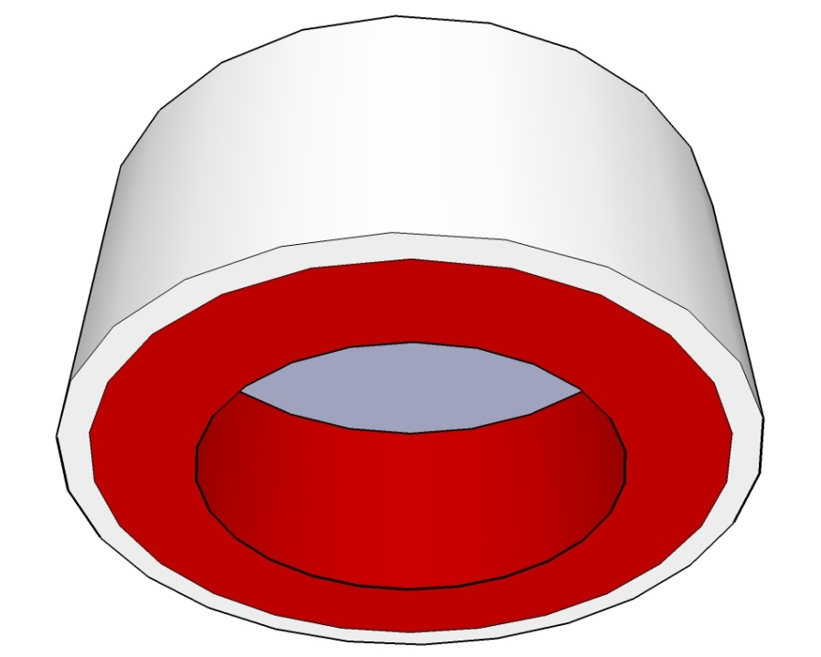
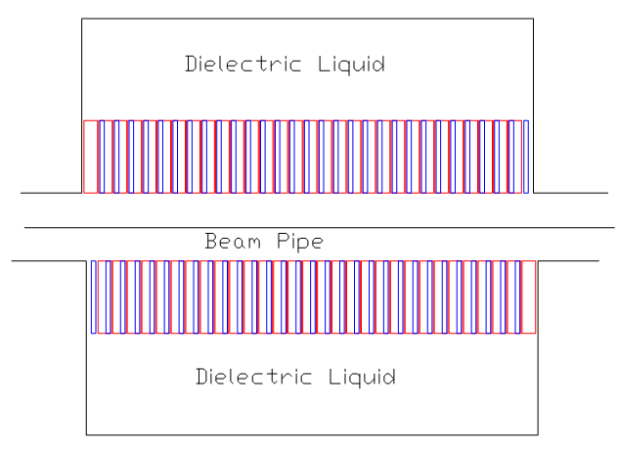
μ
Muons, Inc.
A Tale of Two Cavities
Best of Times-Worst of Times
For HCC
Vacuum Cavity
Cu/Steel
ceramics
Vacuum/H/He

Slide 5
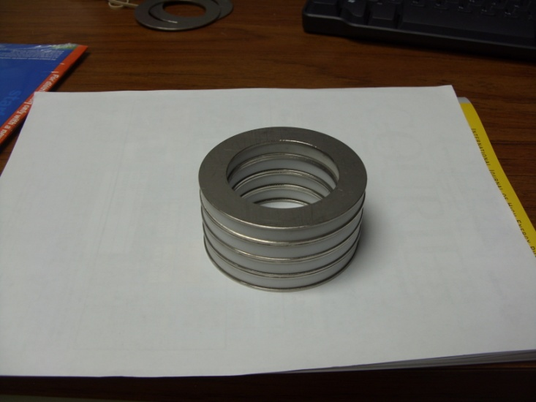
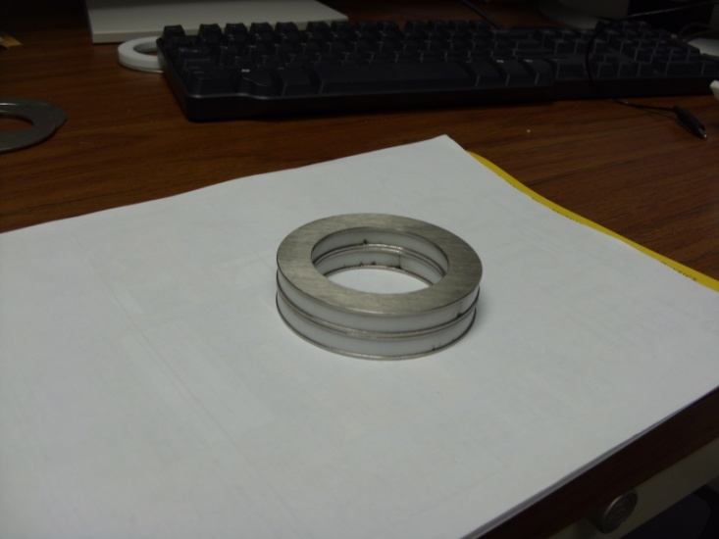
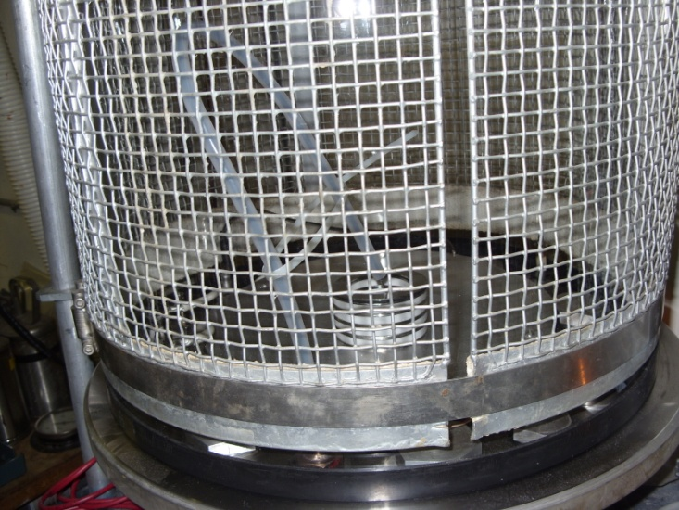
μ
Muons, Inc.
DC/AC Measurements
DC
AC
 |  | mm | kV | kV/mm
 | Air-SolCer | 25.8 | 25 | 0.968992
Air | 4-CeRin | 35.784 | 30 | 0.838364
3.00E-04 | 4-CeRin | 35.784 | 65 | 1.816454
 | 2-Ce_Rin | 16.228 | 48 | 2.957851
Oil | 2-Ce_Rin | 16.228 | 55 | 3.389204
SF6 | Colm750 | 63.5 | 125 | 1.968504
25-Sep-09 |  | Freq(Hz) | C(pF) | Q
CP-Q | 4_rings | 100 | 8.9 | 21.1
Averege=50 |  | 120 | 8.9 | 22.4
 |  | 1000 | 8.63 | 70.8
 |  | 10000 | 8.59 | 132.7
 |  | 100000 | 8.53 | 240

Slide 6
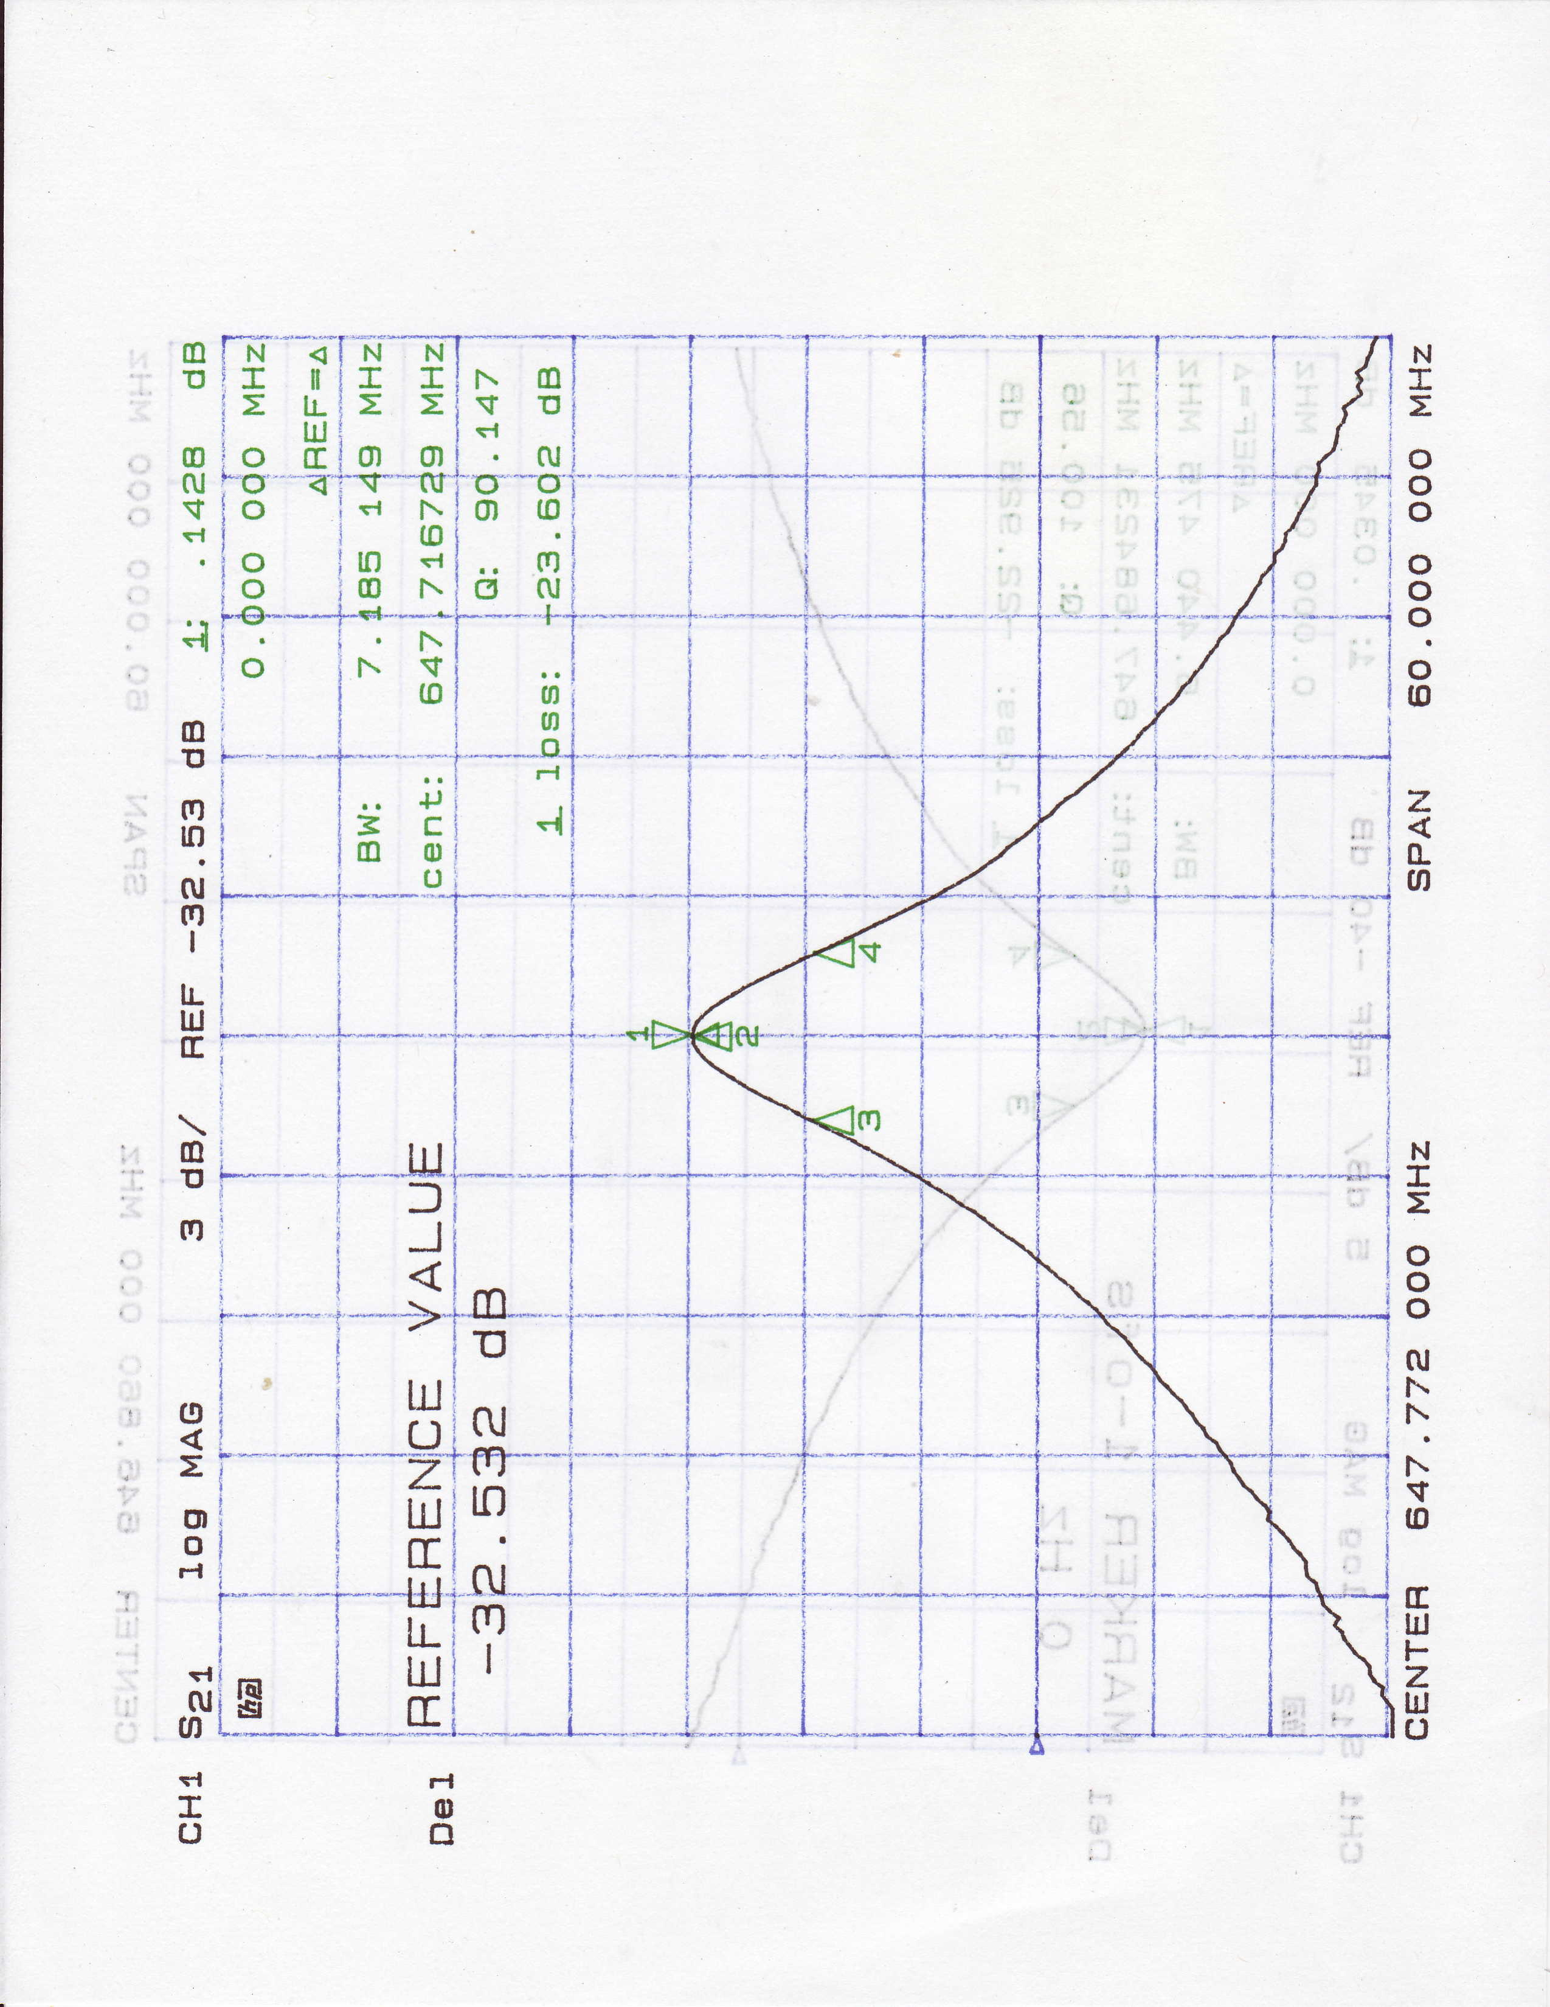
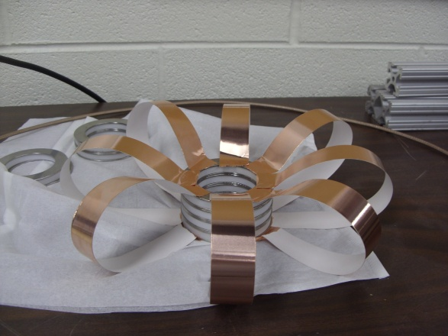
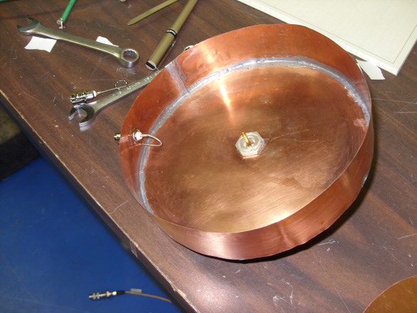
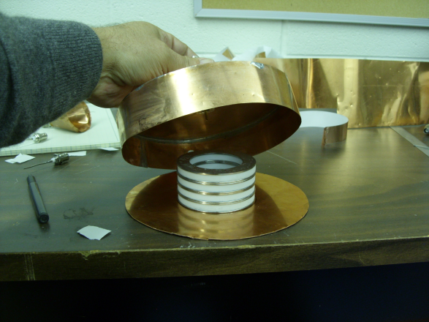
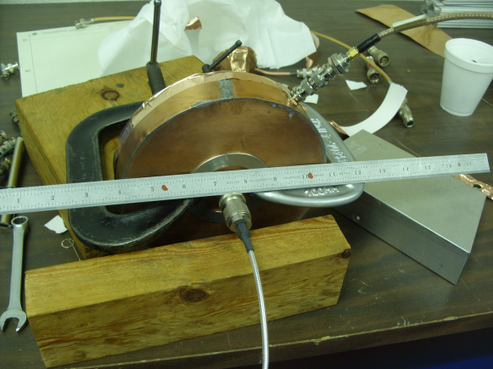
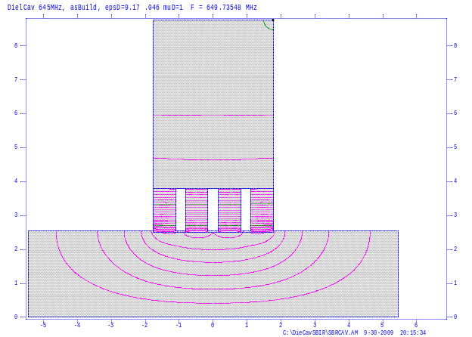
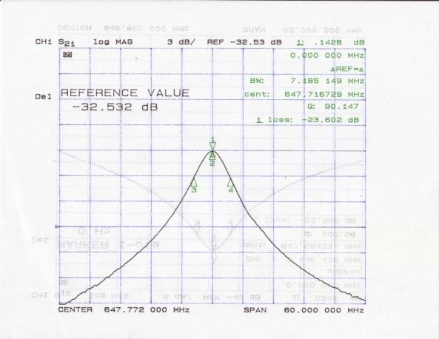
μ
Muons, Inc.
RF Measurements
Superfish output summary for problem description:
DielCav 645MHz, asBuild, epsD=9.17 .046 muD=1
Dimensions
Problem file: C:\DieCavSBIR\SBRCAV.AM 10-01-2009 19:58:46
-------------------------------------------------------------------------------
All calculated values below refer to the mesh geometry only.
Field normalization (NORM = 0): EZERO = 1.00000 MV/m
Frequency = 649.73548 MHz
Particle rest mass energy = 938.272029 MeV
Beta = 0.9900000 Kinetic energy = 5712.962 MeV
Normalization factor for E0 = 1.000 MV/m = 28866.790
Transit-time factor = 0.9664768
Stored energy = 0.0492526 Joules
Using standard room-temperature copper.
Surface resistance = 6.65012 milliOhm
Normal-conductor resistivity = 1.72410 microOhm-cm
Operating temperature = 20.0000 C
Power dissipation = 888.5632 kW
Q = 226.286 Shunt impedance = 0.123 MOhm/m
Rs*Q = 1.505 Ohm Z*T*T = 0.115 MOhm/m
r/Q = 55.194 Ohm Wake loss parameter = 0.05633 V/pC
Average magnetic field on the outer wall = 7661.52 A/m, 19.5177 W/cm^2
Maximum H (at Z,R = 0.0,3.801) = 14848.7 A/m, 73.3126 W/cm^2
Maximum E (at Z,R = 1.775,2.54) = 5.07623 MV/m, 0.213485 Kilp.
Ratio of peak fields Bmax/Emax = 3.6759 mT/(MV/m)
Peak-to-average ratio Emax/E0 = 5.0762

Slide 7
SuperFish, Different Ceramics
μ
Muons, Inc.
Superfish output summary for problem description:
DielCav 645MHz, asBuild, epsD=9.17 .046 muD=1
Dimensions
Problem file: C:\DieCavSBIR\SBRCAV.AM 10-01-2009 19:58:46
-------------------------------------------------------------------------------
All calculated values below refer to the mesh geometry only.
Field normalization (NORM = 0): EZERO = 1.00000 MV/m
Frequency = 649.73548 MHz
Particle rest mass energy = 938.272029 MeV
Beta = 0.9900000 Kinetic energy = 5712.962 MeV
Normalization factor for E0 = 1.000 MV/m = 28866.790
Transit-time factor = 0.9664768
Stored energy = 0.0492526 Joules
Using standard room-temperature copper.
Surface resistance = 6.65012 milliOhm
Normal-conductor resistivity = 1.72410 microOhm-cm
Operating temperature = 20.0000 C
Power dissipation = 888.5632 kW
Q = 226.286 Shunt impedance = 0.123 MOhm/m
Rs*Q = 1.505 Ohm Z*T*T = 0.115 MOhm/m
r/Q = 55.194 Ohm Wake loss parameter = 0.05633 V/pC
Average magnetic field on the outer wall = 7661.52 A/m, 19.5177 W/cm^2
Maximum H (at Z,R = 0.0,3.801) = 14848.7 A/m, 73.3126 W/cm^2
Maximum E (at Z,R = 1.775,2.54) = 5.07623 MV/m, 0.213485 Kilp.
Ratio of peak fields Bmax/Emax = 3.6759 mT/(MV/m)
Peak-to-average ratio Emax/E0 = 5.0762
Superfish output summary for problem description:
DielCav 645MHz, epsD=9.17 .00029 muD=1
Dimensions
Problem file: C:\DieCavSBIR\SBRCAV.AM 10-01-2009 20:28:02
-------------------------------------------------------------------------------
All calculated values below refer to the mesh geometry only.
Field normalization (NORM = 0): EZERO = 1.00000 MV/m
Frequency = 649.75078 MHz
Particle rest mass energy = 938.272029 MeV
Beta = 0.9900000 Kinetic energy = 5712.962 MeV
Normalization factor for E0 = 1.000 MV/m = 28864.919
Transit-time factor = 0.9664752
Stored energy = 0.0492532 Joules
Using standard room-temperature copper.
Surface resistance = 6.65020 milliOhm
Normal-conductor resistivity = 1.72410 microOhm-cm
Operating temperature = 20.0000 C
Power dissipation = 33.6972 kW
Q = 5967.16 Shunt impedance = 3.235 MOhm/m
Rs*Q = 39.683 Ohm Z*T*T = 3.021 MOhm/m
r/Q = 55.192 Ohm Wake loss parameter = 0.05633 V/pC
Average magnetic field on the outer wall = 7661.65 A/m, 19.5186 W/cm^2
Maximum H (at Z,R = 0.0,3.801) = 14848.8 A/m, 73.3145 W/cm^2
Maximum E (at Z,R = 1.775,2.54) = 5.07621 MV/m, 0.213482 Kilp.
Ratio of peak fields Bmax/Emax = 3.6759 mT/(MV/m)
Peak-to-average ratio Emax/E0 = 5.0762

Slide 8
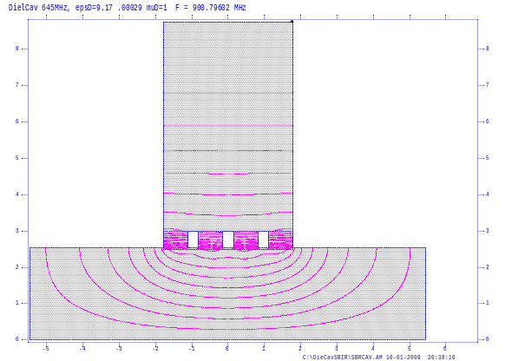
SuperFish, Different Ceramics Thickness
μ
Muons, Inc.
Superfish output summary for problem description:
DielCav 645MHz, epsD=9.17 .00029 muD=1
Dimensions
Problem file: C:\DieCavSBIR\SBRCAV.AM 10-01-2009 20:28:02
-------------------------------------------------------------------------------
All calculated values below refer to the mesh geometry only.
Field normalization (NORM = 0): EZERO = 1.00000 MV/m
Frequency = 649.75078 MHz
Particle rest mass energy = 938.272029 MeV
Beta = 0.9900000 Kinetic energy = 5712.962 MeV
Normalization factor for E0 = 1.000 MV/m = 28864.919
Transit-time factor = 0.9664752
Stored energy = 0.0492532 Joules
Using standard room-temperature copper.
Surface resistance = 6.65020 milliOhm
Normal-conductor resistivity = 1.72410 microOhm-cm
Operating temperature = 20.0000 C
Power dissipation = 33.6972 kW
Q = 5967.16 Shunt impedance = 3.235 MOhm/m
Rs*Q = 39.683 Ohm Z*T*T = 3.021 MOhm/m
r/Q = 55.192 Ohm Wake loss parameter = 0.05633 V/pC
Average magnetic field on the outer wall = 7661.65 A/m, 19.5186 W/cm^2
Maximum H (at Z,R = 0.0,3.801) = 14848.8 A/m, 73.3145 W/cm^2
Maximum E (at Z,R = 1.775,2.54) = 5.07621 MV/m, 0.213482 Kilp.
Ratio of peak fields Bmax/Emax = 3.6759 mT/(MV/m)
Peak-to-average ratio Emax/E0 = 5.0762
Superfish output summary for problem description:
DielCav 645MHz, epsD=9.17 .00029 muD=1
Dimensions
Problem file: C:\DieCavSBIR\SBRCAV.AM 10-01-2009 20:38:10
-------------------------------------------------------------------------------
All calculated values below refer to the mesh geometry only.
Field normalization (NORM = 0): EZERO = 1.00000 MV/m
Frequency = 900.79602 MHz
Particle rest mass energy = 938.272029 MeV
Beta = 0.9900000 Kinetic energy = 5712.962 MeV
Normalization factor for E0 = 1.000 MV/m = 19798.042
Transit-time factor = 0.9361509
Stored energy = 0.0220430 Joules
Using standard room-temperature copper.
Surface resistance = 7.83023 milliOhm
Normal-conductor resistivity = 1.72410 microOhm-cm
Operating temperature = 20.0000 C
Power dissipation = 14.4611 kW
Q = 8627.30 Shunt impedance = 7.537 MOhm/m
Rs*Q = 67.554 Ohm Z*T*T = 6.606 MOhm/m
r/Q = 83.458 Ohm Wake loss parameter = 0.11809 V/pC
Average magnetic field on the outer wall = 5255.24 A/m, 10.8126 W/cm^2
Maximum H (at Z,R = 0.0,2.987) = 9634.49 A/m, 36.3414 W/cm^2
Maximum E (at Z,R = 1.775,2.54) = 4.95047 MV/m, 0.180996 Kilp.
Ratio of peak fields Bmax/Emax = 2.4456 mT/(MV/m)
Peak-to-average ratio Emax/E0 = 4.9505

Slide 9
Ceramic Losses
Mike Neubauer Muons, inc. MCDW BNL Dec 1-3
μ
Muons, Inc.
For full ceramic
loaded cavity
Q=1/tanδ
Q_{70K}~20,000
Copper only
Q_{70K}~100,000

Slide 10
Main Issues
μ
Muons, Inc.
Ceramics, Loss Tangent
Surface coating
Dielectric Cooling/Tuning Liquid
Geometric/Power Optimization
RF and Mechanical Engineering
~50k$ + 1FTE to Start

Slide 11
μ
Muons, Inc.
Phase I-SBIR/STTR Fiscal Year 2010
(All information provided on this page is subject to release to the public.)
NAME of PRINCIPAL INVESTIGATOR: Michael Neubauer PHONE NUMBER: (707) 360-5038
FIRM NAME: Muons, Inc. | RESEARCH INSTITUTION: Fermi National Accelerator Laboratory Milorad Popovic, subgrant PI
ADDRESS: 552 N. Batavia Ave. Batavia, IL 60510 | ADDRESS: P. O. Box 500 Batavia, IL 60510
Loss tangent tan d = 1/Q_{dielectric}-1/Q_{air}
Loss tangents of specially formulated alumina with TiO₂ have been reported to be close to sapphire at 1e-5 . So it is easy to see that today’s ceramics may be used in this novel idea without suffering a great deal in cavity Q at low frequencies.
The other problem with ceramics in vacuum with beams is that of surface charging of the ceramic. And again, much work has been done in coatings, from Chromium Oxide to TiN to, more recently, ion implantation
Air gap between the dielectric and metal plates will be one of the issues that must be tested experimentally

Slide 12
μ
Muons, Inc.
Ceramics can play additional role, making volume of Hydrogen smaller and making cavity stronger so the walls do not have to be as thick as without ceramics.
RF power can be fed using loop between two rings.
Cavities can be put next each other so the side wall can be made thin
We should do experiments in the MTA
201MHz (with solenoid?)
805MHz with solenoid!

Slide 13
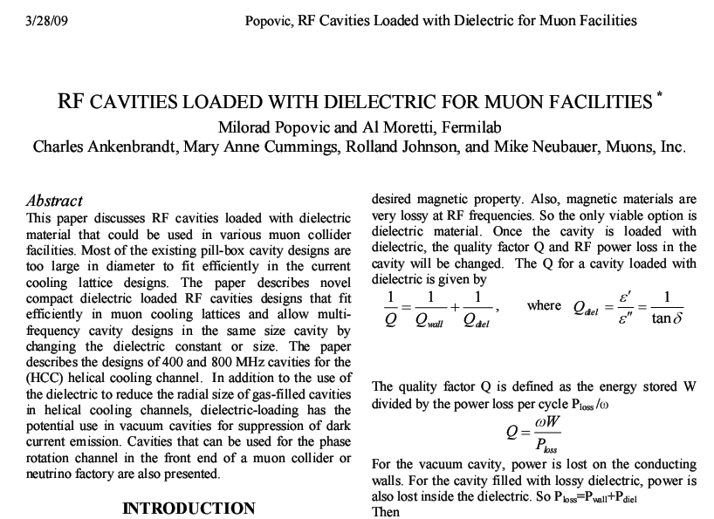
PAC09 Paper
μ
Muons, Inc.

Slide 14
Other Applications
(Vacuum Cavities)
μ
Muons, Inc.
May be we can use this type of cavity for Neuffer’s Phase Rotation Channel. This was Cary Yoshikawa suggestion. The channel needs many cavities in range from ~300 to 200MHz. We can use, let say two sizes of Pill Box Cavity (same size different dielectric!) and adjust frequency in between using different iner radius, re-entrant nose cones!

Slide 15
Outlook
μ
Muons, Inc.
There is no Concluding Slide
Work on this is just at Beginning
So Please HELP
Everybody is Welcome

Slide 16
Help
This letter is in support of a proposal submitted to your office by Dr. Robert Garnett of Los Alamos National Laboratory (LANL) for potential funding of the maintenance, distribution, and on-going development of several key LANL accelerator design and simulation codes. These codes have a long history of use by the broader accelerator community as well as by FNAL in support of our accelerator design efforts and to support operations. They are well bench-marked and have been used in many successful projects, including more recently the design of the Spallation Neutron Source (SNS) at Oak Ridge National Laboratory. They are also used to benchmark newer codes such as the Argonne code TRACK which is being used to model and design the linac for Project X.
In the recent past these codes were well-maintained and adequately supported by LANL. It is our understanding that due to inadequate funding in recent years, the support to the users and development of these codes has been very limited. Support for us as users of these codes is very important as well as are improvements of the physics they contain and modernization of the code architecture.
We strongly endorse funding this proposal in order to preserve what we believe to be a national resource and a valuable service to the accelerator community.
Sincerely,

