Slide 1
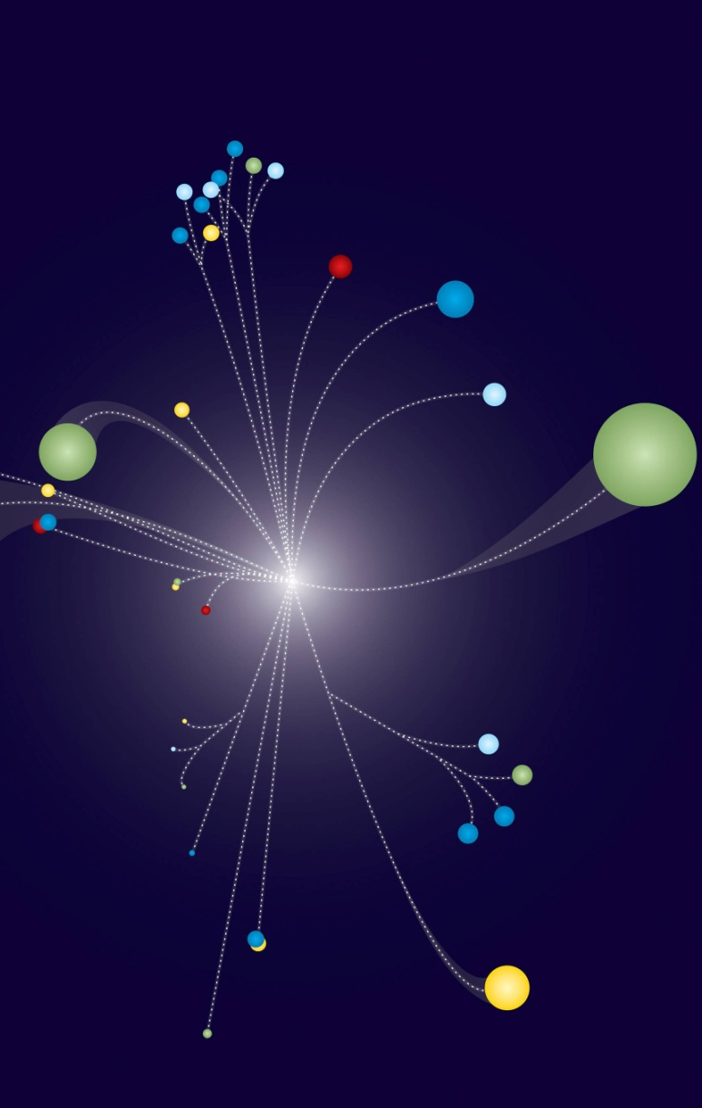
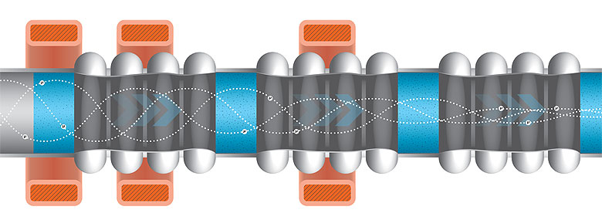
Detector Summary
Muon Collider Physics Workshop
Fermilab Nov. 10-12, 2009
Marcel Demarteau
Fermilab
NFMCC Collaboration Meeting
Oxford, January 13 - 16, 2010

Slide 2
Working Group 2: Detector
Conveners: Sergey Klimenko, John Hauptman
Five sessions
  One session combined with the two other subgroups
  One session combined with MDI subgroup
  Total of 15 presentations covering
    Tracking
    Vertex detectors
    Calorimetry
    Simulation tools
    MDI and backgrounds
All slides in this talk ‘borrowed’ from the presentations at the workshop
Please see original talks for much more detailed information

Slide 3
Conclusions
Personal conclusions from the workshop
  1. Established the environment in which the physics at a Muon Collider will be gauged
    ILC – CLIC – Muon Collider
  2. Emphasis on establishing reference frame of machine parameters
    Luminosity, Energy, Polarization and their measurements, backgrounds, …
  3. Established criticality of Beam Delivery – Detector Interface (MDI)
  4. Established involvement of simulation frameworks and their experts
    Detector framework – Background overlay – Physics simulation
  5. Initiated designs of new detector concepts and renewed evaluation of the “cone”
  6. Initiated defining the physics metric
  …
Overall, the workshop was highly successful !

Slide 4
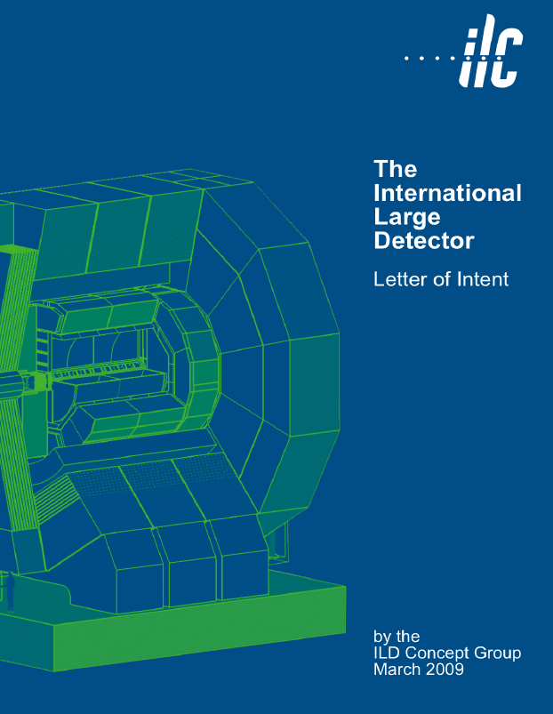
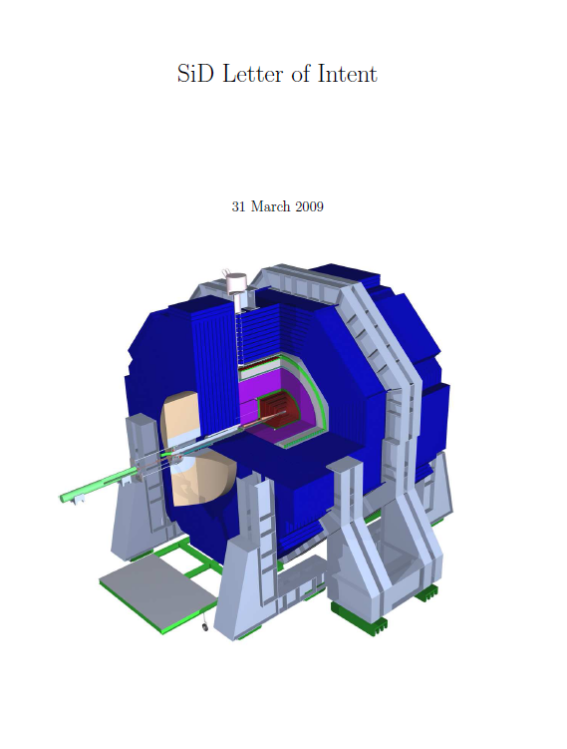
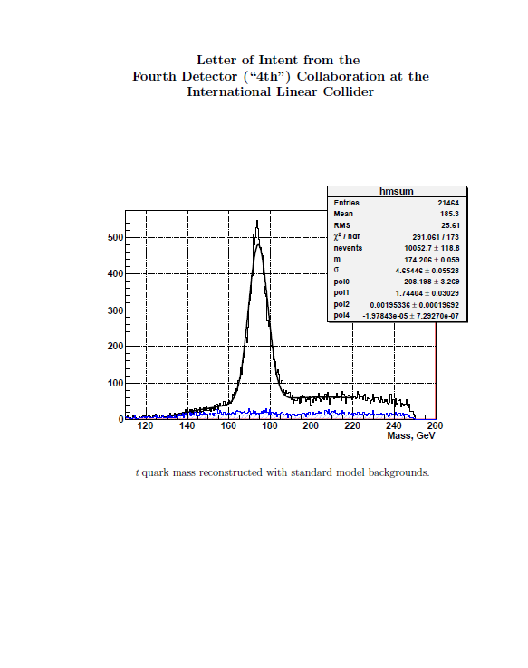
1: ILC Benchmark Reference
The three ILC detector concepts submitted LOIs on March 31, 2009
These documents form a solid reference and benchmark for the detector and physics performance at a lepton collider in the energy range of 500 GeV – 1 TeV
http://www.linearcollider.org/cms/?pid=1000472
ILD
SiD
4th

Slide 5
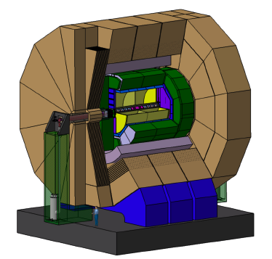
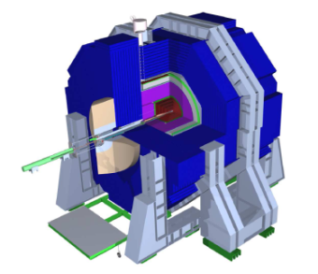
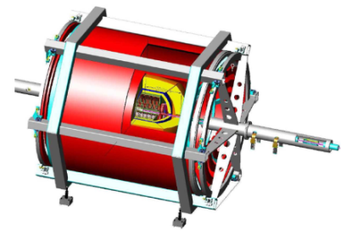
ILC Benchmark Reference
The three ILC detector differ substantially in their designs
ILD
SiD
4th
Detector | Premise | Vertex Detector | Tracking | EM calorimeter | Hadron calorimeter | Sole-noid | Muon System
ILD | PFA | 5-layer pixels | TPC Gaseous | Silicon-Tungsten | Analog- scintillator | 3.5 Tesla | Instrumented flux return
SiD | PFA | 5-layer silicon pixel | Silicon strips | Silicon-Tungsten | Digital Steel - RPC | 5 Tesla | Instrumented flux return
4th | Dual Readout | 5-layer silicon pixel | TPC Gaseous | 2/3-readouts Crystal | 2/3-readouts Tungsten-fiber | 3.5 Tesla | Iron free dual solenoid

Slide 6
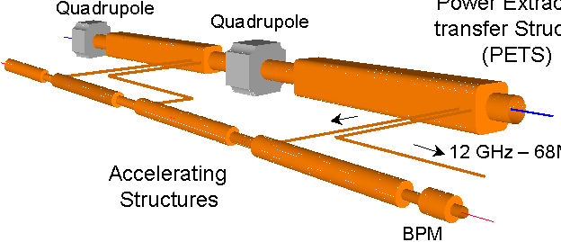
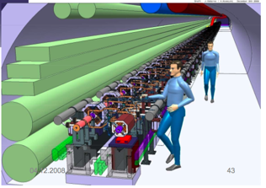
CLIC Benchmark Reference
The CERN Linear Collider Physics and Detector project has called for a 4-volume Conceptual Design Report (CDR) by the end of 2010.
  Executive summary document
  CLIC accelerator and site facilities
  Physics and Detectors
  Costing
The CDR will mostly be based on simulation studies for the CLIC case and existing ILC hardware experience
  CLIC-specific hardware R&D will commence
  after 2010
  The CDR will not demonstrate feasibility
  for all issues
Reports provide useful reference for μC
physics reach and create synergies
CLIC

Slide 7
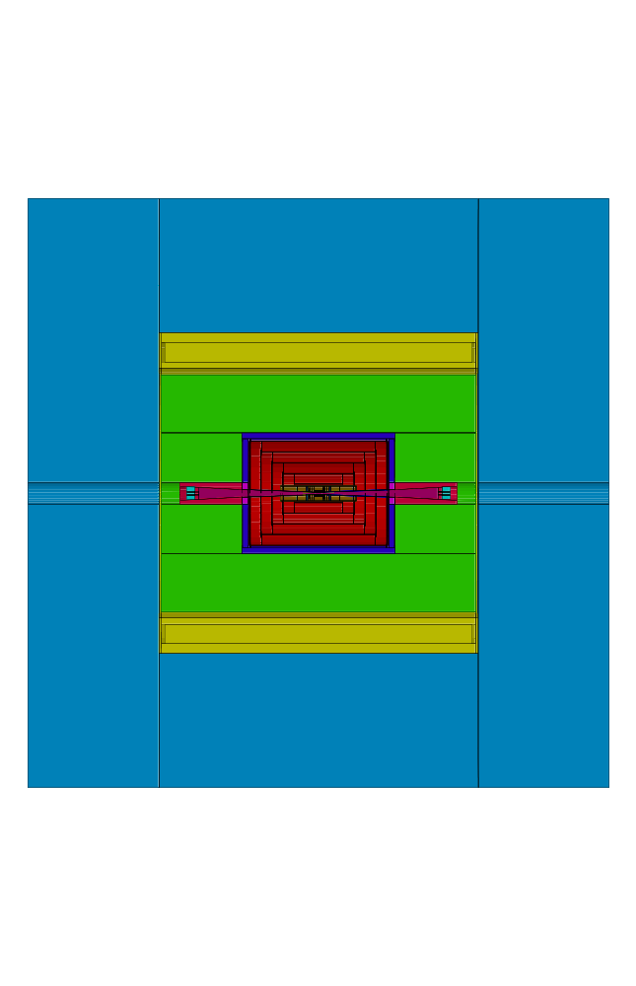
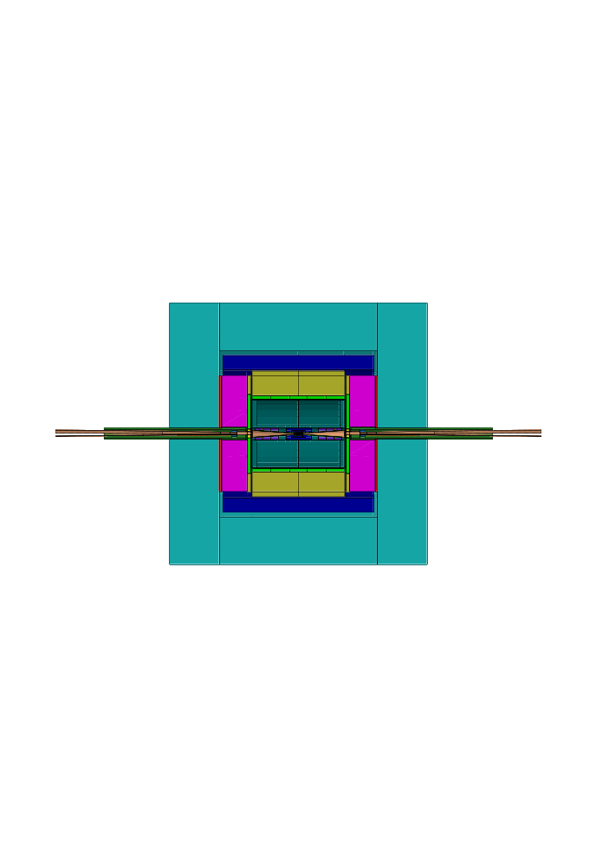
CLIC Detectors
Based on validated ILC detectors, created 3 TeV detector models with the following main differences:
    20 mrad crossing angle (instead of 14 mrad)
    Vertex Detector: ~30 mm inner radius, due to Beam-Beam Background
    Hadron Calorimeter, denser and deeper (7.5 λ) due to higher energetic jets
    For SiD-like detector: moved coil to 2.9m (CMS like)
CLIC_SiD
CLIC_ILD
Height:
6.9 m
Height:
7.0 m
Length: 6.9m
Length: 7.1m (not to Scale)
7
7

Slide 8
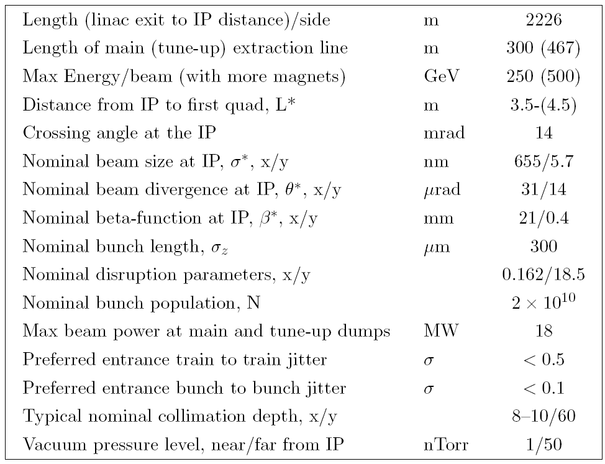
2: Machine Parameters
CLIC and ILC machine parameters, which frame the physics and detector studies, are well defined and relatively stable over time
ILC BDS RDR Parameters
CLIC BDS Parameters
Maximum Energy/beam | 1.5 TeV
Length (linac exit to IP distance)/side | 2.75-2.84 Km
Distance from IP to first quad, L* | 3.5-4.3 m
Nominal beam size at the IP, x/y | 45 nm / 1 nm
Nominal beta function at IP, x/y | 6.9 mm / 0.068 mm
Nominal bunch length | 45 μm
Number of particles/bunch | 3.72 10⁹
Bunch separation | 0.5 nsec
Bunch train length | 156 nsec
Beam power | 14 MW
Crossing angle at the IP | 20 mrad
Jitter tolerance (FD) (for 2% L loss) | 0.14-0.18 nm

Slide 9
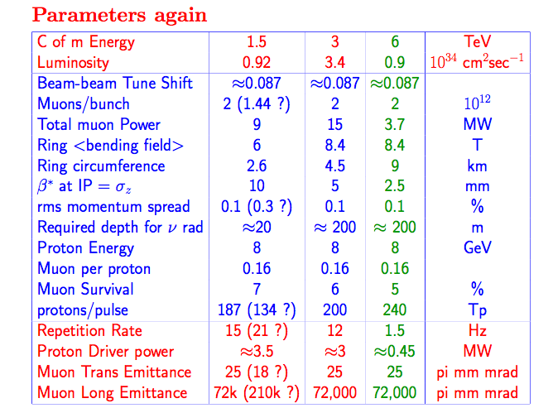
Machine Parameters
A stable reference machine parameter set is essential for physics and detector studies.
Even though hampered with large uncertainties, a reference parameter set needs to be established
Great to see the list is being revisited
The 3 TeV numbers are far less studied than the 1.5 TeV ones
The numbers keep changing and remain uncertain. We just don’t know enough
The 6 TeV numbers are a blind extrapolation with the same ν radiation
Bob Palmer

Slide 10
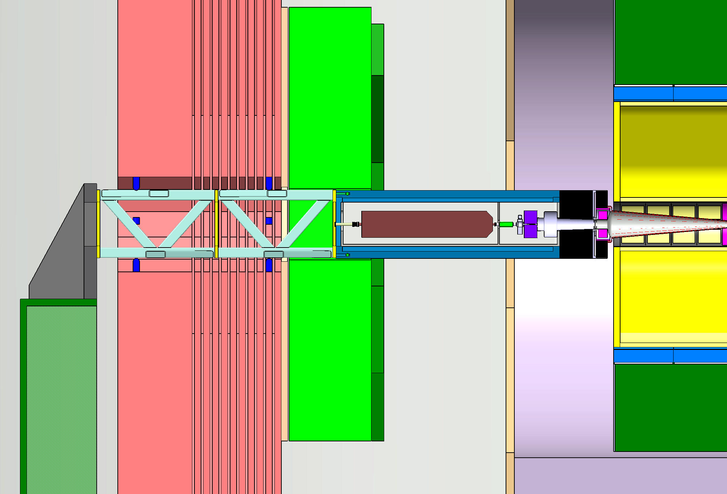
3: Machine Detector Interface
Firmly established the importance of a strong MDI group
Machine
Luminosity
Backgrounds
Diagnostics
……….
Detector
Physics
CLIC
QD0
IP
HCAL/
ECAL
end-cap
Yoke +
muon det.

Slide 11
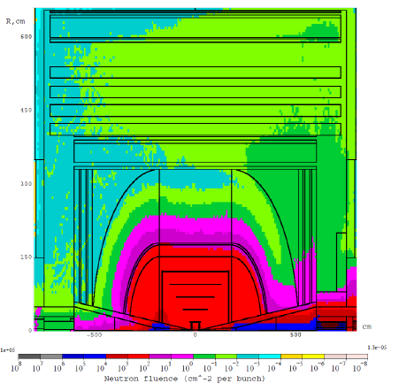
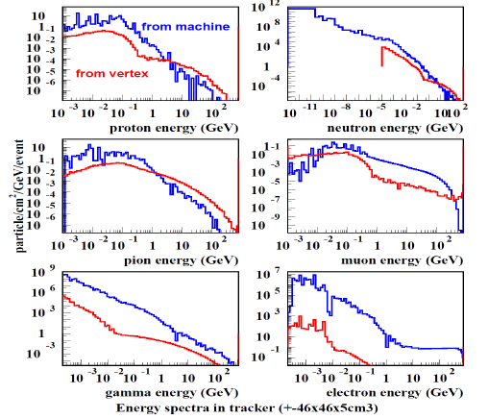
Updated Backgrounds
Neutron fluence for one 750 GeV beam of 2 10¹² muons, coming from the right
Energy spectra for background and SM physics processes
Neutron fluence

Slide 12
4: Simulation
MC4MC (Steve Mrenna)
  Tools to generate the Standard Model “cocktail” at multi-TeV MC
ILCROOT (Corrado Gatto)
  A simulation framework combining a zoo of available simulation tools: GEANT, Fluka, Event generators, HPSS, etc
MARS (Nikolai Mokhov)
  Simulation of beam delivery and backgrounds
  Can be integrated into detector simulation
LCIO (Norman Graf)
  Common simulation format/IO for ILC
CERN based tools (Pere Mato)
  A true arsenal of tools available
In my humble opinion, all tools exists. One ‘just’ needs a czar to put it all together

Slide 13
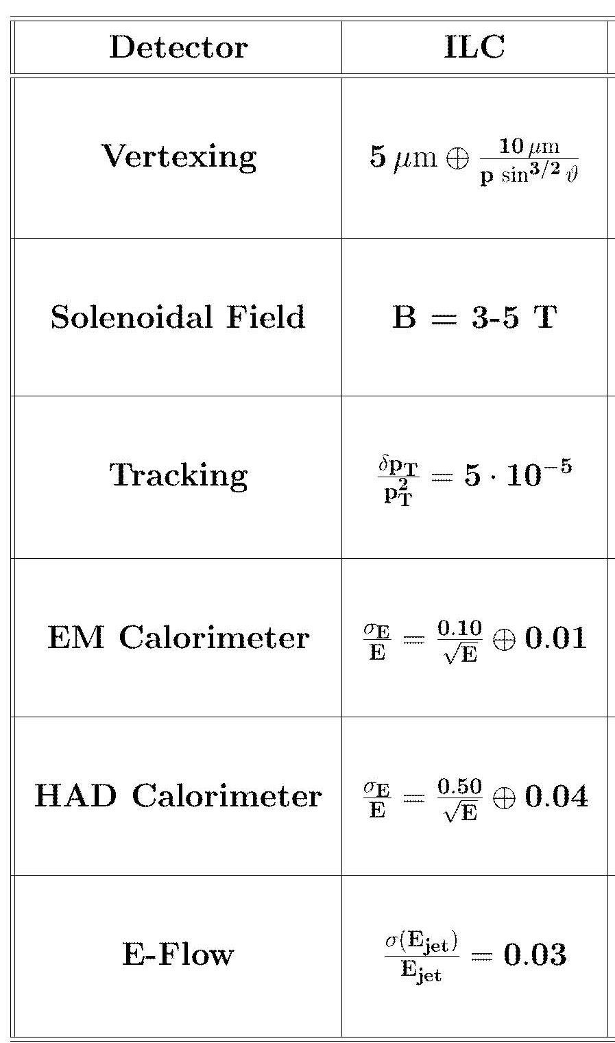
5: Detector Designs
Specifications for e⁺e⁻ colliders have been clearly formulated over the course of the last years for:
  Collider parameters
    Energy, Luminosity, Polarization, Final Focus,
    Beam Delivery, Train Structure, Repetition
    Rate, Bunch Structure, …
  Measurement of collider parameters
    Energy, Luminosity, Luminosity Profile,
    Polarization
  Collider detectors
    See table
More than a decade of detector R&D
has occurred, in large part driven by the
ILC project, to meet these specifications
A benchmark for physics processes
now exists

Slide 14
Vertex Detector
Basic requirements of vertex detectors well understood from ILC studies:
  Excellent space point resolution (< 5 microns )
  Superb impact parameter resolution ( 5µm ⊕ 10µm/(p sin^{3/2}θ) )
  Transparency ( ~0.1% X₀ per layer )
  Stand-alone pattern recognition (SiD)
Muon Collider modifications:
  Space point resolution can be retained
  Impact parameter resolution will degrade
    Impact on physics to be studied
  Transparency most likely degraded by factor of 4
    Mass associated with liquid cooling
    Power density
  Integration time for readout close to 10 μs for μC
  In addition, sensors need to be significantly radiation hard
Ron Lipton

Slide 15
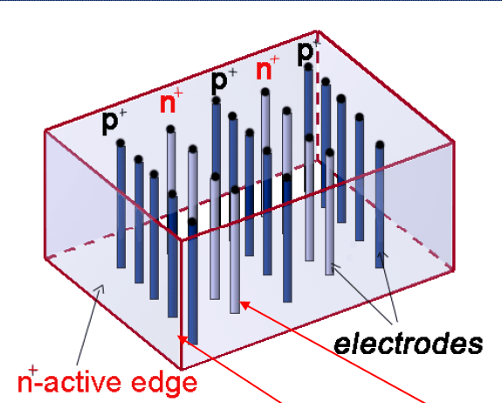
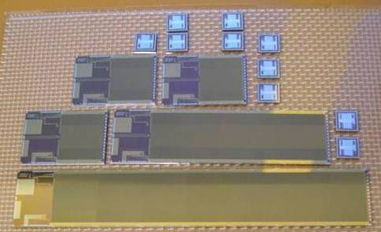
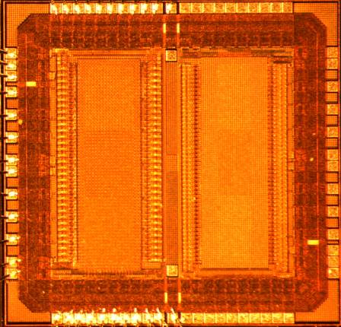
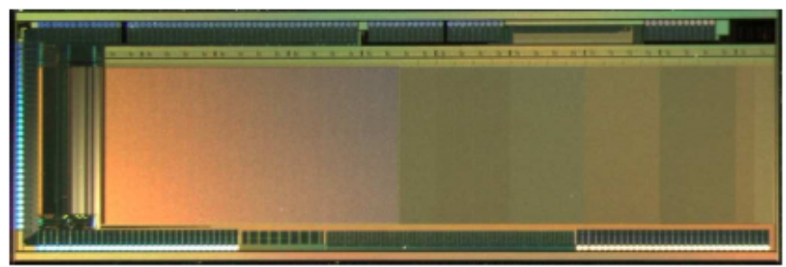
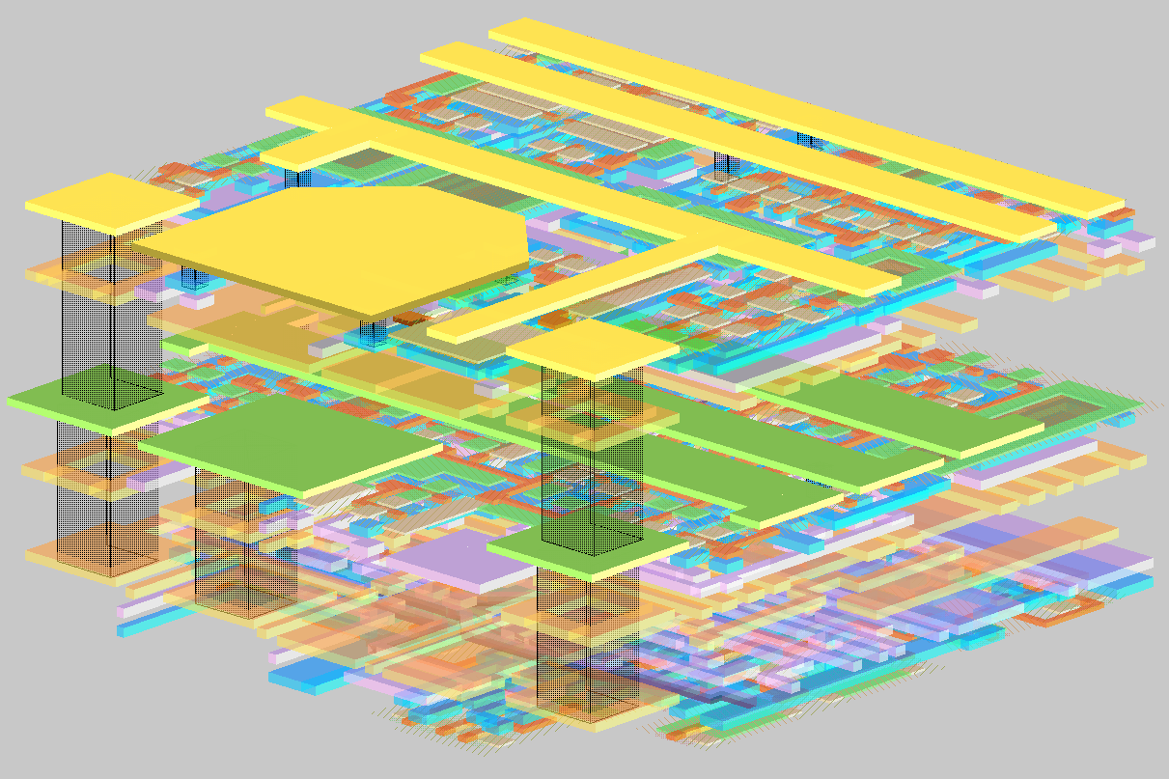
Vertex Detector Technology
20th Century studies assumed
300 μm square pixels
ILC studies assume ~ 20 μm
square pixels and 225 less
occupancy/pixel
  Mimosa-26 with pixel size
  18.4 x 18.4 µm² running at CERN
It is likely that these smaller
pixelated devices will provide
sufficient resolution for good
pattern recognition.
Technologies:
  CCD’s
  CMOS Active Pixels
  SOI
  3D Vertical Integration
  3D Columns
  DEPFET (Munich)
3D Columns
CPC2
MIMOSA25
MIMOSA22
16x96
Pitch 20µm
Pixel array
136 x 576
pitch 18.4 µm
FNAL 3D VIP
3D
DEPFET

Slide 16
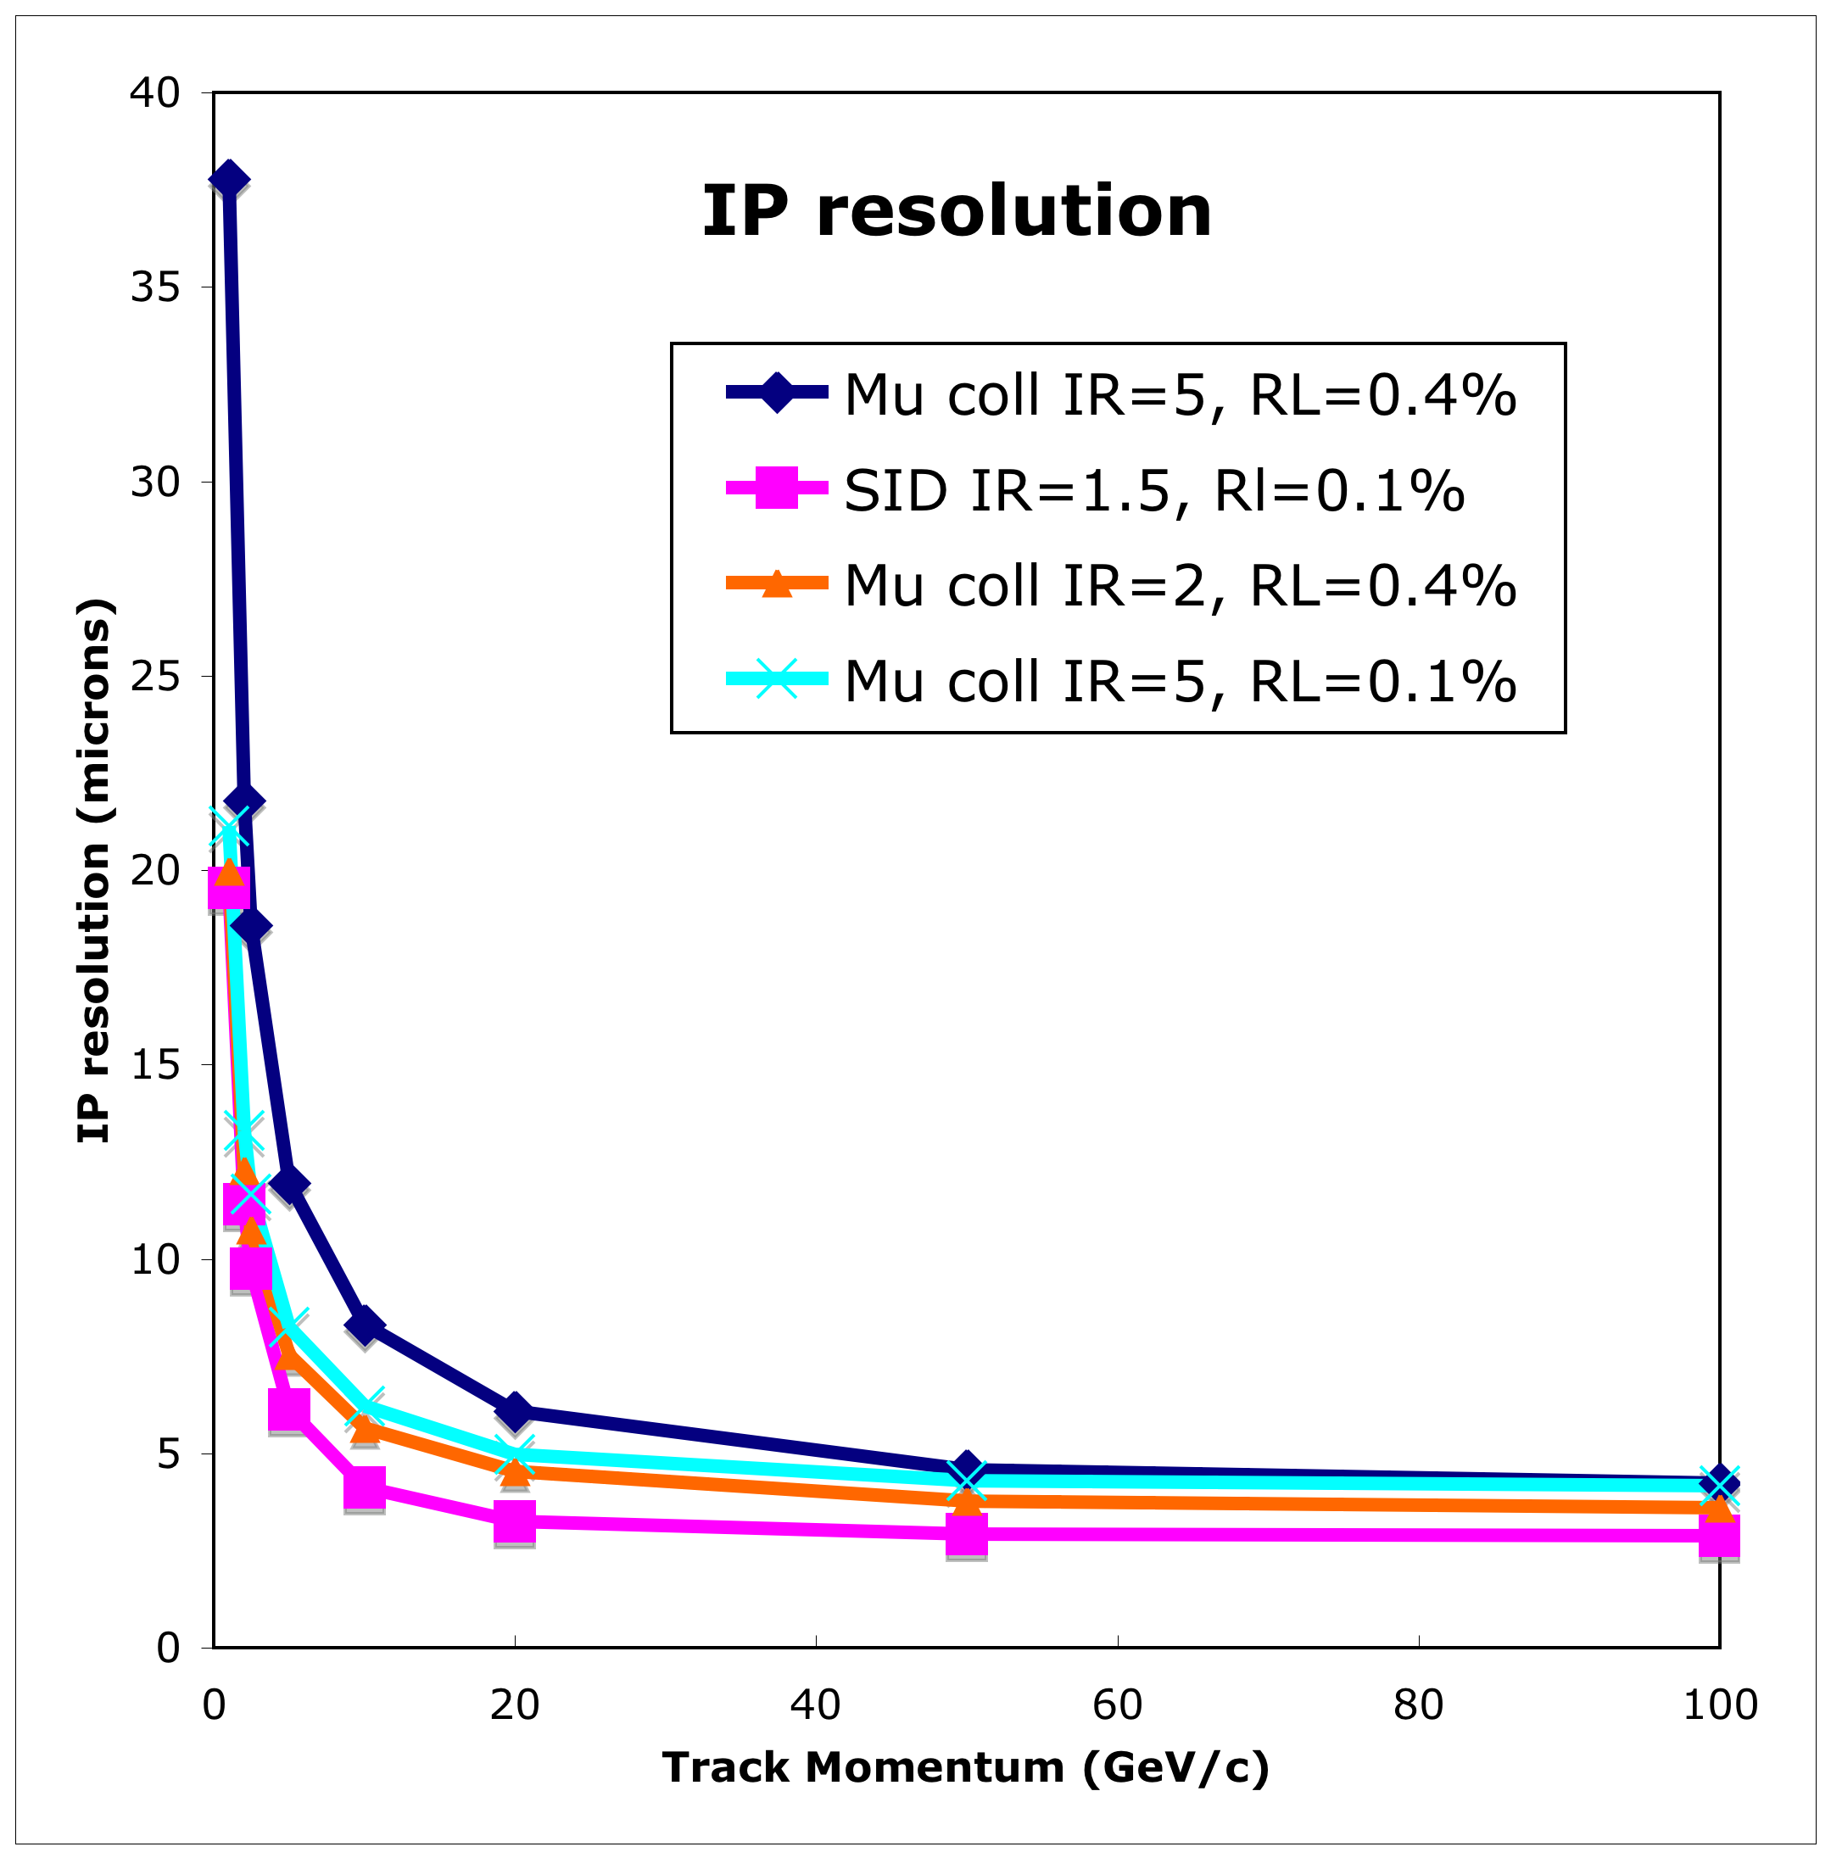
Impact Parameter Resolution
Design
  ILC: radii of 1.5 → 6 cm
  μC: radii of 5 → 20 cm
  or 2 → 20 cm
Spreadsheet estimate of the
degradation of resolution
  Based on SiD design
  5 mm vertex and 12 mm
  track hit resolution
  0.1% RL/layer → 0.4%
Resolution factor 2 worse
Keeping constant r_{in}/r_{out} is
important
Can trade radius for X₀, but
how realistic is that with need for active cooling?
Ron Lipton

Slide 17
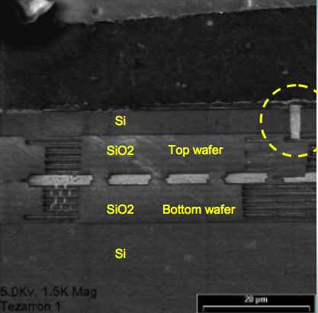
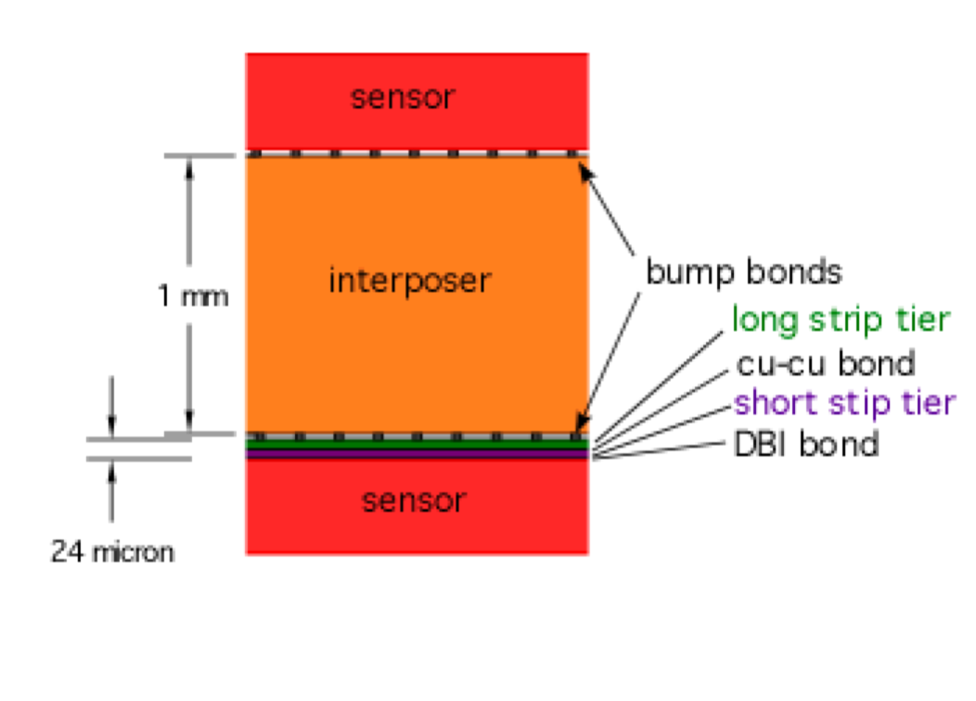
3D Technology
Background hit rejection will be very important at the μC
The 3D technology could possibly be used to reduce occupancy based on inter-layer correlations
  This technology is being developed for the CMS upgrade
  Random false hits can be rejected with minimal material and modest power penalty using 3D bonded monolithic active pixel ICs
  First proof of principle this year!!
Hit Correlation circuitry
2009 Track trigger module for CMS Phase II
Based on 3D electronics
track
Ron Lipton

Slide 18
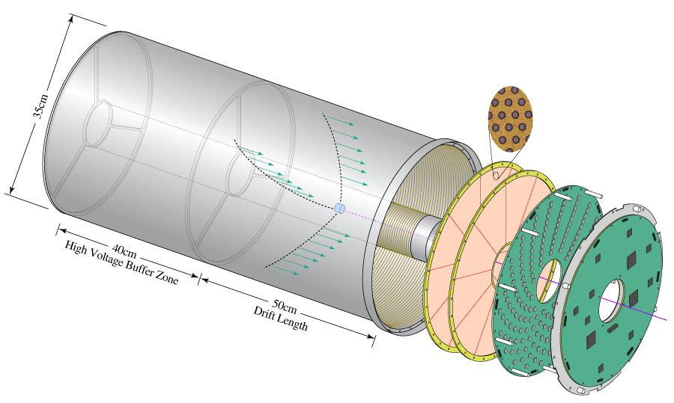
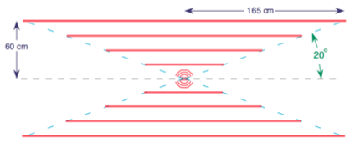
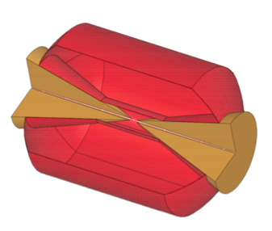
Tracking
Tracking at a μC is very challenging due to large backgrounds
Two different strategies may be applied to cope with the huge backgrounds
  Increase detector granularity
  Increase transparency to neutrals and
  use low density for electrons
Options with perceived disadvantages:
  TPC
    suffers from longer integration of bkgnd
    heavier and more interacting gas
    ion build-up (backflow, E-field distortions)
  Si
    lack of redundancy
    pattern recognition
  Cluster Timing
    may not be able to cope with backgrounds
    alone at small radii
TPC
Si
CluClou

Slide 19
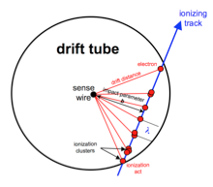
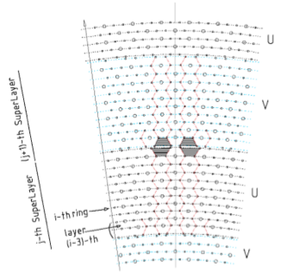
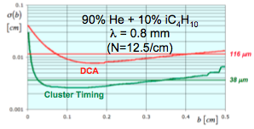
Drift Chamber
Cluster counting – timing drift chamber has been proposed
  Consists of recording the drift times of all
  individual ionization clusters collected on a
  sense wire
  Requires high-speed, low-power Gsa/s
  waveform digitizer with ~6 bit ADC
  All stereo wires, He based gas, Cf support
  Maximum drift time within one BX
Franco Grancagnolo

Slide 20
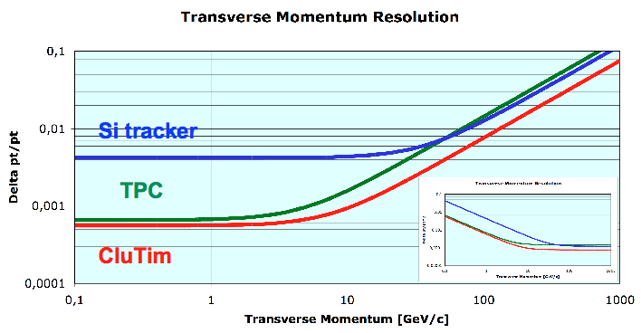
Expected Performance
Single particle momentum resolution as simulated without inclusion of backgrounds
Franco Grancagnolo

Slide 21
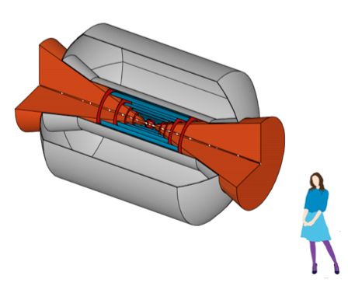
Cluster Timing + Silicon
Hybrid of cluster timing chamber and silicon inner and forward tracking
Layout
  20 degree W cones
  5 inner Si μstrip cylinders
    total X₀ < a few %
  5 inner Si pixel disks
B = 4 Tesla
Parameters
  R_{in} = 50 cm, R_{out} = 150 cm
  σ_{xy} = 60 μm, σ_{z} = 300 μm
  cell size = 5-7 mm hex.
  # of layers = 107
  # of s.w. = 52,000 (20 μm W)
  # of f.w. = 120,000 (80 μm Al)
X₀ (gas+w.) = 2.54 10⁻³
δ (gas+w.) = 7.10 10⁻⁴ g/cm³
Franco Grancagnolo

Slide 22
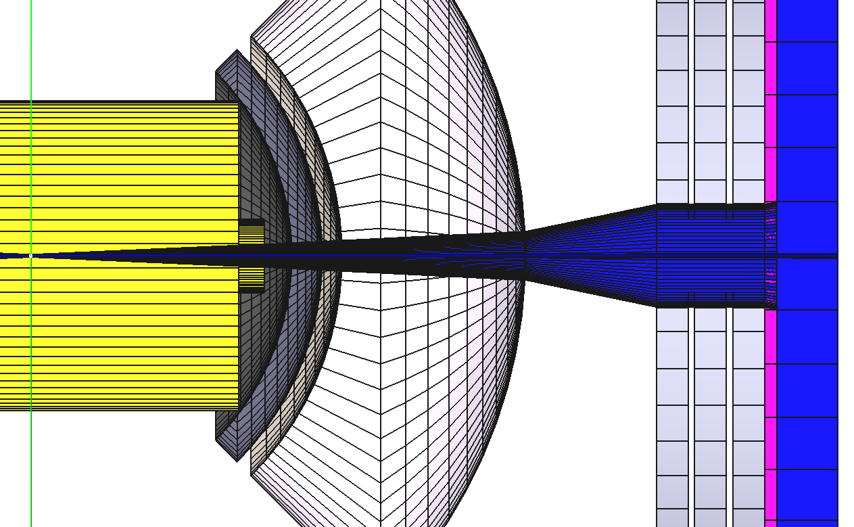
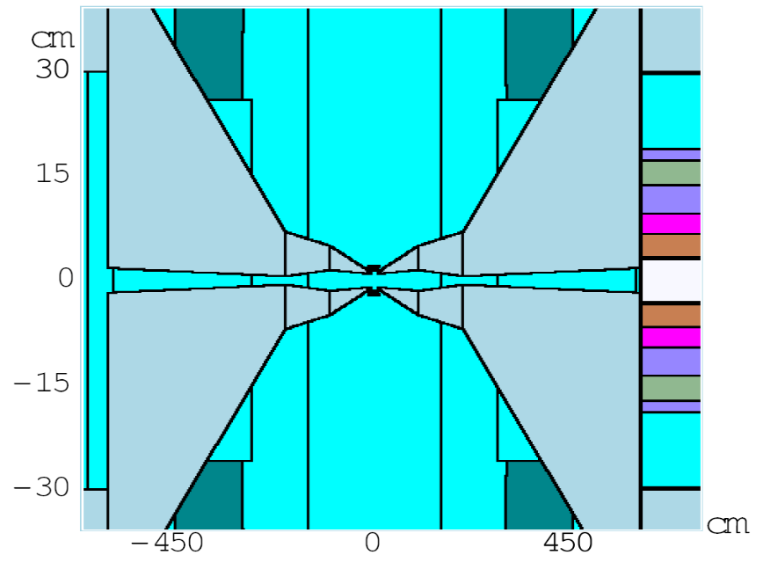
Calorimetry
The calorimeter of the ILC 4th
concept adopted for μC
  BGO ECAL
  Fiber calorimeter employing copper
  matrix loaded with 1 mm diameter
  alternating scintillating and clear
  ﬁbers every 2 mm for HCAL
  Based on well-established dual
  readout calorimetry with DREAM
Shielding implemented to mitigate
background effects
  Inner W cone 6-9 degrees
  Forward shielding
50 cm thick W
10 cm thick
Polyethylene
Corrado Gatto
Vito DeBenedetto
Anna Mazzacane

Slide 23
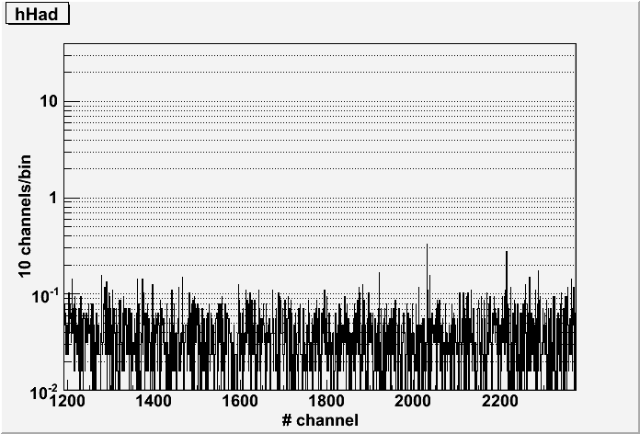
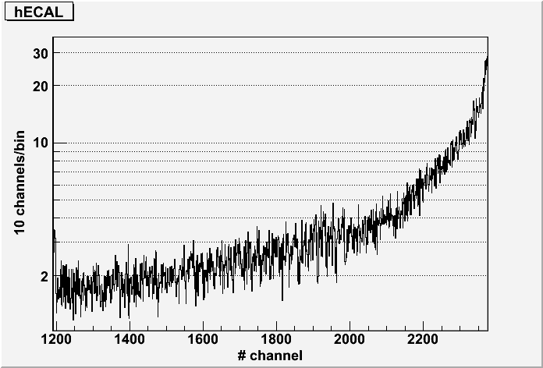
Calorimetry
Correct Final Focus as in MARS included in studies
New MARS-to-ILCroot interface to incorporate backgrounds
Preliminary results show strong contribution from electrons
GeV/10 tower
GeV/(40 crystals)
HCAL
ECAL
Preliminary
Preliminary
90° 3°
90° 3°

Slide 24
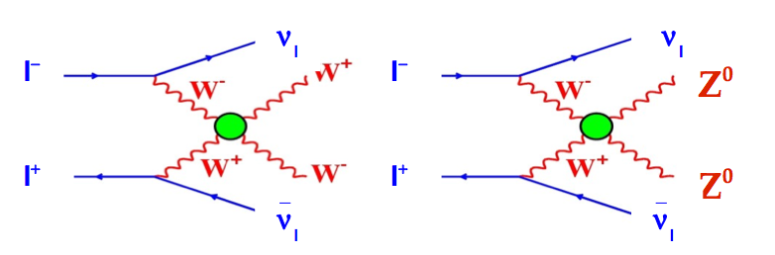
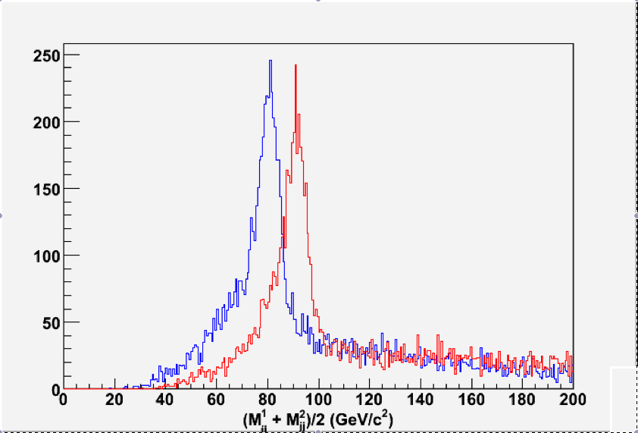
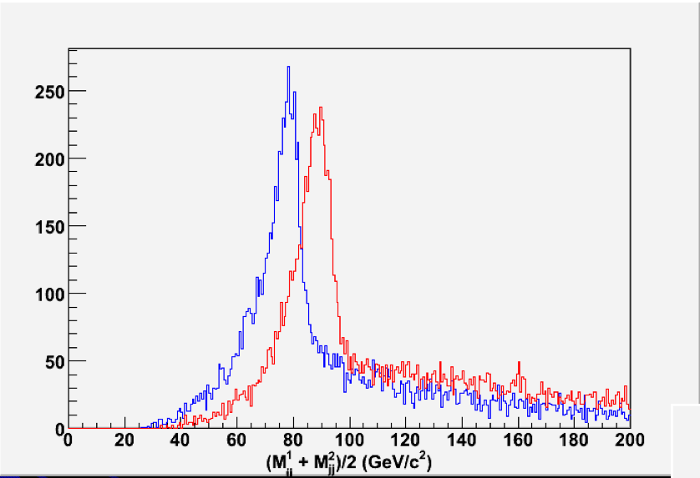
W-Z Separation
Full physics study of WW scattering at μC
  W/Z forced to decay to jets;
  all three combinations plotted
  Some preliminary observations:
    Mean values at lower masses
    Width distributions larger
    Results actually better than
    expected with beam backgrounds!
CLIC 3 TeV
MuonC 1.5 TeV

Slide 25
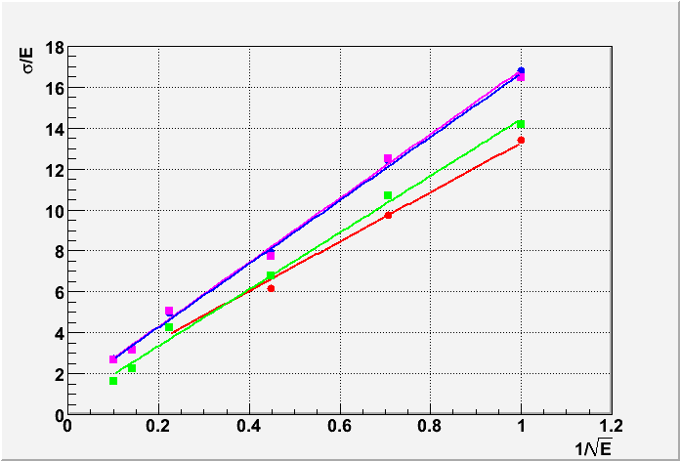
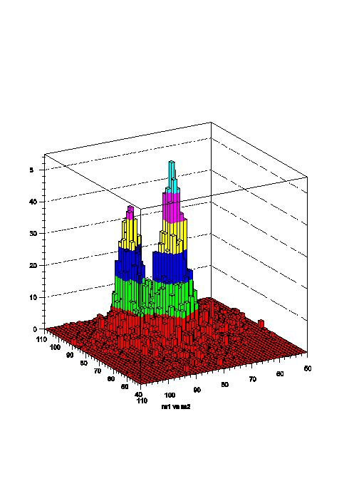
Crystal Calorimetry
Total absorption hadron calorimetry
has been proposed with dual readout
  Differentiate Čerenkov and
  scintillation light
    Optical filters
    Timing
Implement in Monte Carlo simulation
(without backgrounds) and determine
single pion response
Study of WW/ZZ final states
Single pion response
BGO,LCPhys:
(E)/E=1.2 + 15.6/sqrt(E) %
PbWO4, LCPhys:
(E)/E=1.2 + 15.5/sqrt(E) %
BGO, QGSP_BERT:
(E)/E=1.2 + 12.0/sqrt(E) %
BGO(dense),LCPhys:
(E)/E=0.6 + 13.8/sqrt(E) %
Hans Wenzel

Slide 26
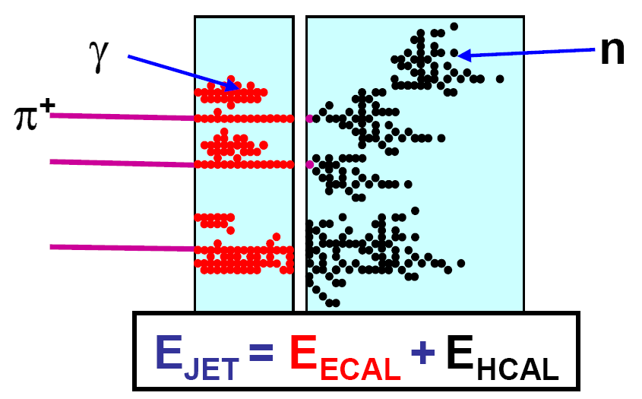
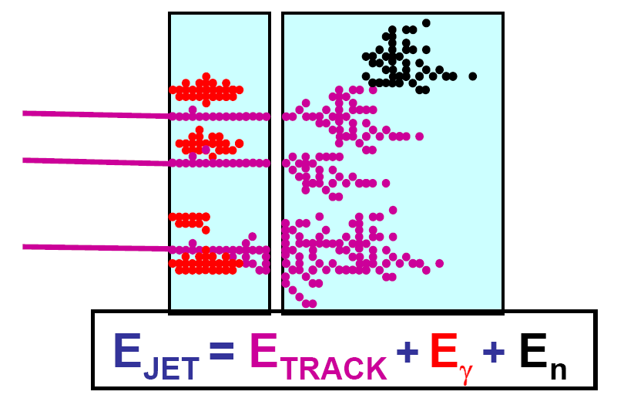
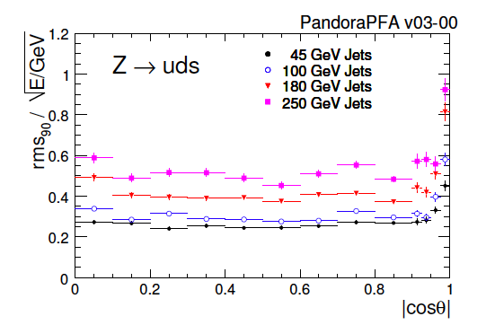
PFA
Goal: obtain a jet energy resolution of 3-4% for 40 Gev < E_{jet} < 500 GeV, through a combined use of the tracking and ECAL system and using the HCAL to only measure neutrals
Robust PFA algorithms have been
developed within the ILC
community
  Goal of 3% energy resolution
  achieved based on MC studies
Hitoshi Yamamoto

Slide 27
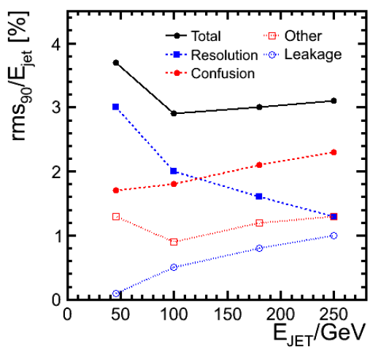
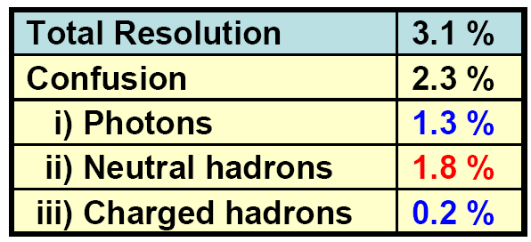
PFA Performance
Quantitative understanding of
PFA performance being developed
(M. Thomson, ALCPG09)
Breakdown of the various
contributions to the energy
resolution
At high energy the confusion term
dominates
  Confusion = incorrect assignment
  of hits to tracks / EM clusters
  Cross-over at E_{jet} = ~100 GeV
How viable is PFA (at a μC ?)
  Yamamoto: “Extremely promising,
  but simulation alone cannot be
  trusted”
250 GeV Jets
Hitoshi Yamamoto

Slide 28
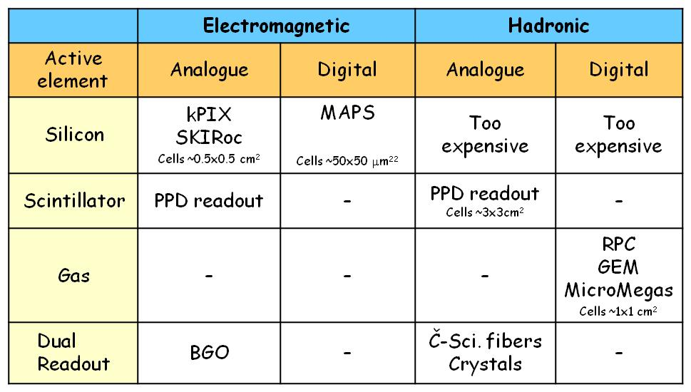
Calorimeter Technologies
Superb calorimetry lies at the heart of lepton collider detectors, partly because of the very small cross sections
It has been accepted that a jet energy resolution of 3-4% is required for a lepton collider
  Ability to separate Z → qq from W → qq’
An extremely active R&D program is being carried out

Slide 29
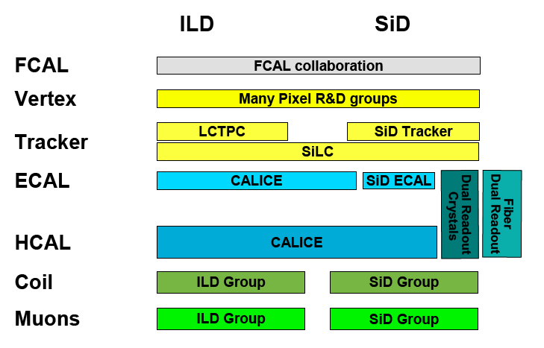
Detector R&D
Well established effort for ILC and CLIC
  Note, CERN is becoming
  member of many horizontal
  detector R&D collaborations
  to strengthen detector design
  work for CLIC detectors
What is the place of the μC detector in this picture?
  Horizontal R&D collaborations?
  Dedicated R&D?
  Are their synergies that could be exploited?
Answer will in part depend on how exciting the μC physics program is
Sergey Klimenko

Slide 30
ILC Newline, Jan 7, 2010
Director’s corner by Barry Barish:
‘Reflections on the New Year’ :
  “I might comment that I firmly support developing all options for a lepton collider, including a muon collider, …
  However, at the same time, the muon collider option must be kept in perspective as an approach that still requires major advances in accelerator techniques that have not been demonstrated, plus the design and costing of such a machine remains for the future.
  Perhaps more importantly, there remains serious doubt whether a muon collider could ever provide a clean enough experimental environment to carry out the type of precision science program that has been demonstrated for the ILC through the LOI process, as discussed above.”
That perfectly states the charge for the Muon Collider Physics and Detector community

Slide 31
Closing Remark
The workshop got the group off to a very good start
Innovative solutions are being proposed to address the μC environment, based on state of the art technology
Infrastructure for simulations exists
The key is to form a core constituency to keep and build the momentum !
  The bar is set high by the ILC (CLIC) LOIs
  The problems are very challenging

