Slide 1

Report of High Pressurizing gaseous Hydrogen filled RF cavity experiment
Muons, Inc.
K. Yonehara
on behalf of HPRF working group
APC, Fermilab

Slide 2
Goal of HPRF project
Demonstrate High Pressure RF cavity under high radiation condition
Study hydrogen plasma physics
Investigate RF breakdown from different aspect

Slide 3
HPRF with beam
Find maximum acceptable beam intensity with pure GH2
  RF Q reduction
  Recovery time
Improve limitation of beam intensity
  Doping electro-negative gas
Optimize HPRF to apply various projects
  μ cooling channel for ν-Factory and μ-Collider
  μ acceleration at LBNL

Slide 4
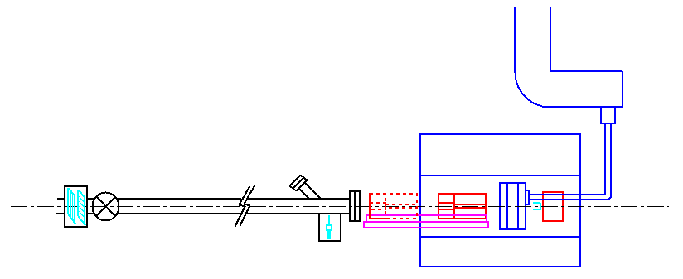
Design HPRF beamline
Two collimators
(solid: at operation mode
broken: pull collimator out to
change second collimator)
Waveguide
Beam absorber
Viewport of viewer
Coax cable
5-T solenoid magnet
BPM
G-valve
Vacuum window
Beam pipe
400 MeV proton beam
from Linac
Viewer & storage
Collimator support rail
HP cavity
Faraday cup (?)
~ 10¹³ protons/RF pulse is generated in Linac
Change proton intensity by using various sizes of collimator and focusing magnet

Slide 5
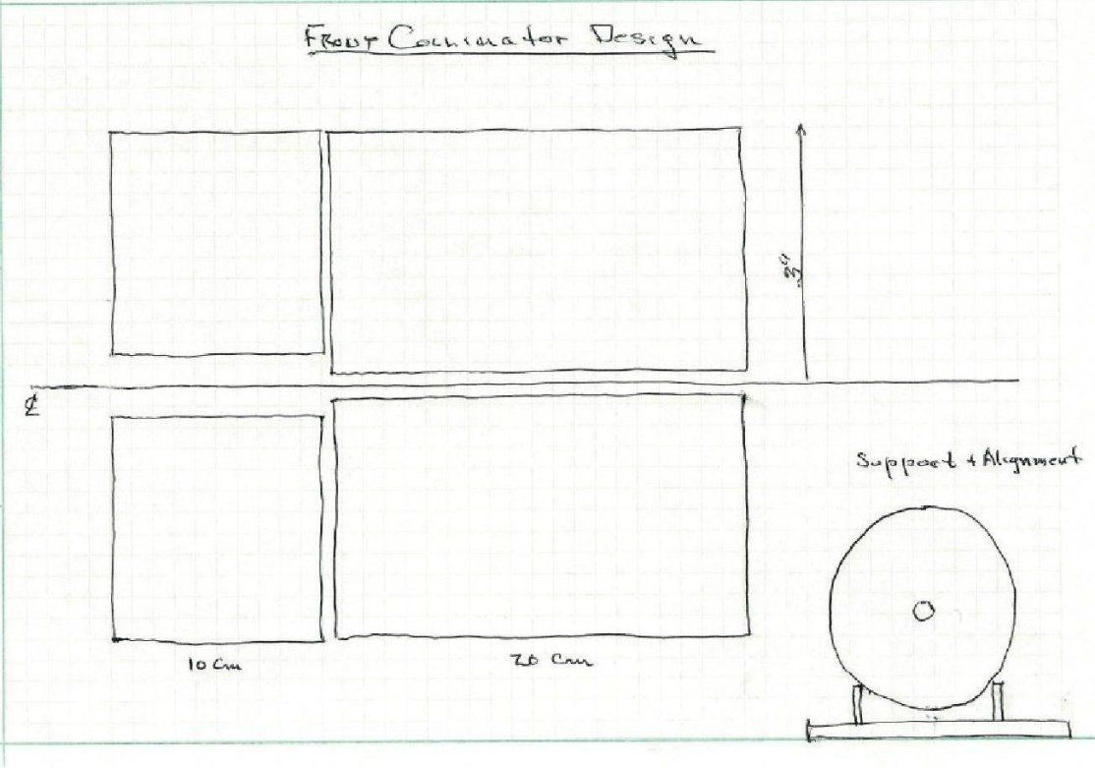
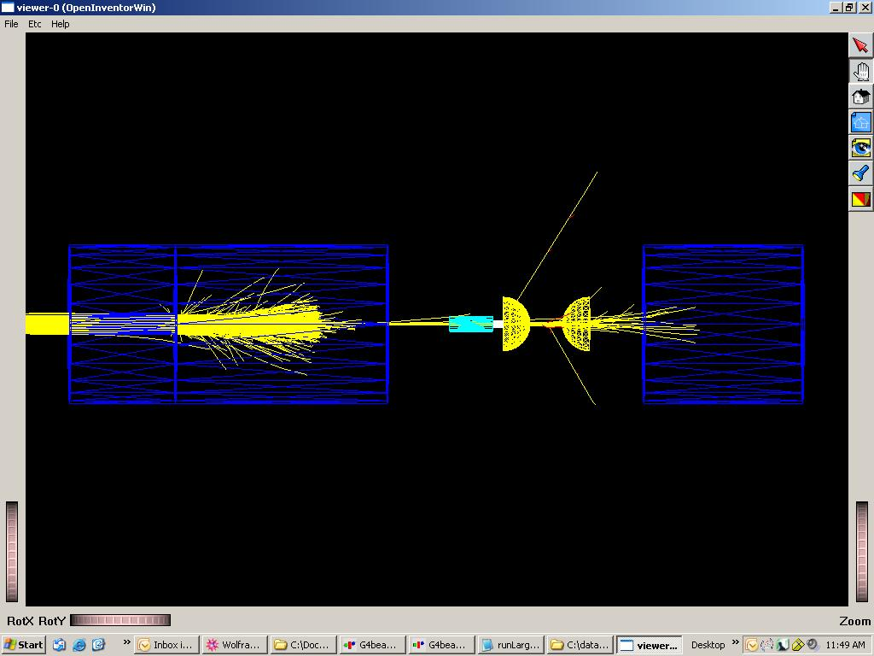
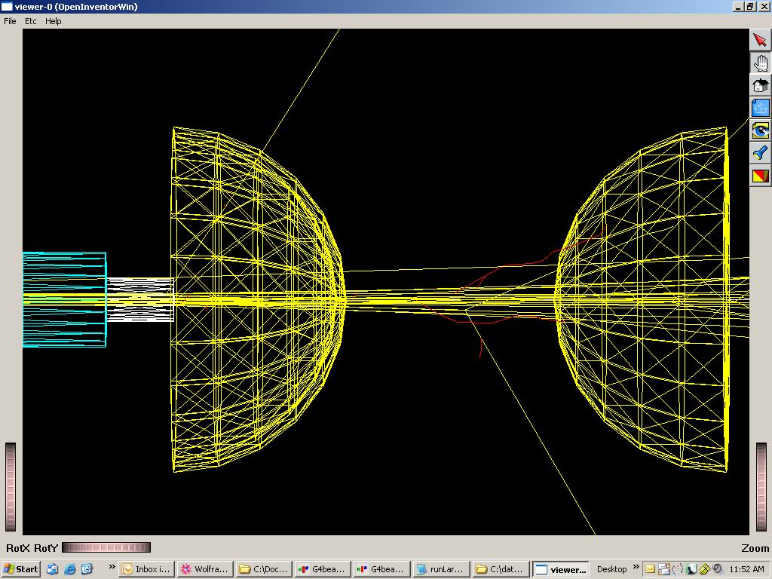
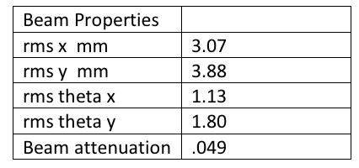
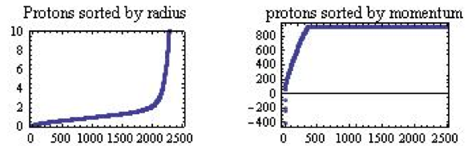
Design collimator
A. Tollestrup
G4bl out:
Cavity plate and wall are invisible
Blue: collimator, beam absorber
Yellow hemisphere: Cu electrode
Light blue: Contour hole
White: Thread rod to hold electrode
Enlarged picture (yellow straight line: proton)
Upstream electrode is a hollow dome
Thickness of wall will be ~ 1mm

Slide 6
Expected observation
M. Chung
p ~1000 psi
β_{r} ~ 10⁻⁸ cm³/s
32 mA H⁻ ~ 2.5 x10⁹ MIP
Without SF₆
With SF₆
Effects of
recomb.
We assume T_{e} = const. in this example.
However, T_{e} = T_{e} (V_{c}) in general.
Effects of recomb.
= saturation + linear recovery (>> RC)
Too much of SF₆ (Z = 70, A = 146) will change electron dynamics.
e⁻ + SF₆ → SF₆⁻
e⁻ + SF₆ → SF₅⁻ + F

Slide 7
Action item for first beam test
Radiation safety assessment
Design and make beam collimator and absorber
Modify RF cavity
Study modulation of RF wave
  Handle RF start timing to study recovery time of HPRF
Design and make beam position/current monitors
Re-configure RF waveguide
Install RF power circulator
Study flexibility of beam phase space

Slide 8
Hydrogen plasma physics
Historic subject
But, it is still hot!
  Simplest system to test quantum mechanics, theory of many-body system, etc
  Nuclear fusion
  Astrophysics
Not many experiments and theories have been made in our HPRF condition
  Typically, they’ve investigated hydrogen plasma in DC, no B field, and
  relatively low gas density condition
  In our case, high RF E field, high B field, high gas density, low temperature,
and high radiation in near future
Our interest is recombination process

Slide 9
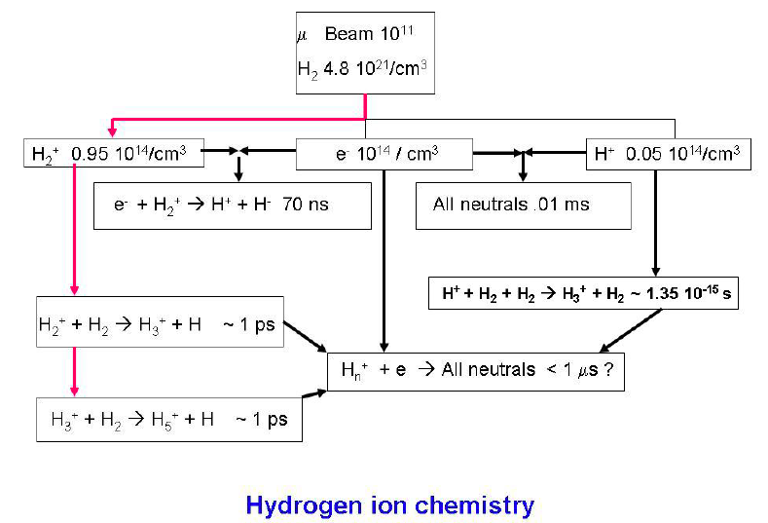
Polyatomic hydrogen
A. Tollestrup
Updated by KY
H₃⁺, H₅⁺, H₇⁺,… can be formed in very short
time (10⁻¹⁵ s) via three body interaction
Unfortunately, no de-excitation light in
electron recombination process
e⁻ + H₂⁺ → 2H < 70 ns
(T. Oka suggested)
H₃⁺ + H₂+ H₂ → H₅⁺ + H₂ 3 × 10⁻¹⁵ s (T. Oka suggested)

Slide 10
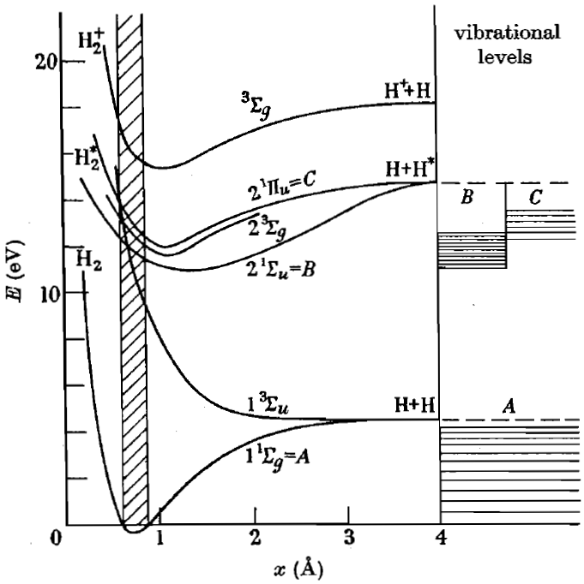
Recombination process
Z. Insepov
Primary channel:
H₂⁺ + e⁻ → 2H (+ hν)
σ_{max} ~10⁻¹⁴ cm²
H₂⁺ + e⁻ → H⁺ + H⁻
σ = 3 × 10⁻¹⁸ cm² @ K_{e} = 1 eV
H₂⁺ + e⁻ → H₂ + hν
β ~ 10⁻¹⁵ cm³/s @ T_{e} = 10000 K
Polyatomic state:
(α > 10⁻⁸ cm³/s, n_{e} ~ 10¹⁴ electrons/cm³)
Challenge in simulation:
Above values are obtained from dilute condition
Density effect will be dominant in the HPRF condition
Reaction kinetics in a dense gas is diffusion-limited
Polyatomic hydrogen seems to be coherent state
It may requires many-body quantum mechanics

Slide 11
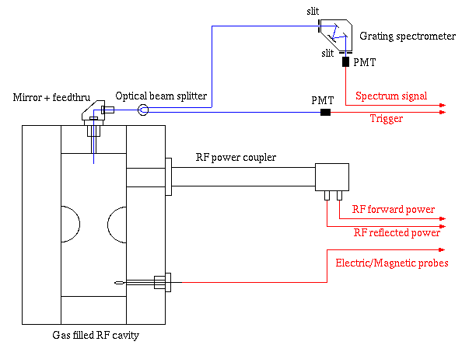
New approach: Optical measurement
Gap = 3 cm

Slide 12
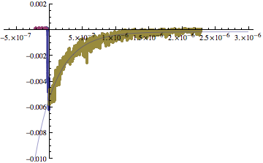
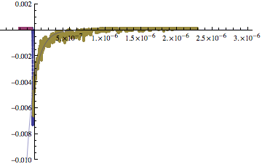
Observed optical signal
656 nm
500 nm
Two spectroscopic measurements have made at GH2 pressure 620 and 810 psi
Applied electric fields were ~42 MV/m at 620 psi and ~47 MV/m at 810 psi, respectively
Applied RF pulse length was 20 μs
Above spectrum were taken in spectrometer as monochromatic mode and averaged over
50 breakdown lights at GH2 pressure 620 psi
Resolution of spectrometer is 2 nm
656 nm is on H-alpha line
Cu lines are spread in VIS region, i.e. it covers around 500 nm but atomic H does not have
any lines around it (ref. NIST)

Slide 13
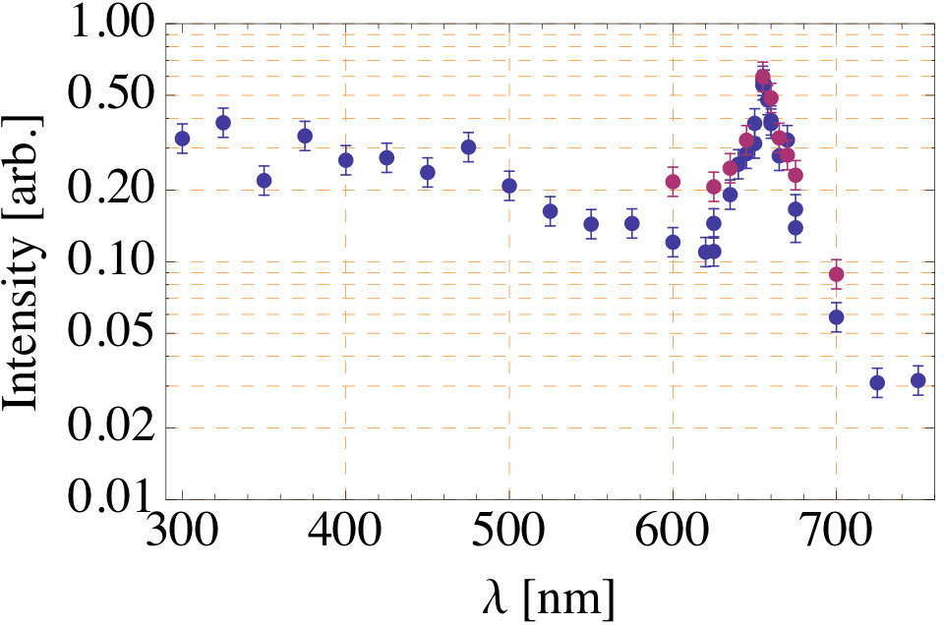
Spectroscopy in HPRF
620 psi
810 psi
H-beta line (480 nm)
H-alpha line (656 nm)
A point is the integrated PMT signal that is shown in previous slide
Data are calibrated with wavelength dependence on PMT

Slide 14
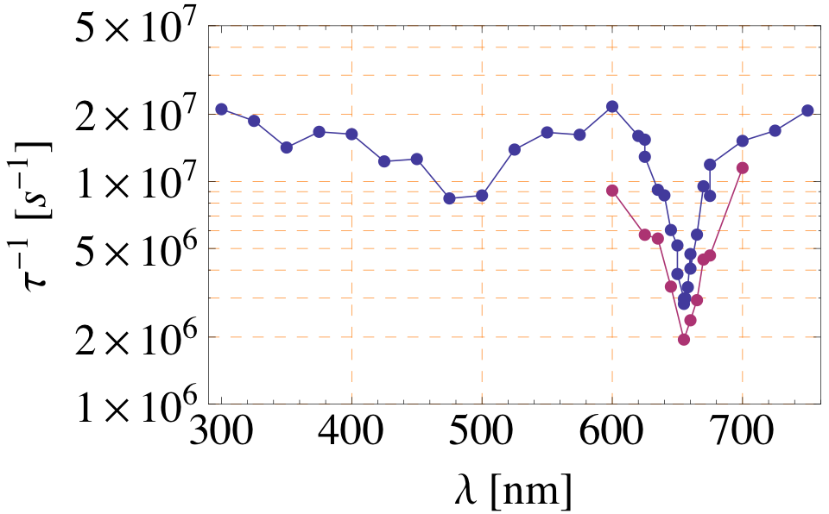
Decay time
620 psi
810 psi
Decay time seems to be more sensitive on the resonance line
With and size of τ⁻¹ are changed by GH2 pressure

Slide 15
Observations in optical measurement
We confirmed that a light was produced in the HPRF cavity only when a breakdown happened, where the breakdown is that the RF cavity releases significant amount of RF power in a very short time
We observed one large peak around 656 nm and one small peak around 480 nm in breakdown spectra
The width of each peak is (unexpectedly) broadened
We observed a high intensity continuum spectrum
We observed strong correlation between PMT decay time and wavelength
The observed rise time of PMT signal is 5 ~ 10 ns, this time scale is reasonably matched to the observed decay time of electric and magnetic probes (10 ~ 15 ns)
However, there is a dependence on wavelength and PMT rise time, e.g. τ ≈ 10 ns at λ = 656 nm, τ ≈ 5 ns at λ = 400 nm
Decay time at λ = 656 nm is 500 ns which is well matched with Einstein coefficient
Decay time at λ = 400 nm is 60 ns

Slide 16
RF breakdown in dense GH2
Experimental facts:
  Cavity is insensitive to B field by filling dense GH2
  Maximum E field is determined by gas density at gas breakdown region
  Maximum E field seems to saturate at metallic breakdown region

Slide 17
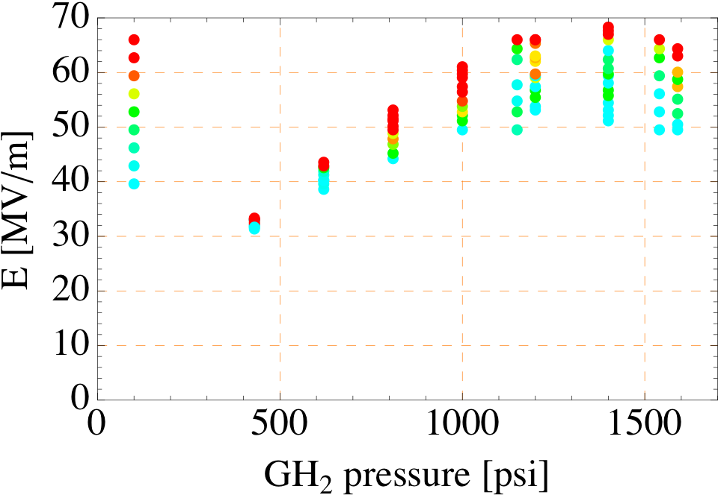
Maximum E vs GH2 pressure
Probability
1.0
0.1
0.01
0.005
0.002
0.001
0.0005
Nov, 2009 run
0.0001
0

Slide 18
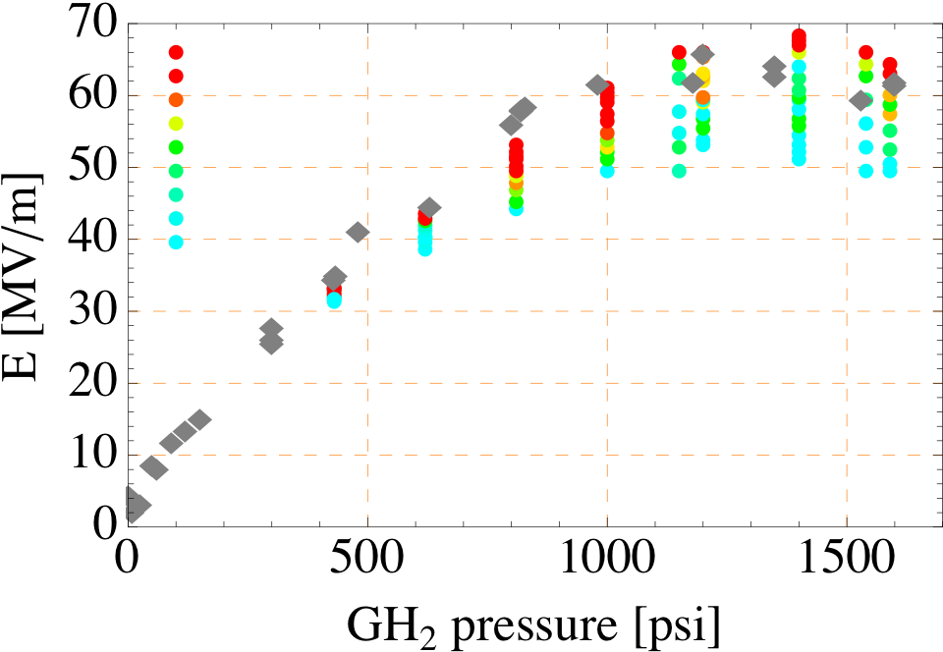
Maximum E vs GH2 pressure
Compare with previous result
Probability
1.0
0.1
0.01
0.005
0.002
0.001
0.0005
Nov, 2009 run
0.0001
0
Sep., 2008 run

Slide 19
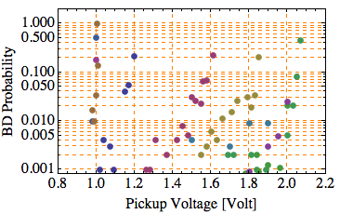
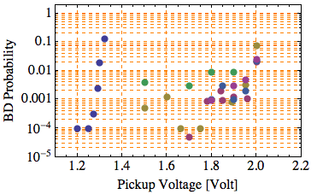
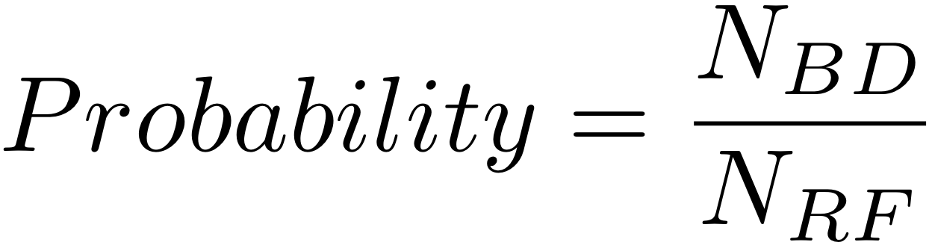


Probability of breakdown
Normal run (1k RF pulses)
Long run (10~20k RF pulses)
620 psi
1150 psi
: # of breakdowns
: # of RF pulses
BD probability curve is very clear shape at low pressure region
Boundary becomes fuzzy at high pressure region (> ~1000 psi)

Slide 20
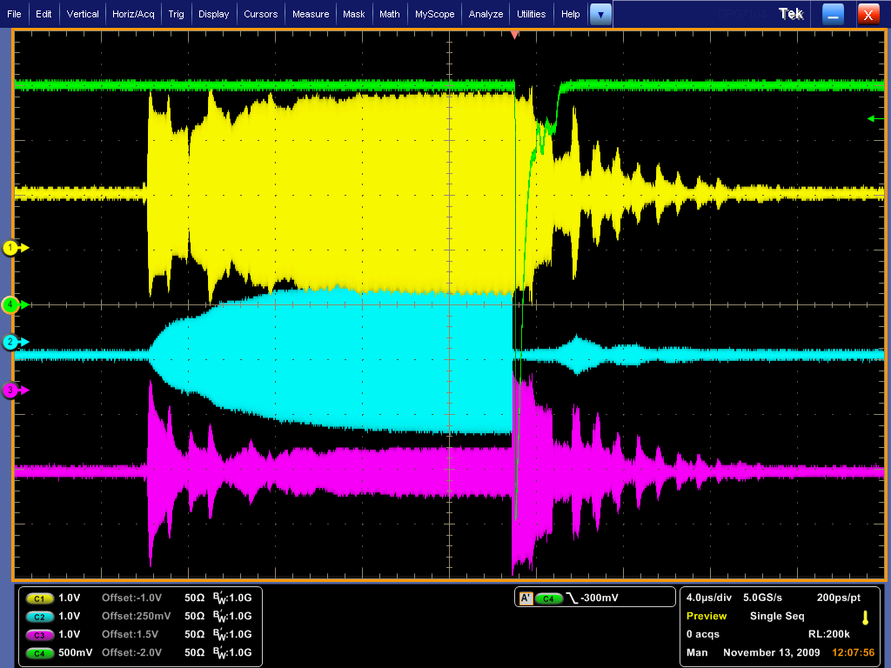
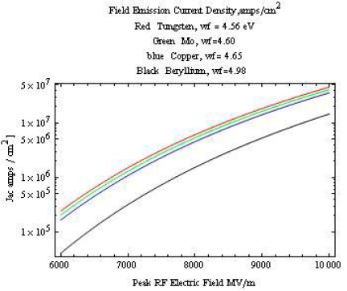
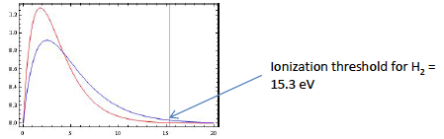
Questions
RF power decays in 10 ~ 20 ns at breakdown event while propagation of plasma only makes a few mm in this time scale. How does electronic breakdown happens?
PMT signal seems to be observed only when breakdown takes place. If some amount of field emission electrons exist in the HPRF why they do not induce de-excitation light? Poor light sensitivity or no high energy electron?
PMT signal
RF forward pwr
RF pickup probe
RF reflection pwr
Have we ever seen any evidence of electron accumulation process even there must be a lot of field emission electrons?
A. Tollestrup
Electron energy distribution
(Red: E/P < 14 V/cm/mmHg
Blue: E/p > 14 V/cm/mmHg)
A. Tollestrup

Slide 21
Timetable for HPRF project
Jan., 2010 HPRF with no beam test
Spring 2010 First beam test
Summer 2010 Second beam test, test proto-type HPRF
Winter 2010 Third beam test, test dielectric loaded RF
2011~ 6D cooling demo experiment

Slide 22
Conclusions
Start preparing first beam test
  Design collimator to vary beam intensity
Non-beam test analysis has been made from two successful runs (Sep. ’08 and Nov. ’09)
  Always observed a big spark light at breakdown
  But, no de-excitation light without breakdown is observed
  Need to find out why we do not see it

