Slide 1
MICE RFCC Module Status: RF Cavities
NFMCC Collaboration Meeting
The University of Mississippi, Oxford, MS
January 16, 2010
Derun Li
A. DeMello, S. Virostek, M. Zisman
Lawrence Berkeley National Laboratory

Slide 2
Overview
First five RF cavities (one spare) are complete
  Cavity fabrication awarded to Applied Fusion in February 2009
  Cavity body fabrication started in April 2009
  Welding the stiffener ring to the shell and cutting the irises
  E-beam welding 10 copper shells with the stiffener rings to 5 cavities
  Ports extruding
  Welding the nose ring into the cavity irises
  Welding the strut mounting posts onto the cavity
  Welding of the water cooling tubing onto the cavity
  The first 5 cavities are scheduled were delivered to LBNL on December 2009
Coupling coil design (MICE/MuCool) and fabrication are being provided by ICST of HIT, Harbin, China
  Fabrication contract expects to be awarded on March 15, 2010
MICE cavity design is heavily based on MuCool 201-MHz prototype RF cavity: fabrication techniques + post processing

Slide 3
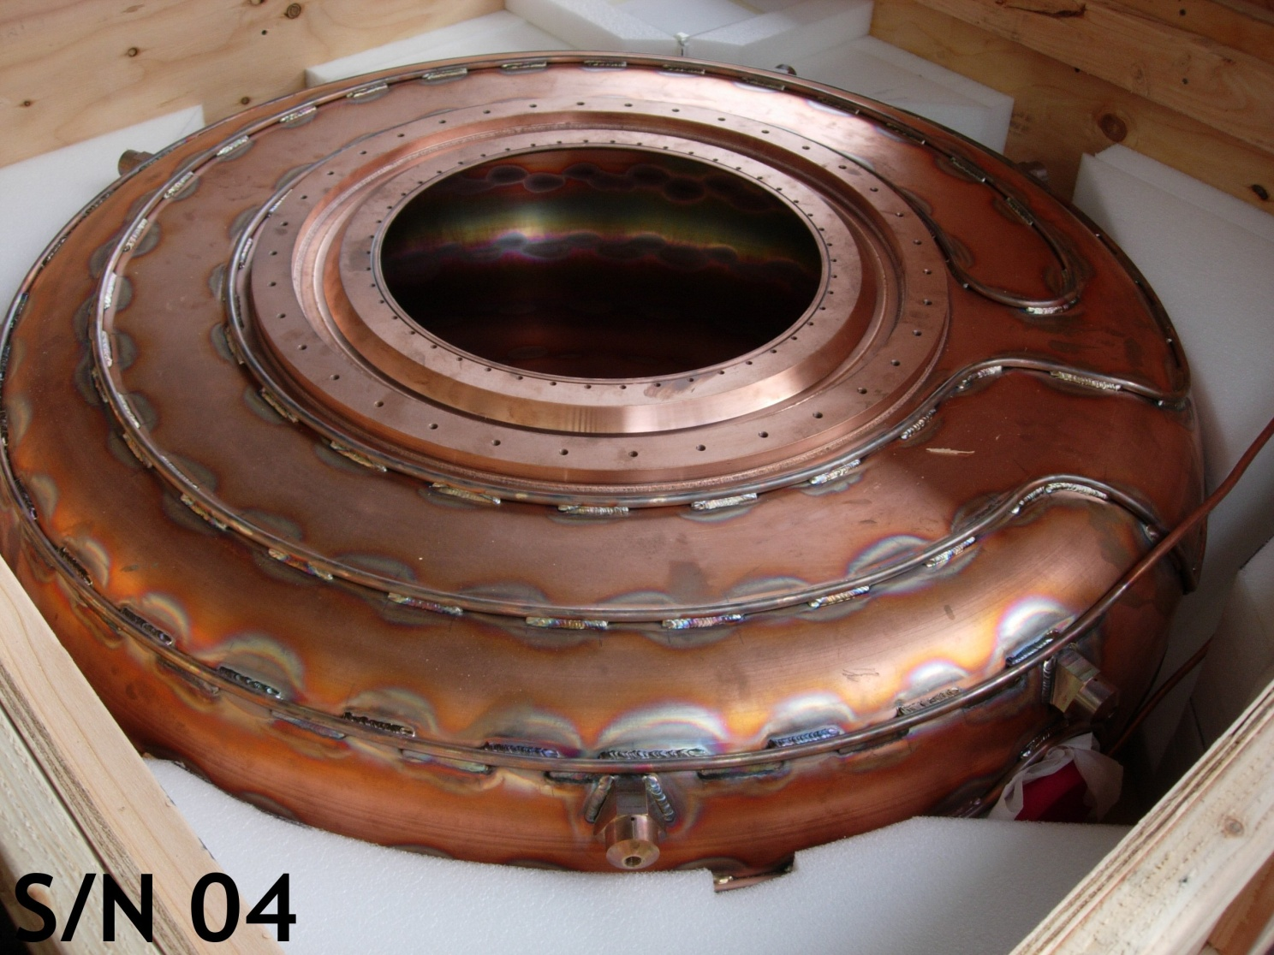
4 Completed Cavities, 1 Spare Cavity
Photo taken Jan. 2010 at LBNL

Slide 4
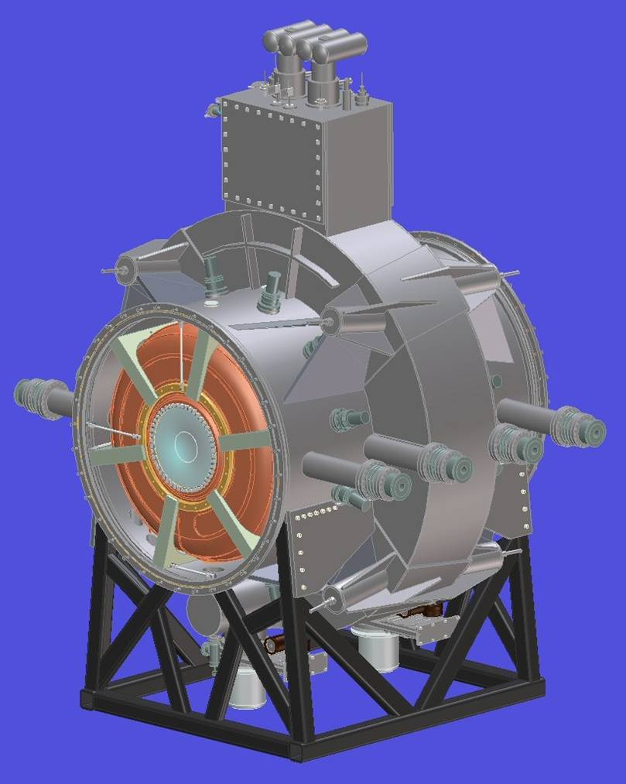
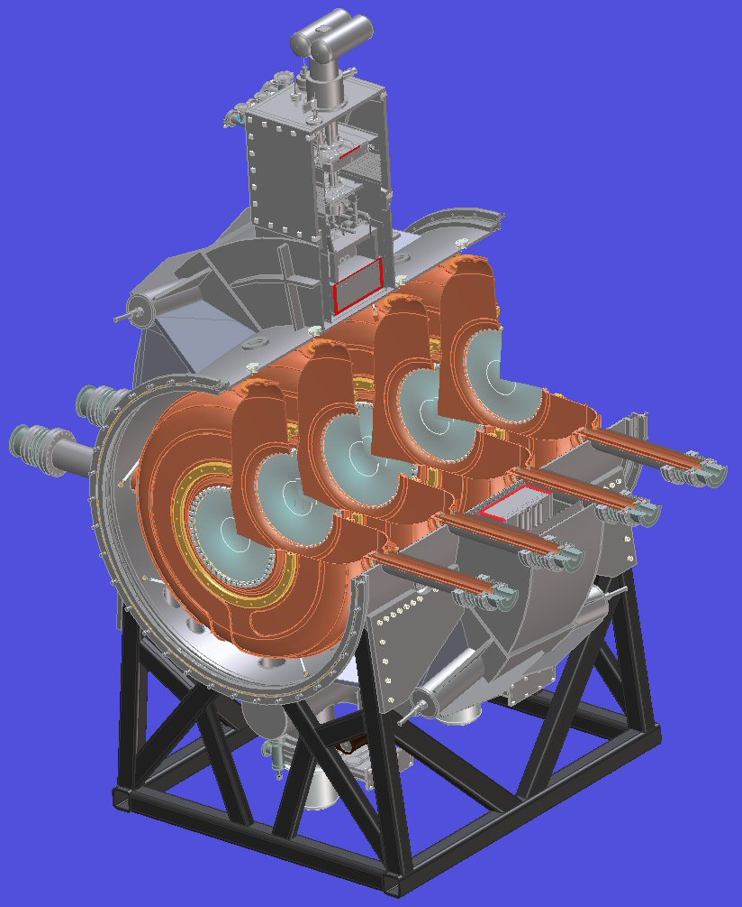
RFCC Module
Curved
Be window
SC coupling Coil
Cavity Couplers
201-MHz cavity
Vacuum Pump

Slide 5
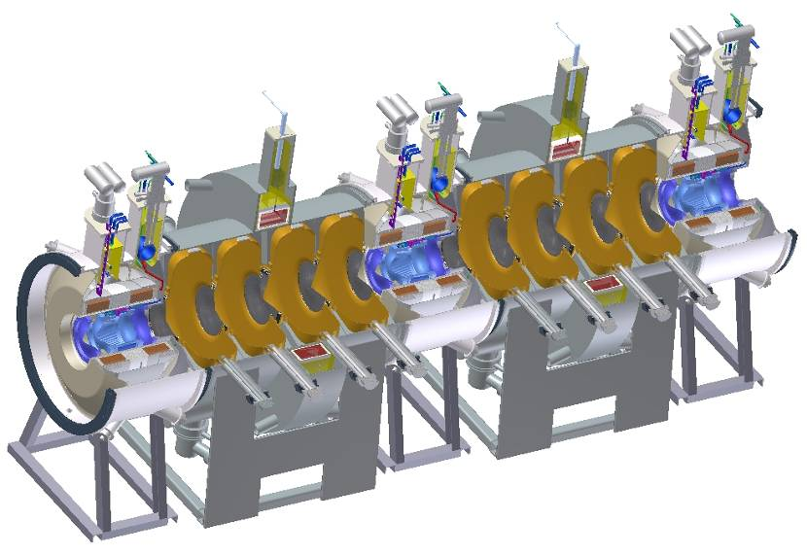
Eight 201-MHz Cavities & Two CC Magnets
Eight 201-MHz RF cavities
RFCC modules

Slide 6
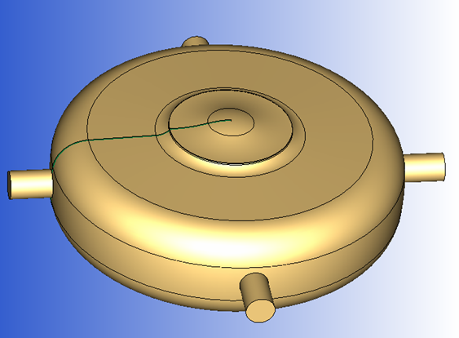
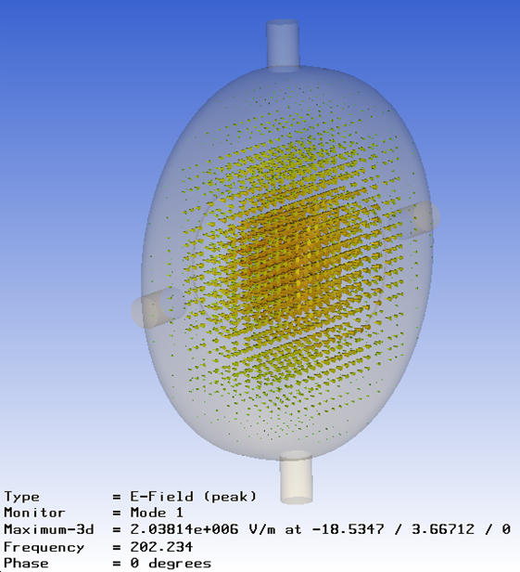
MICE RF Cavity Design
3-D CST MWS parameterized RF model including ports and curved Be windows to simulate frequency, E_{peak}, power loss & etc.
Estimated frequency variations between cavities should be within ± 100 kHz (after fabrication)
Absolute frequency: 201.25-MHz ± 400-KHz
Approach
  Slightly modify prototype cavity diameter
  Target a higher cavity frequency
  Tune cavities close to design frequency by deformation of cavity body (if needed)
  Tuners operate in the push-pull mode

Slide 7
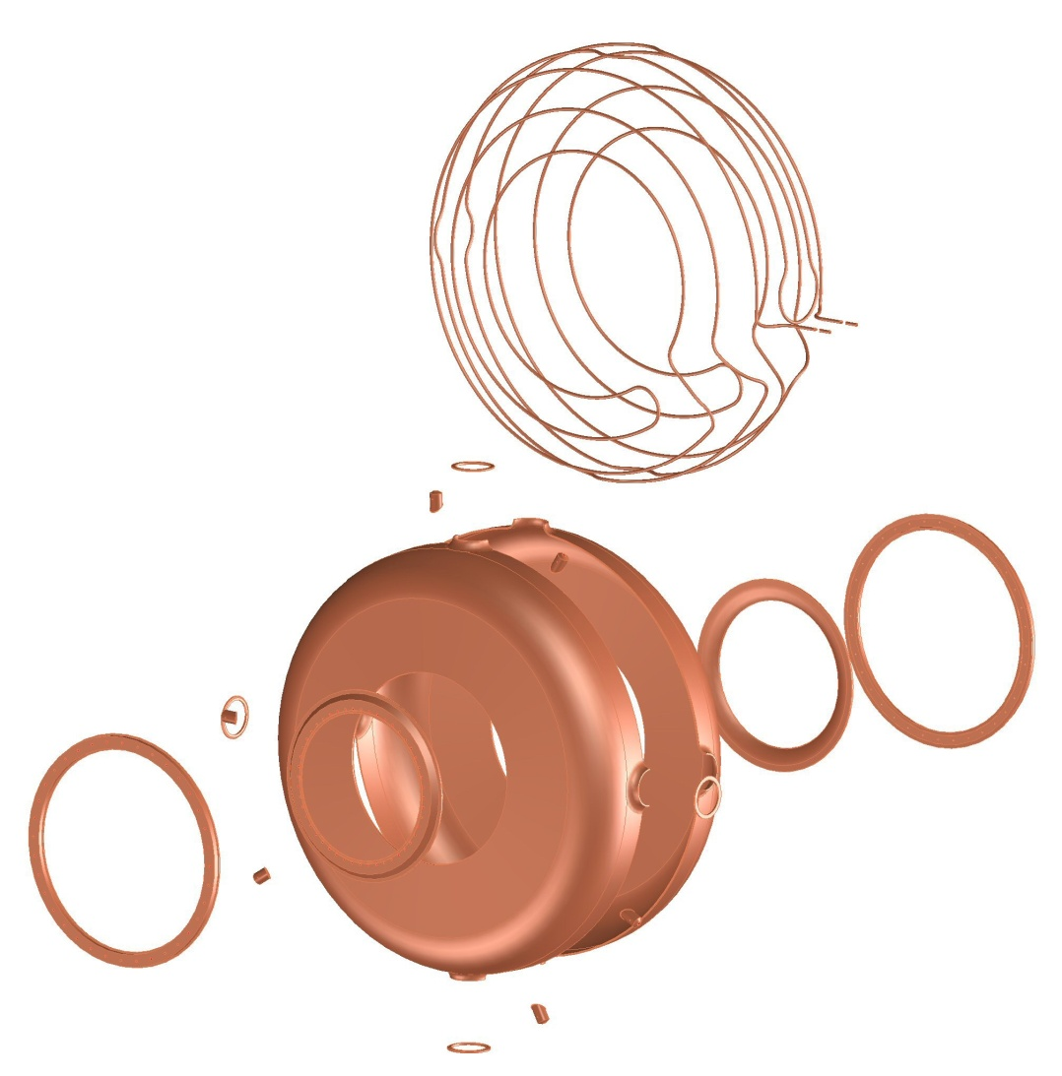
Cavity Component Parts
Strut
Mounting Post
Cooling Tubing
Cavity Shells
Stiffener Ring
Extruded
Port Flange
Nose Ring

Slide 8
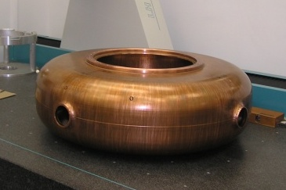
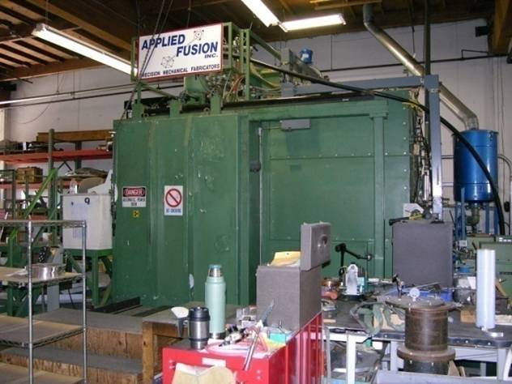
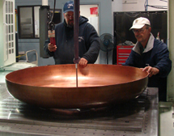
Cavity Fabricator - Applied Fusion, Inc.
Applied Fusion’s e-beam welder is a German made machine
Applied Fusion has the machining equipment necessary to fabricate the complete RF cavity (minus spinning)
Cavity Inspection
Electron beam welding machine

Slide 9
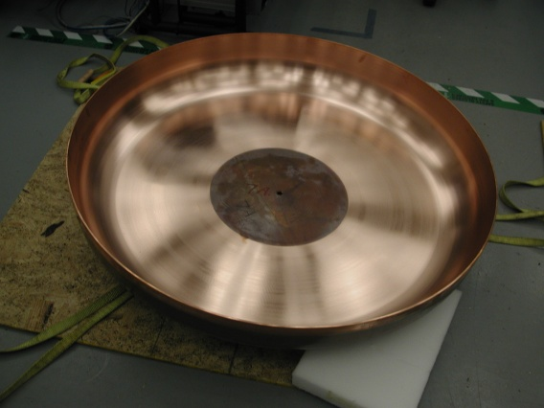
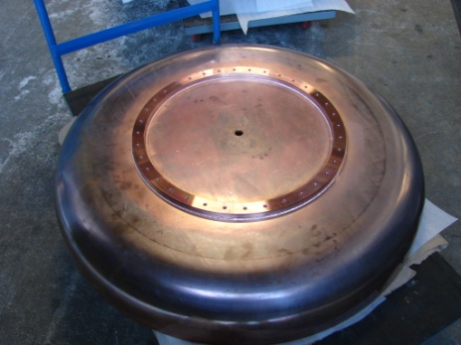
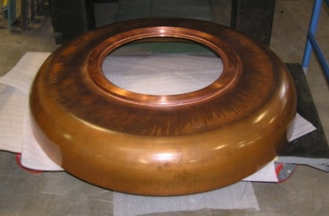
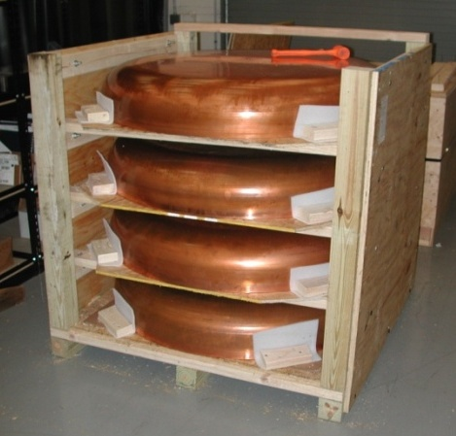
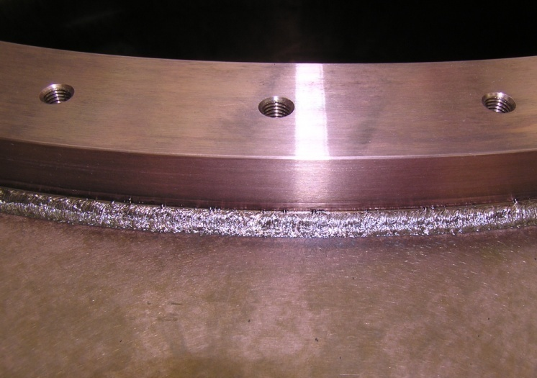
Cavity Stiffener Ring
Title Here
Spun shells from Acme, MN
The stiffener ring is welded on to the half shell
Equator welding
The iris is machined out

Slide 10
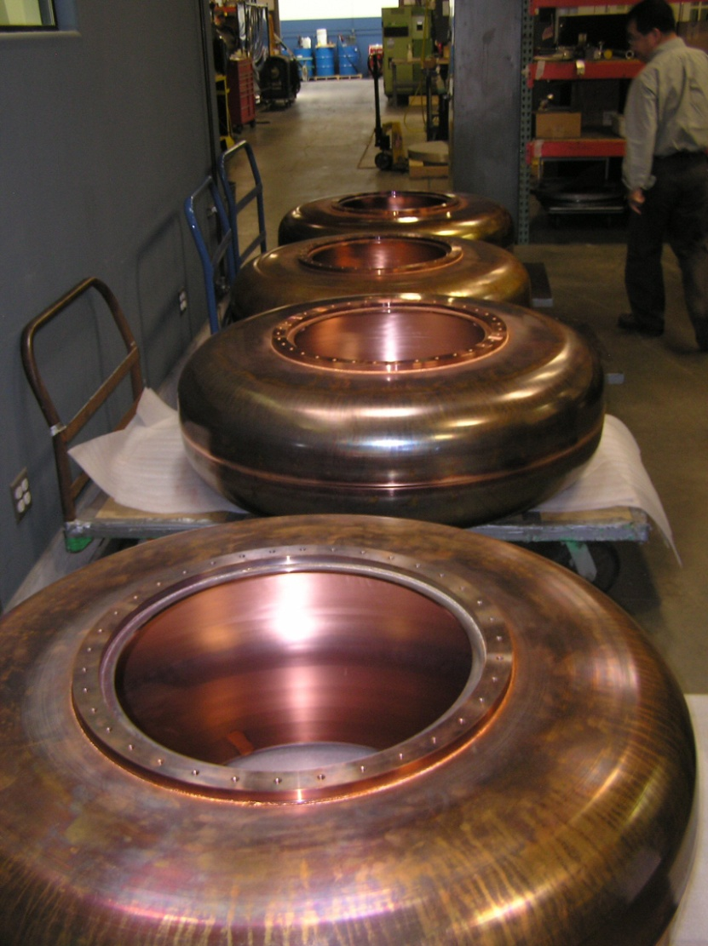
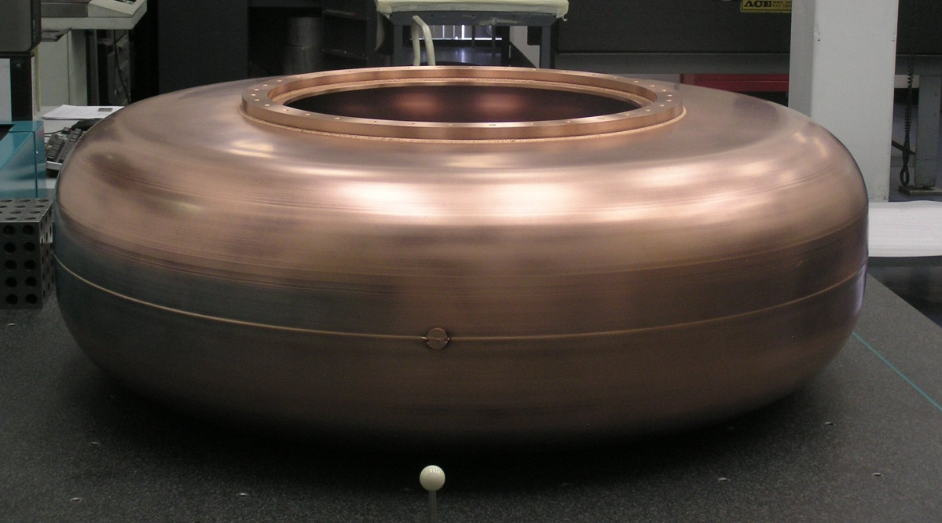
E-beam Weld Shells into a Cavity
The cavity shells were inspected at LBNL and paired for best inside edge match
The cavity shells are oriented (clocked) to the stiffener rings with a pin
Matched shells were e-beam
welded into a cavity

Slide 11
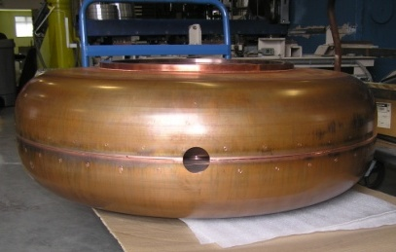
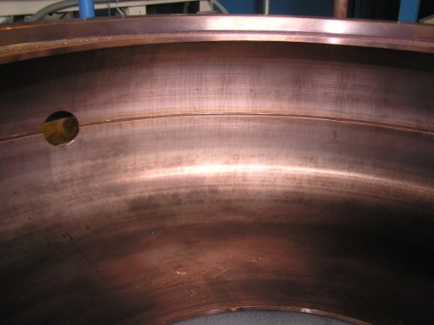
Preparation for Extruded Port
Cavity is placed on a horizontal milling machine to bore the pilot hole for the extruded ports
The shell alignment key is bored out as one of these pilot holes

Slide 12
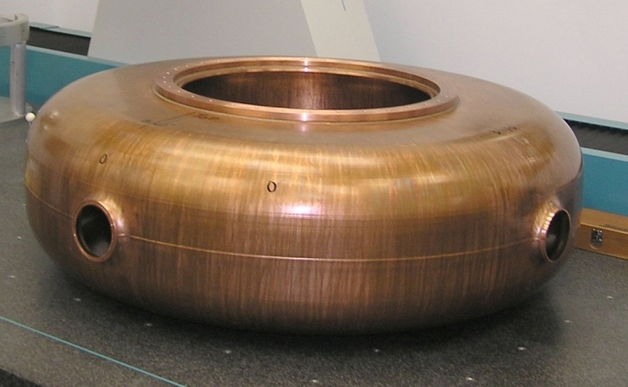
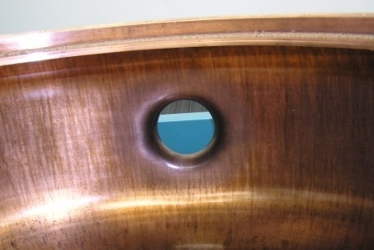
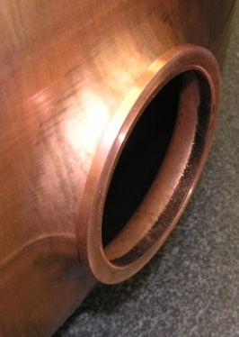
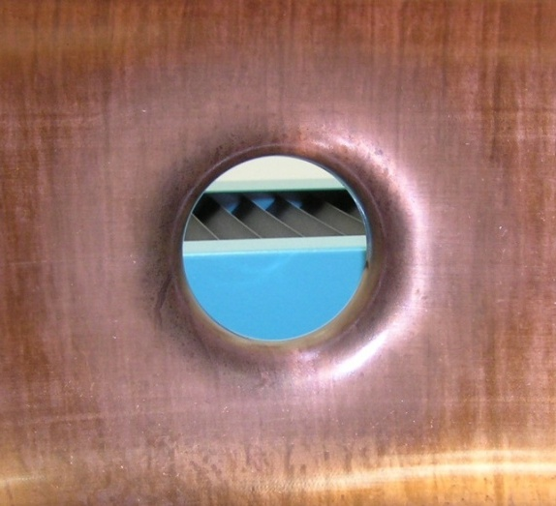
Extruded Port
Ports are extruded using LBNL-Jlab provided tool
The inside of the perimeter weld is ground to blend the two shell halves
Port flange is e-beam welded to a machined port face

Slide 13
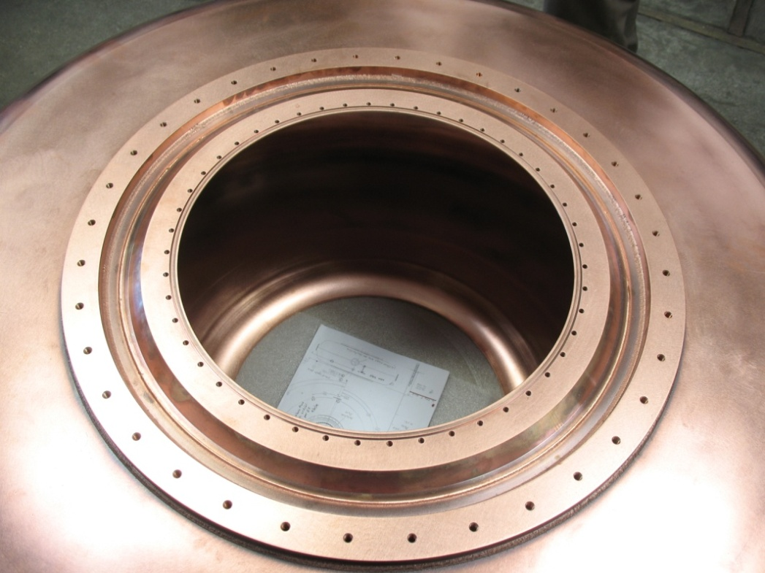
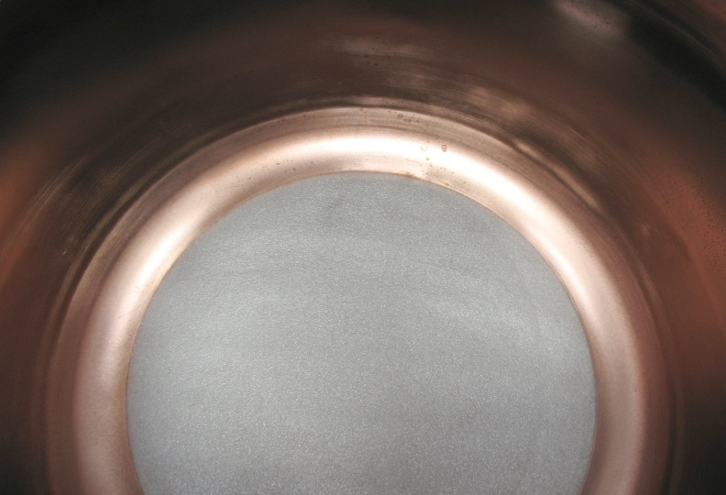
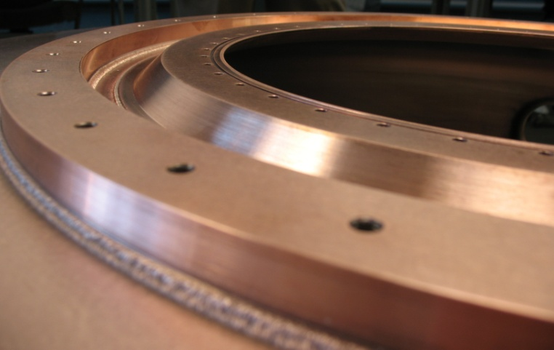
Nose Ring Welded into Cavity Iris
The nose ring is welded into the iris
The inside weld is ground down to blend the nose ring into the cavity wall
Threaded holes for mounting the Be window to the cavity

Slide 14
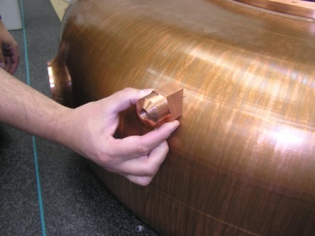
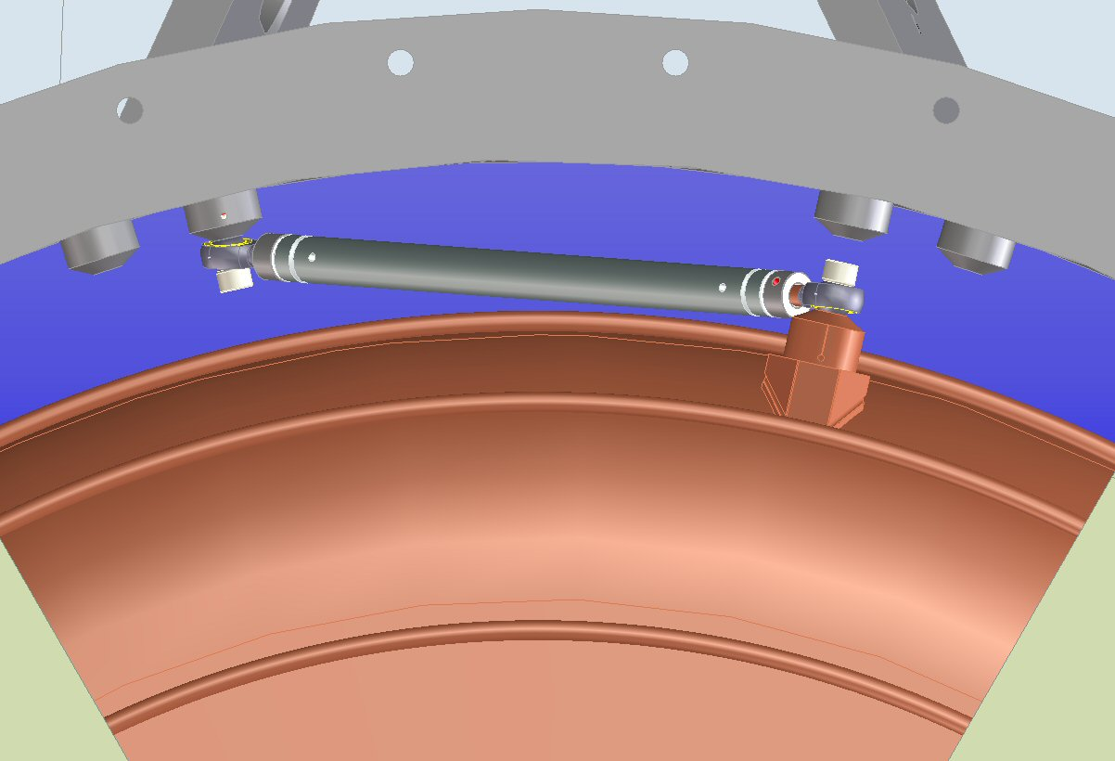
Strut Mounting Post
The cavities will be suspended inside the vacuum vessel with 6 struts in a hexapod arrangement
Strut mounting posts are TIG welded to the cavity
Strut mounting posts will have a Heli-coil thread insert for strength

Slide 15
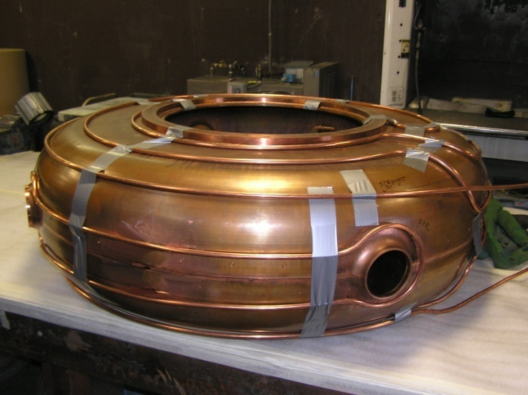
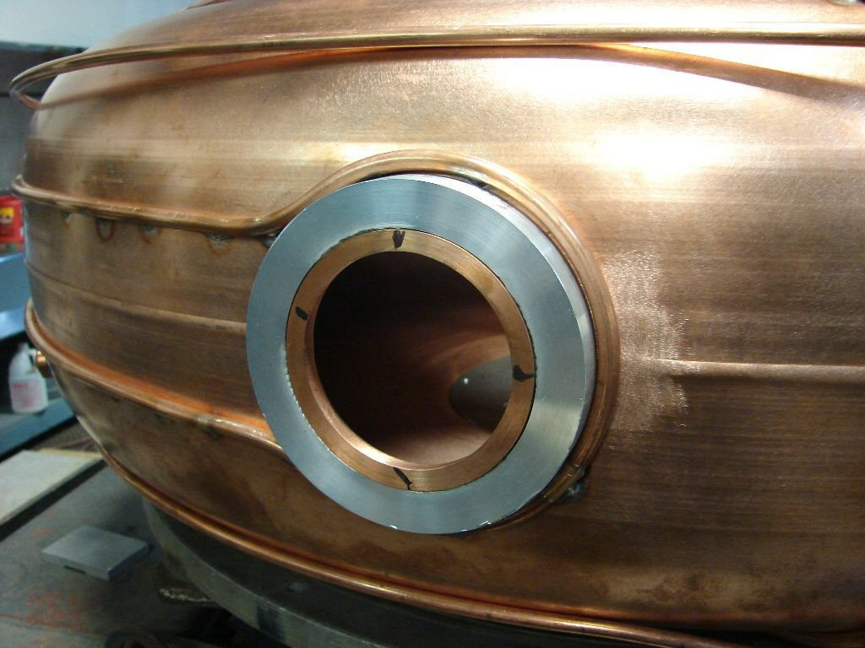
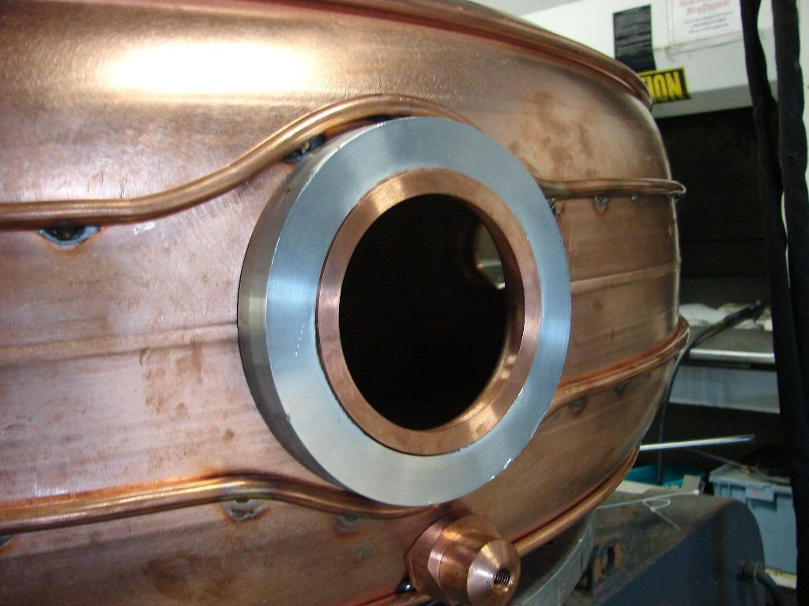
Cooling Tubing
Cavity cooling circuit uses one continuous tube
No in vacuum cooling tube joints
Tubing is TIG brazed to the (pre-heated) cavity with argon gas flow inside the tube
Minimizing cavity distortion

Slide 16
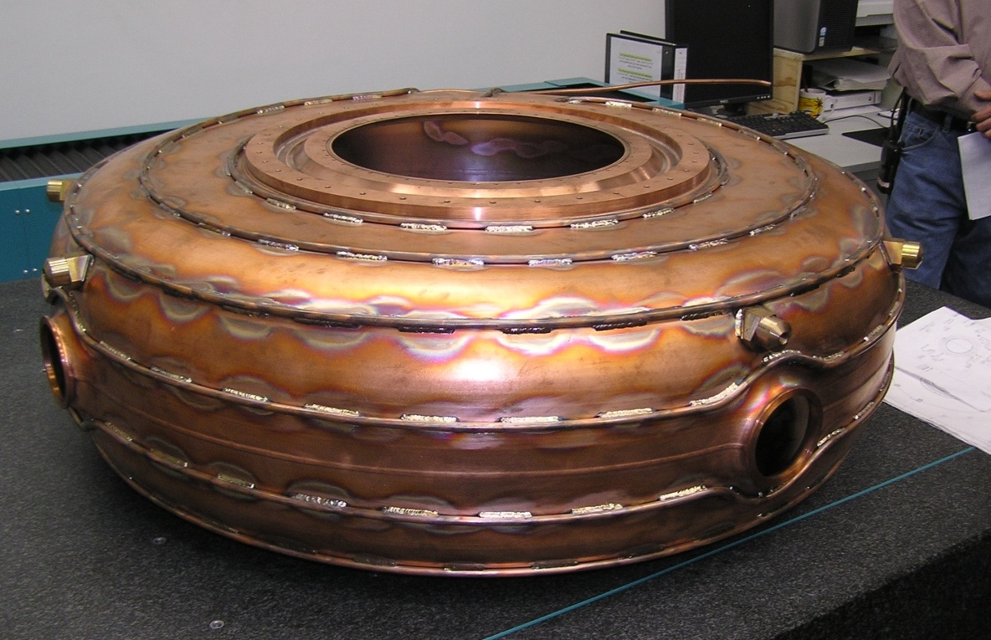
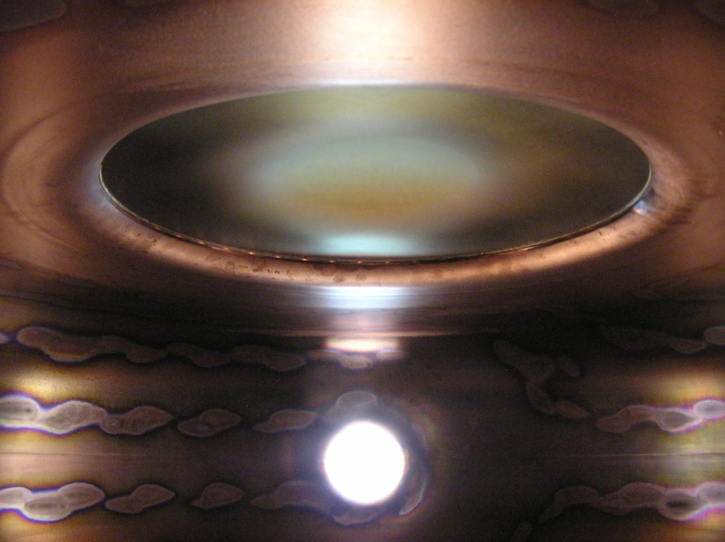
Cooling Tubing (cont’d)
Visible discoloration both outside and inside the cavity after (nearly continuous) TIG brazing
Visual inspection did not find any surface deformation
Slightly sagging of the nose ring (surface) for mounting the Be window

Slide 17
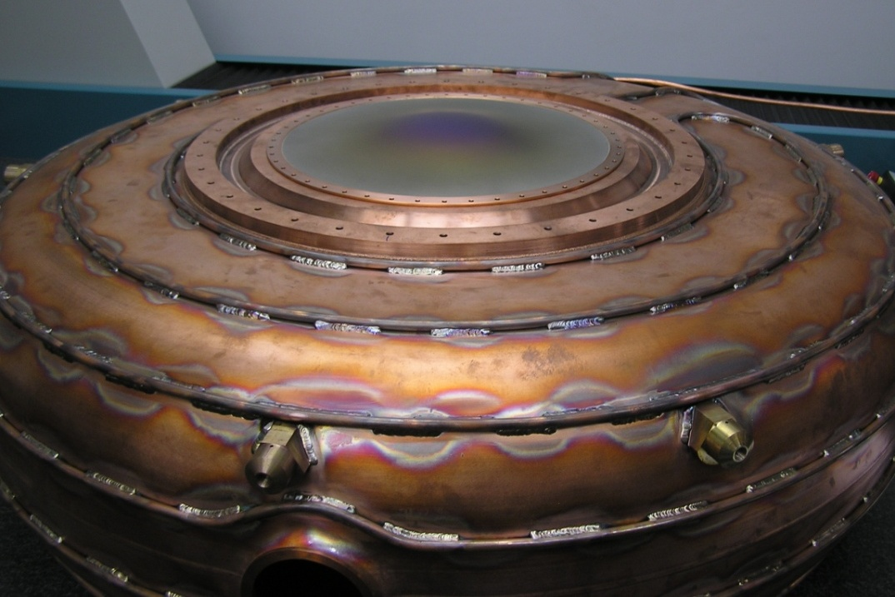
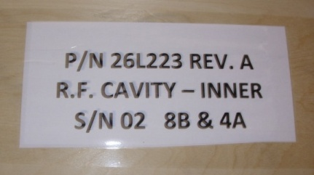
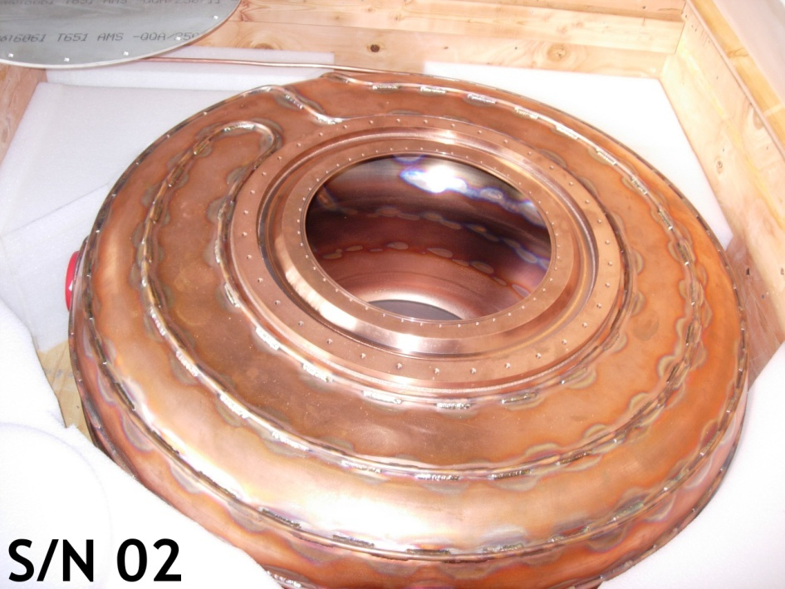
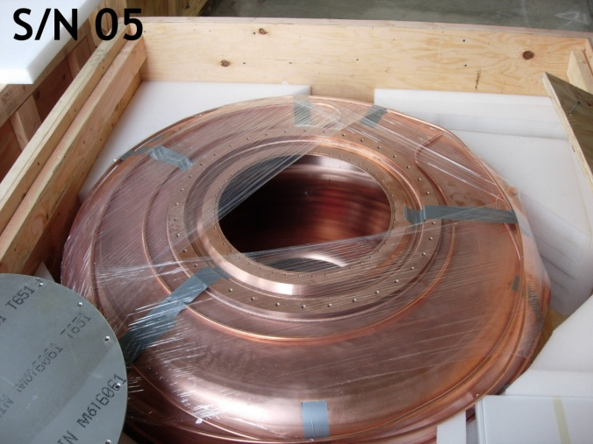
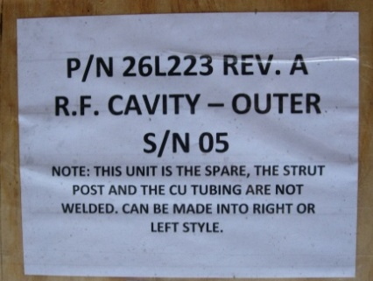
Completed Cavity
With beryllium window on to check the alignment of mounting holes and surface flatness
One spare cavity (No.5)

Slide 18
Future Plans
Cavities must be “tuned” to each other for best center frequency (four cavities) by plastic deformation (will be done at LBNL)
  Measure cavity frequencies and find the average frequency (to be completed by next MICE CM)
Cavity post-processing
  The inside surface of each cavity needs to be cleaned and electro-polished (to be done at LBNL)
Frequency tuner system testing and verification will be conducted on a finished cavity
  Prototype for tuner test is in fabrication + MTA tests
Option to order the remaining 5 cavities (four plus one spare) for the second RFCC module
  Decision needs to be made soon
Continue to work on other accessory components: coupler, ceramic windows and Be windows, support structures and vacuum vessels

Slide 19
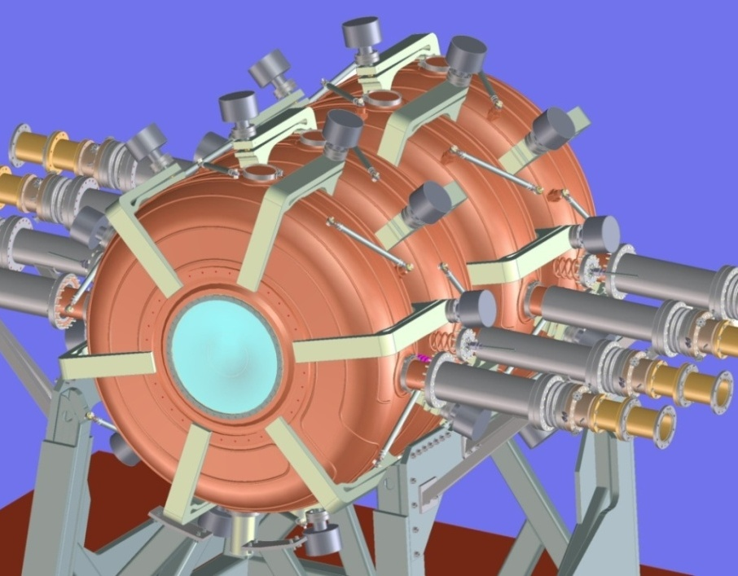
Cavity Tuner Design
The design parameters are based on a finite element analysis of the cavity shell, and tuning range is limited by material yield stress:
  Overall cavity stiffness: 7950 N/mm
  Tuning sensitivity: ±230-kHz/mm per side
  Total tuning range: 460 kHz (±1 mm per side)‏
  Number of tuners: 6
  Maximum ring load/tuner: 5.3 kN
  Max actuator press. (100 mm): 200 psi
Six tuners, spaced evenly every 60º around cavity, provide frequency adjustment;
Clocking of tuner position between adjacent cavities avoids interference;
Tuners touch cavity and apply loads only at the stiffener rings;
Tuner/actuators are thermally independent of the vacuum vessel
Tuners operate in a bi-directional Push-Pull mode.

Slide 20
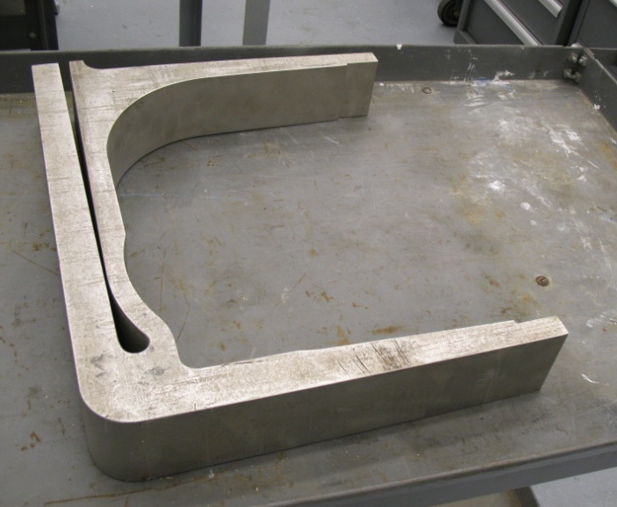
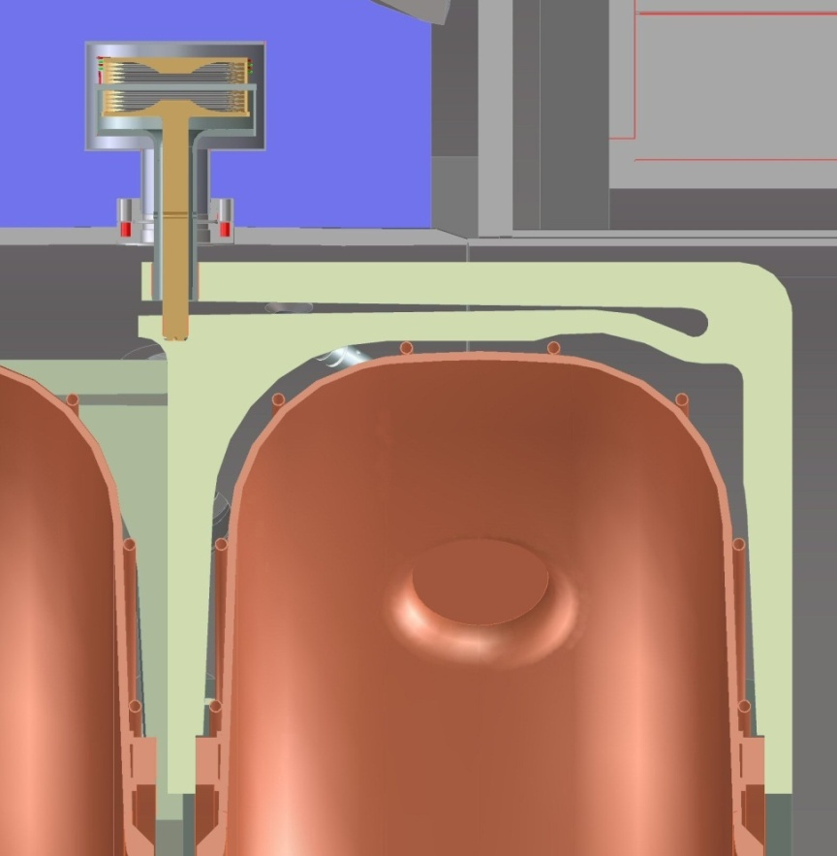
Cavity Tuner Prototype
  Dual–action tuner actuator
Flexure
tuner arm
Dual bellows
vacuum sealing
Actuator is
screwed into
the tuner arm
Screws fix the tuner to the cavity stiffener ring (both sides)
The tuner prototype is in fabrication at LBNL
Fixed‏
connection
Forces are transmitted to the stiffener ring by means of push-pull loads applied to the tuner lever arms by the dual action actuator.

Slide 21
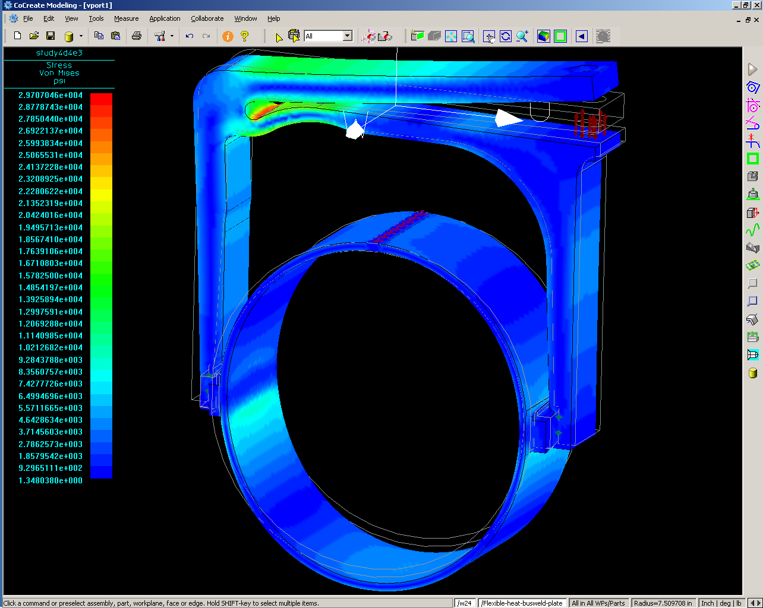
Stiffener Ring Analysis (Prototype test):
Applied Displacement
The Von Mises stress at the flexure is 29.7Kpsi
The input load by the air actuator is 800 lbs
The flex-arm displacement is 0.214” (~0.43” bi-directional)
The cavity displacement is 1.05mm per side

Slide 22
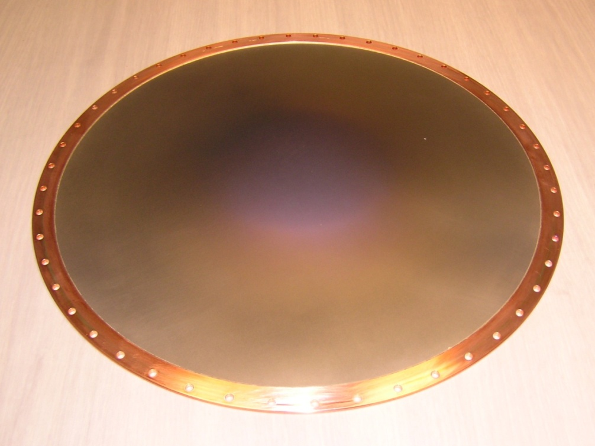
Beryllium Windows
We have received two “good” beryllium windows at LBNL
  Curved thin beryllium window brazed (sandwiched) between) two annular copper rings;
  Beryllium windows coated with TiN on both sides (can be installed on either side of the cavity)
  41-cm in diameter;
  0.38-mm in thickness.
The two windows will be used
for frequency measurements of
the five MICE cavities;
Eight more windows are coming
soon.

Slide 23
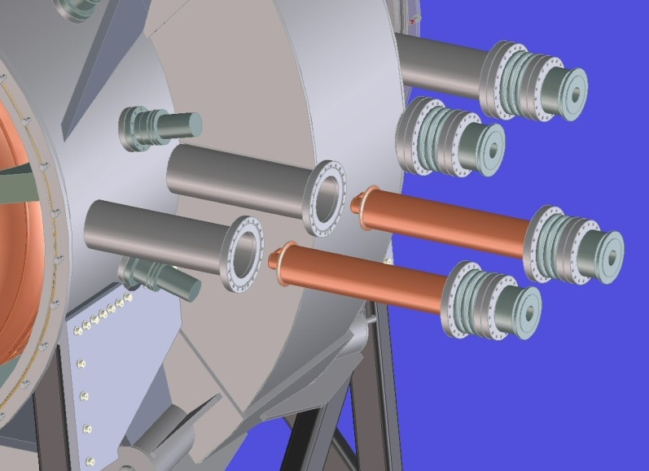
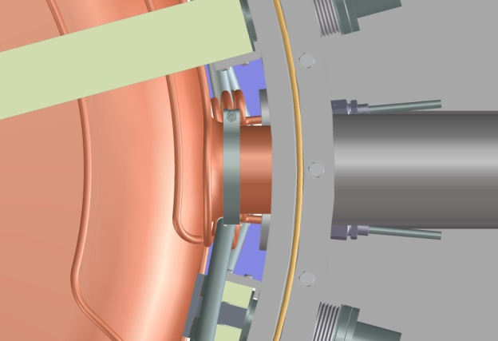
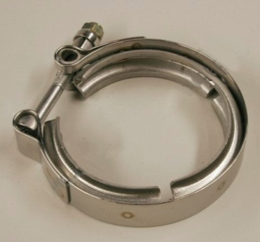
MICE Cavity RF Couplers
A bellows connection between the coupler and the vacuum vessel provides compliance for mating with the cavity
Off the shelf flange “V” clamp secures RF coupler to cavity
Notes:
23
23

Slide 24
Progress: MuCool/MICE CC Magnets
Collaboration between LBNL and ICST of HIT, Harbin
Final design review was held in Harbin (Dec. 2008)
  Little progress since the review due to personnel, funding issues and cryogenic test system
Recent visit to HIT (Dec. 2009)
  New management team formed and near term plan developed
    Good progress on drawing reviews and initiating contract
  CC fabrication contract open for bidding: three registered vendors (deadline was Jan. 9th 2010)
  Fabrication contract to be awarded on March 15th 2010
Outlook
  Cautiously optimistic on the fabrication contract
  Management and monitoring the contract
  MuCool CC magnet (1st) could be ready around end of 2010
    Three forged Al mandrels expect to arrive Qi Huan Company, Beijing in March 2010

Slide 25
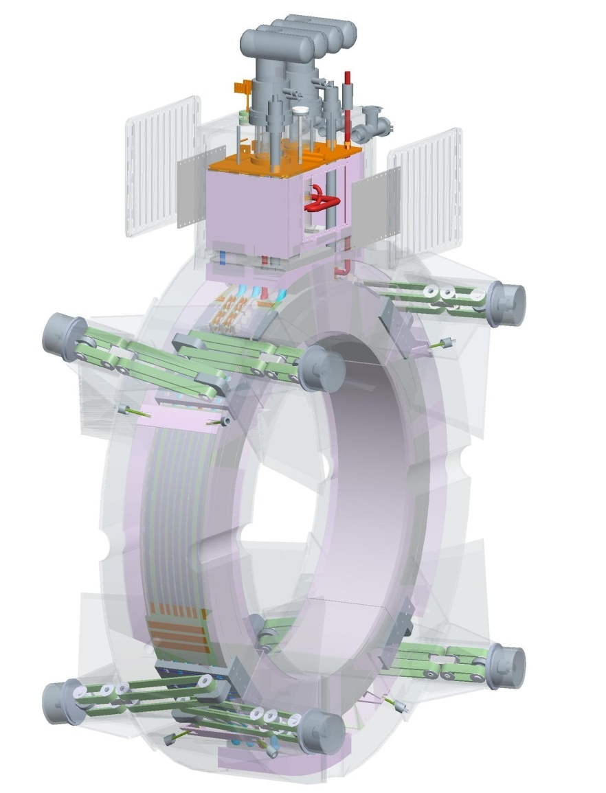
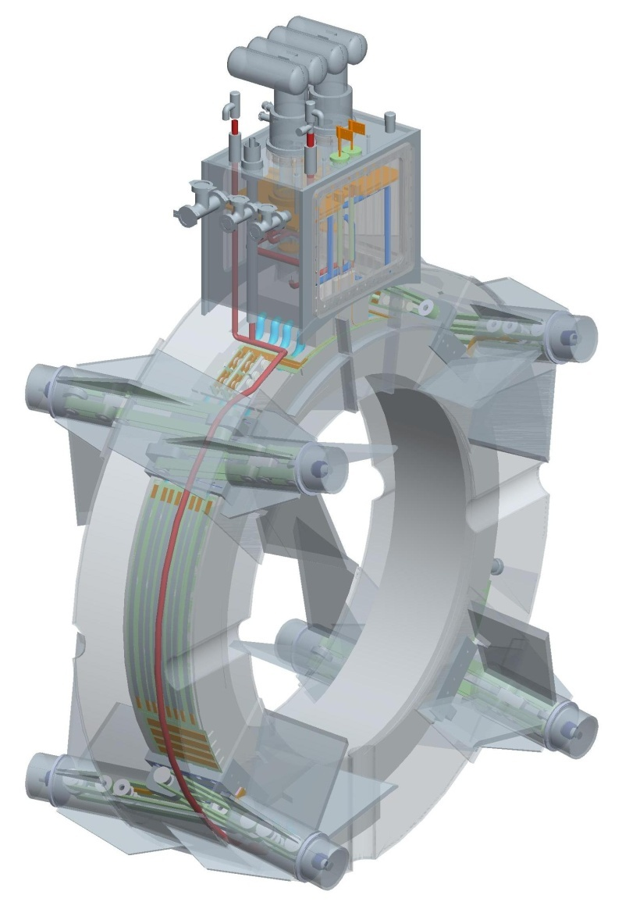
MICE Coupling Coil Magnets
Thermal shields and intercepts
Cryocoolers
Cold mass supports
Power leads
He condenser
Vacuum
vessel
He cooling pipes
Notes:
25
25

Slide 26
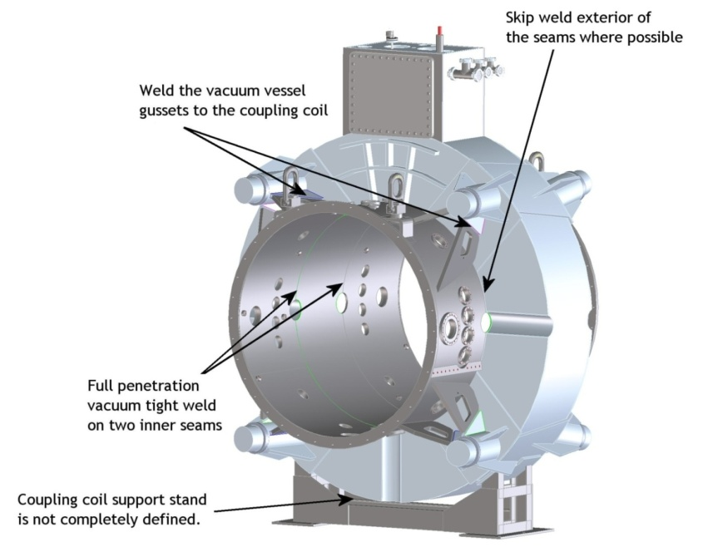
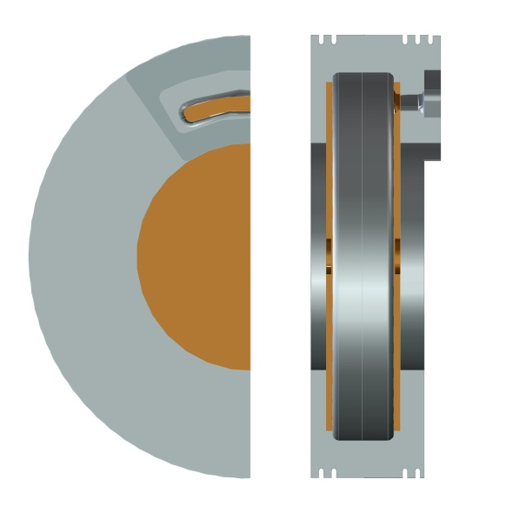

Summary
Completed five MICE RF cavities
  Continue working on accessory components
  Cavity tests
Progress on MuCool/MICE CC magnets
  Fabrication contract to be awarded on March 15th 2010
Continue working on the RFCC module
  Vacuum vessel, module assembly, packing, shipping and etc.
MTA RF tests, Be cavity and more

