Slide 1
Cubic Pill-Box Cavity
for the Study of E x B Effects
NFMCC Collaboration meeting
LBNL Perseverance Hall
01/28/09
Al Moretti

Slide 2
Outline:
Breakdown vs. magnetic field
Cartoon of the concept.
Description of the RF power coupler
Simulations of the cavity design with HFSS
Specifications.
Qo, Resonant Impedance, Power requirements, peak surface fields.
Conclusion.

Slide 3
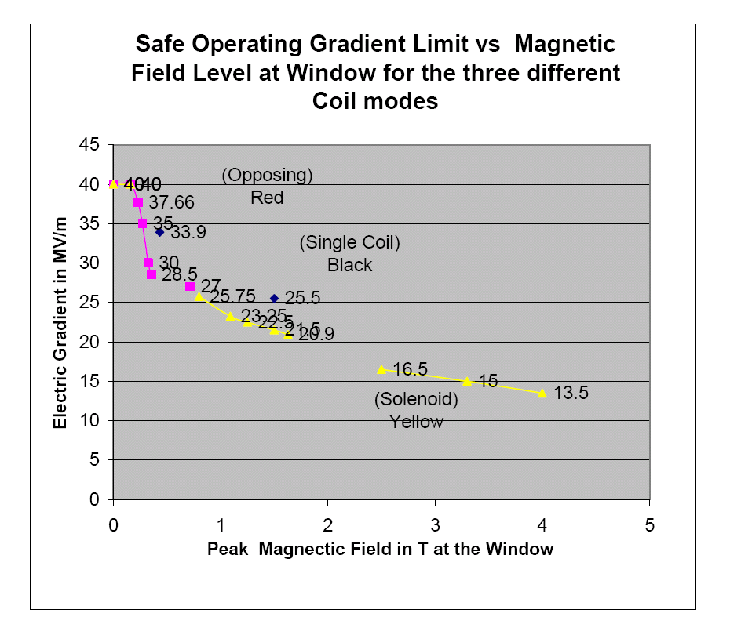
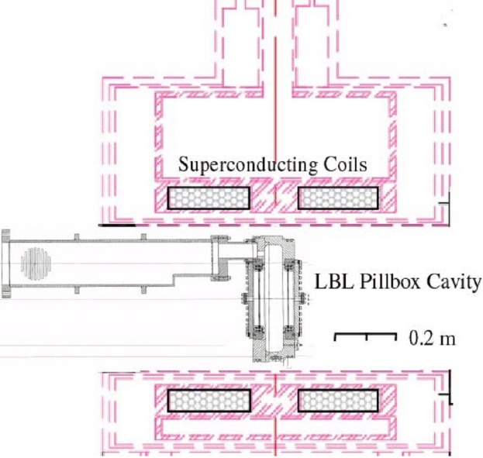
B field effect on breakdown
Data seem to follow universal curve
  Max stable gradient degrades quickly with B field
Re-measured
  Same results

Slide 4
Simplified View of WG Cavity for Field Orientation Studies
Min ConFlat pickup (2) places
DC magnetic field direction.
Waveguide Flange Perpendicular Orientation or could be at different angle
RF Electric Field Direction Max in center

Slide 5
Construction techniques:
Rectangular Cubic cavity made of welded SS plates, brazed or electron beam welded; electro-plated with copper and/or machined out of one piece with the top brazed on and flange and aperture cut into the surface.
Rectangular Cubic cavity made of welded copper plates, brazed or electron beam welded; and/or machined out of one piece copper with the top brazed on, the side would have SS flange brazed on and aperture cut into the surface.
Rectangular Cubic cavity made of welded copper clad SS plates, brazed or electron beam welded together; Flange and aperture would be cut into the side of the cavity.

Slide 6
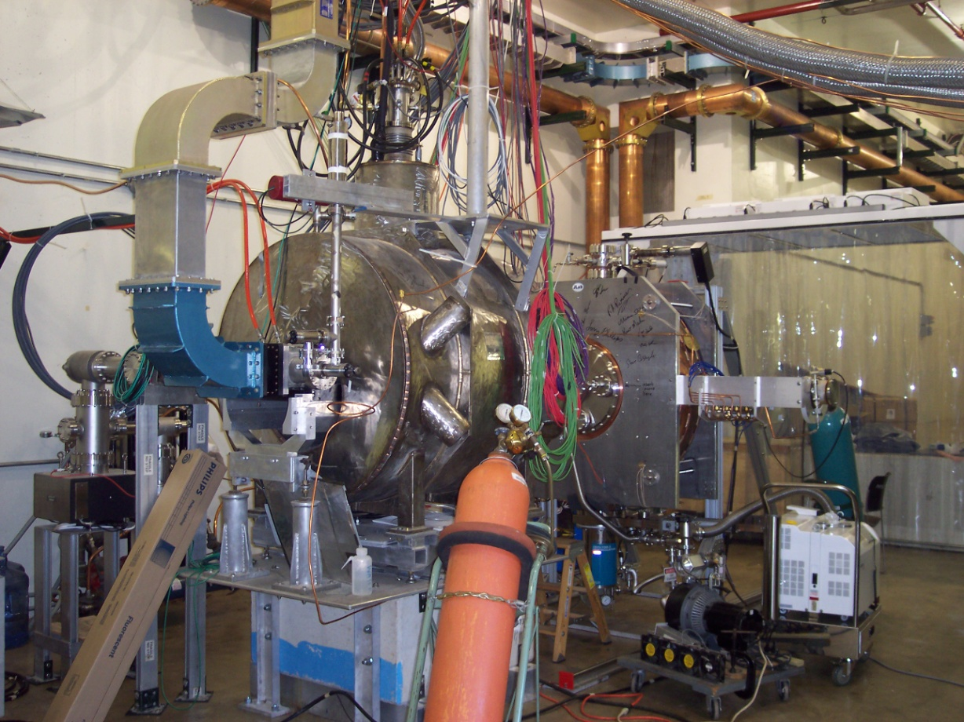
Very Early Construction stage of the MTA before Reconfiguration
Waveguide 90 degree bend
Waveguide Ceramic Cavity vacuum window ( Black item)
Cavity Waveguide Coupler
Cavity Support Structure

Slide 7
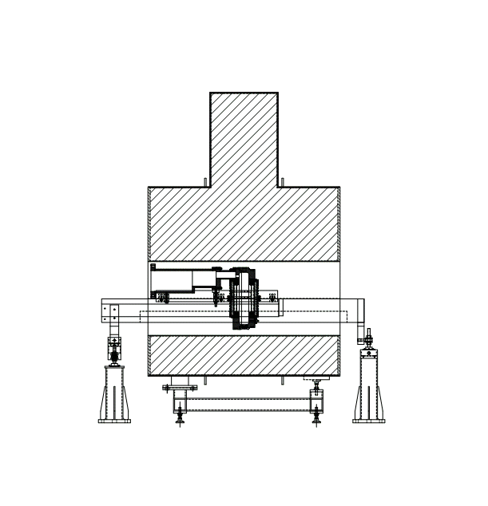
Waveguide Section for WG Cavity Design
To Couple the Cavity to the vacuum system and Waveguide, the LBL button cavity waveguide section would be used
It would be broken at the second Tin seal section.
The mating flange design would be machined into the side of the cavity.
The Kidney Cell would be replaced by a straight WG section.
Drawing Not to scale
LBL Waveguide section

Slide 8
Possible Rotation method
With a pivot Mounting axle and proper support structure, the cavity mounting structure could be rotated up to about 15 degrees.
Also, by installing special waveguide arc pieces, we can cover 90-105º

Slide 9
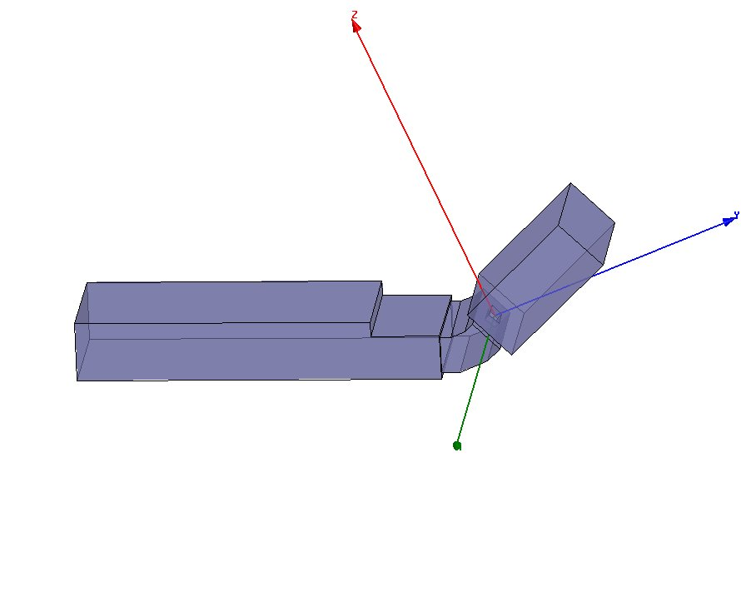
Method to increase the Covered Angles
This allows angles to be covered from 22.5 Degrees to 37.5 Degrees.
Other bend angles will allow more angle coverage.
22.5 Degree Mitered Coupler Cell bend

Slide 10
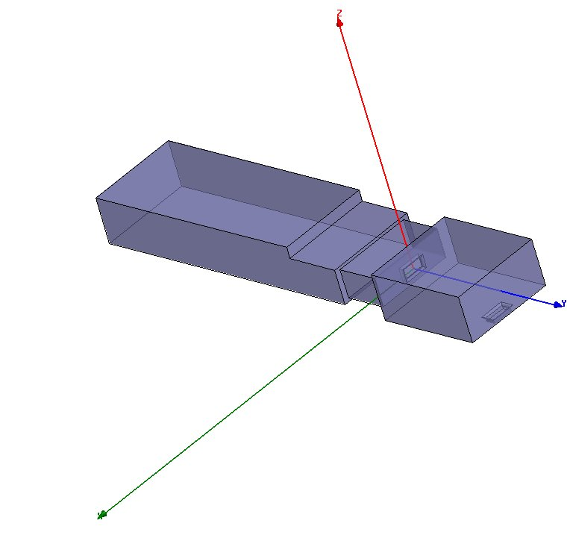
Orthogonal E and H Case
Rectangular Coupling aperture with rounded edges
WG RF power Coupler section
This Aperture not present in final design
Model only shows inside dimensions of the RF cavity and WG coupler

Slide 11
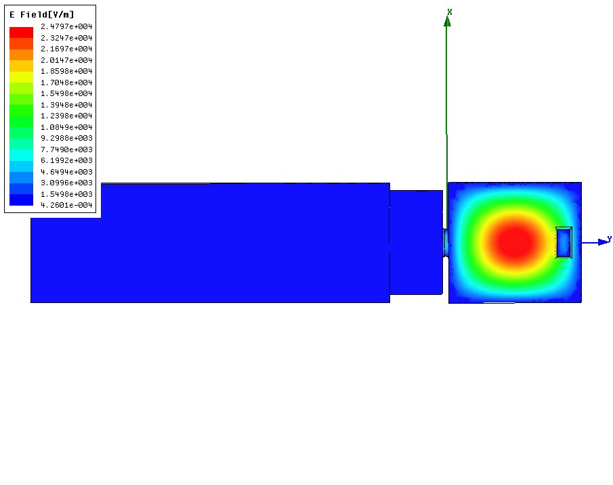
Simulation of the E field in the cavity
Simulation shows that the system is:
well matched at 805 MHz (Dark Blue),
Coupling aperture has a peak surface field ~1/2 of the peak cavity field.
Shorted aperture has peak surface field of 75% of the peak cavity Field
The aperture may need a larger radius or needs to be moved off axis; this will need more study.

Slide 12
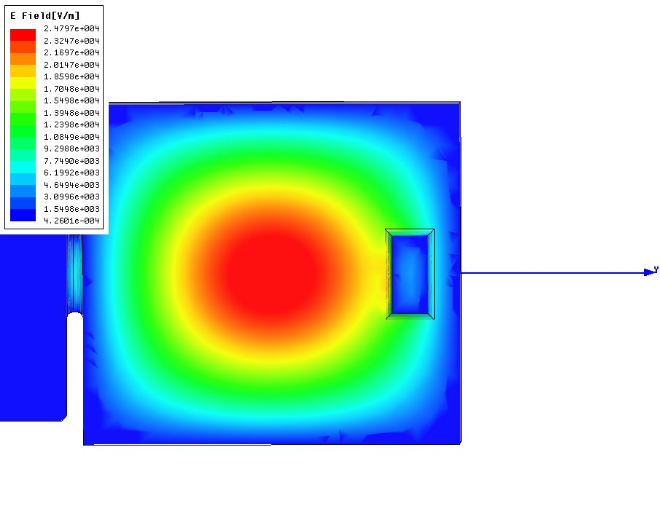
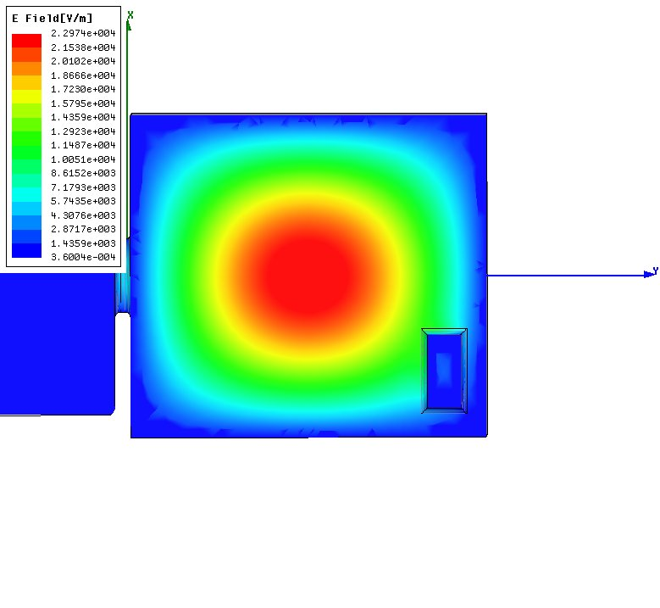
Close-up view of the E field in the shorted aperture
Moving the shorted aperture middle end to the right lower corner, reduces the peak surface from 75% to 50 % of the peak center field.
More square slot aperture reduces peak surface field on edges, radius on edges produces further reduction.

Slide 13
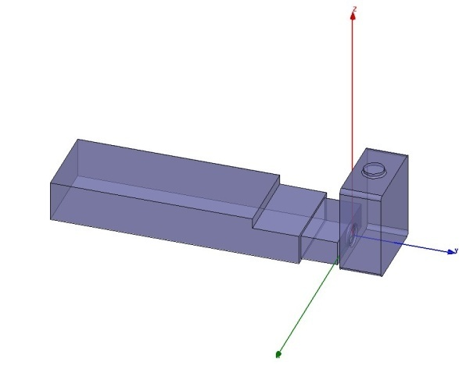
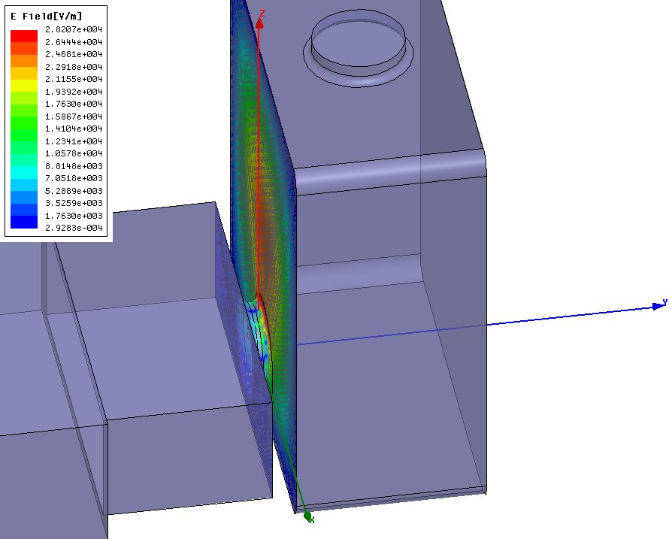
Parallel E and H case
Not present Final design
Drawing Not to scale
A solution exists but with circular apertures. It needs to be calculated with rectangular apertures. The plot shows that the highest peak field is at the radius of the coupling aperture. This is the reason to study the rectangular coupling aperture.
Rectangular aperture final design

Slide 14
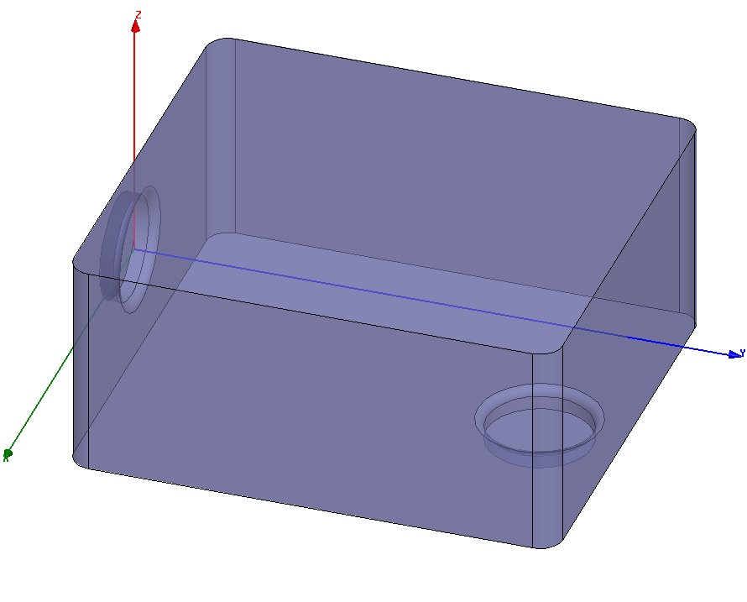
Calculated Parameters of the cavity and cavity dimensions
HFSS normalizes all parameters to 1 W of input power to the waveguide coupler and solves for the frequency, gradient, coupling factor, Qo (in cavity mode) etc.
1W produces a gradient of 25 kV/m by scaling:
25 MV/m would take 1 MW ideal.
The Impedance across the center of the cavity is
Imp =9.5 MΩ.
This is the resistance across the center of the cavity given by
Imp = (gap Voltage)²/1 W.
This uses the peak voltage and is in agreement with SuperFish and most published accelerator designs.
276.50 mm
250 mm
123.82 mm
Final design will have rectangular aperture
Final Design will not have this aperture.

Slide 15
Specifications
The following are some of the specs for the square cavity:
Tolerance of parts = ± 0.005"
Inside finish = 30 µ inches
Average power = 5 kW distributed equally of the inside surface.
If machined out of SS, copper plated with 0.0015 inches
If machined out of Al , plating must be non-magnetic, = 0.0015 inches.
Examine Mig welding, electron beam welding, or brazing.
Plans:
Parts could be machined at FNAL or Mississippi
Before welding and plating, machine a much smaller coupling hole, clamp together to measure Frequency, Q, and coupling factor.
After this step, machine a slightly bigger coupling hole and determine the above.
The last step before welding, etc., and plating is to enlarge the hole one more time and determine if we have the correct coupling hole size. Repeat this if necessary.
Finally weld and copper plate. Repeat the above measurements and enlarge the coupling hole if necessary.
All the materials must be non-magnetic including the welding, brazing, etc.

Slide 16
Summary
A team headed by Joel Misek (AD Mechanical Dept), with Tim Hamerla (senior designer) and Mark Lebrun (Co-Op student from IU) have been working on the design and fabrication of the orthogonal cavity. AD mechanical department has great experience in fabrication, welding, brazing, electron beam welding and electro-plating.
The first round of HFSS designs have been completed. The dimensions have been transferred directly from HFSS to the drafting department.
A list of specifications has been developed from the HFSS modeling and MAFIA.
A preliminary concept for rotating the cavity in place has been developed and other schemes are being explored.

