Slide 1
Current progress in The Muon Collider/Neutrino Factory Frontend
HISHAM KAMAL SAYED
Physics Department
BROOKHAVEN NATIONAL LABORATORY
TGT-AAG Meeting Feb. 014 2013

Slide 2
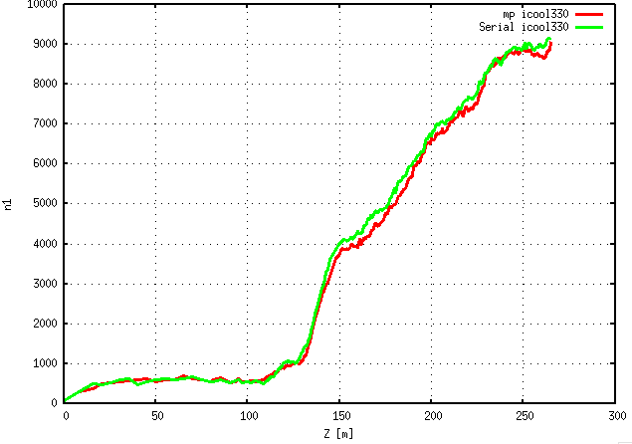
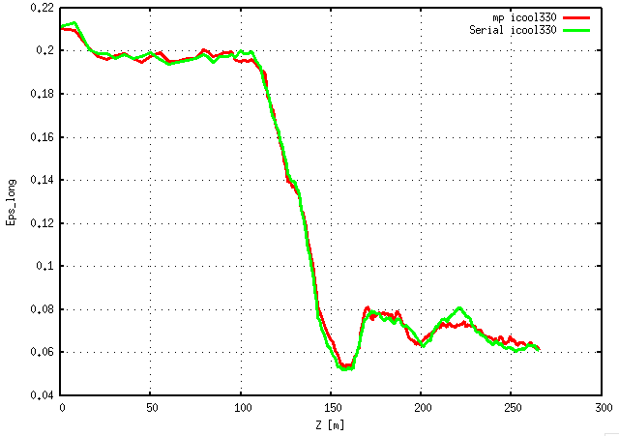
MPI-ICOOL330 on NERSC (R. Ryne)
A new tool was implemented at NERSC ICOOL-MPI by R. Ryne.
Two test runs.
Neutrino Factory Front End Bench Mark
Nmu=45000
Icool330 runtime~ 30 mins - MPI-ICOOL330~ 2 mins with 480 cores

Slide 3
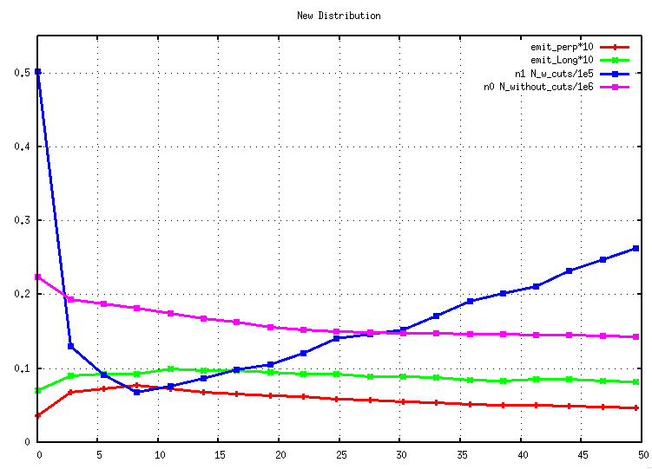
MPI-ICOOL330 on NERSC (R. Ryne)
A new tool was implemented at NERSC ICOOL-MPI by R. Ryne.
Two test runs
Post Merge 6D G cooling Channel (R. Fernow - Diktys version)
Nmu=225000
MPI-ICOOL330~ 2 mins with 480 cores

Slide 4
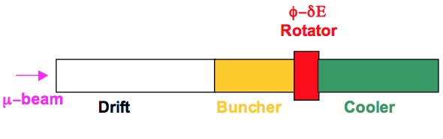
neuffer’s High frequency buncher & phase rotator
D. Neuffer Scheme
Convert a muon bunch with large energy spread into a long string of bunches matched into 200 MHz rf cooling section
MOTIVATION: optimizing upstream capture-decay sections changes phase space distribution getting to buncher-rotator sections.
Ultimately: Global optimization of the Front-End utilizing NERSC & Genetic optimization algorithms (LBL R. Ryne & J. Qiang)
Target – Decay – Buncher – Rotator - Cooling
1. The Drift section: length of the section
2. The Buncher section:
  length of the section
  Bunching voltage
  Voltage increase (parabolic increase in voltage (Vrf = Vrf_{rinal} (z/Lbuncher)²)
  Distance between the reference energy particles.
3. The φ-δE rotation:
The length (optimum rf rotation section length should be adjusted)
rf voltage
The rf frequency is constant and set to the matched value at the end of the buncher
The rf wavelength and phase could be perturbed to optimize performance
Central reference energy could be perturbed for optimization.
4. The cooling system:
The rf wavelength readjusted to match the spacing between the reference particles

Slide 5
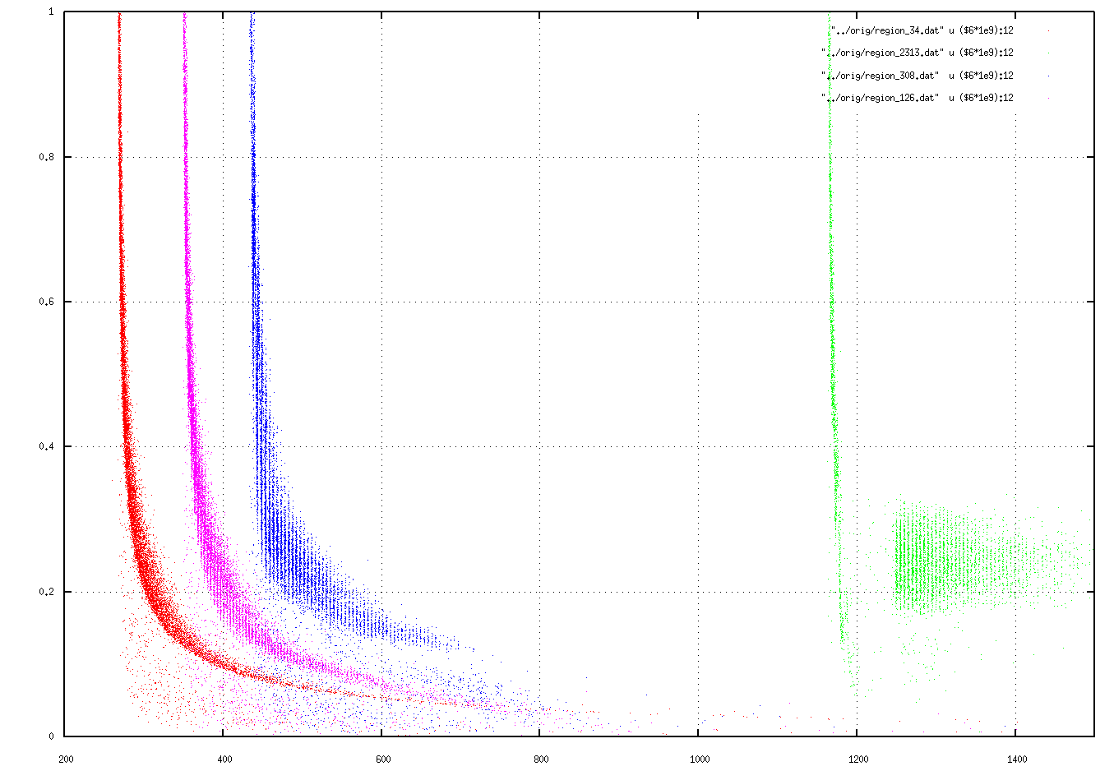
Tweaking neuffer’s High frequency buncher & phase rotator
RF fixed from FE standard Lattice
Drift
Buncher
Rotator
Cooling

Slide 6
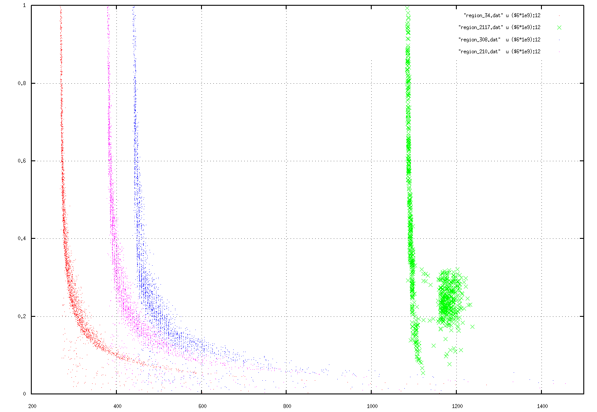
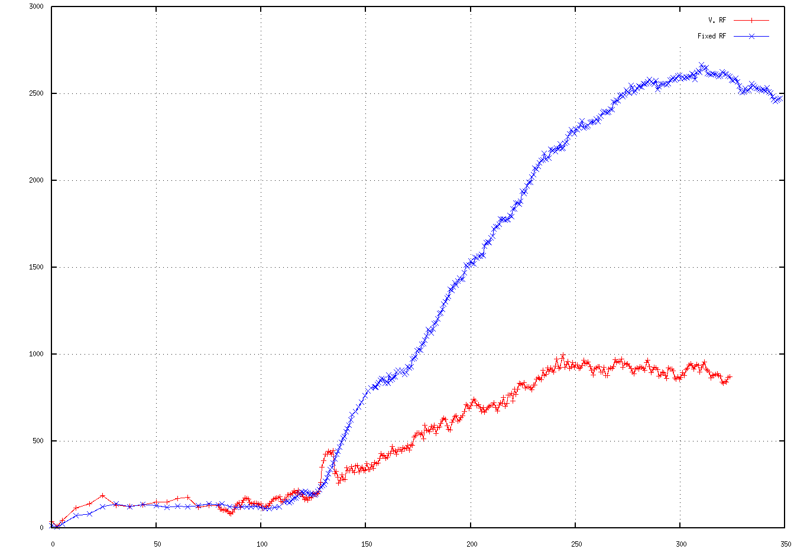
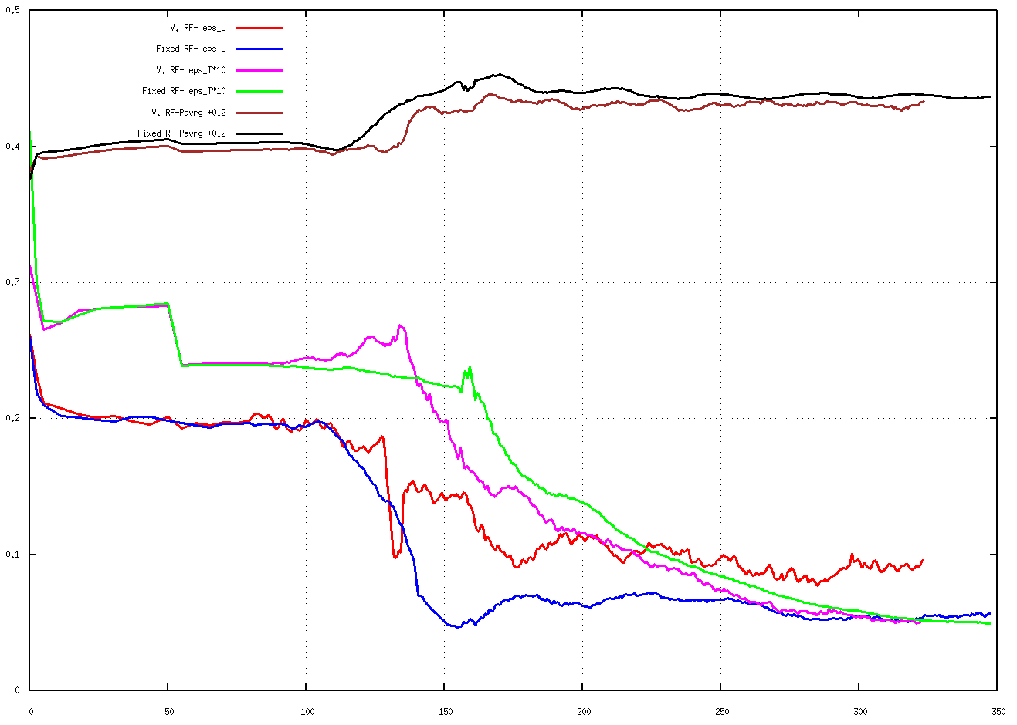
Tweaking neuffer’s High frequency buncher & phase rotator
RF fixed from FE standard Lattice RF Varied by ICOOL from FE standard Lattice
Drift
Buncher
Rotator
Cooling
Drift
Buncher
Rotator
Cooling
RF fixed
P_avg+0.2
Eps_L
RF Varied
Cooling
Eps_T*10

Slide 7
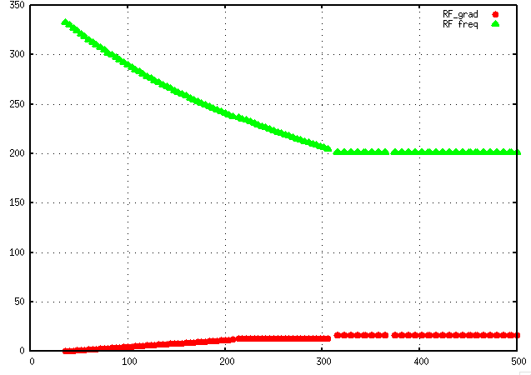
rf Frequency
End of Buncher
End of rotator
FE Section Region # Z [m]
End of decay channel 34 79.6
End of Buncher 210 112.6
End of Phase Rotator 308 130.6
End of Cooling 2117 323.726

Slide 8
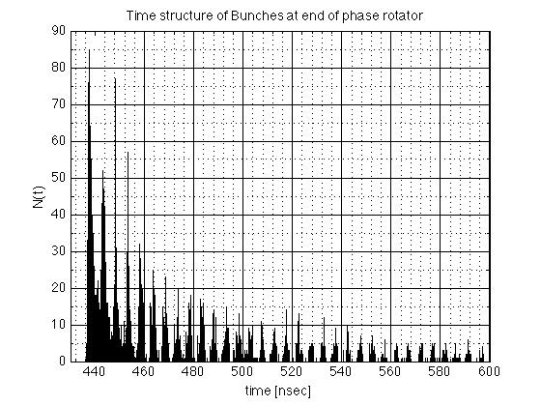
Fourier analysis of bunch structure at end of phase rotator
~ 202 MHz

Slide 9
Conclusion

