Slide 1
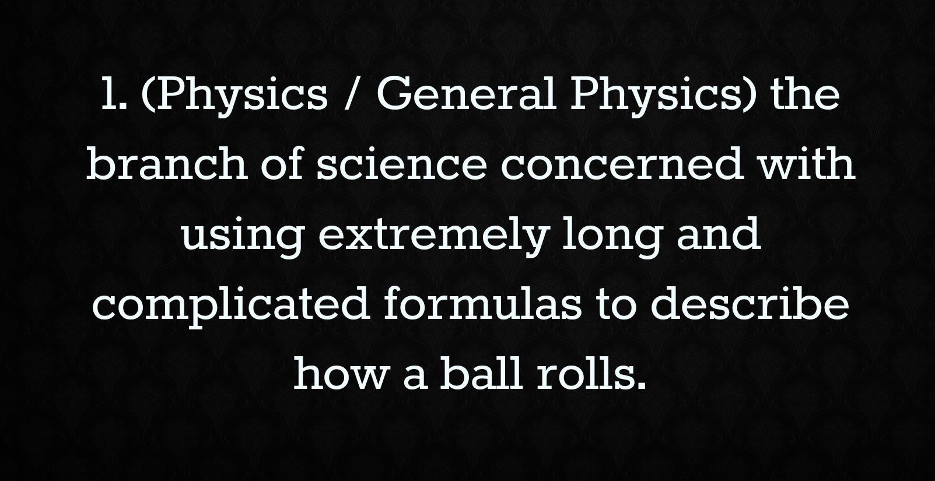
Simulating a 6D post-merging channel with ICOOL-MPI and 6 figure beam distributions
Diktys Stratakis

Slide 2
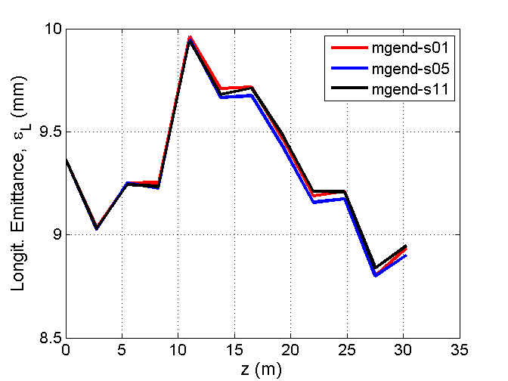
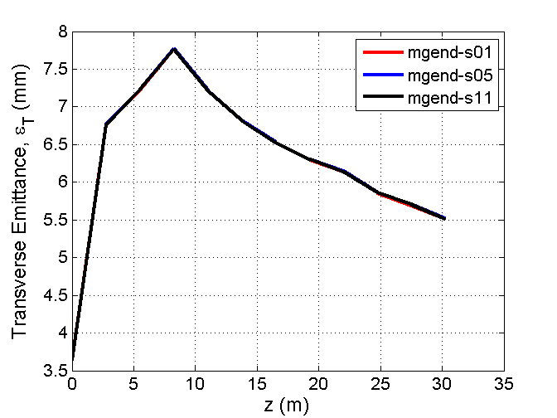
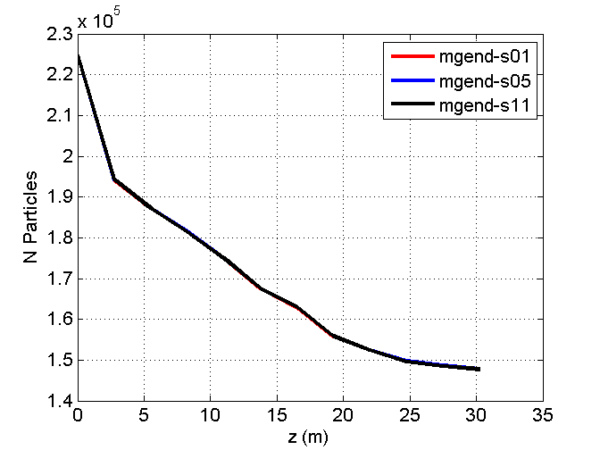
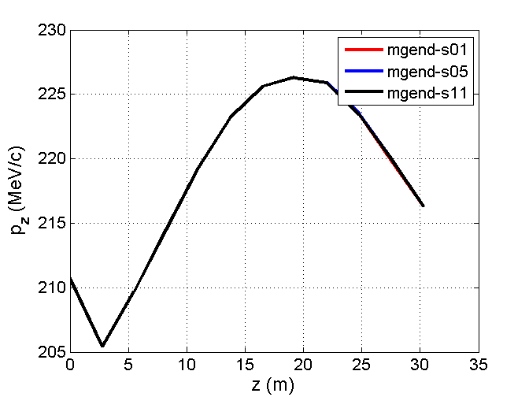
Scott’s Shuffled Distributions

Slide 3
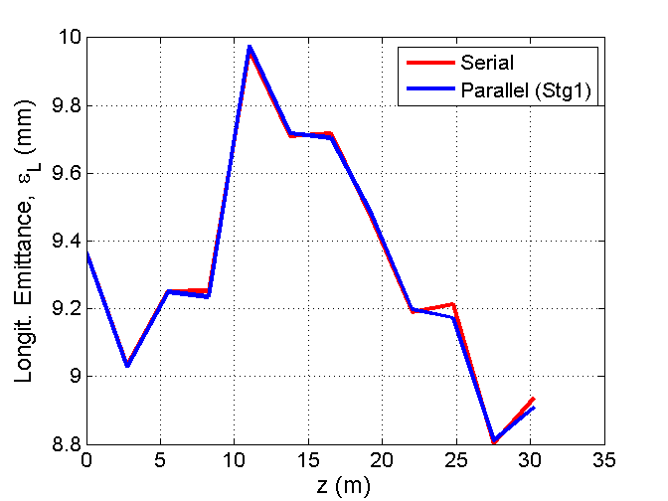
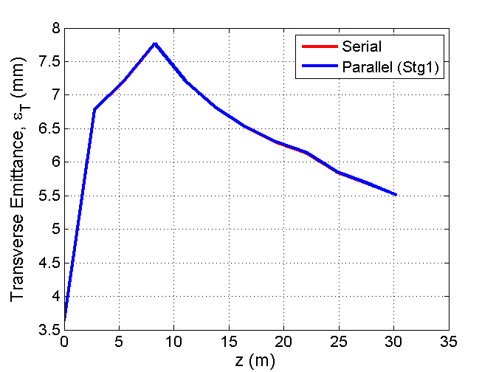
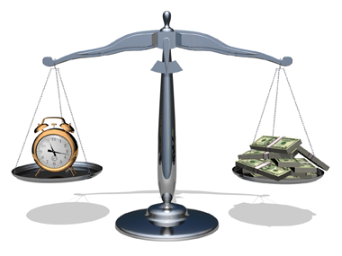
ICOOL-MPI vs. ICOOL Classic
2 minutes (MPI) vs 3 hours (in my fast laptop) vs. 5 hours in my cheap home laptop!

Slide 4
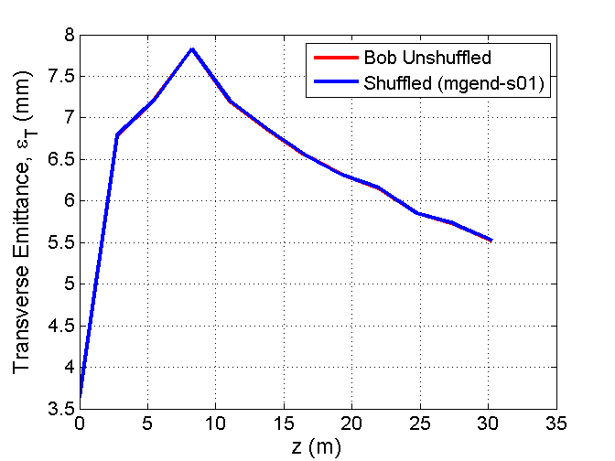
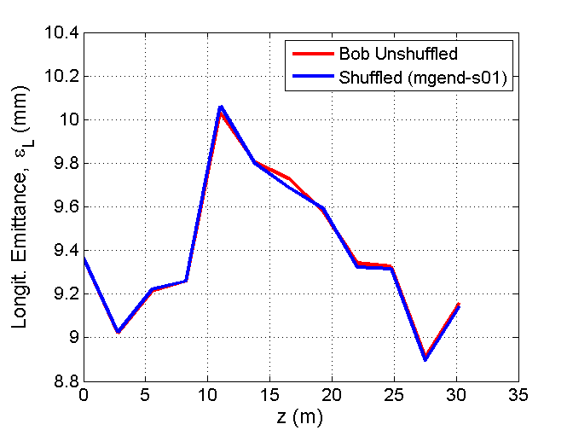
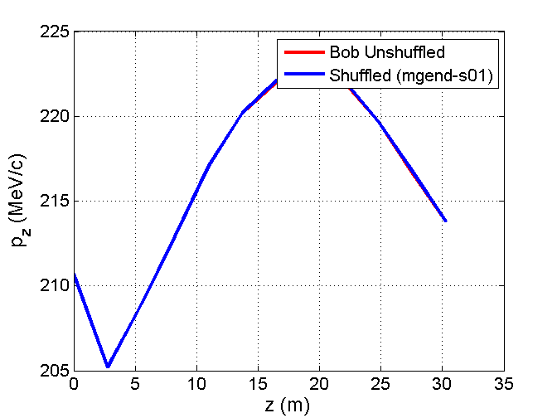
Shuffled and unshuffled

Slide 5
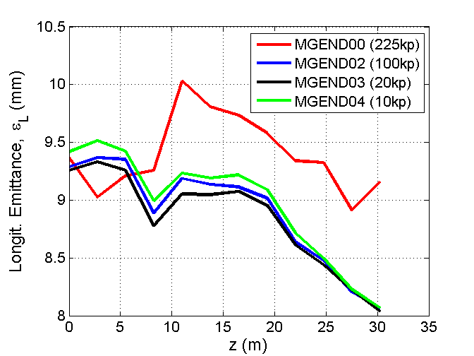
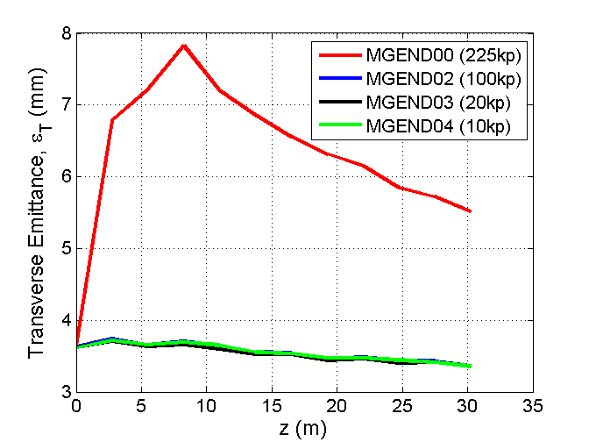
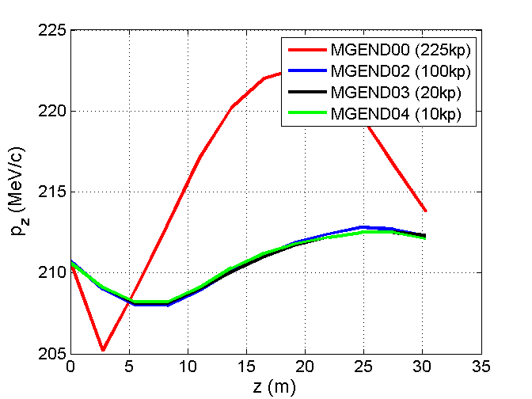
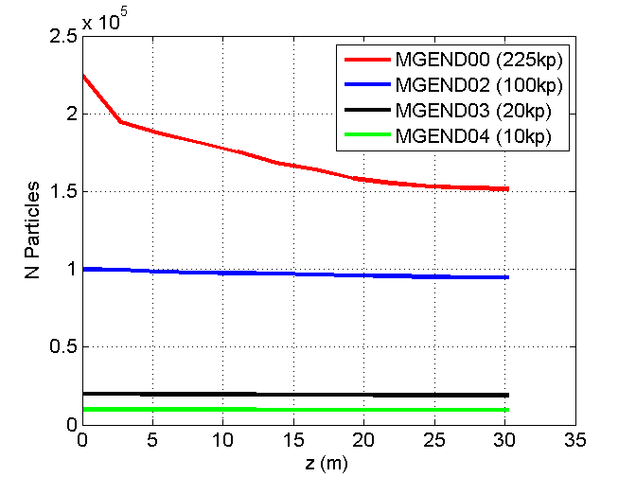
Bob’s Multi-Track Distributions
Shuffled

Slide 6
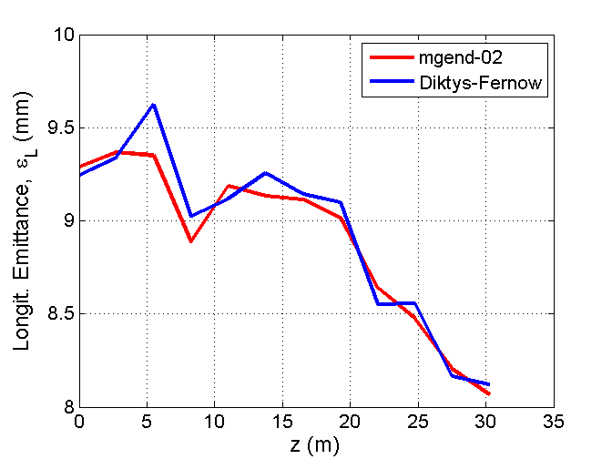
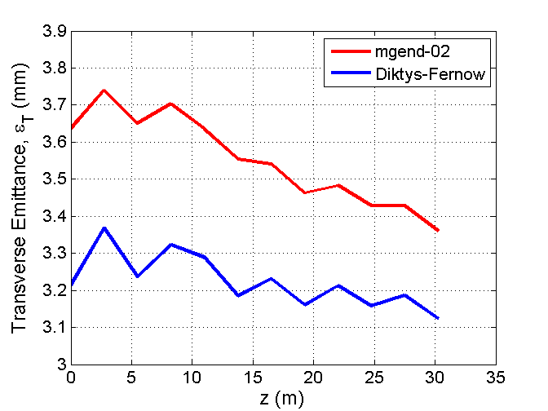
Post-Merging Performance
Requires new optimizations!
Rerun 11 stages of the post-merging Guggenheim

Slide 7
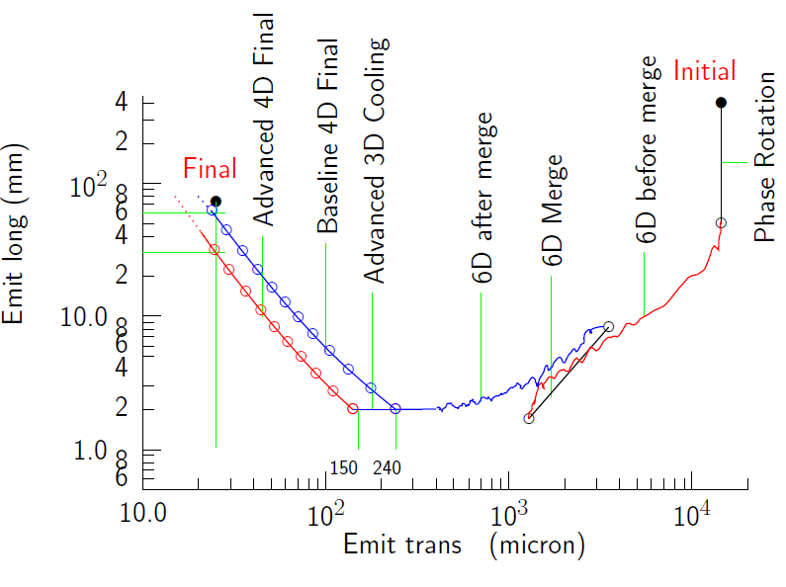
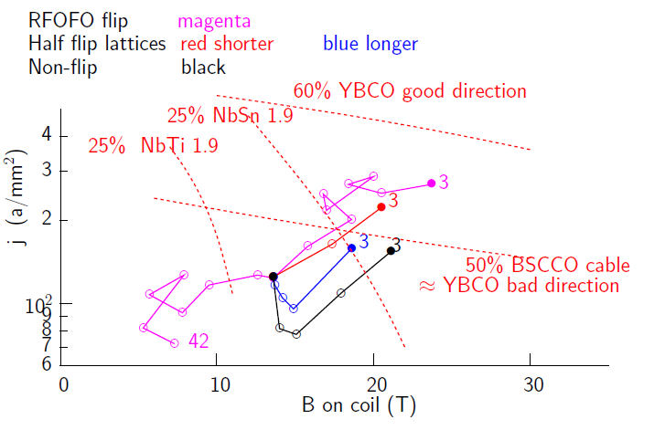
Overview of the 6D Cooling after merging
Two constraints: Do not go below longitudinal ε=2mm & stay within j vs. B plot requirements.
Final beam must have 0.15-0.24 mm and 2 mm trans and long. emittance
Start with a lattice that has the classic flip configuration.
Ask how many stages can we simulate until we exceed the current density threshold? Is it 11 stages?
The what are the best emitances we can get with the classic configuration?
Good news: 6 figure beam distributions and ICOOL parallel!

Slide 8
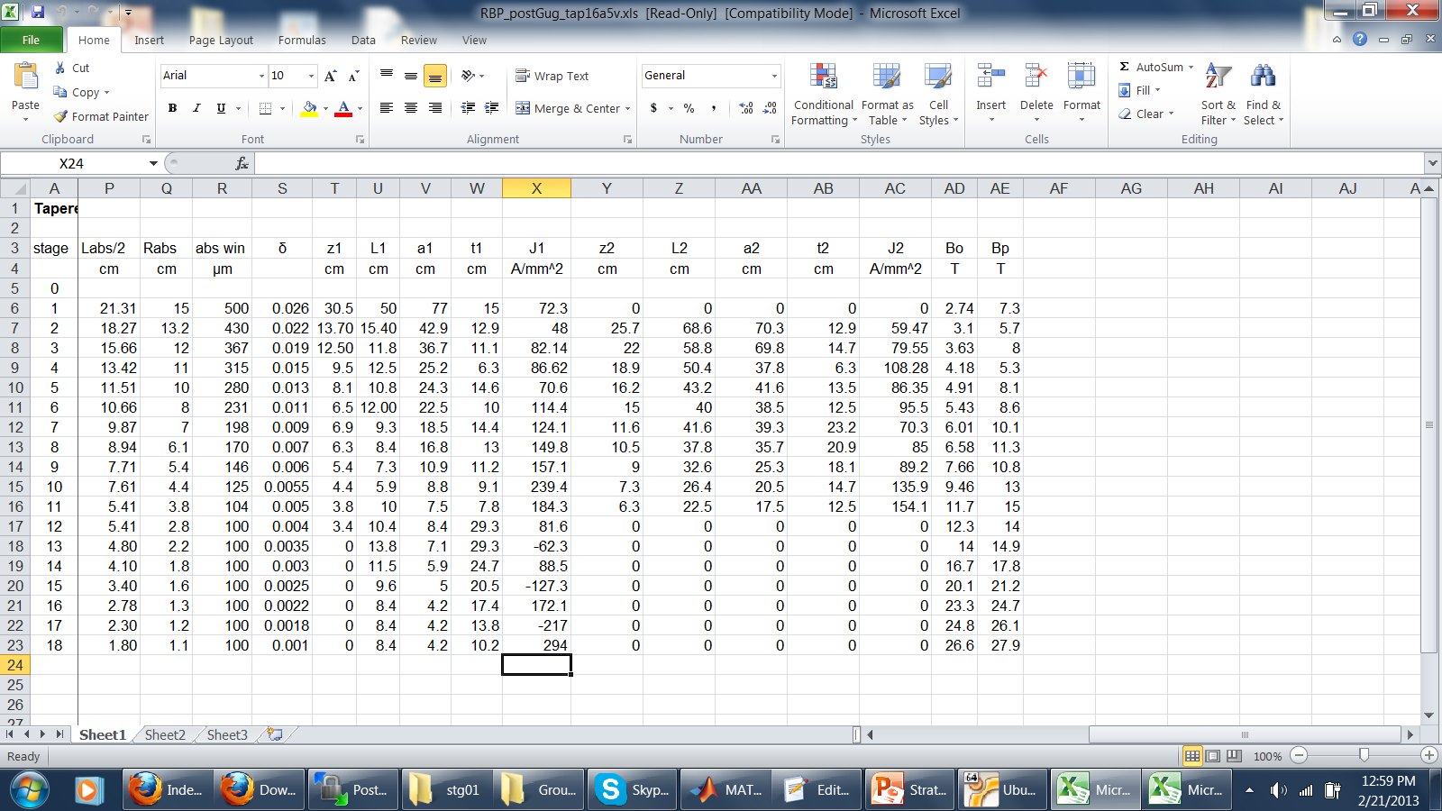
6D Cooling after merging Outlook
Good news:6 figure beam distributions and ICOOL parallel! Any optimizations can be done really fast

Slide 9
