Slide 1
Explo Test and
YBaCuO Jc Fit

Slide 2
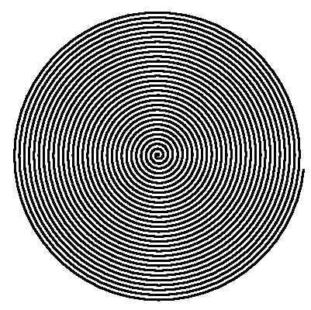
Explo Test
Aim: understand mechanical properties of HTS/Stainless composite
HTS tape co-wound with steel tape
  no epoxy
  unravel?
  friction?
F
F

Slide 3
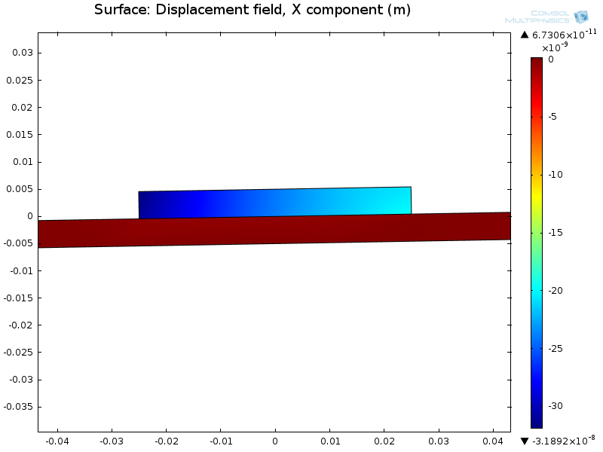
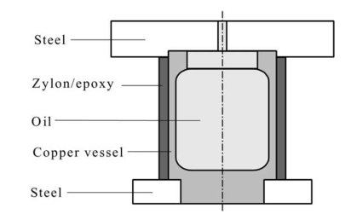
Explo Test
Calculations: little pre-stress should actually suffice
  needs practical verification
Test samples wound
  arrived in Oxford
  prepped for test

Slide 4
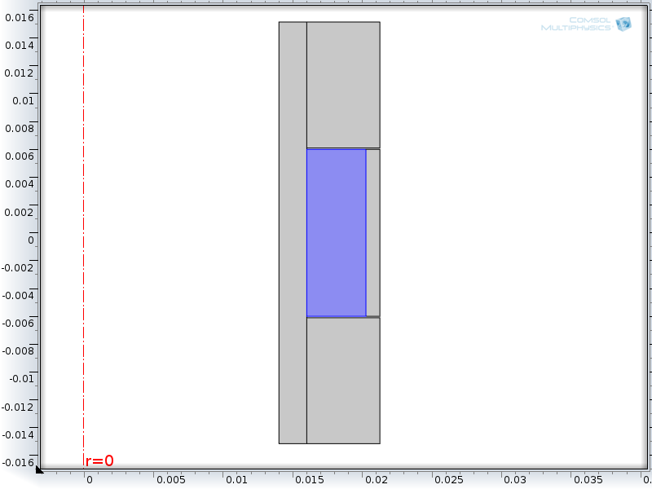
Geometry
Glass
Zylon
HTS
4 mm

Slide 5
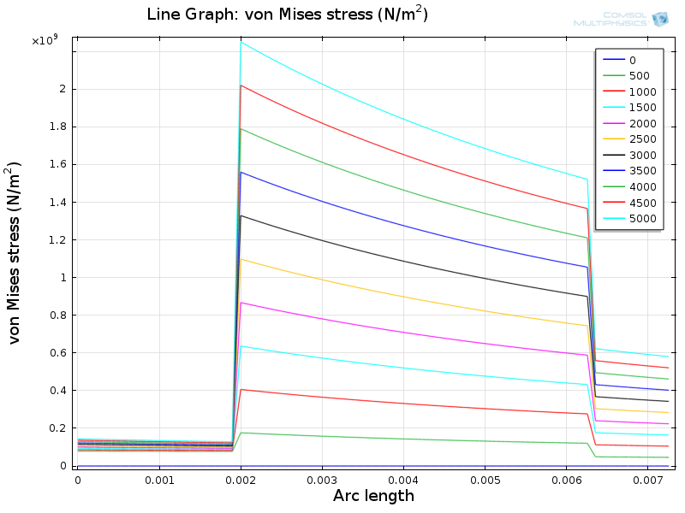
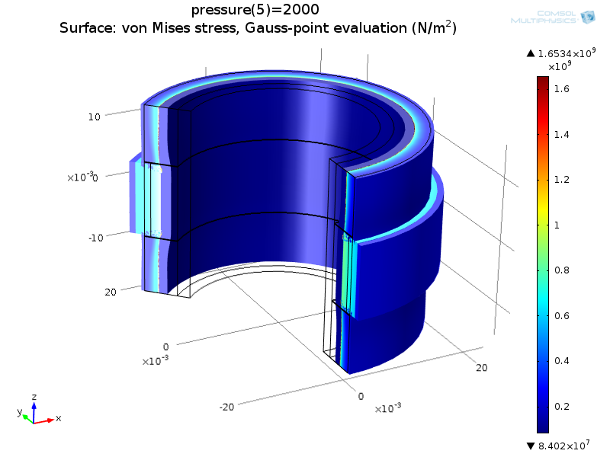
Stress

Slide 6
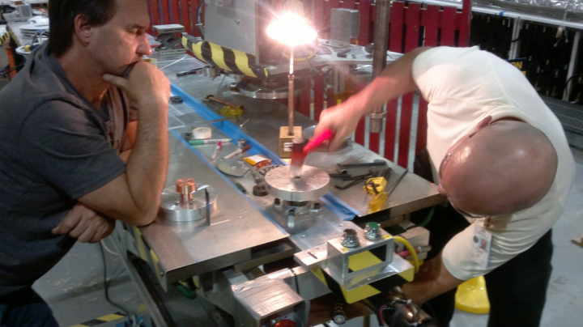
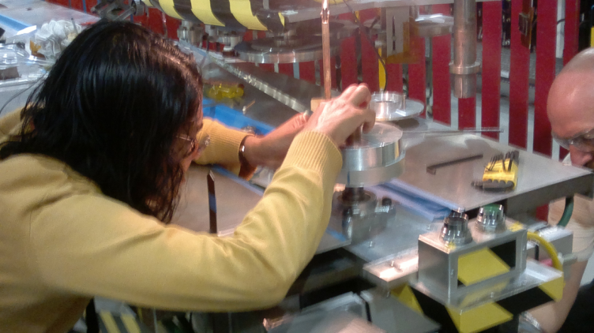
Winding

Slide 7
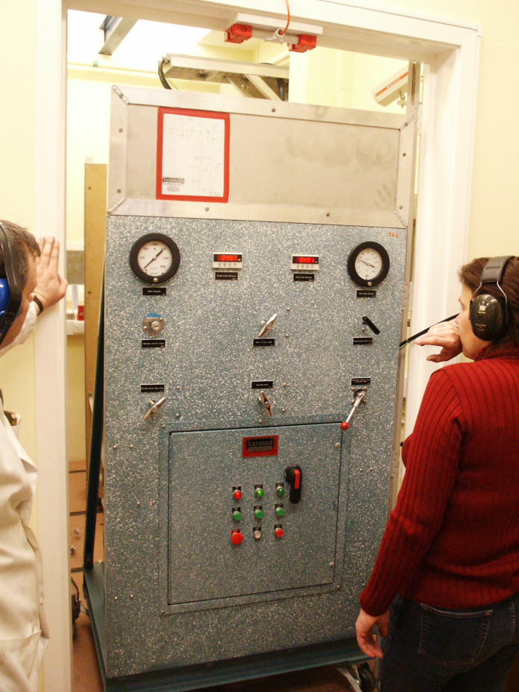
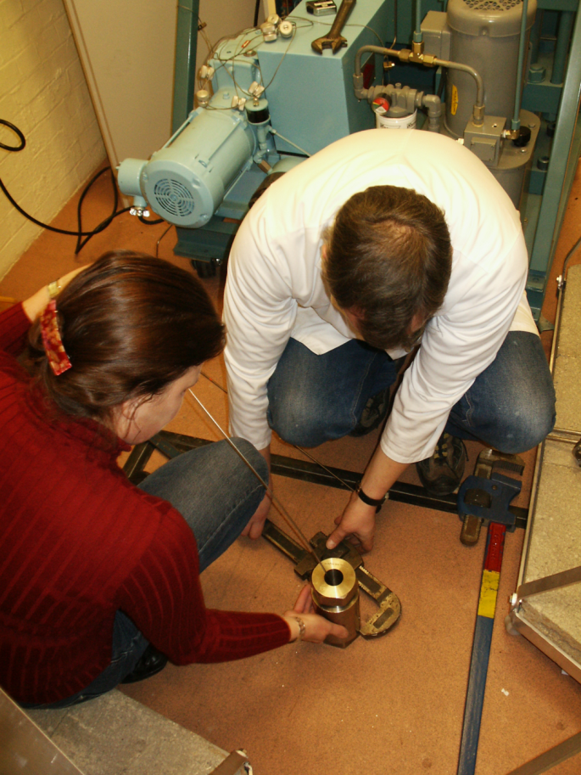
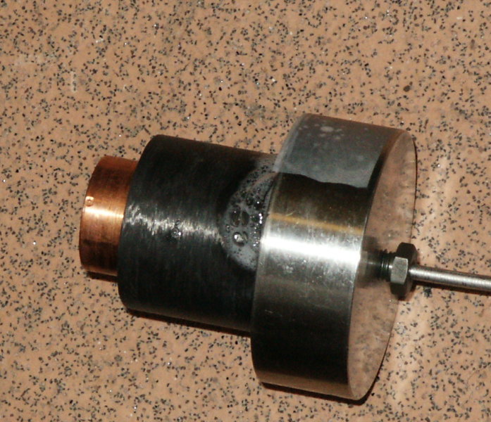
Explo Test
Harwood Engineering high pressure rig
  up to 8 kbar
  He gas
Allows (in principle) to determine orthotropic material properties
  also at 77K
  Y.K Huang: Exploding pressure vessel test on zylon/epoxy composite. http://dx.doi.org/10.1016/S1359-8368(01)00065-8

Slide 8
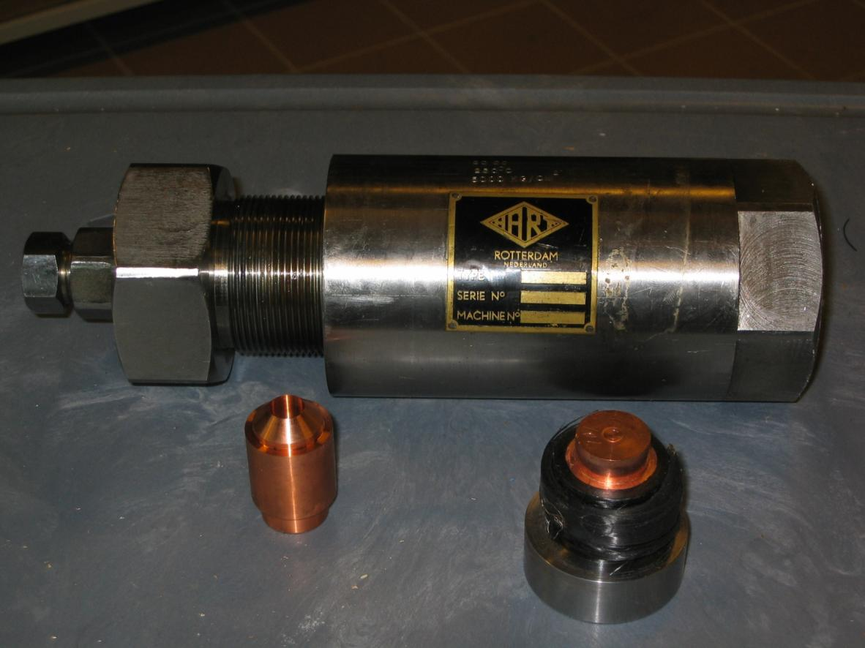
explo vessel

Slide 9
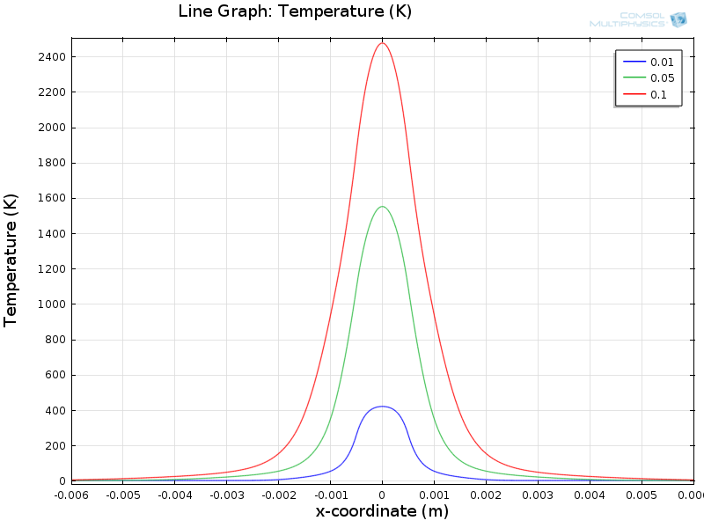
Introduction
HTS Quench
  current in stainless tape
Interesting:
  Propagation
  Temperature
Simulation
  10 cm long stainless tape (100 um thick)
  heating: 1 mm length
  1 s, 500A
I
Quench HTS tape?

Slide 10
Basis
Function for J_{c} of YBaCuO
Drew W Hazelton (SuperPower): Recent Developments in 2G HTS Coil Technology, Applied Superconductivity Conference, August 2010, Washington.
(Vito Lombardo: An I_{c}(B,Θ) parameterization for YBaCuO CC Tapes. FERMILAB-TM-2461-TD. )

Slide 11
General Methodology
Universal relationship between J_{c} and B
  if normalized to J_{c0}(T) and H_{irr}(T)
  for different directions B//c and B//(a,b)
Angular dependence
  added later on with separate expression

Slide 12
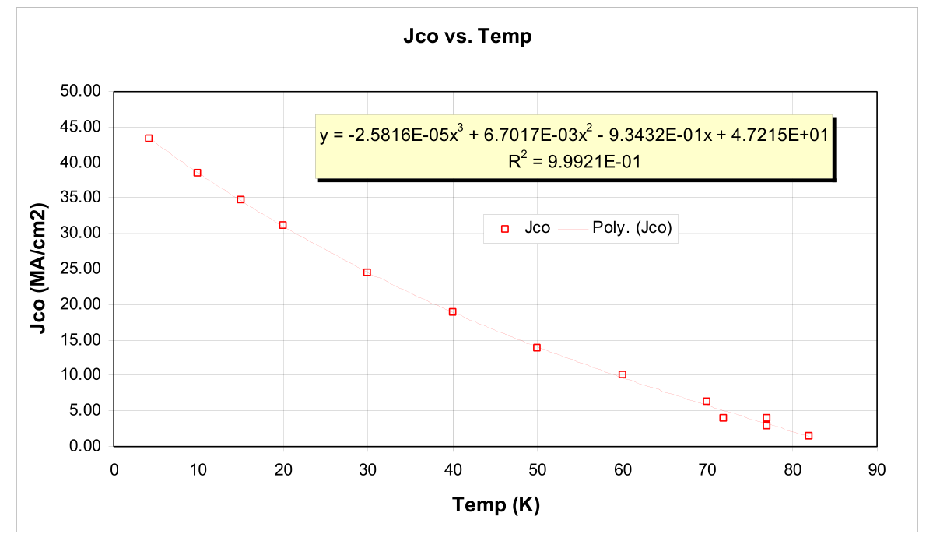
J_{c0}(T)

Slide 13
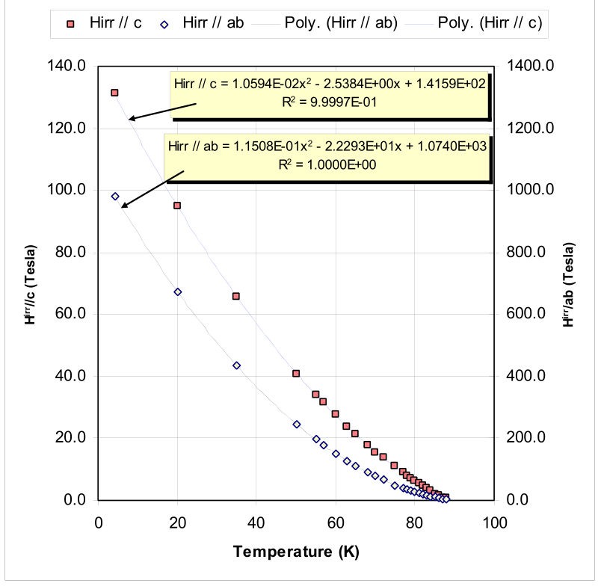
Normal State Phase Diagram
H_{irr} = 120 / 900 T

Slide 14
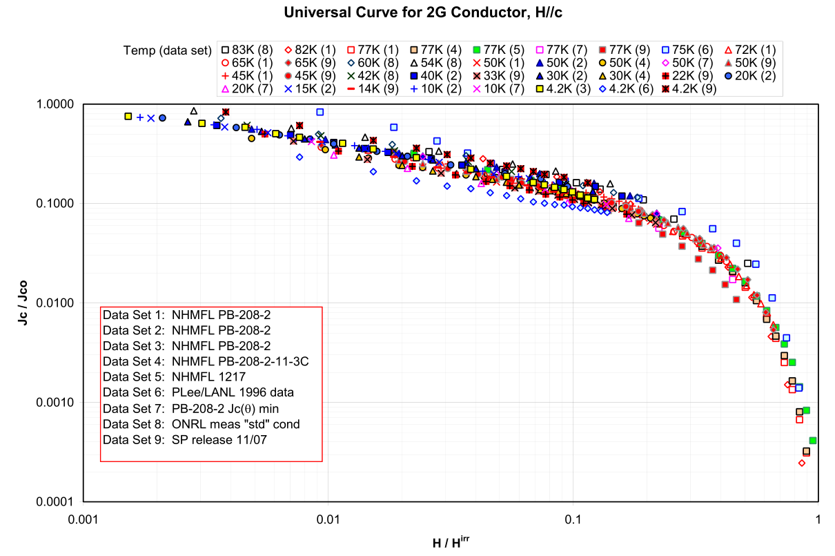
Universal H//c Curve

Slide 15
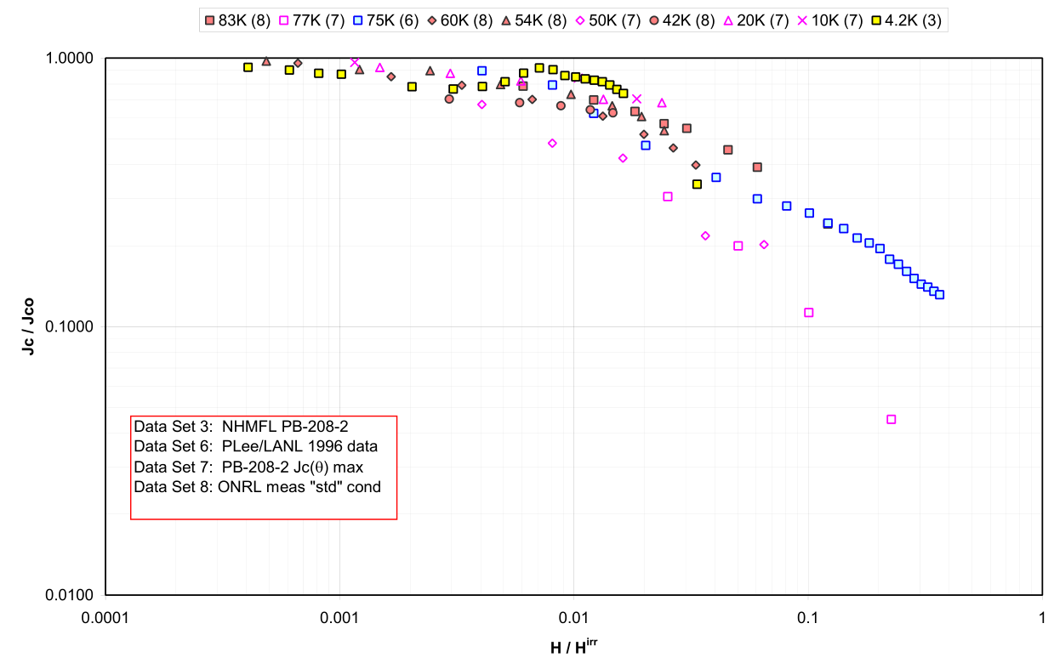
Universal H//(a,b) Curve

Slide 16
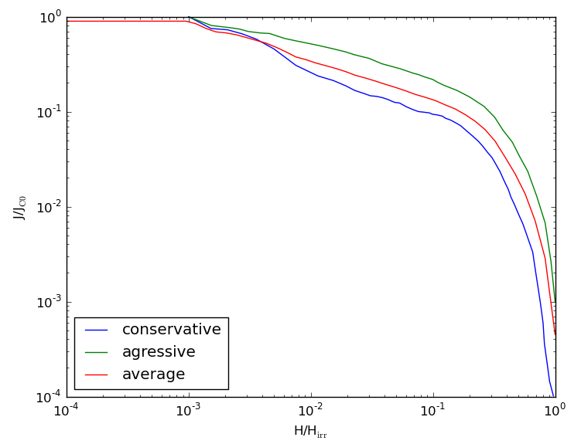
B // c Fit

Slide 17
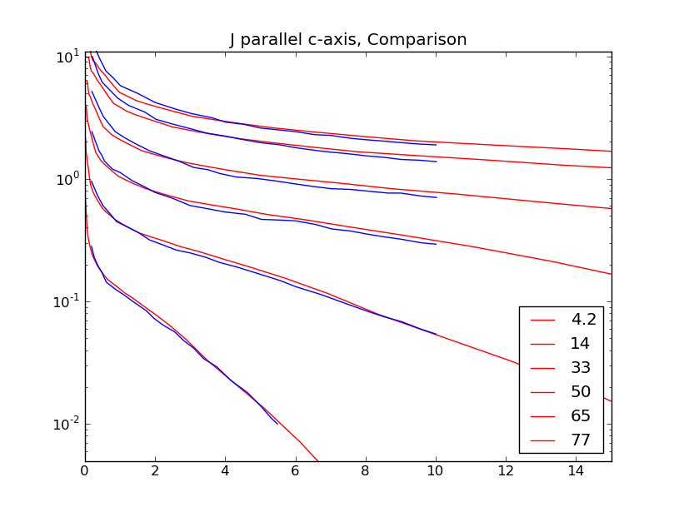
Average Curve, Comparison
Jc/Jc(77K, 0T)
B (T)

Slide 18
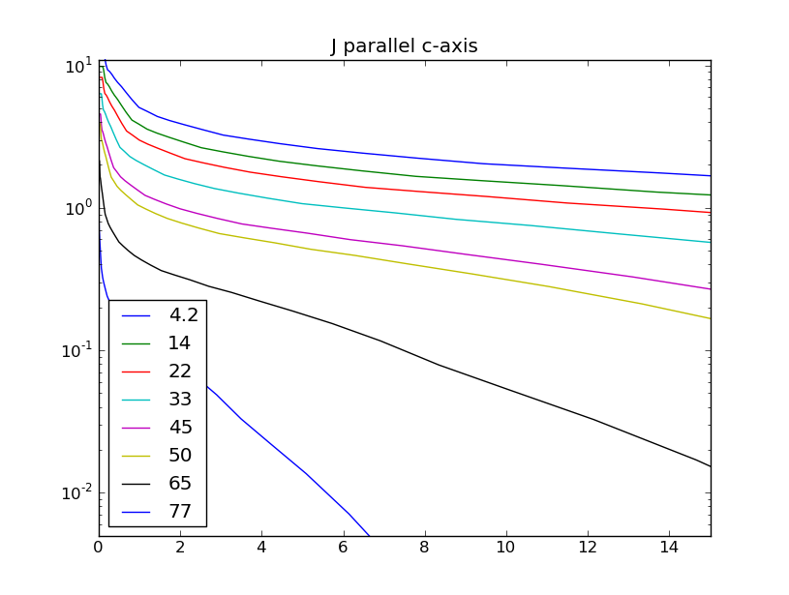
J // c Axis
Jc/Jc(77K, 0T)
B (T)

Slide 19
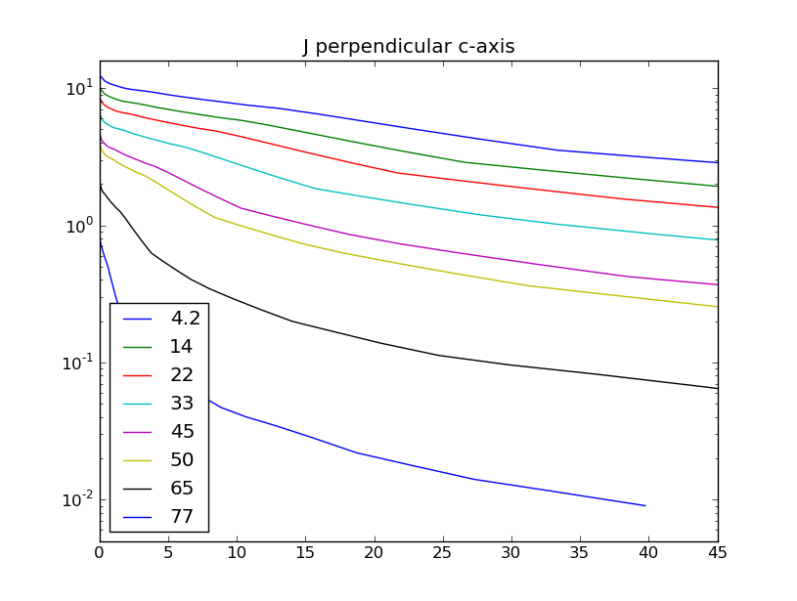
J // (a,b) Axis
Jc/Jc(77K, 0T)
B (T)

Slide 20
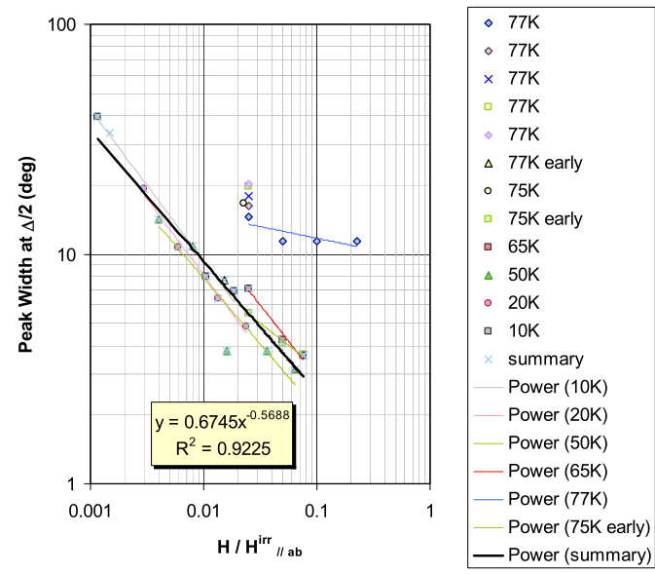
Angular Dependence

Slide 21
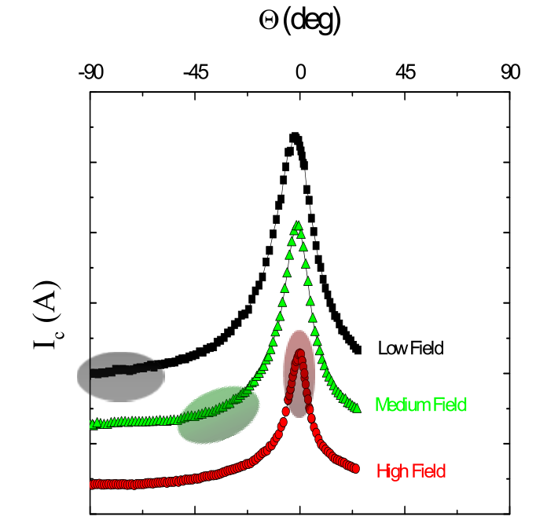
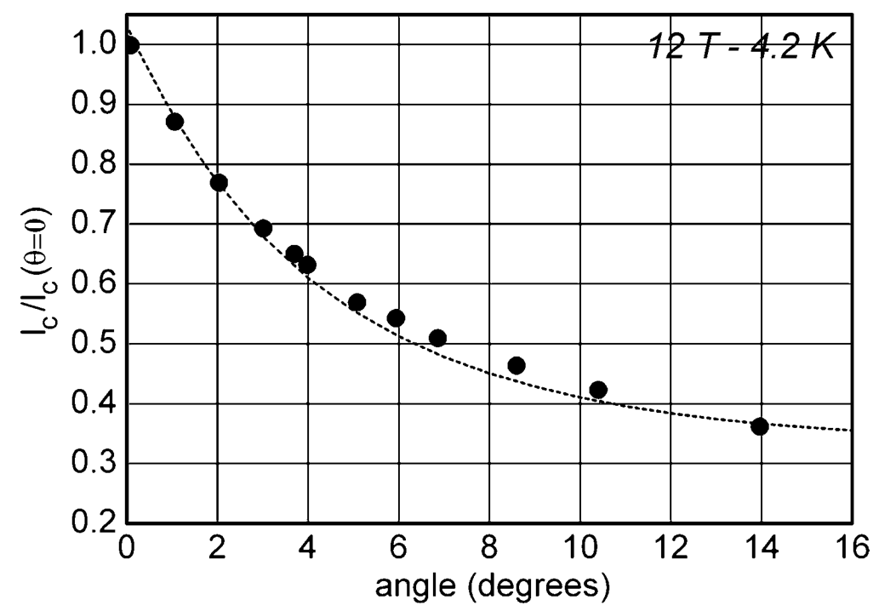
Angular Dependence
Presently implemented as linear function

Slide 22
Summary
Explo test: ongoing
Function for J_{c} of YBaCuO
Implemented as MEX/C code
  C part can be extracted
Also: T_{c} function
  uses iterative method to determine T_{c}

