Slide 1
Dipole for Fast Ramping Synchrotron
Test Magnet

Slide 2
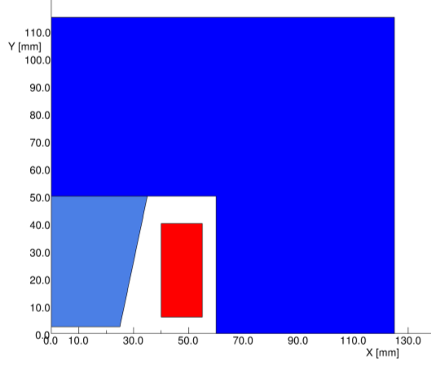
Geometry
Half size model
Dimensions
  width 250 mm
  height 230 mm
  depth 50 mm
Weight:
about 20 kg
Gap: 5 mm x 50 mm
  Good field region: about 32 mm

Slide 3
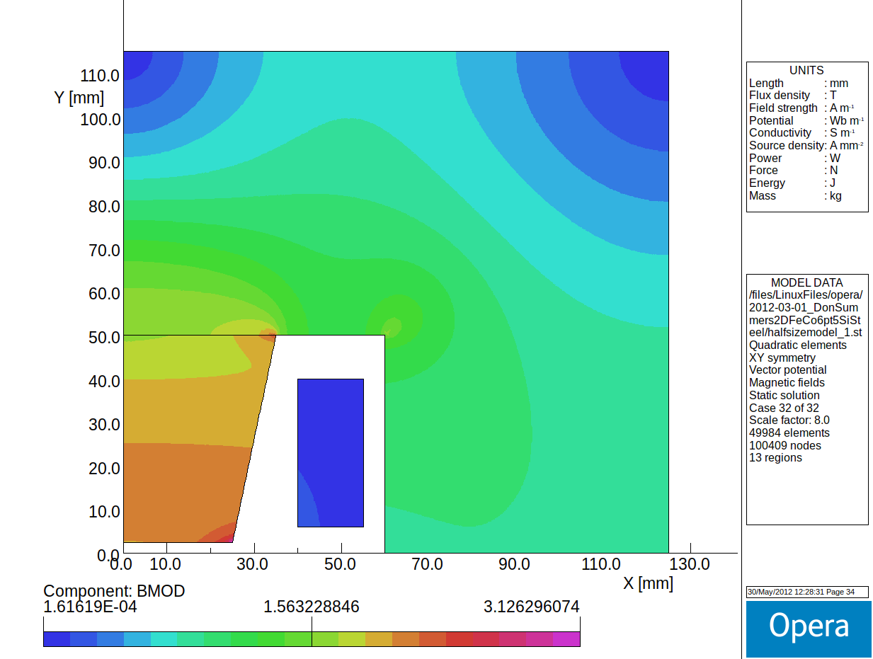
Magnetization
1.3T
1.1T
2T

Slide 4
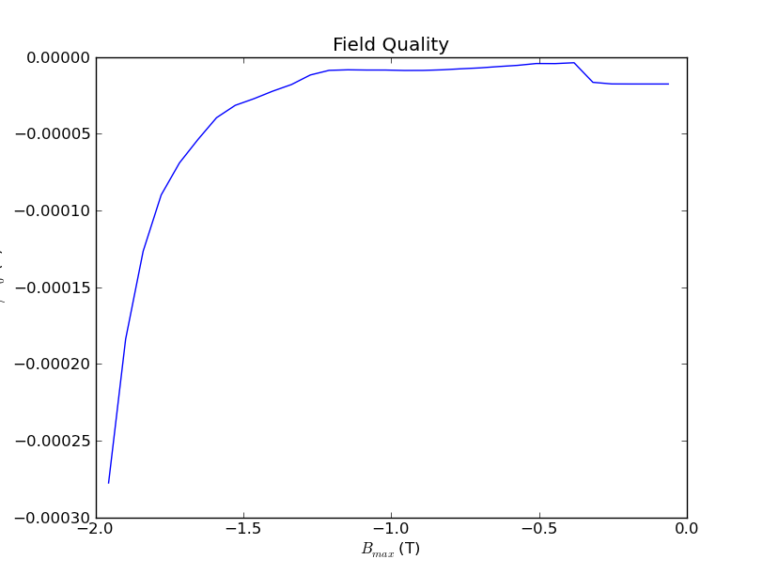
Field Quality
ΔB/B

Slide 5
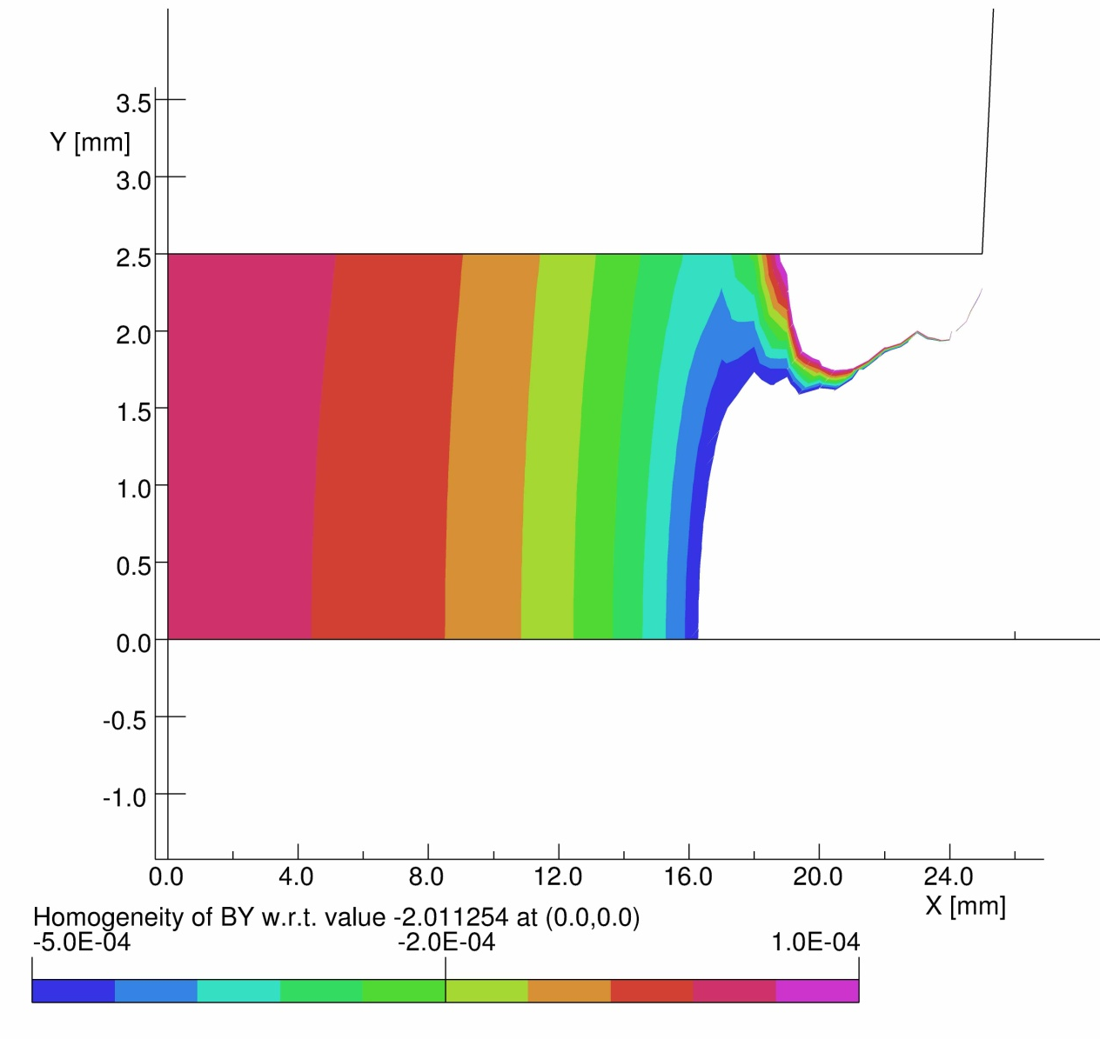
Field Quality Gap

Slide 6
Power Supply
Total current: 4080A for half magnet
  current density for 2T: 8 A/mm²
Magnetic energy: 25J
  PS (f=1kHz):
  100 turns: I=80A, L=7.8 mH, U_{peak}=4kV
  50 turns: I=160A, L=2 mH, U_{peak}=2kV
  Capacitor (f=1kHz):
    100 turns: 3 uF
    50 turns: 12.6 uF

Slide 7
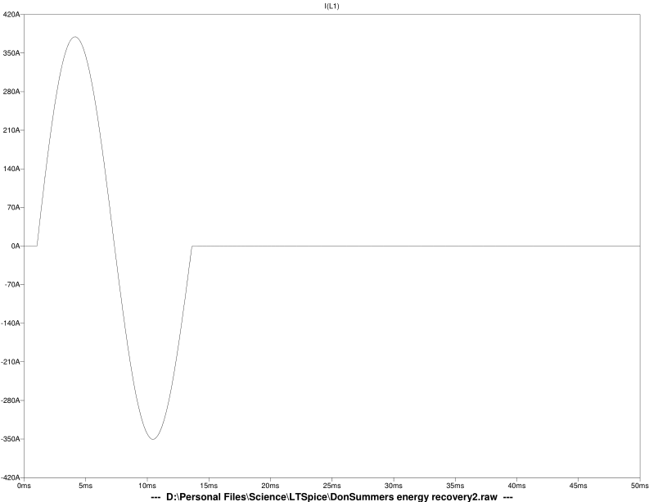
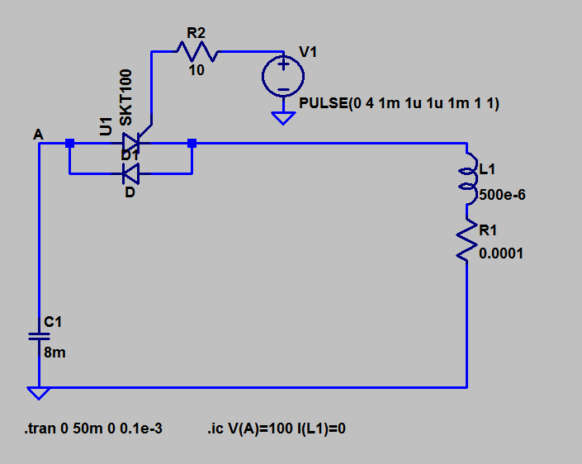
Circuit

Slide 8
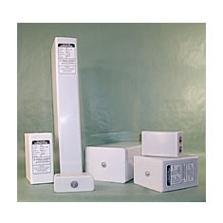
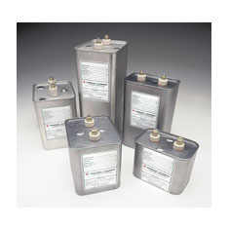
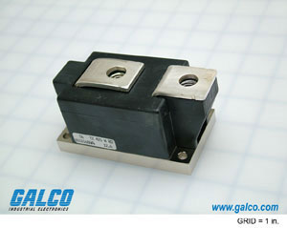
Components
Capacitor: GA
  DE: 2 uF, 5kV, 25 kA
    58 x 150 x 77 (mm), 1kg
  DM: 330DM525
    25 uF, 3kV, 1.2 kA
    2.86 x 4.56 x 4.00 (in)
Switch: thyristor
  Eupec TZ240N
  3.6kV, I_{DC}=240A+
  I_{surge}=6kA
  Cost: $250
  control electronics?

Slide 9
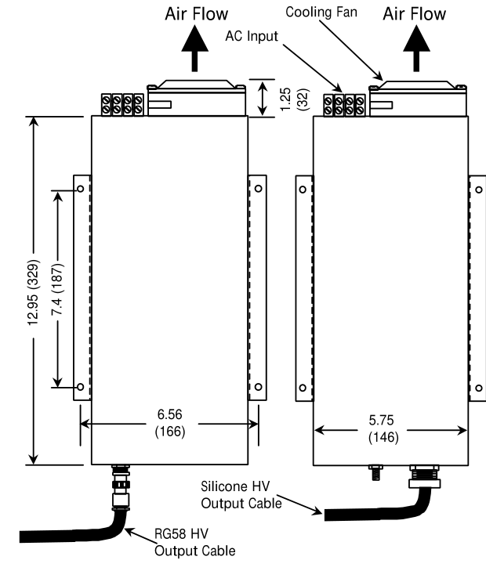
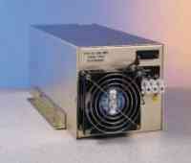
Charger
Dimensions
  330x166x141 (mm)
Charge rate: 500 J/s
Does not tolerate voltage reversal
  switches to detach charger?
  permanent charging via resistor?

Slide 10
Missing components
Firing circuit
  Dynex
Diode
Resistors (dumping energy)
Switches
  Ross relay?
Control system
Diagnostics

