Slide 1
Dipole for
Fast Ramping Synchrotron

Slide 2
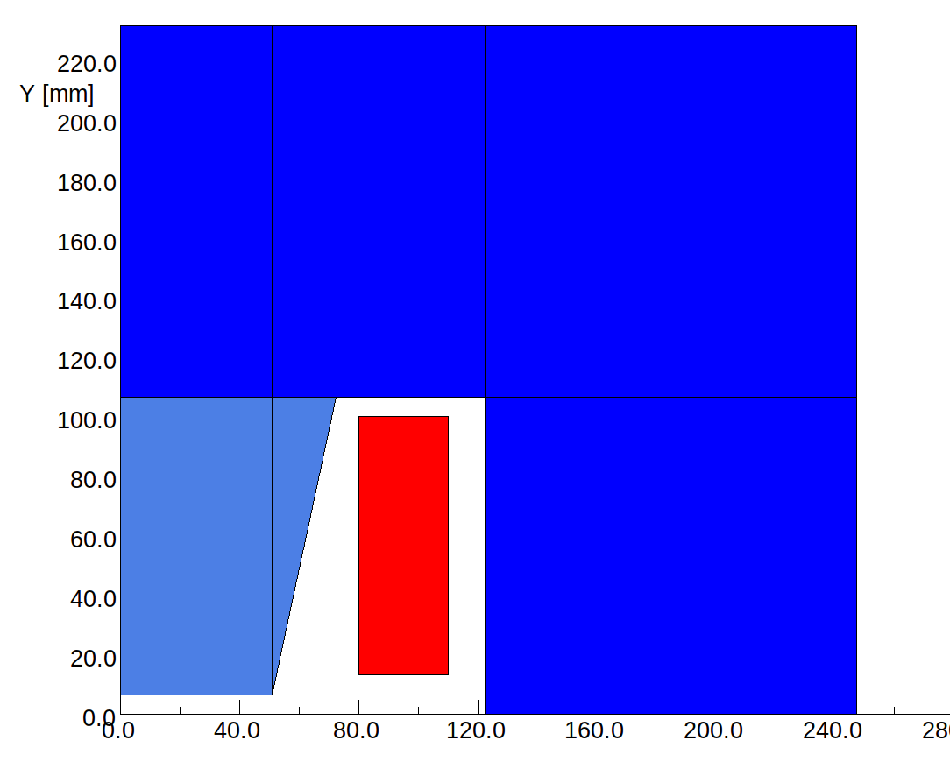
Geometry
Required good field region: 62x10 mm²
Magnet aperture:
100x13 mm²
Magnet dimension:
> 500x500 mm²
6.5%SiFe
FeCo

Slide 3
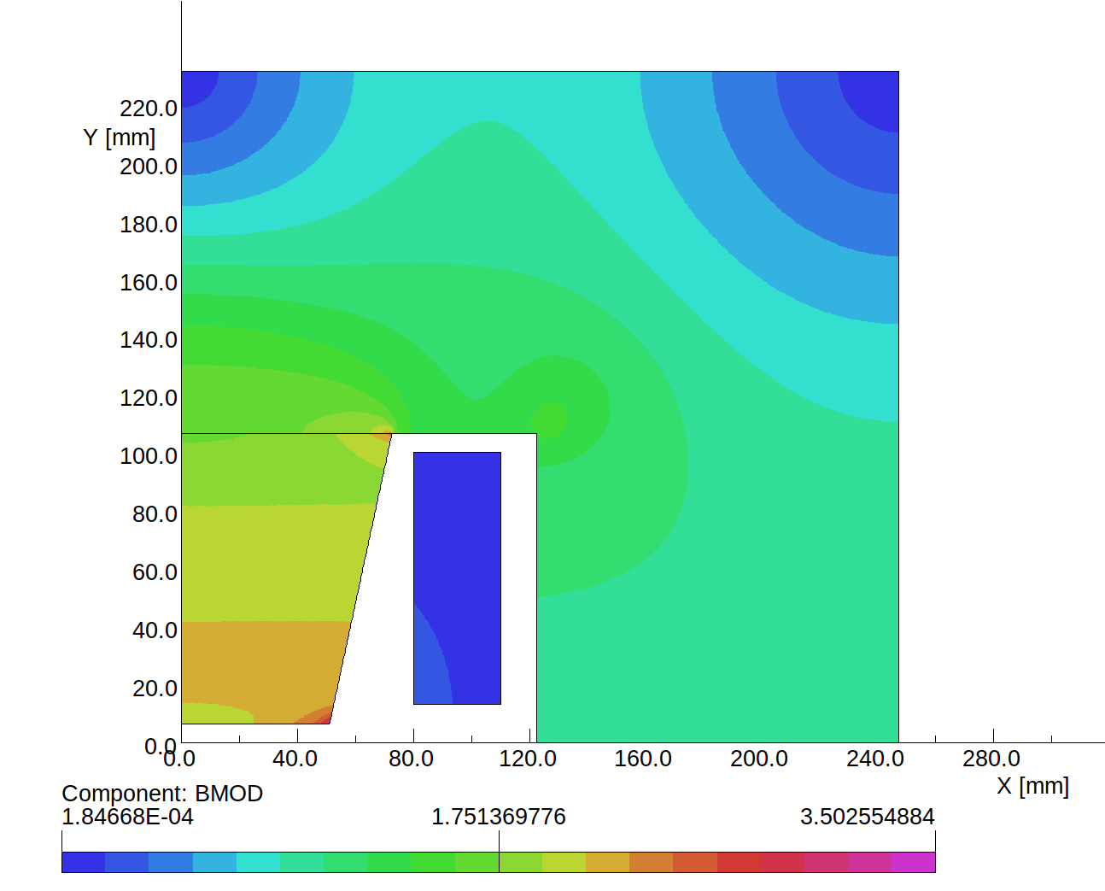
Magnetization
1 T
2 T

Slide 4
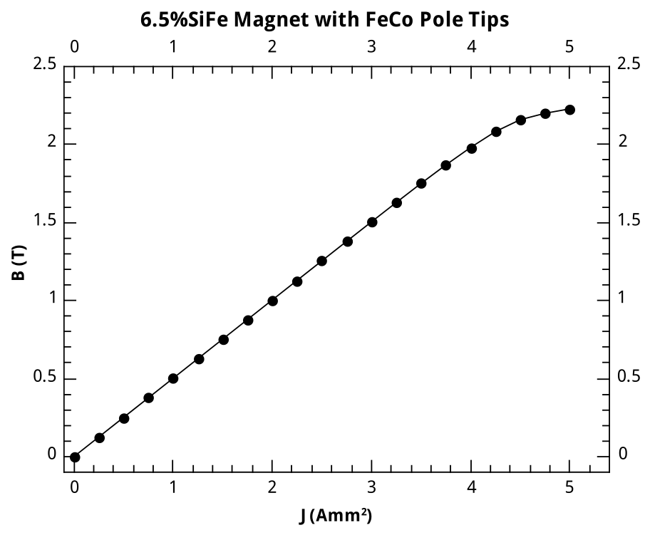
Maximum Field
2T?

Slide 5
Epstein Frame Test
FeCo
  enough material purchased for 9 test strips (24 planned)
6.5SiFe
  100 strips shipped (thanks to Mr. Ninomiya at JFE)
Epstein frame test at Fermilab
  thanks to Robert W Riley and John Zweibohmer

Slide 6
6.5 Si Steel
Measurements
  C-direction
  L-direction
  L/C direction

Slide 7
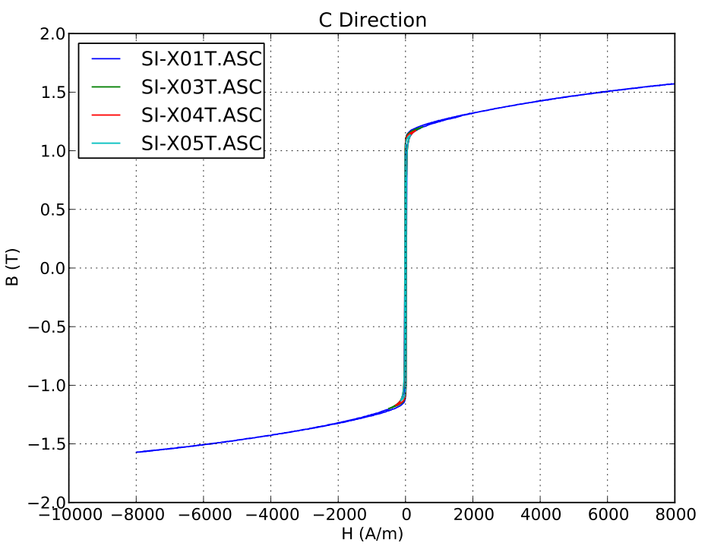
Results 6.5% Si Steel

Slide 8
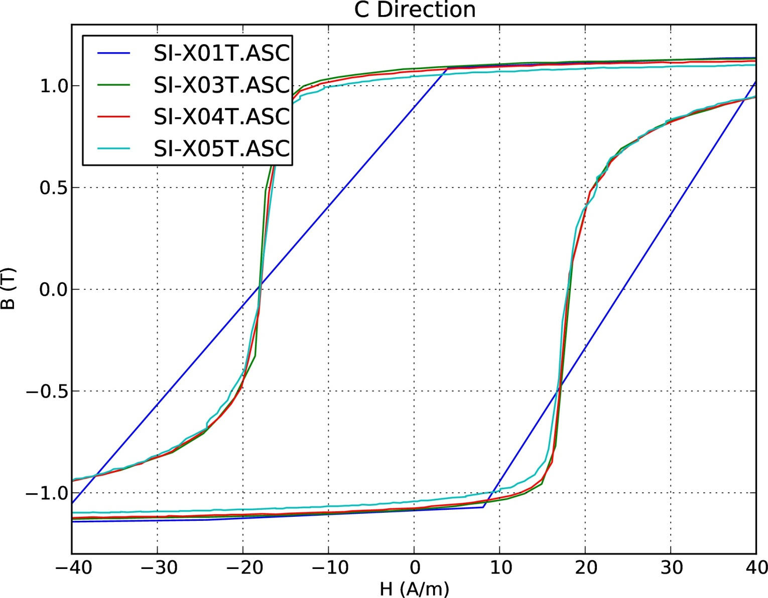
Results 6.5% Si Steel

Slide 9
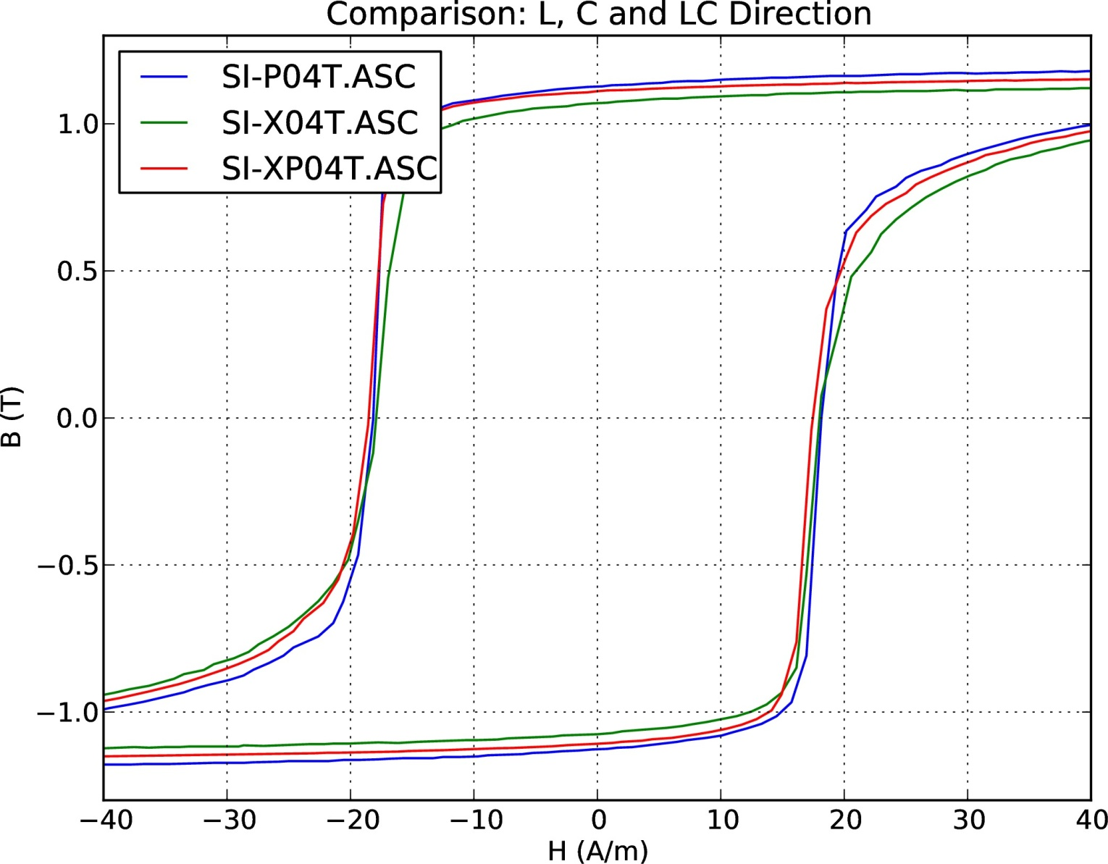
Results 6.5% Si Steel

Slide 10
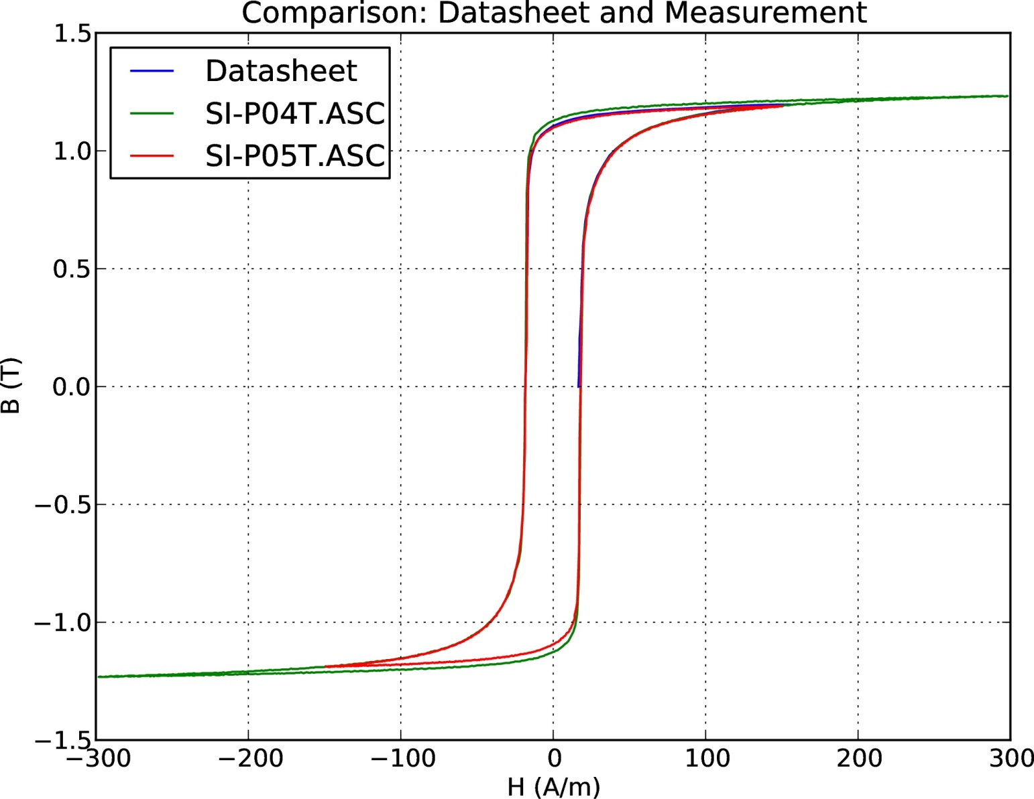
Results 6.5% Si Steel

Slide 11
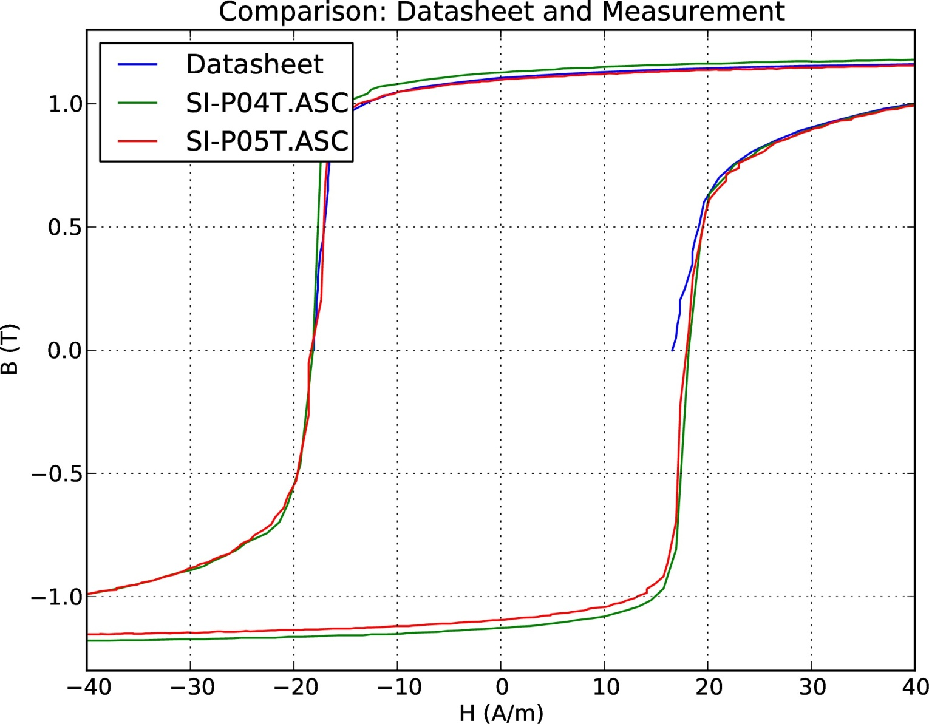
Results 6.5% Si Steel

Slide 12
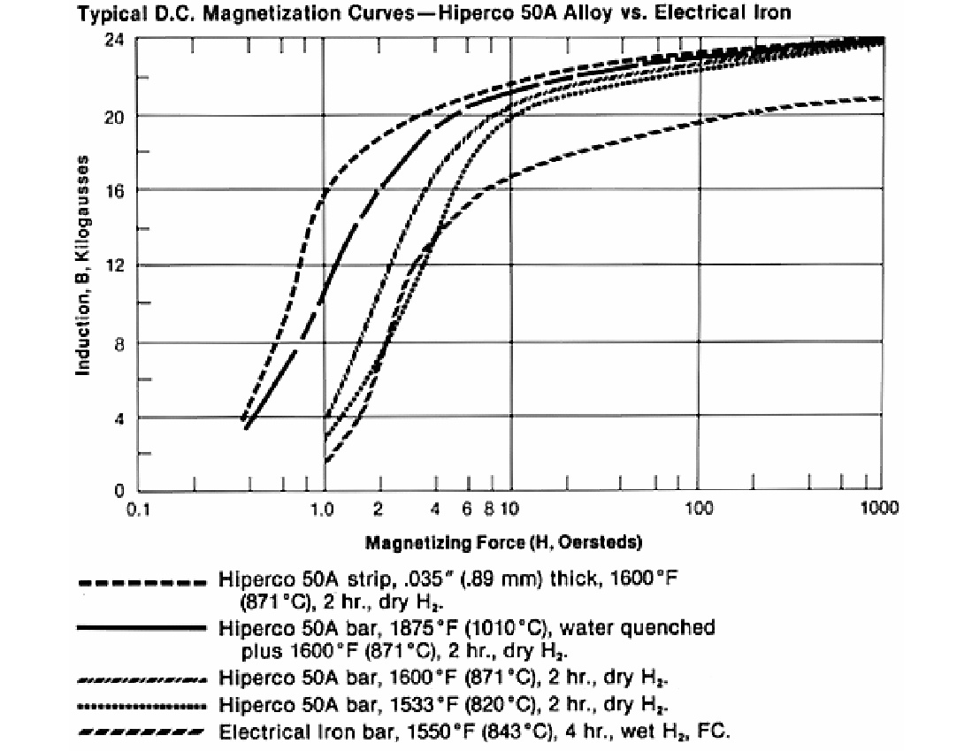
FeCo - Hiperco
Purchased from Ed Fagan
  Hiperco 50 (A)
Cut to size on site
Annealed at IFW in Dresden, Germany
  871 deg C, 2h in vacuum

Slide 13
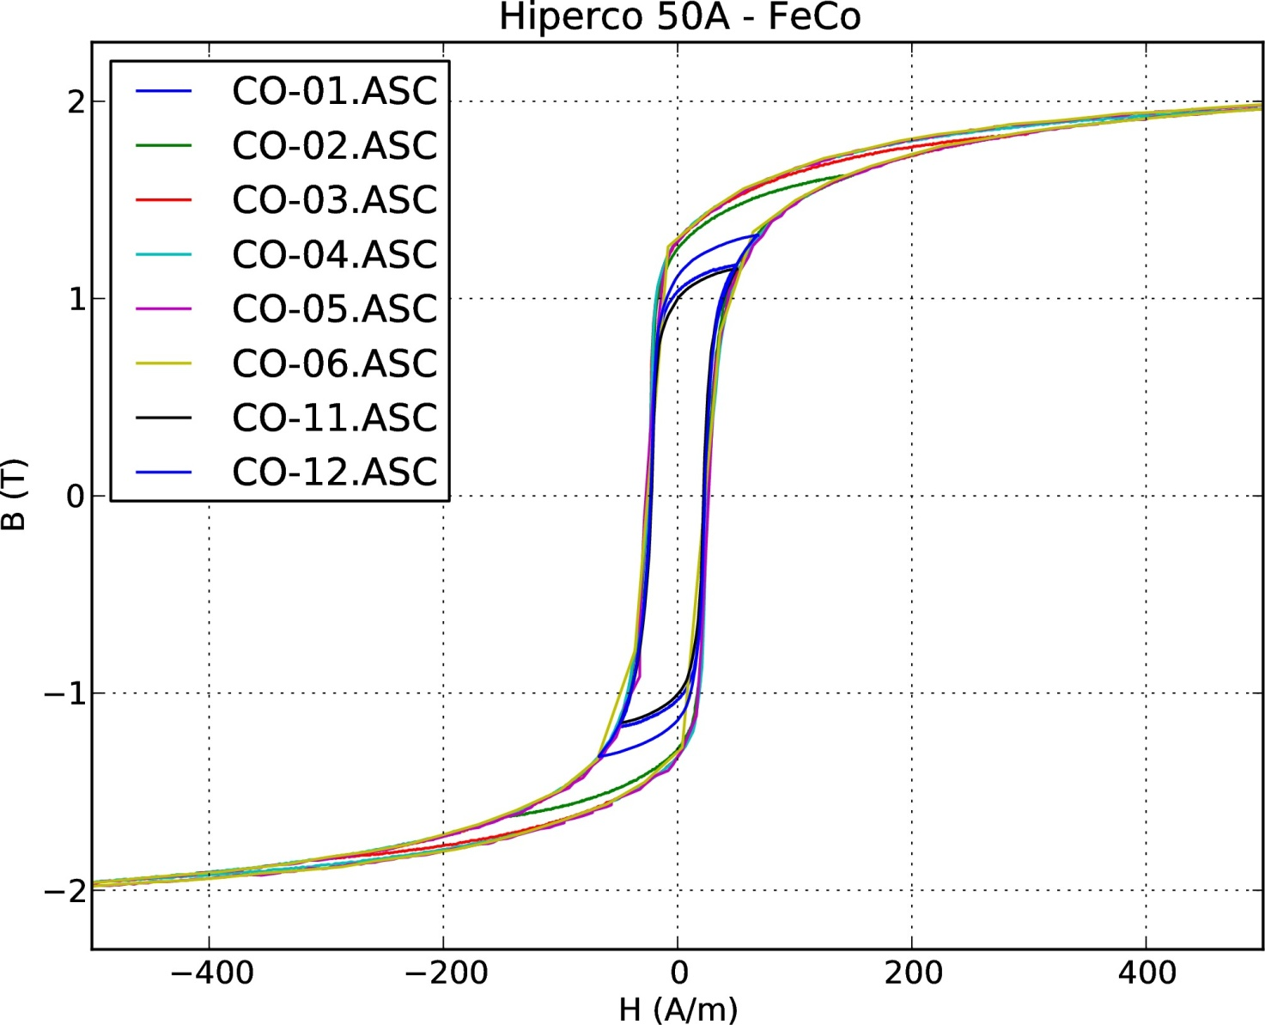
FeCo – Hiperco 50A

Slide 14
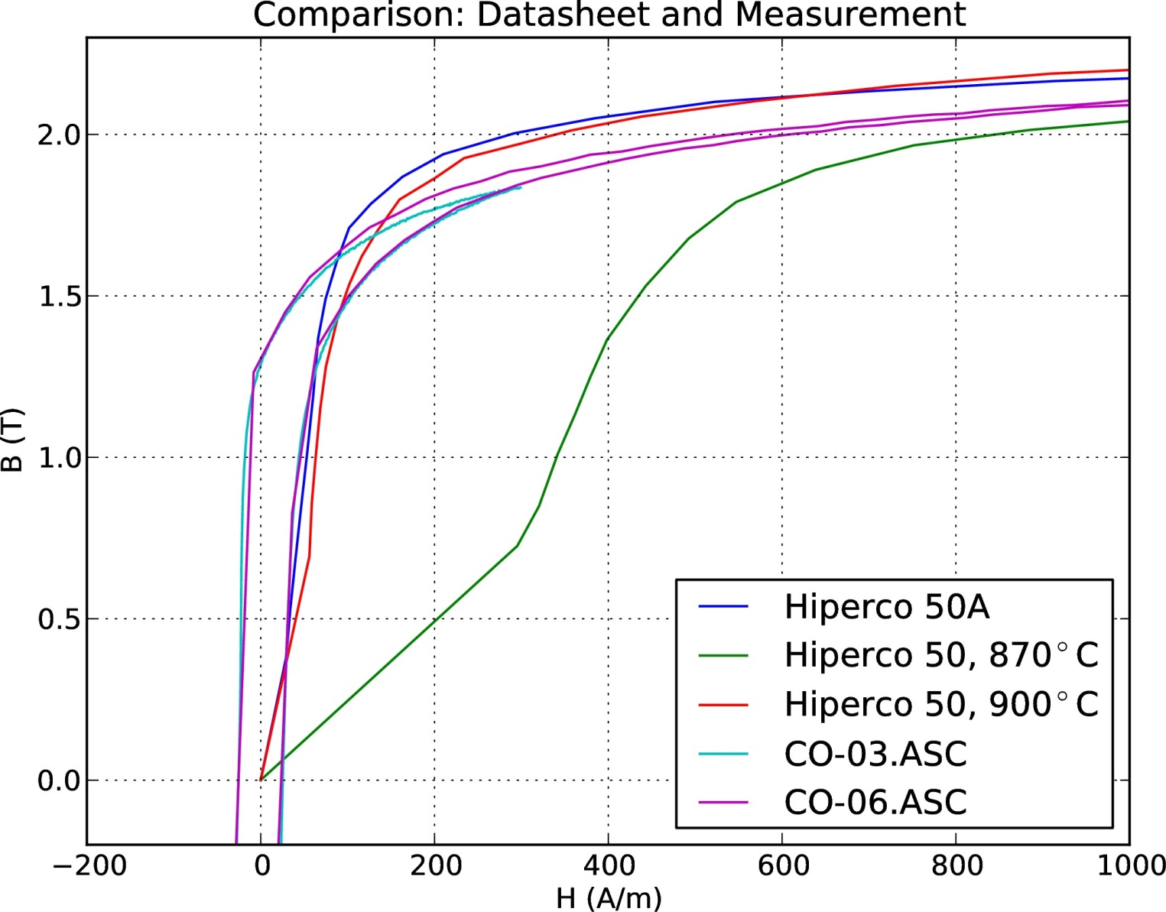
FeCo – Hiperco 50A

Slide 15
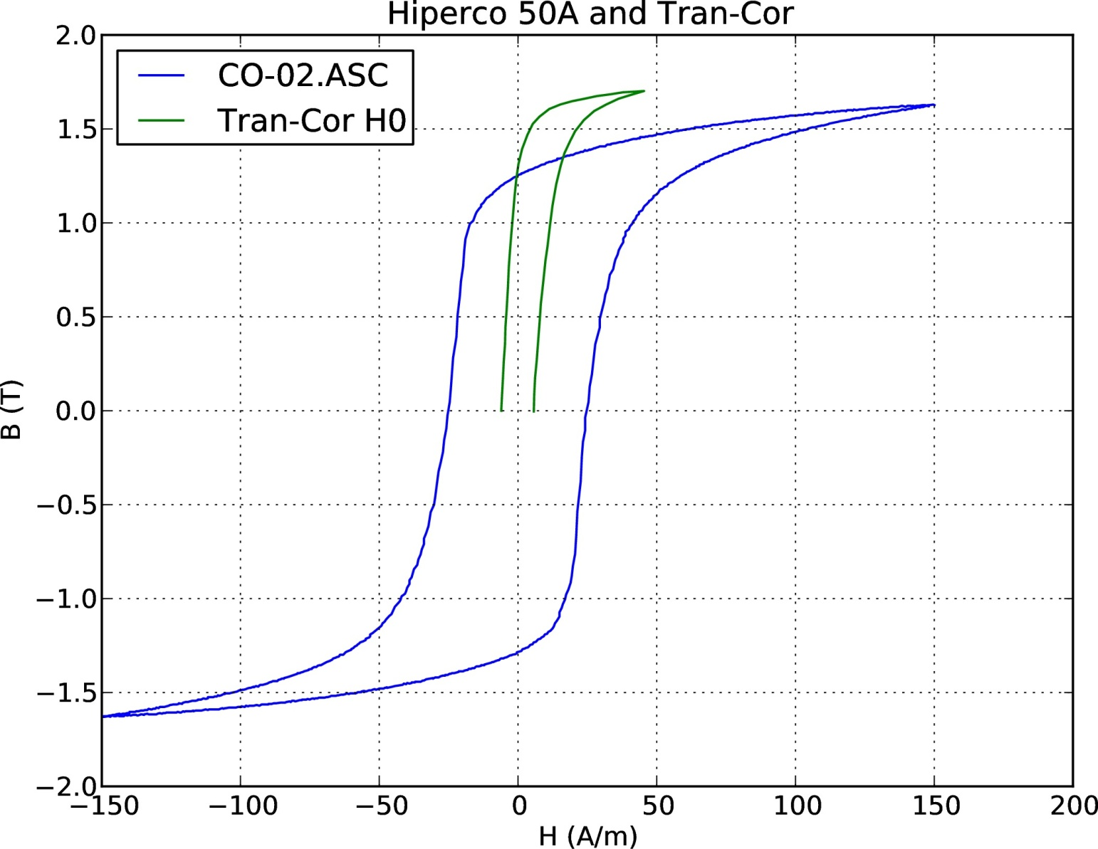
FeCo – Comparison GO Steel

Slide 16
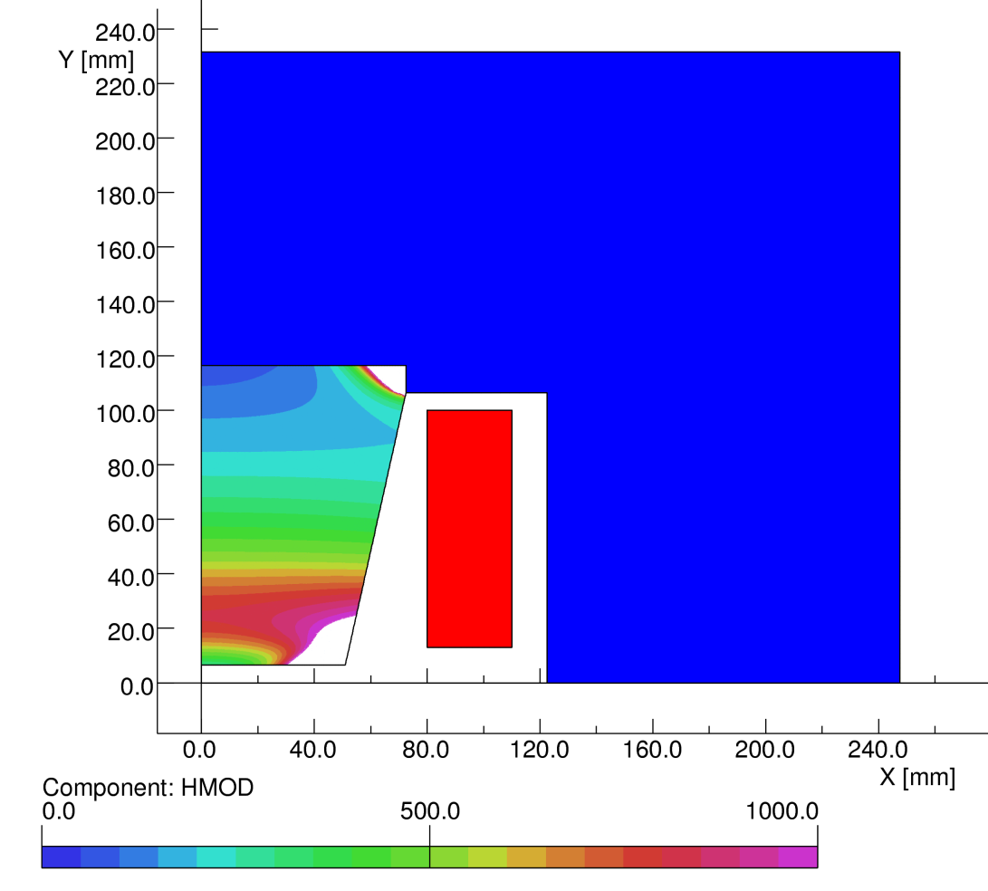
Fe Co Results
about 0.1T short
reason is unknown
  wrong material
  bad batch
  not enough material
  wrong annealing
Vacuumschmelze GmbH & Co. KG
  Hanau, Germany

Slide 17
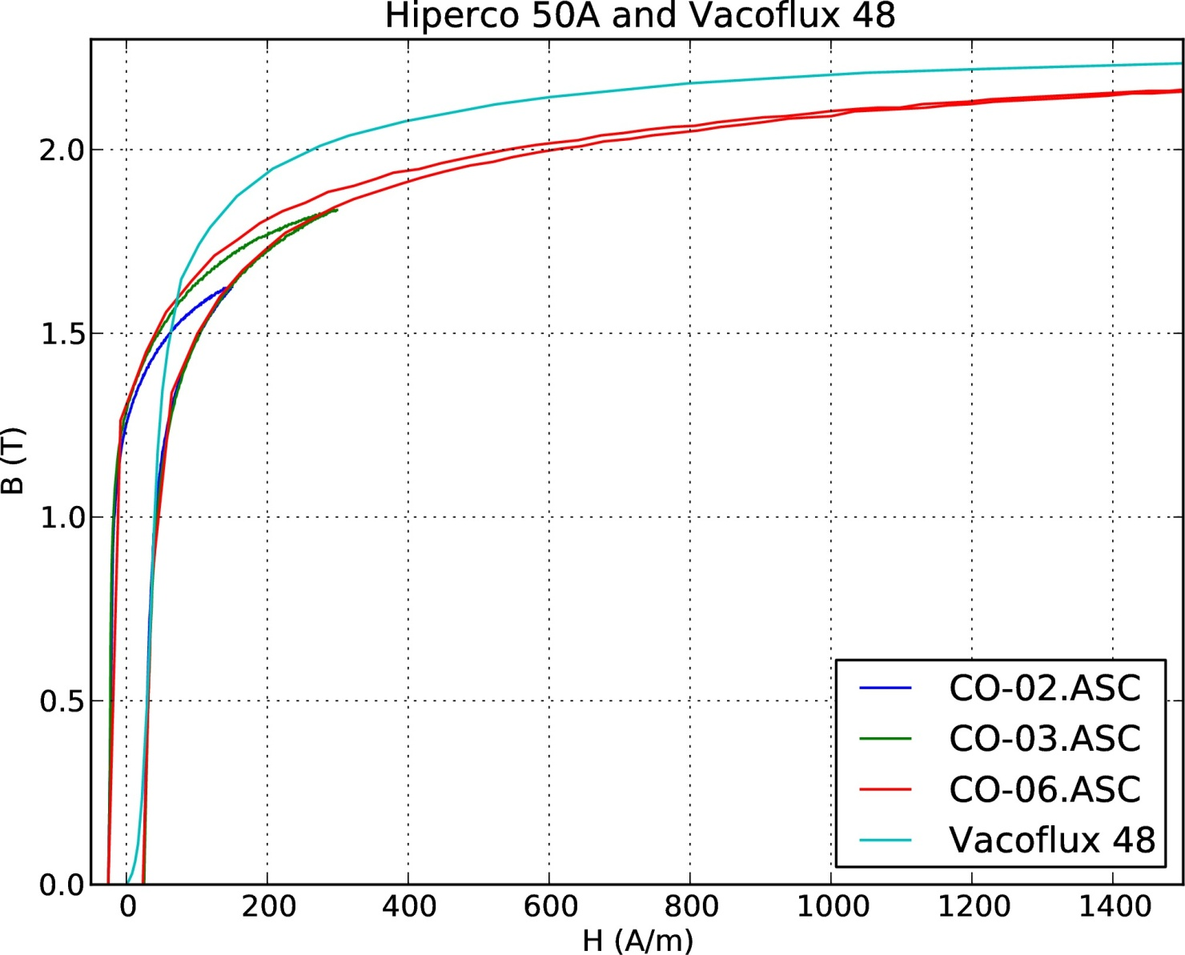
Vacoflux 48

Slide 18
Summary
6.5% Si steel
  confirmed values from datasheet
  almost isotropic
  good match of hysteresis loop
  losses?
FeCo
  discrepancy between datasheet and measurement
  Vacuumschmelze

