Slide 1
Single Proton Tracking
X. Ding, UCLA
AAG, Apr. 11, 2011

Slide 2
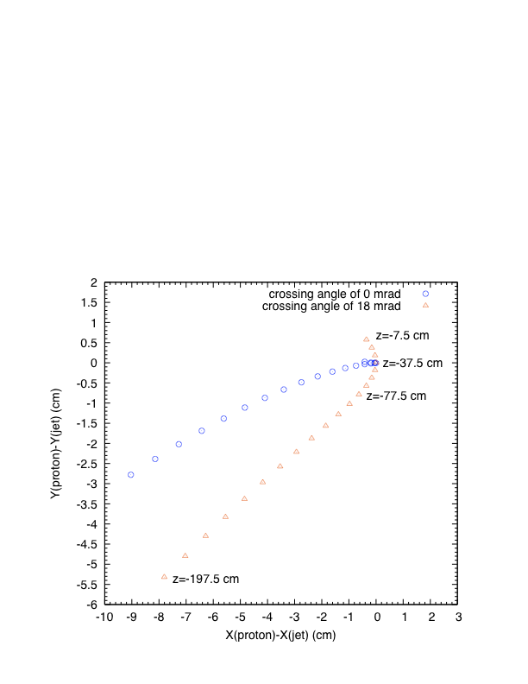
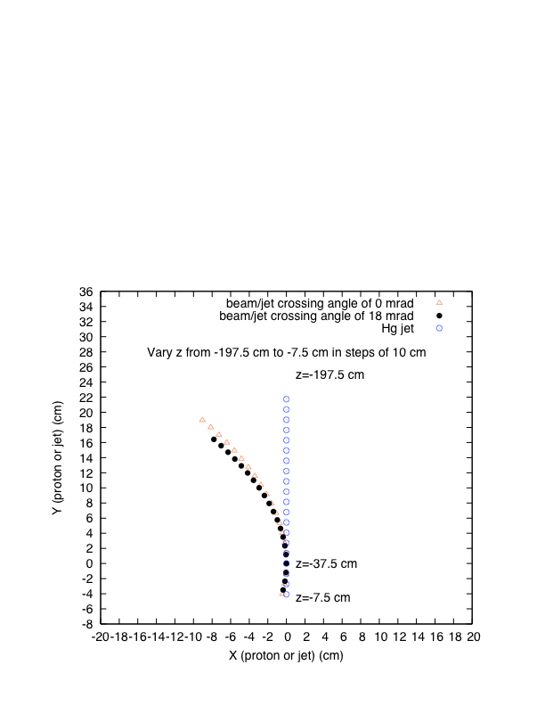
Proton at KE of 8GeV
(Hg jet angle at 135 mrad)

Slide 3
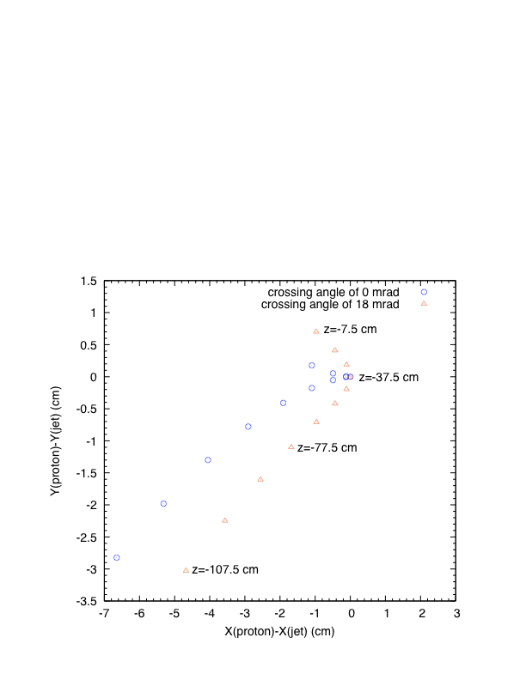
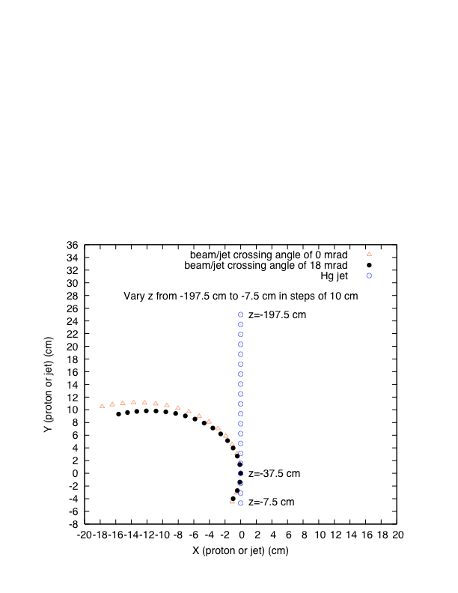
Proton at KE of 3GeV
(Hg jet angle at 155 mrad)

