Slide 1
Coax Magnet
Main Ring Magnets

Slide 2
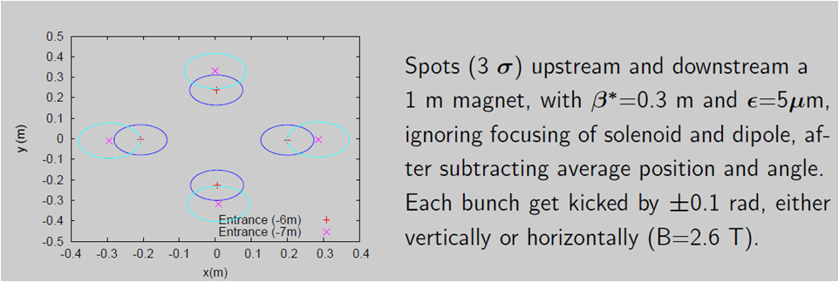
Introduction
Keith Gollwitzer, Accelerator Division Fermilab. Proton Delivery to Target. MAP Meeting 2012.
assume ΔL=3m
equivalent to 0.04 m + beam size (0.18 m)
∴ R=0.13m (outer radius)
B = 1T
L = 1 m

Slide 3
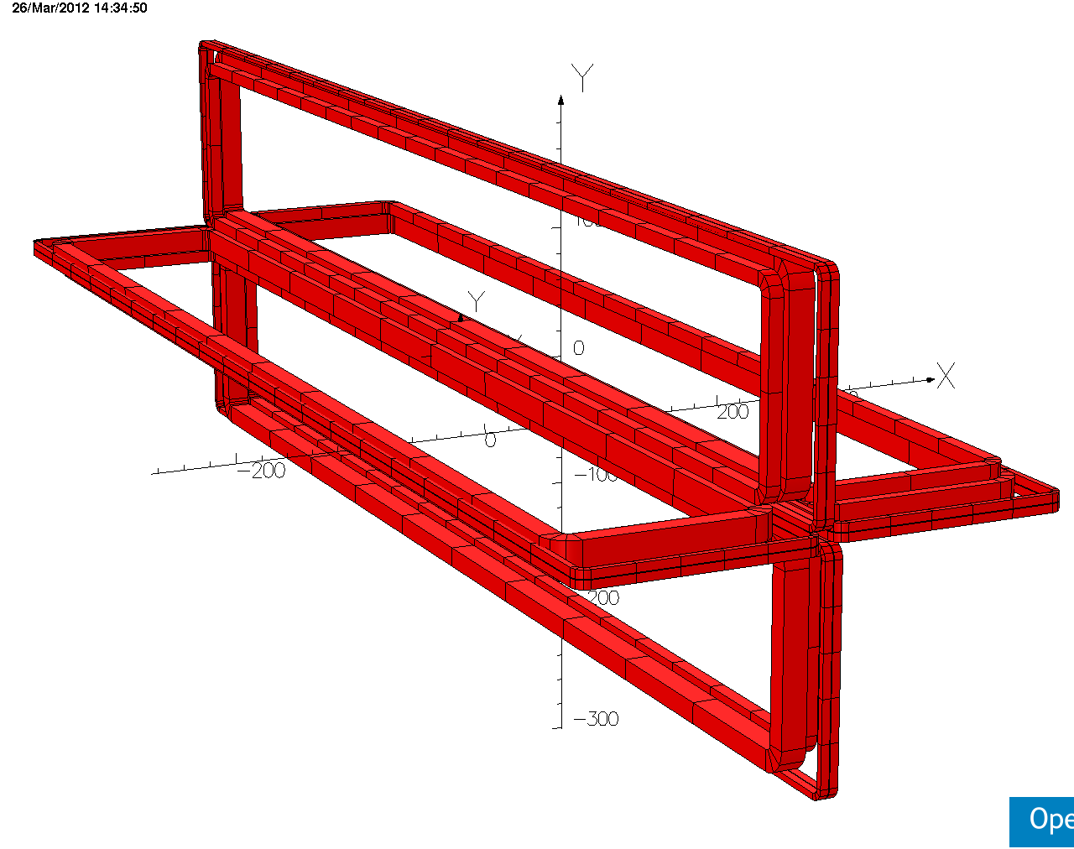
Coax Magnet

Slide 4
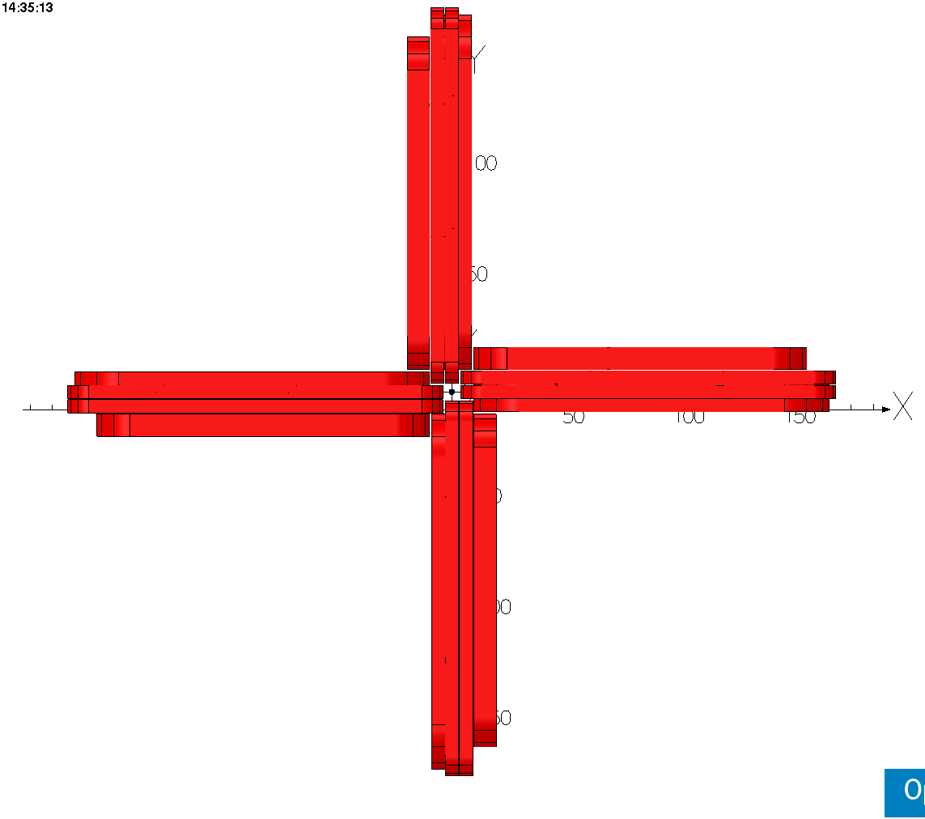
Coax Magnet
Fits into radius
of 30 mm

Slide 5
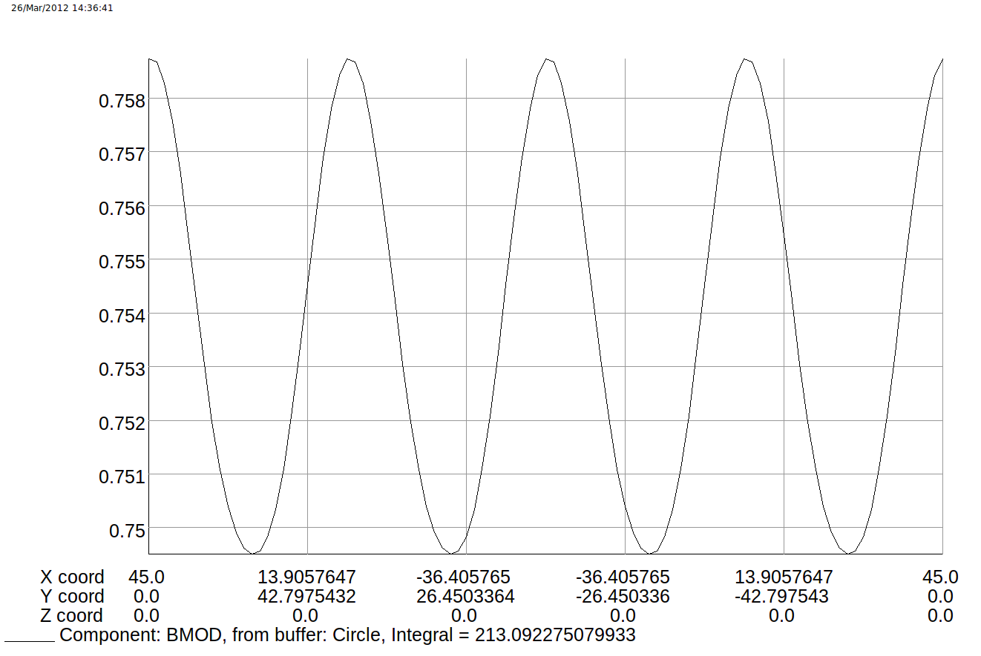
Field
r=45 mm

Slide 6
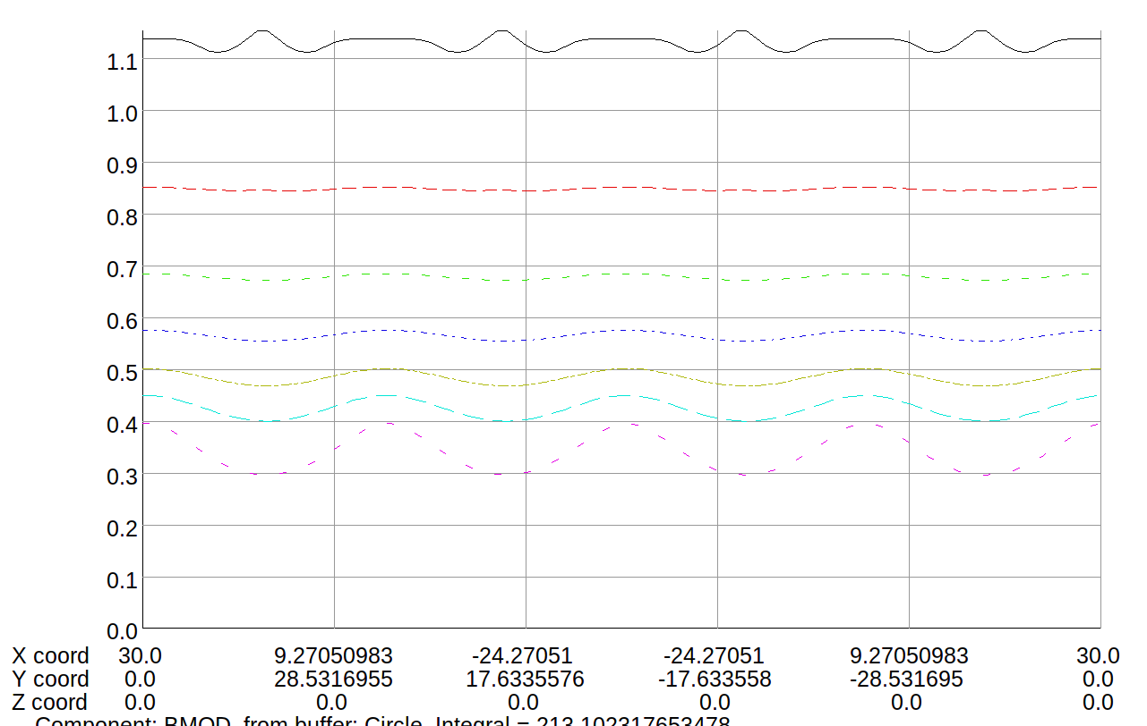
Field 2

Slide 7
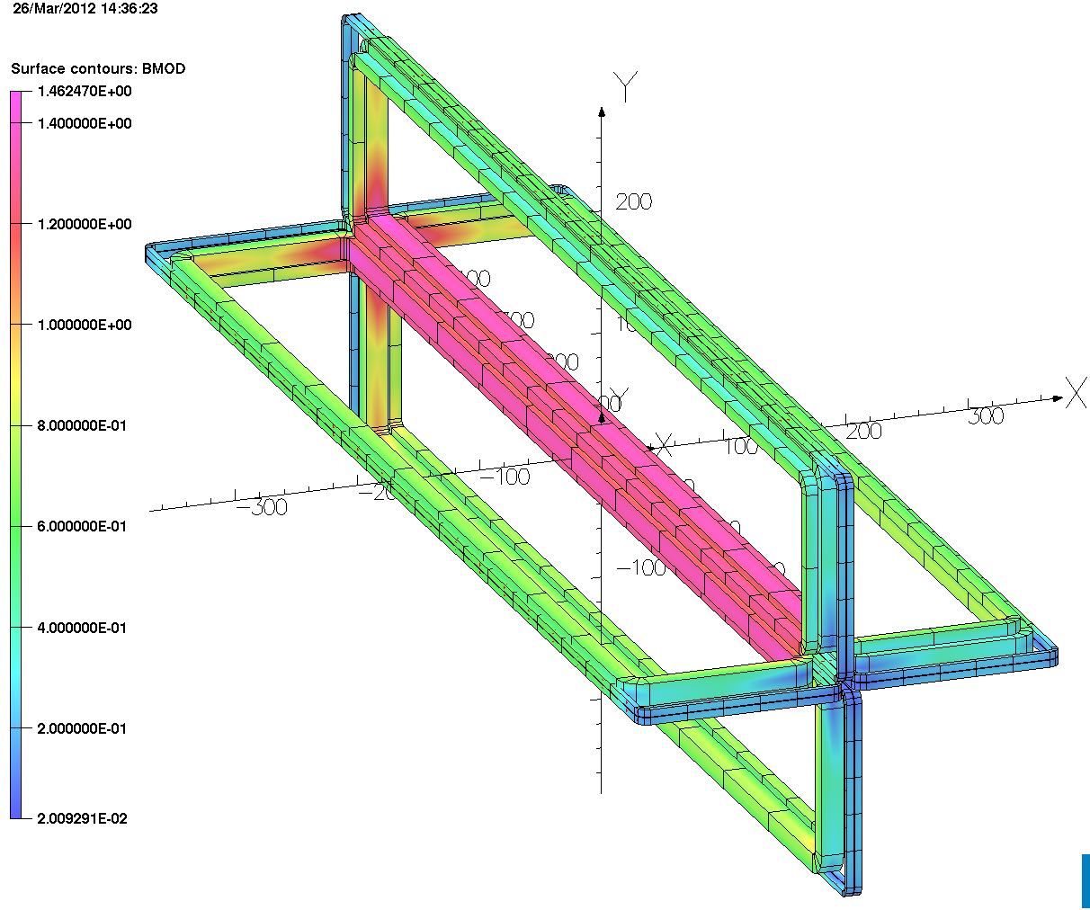
Peak Field on Wire
<1.5T

Slide 8
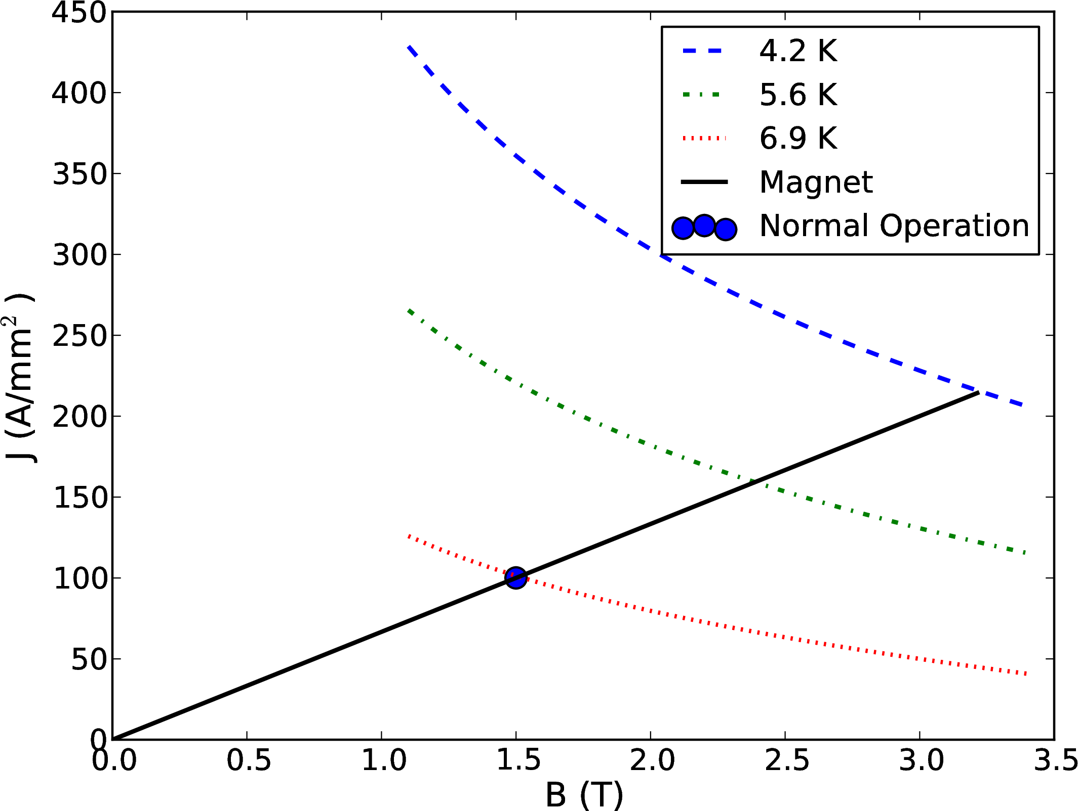
Load Line
Cu:Sc 20:1

Slide 9
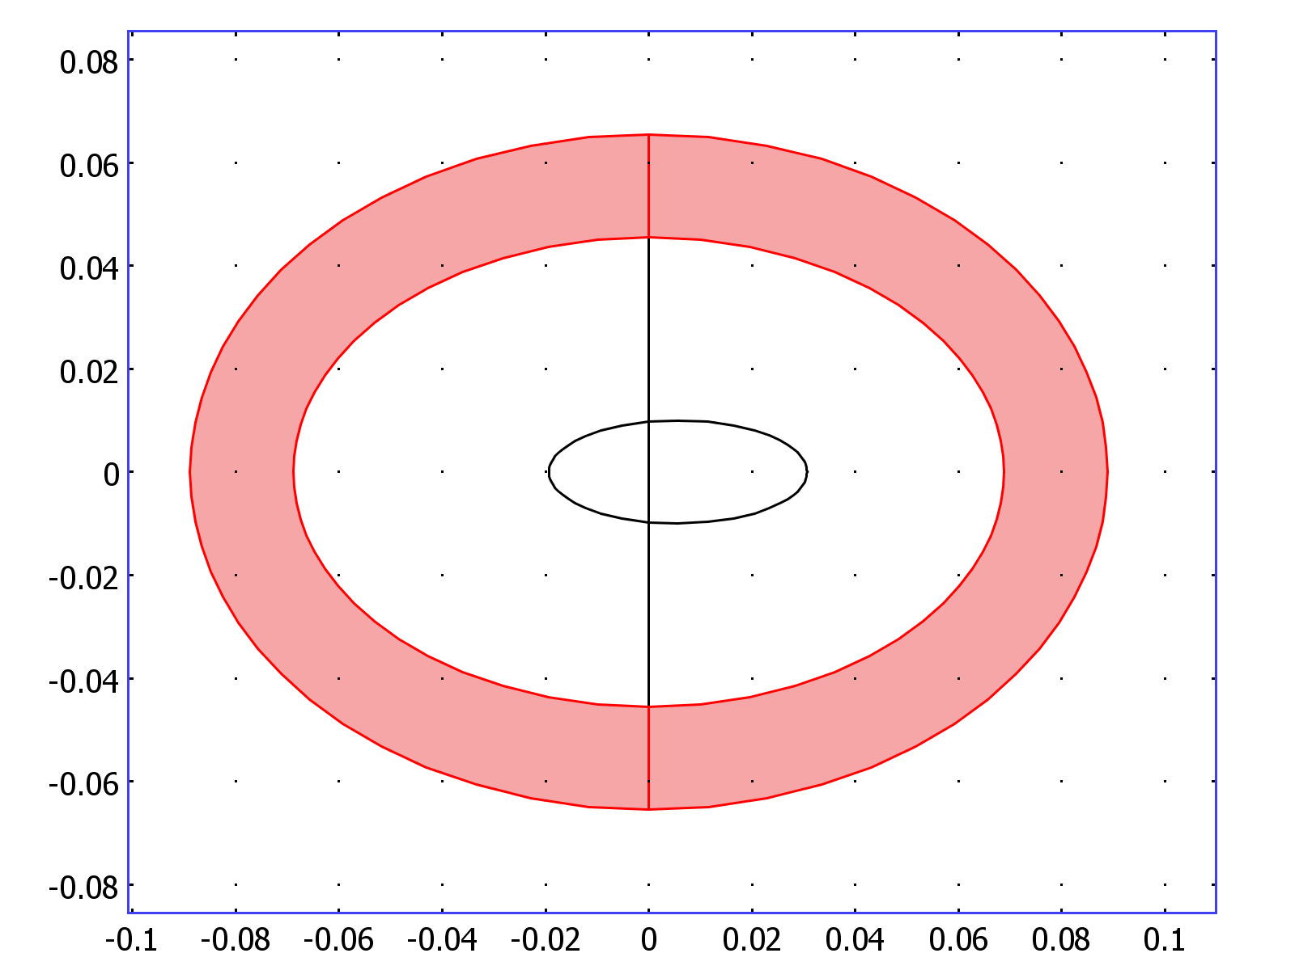
Main Ring Magnets

Slide 10
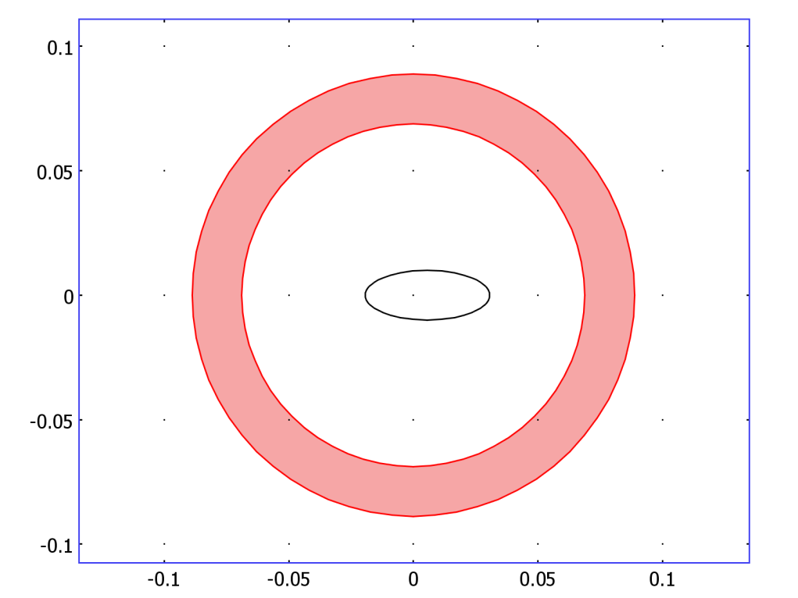
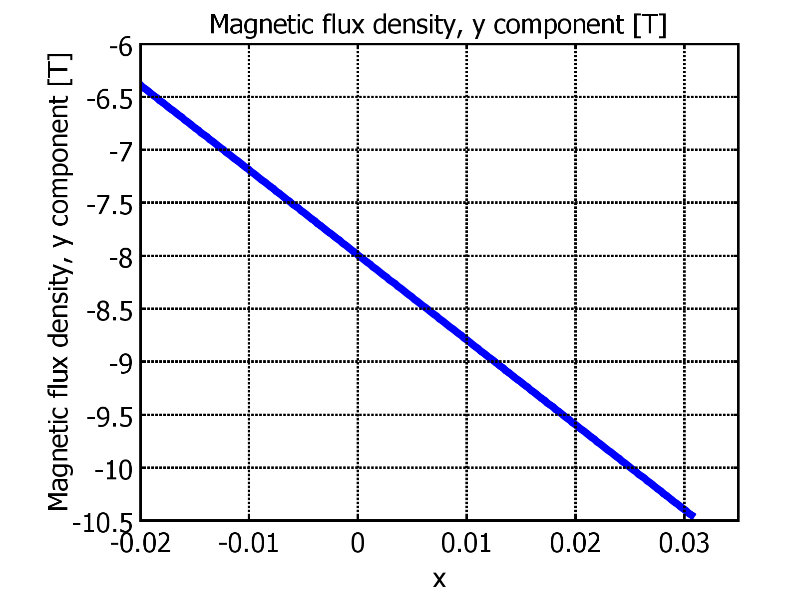
Circular Bore - Field

Slide 11
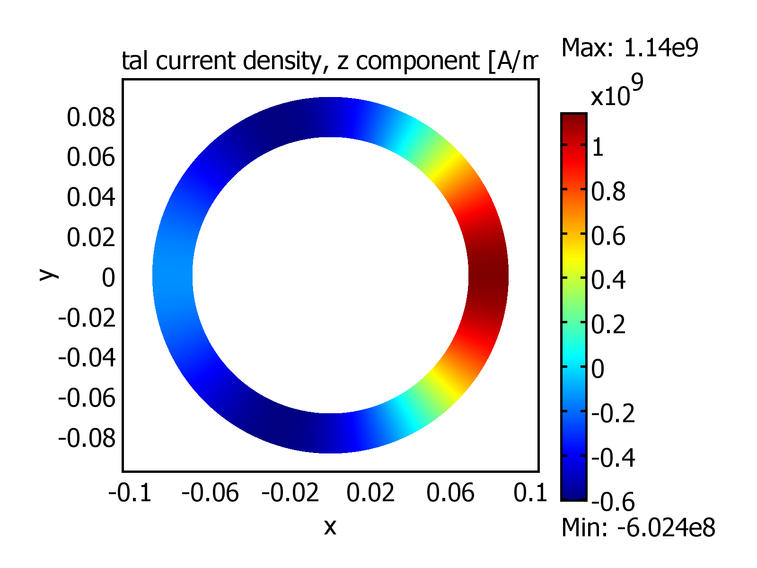
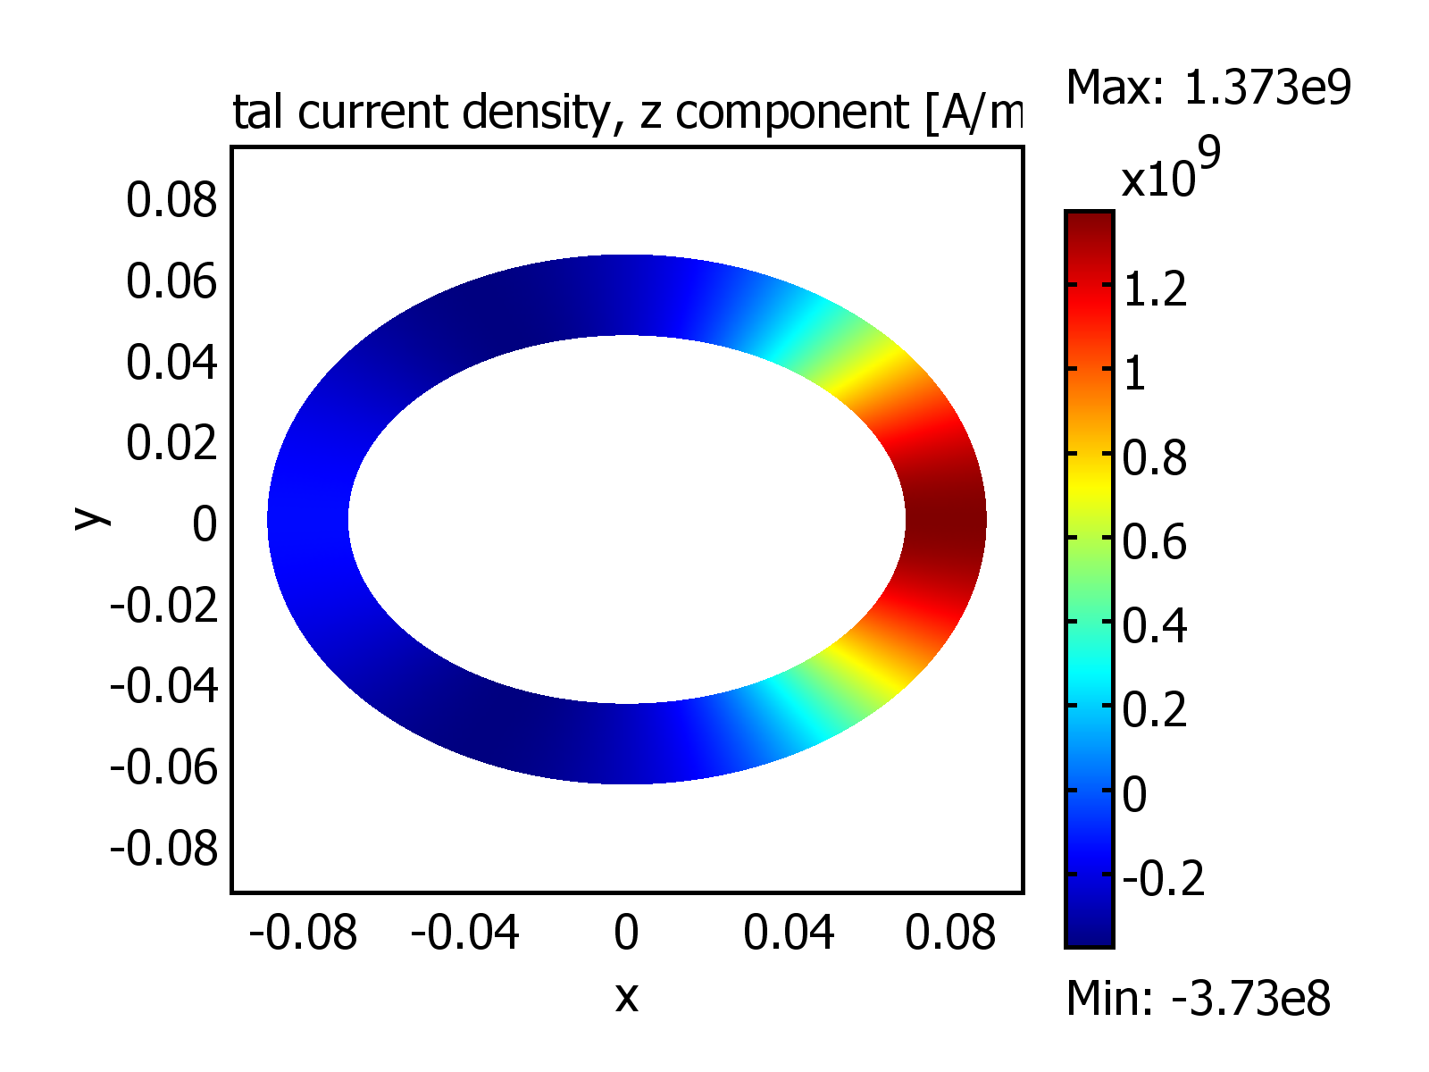
Comparison – Current Density
20% Difference – J is higher for elliptical cross-section

Slide 12
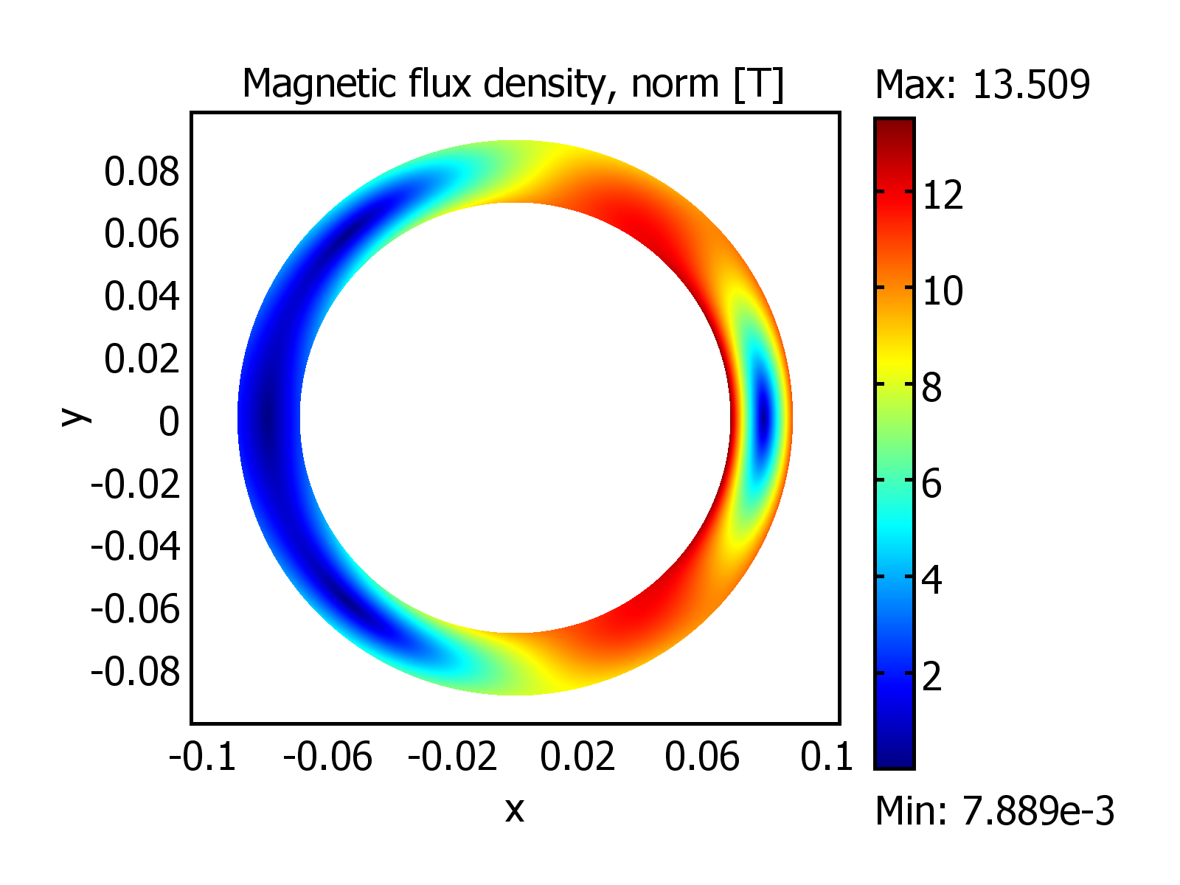
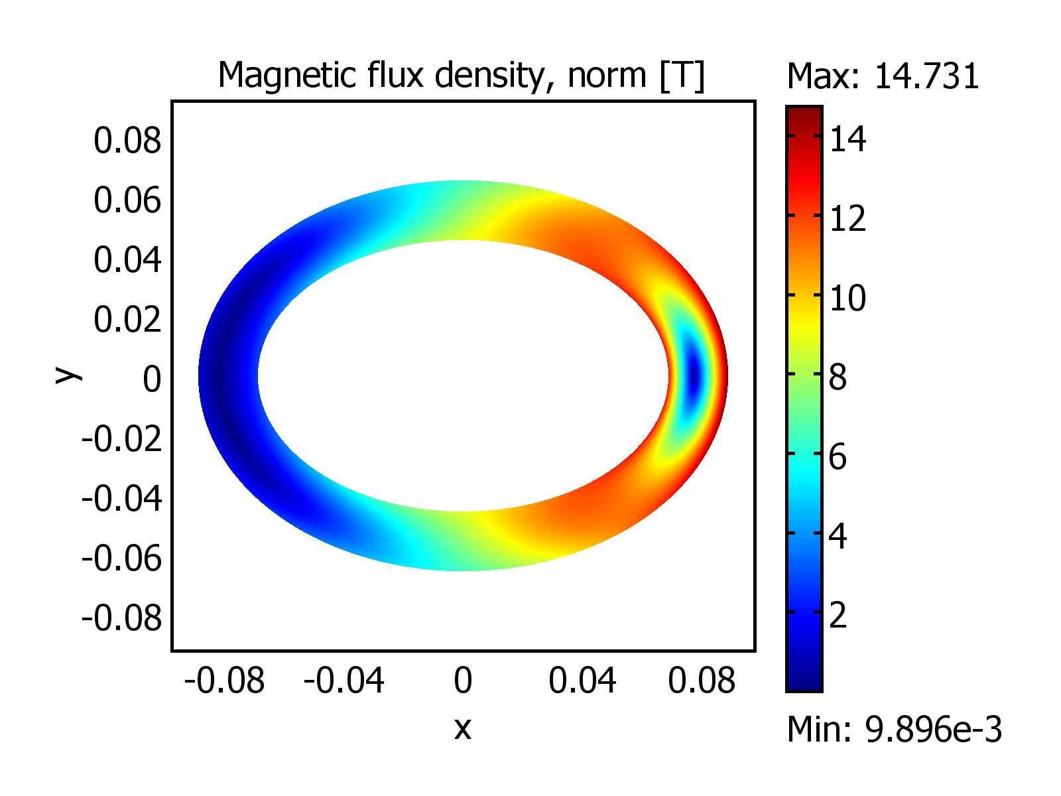
Comparison – Field
10% Difference – B is higher for elliptical cross-section

Slide 13
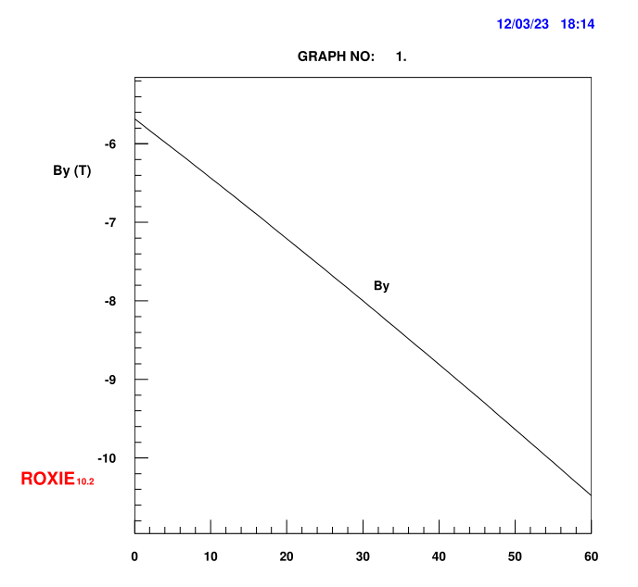
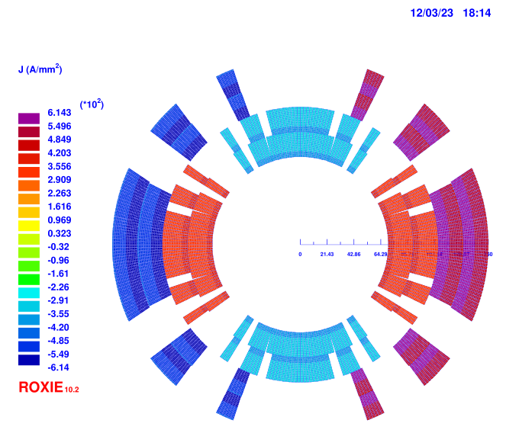
ROXIE Design

Slide 14
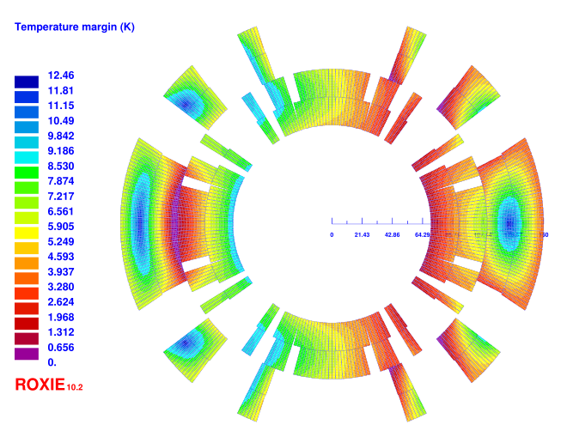
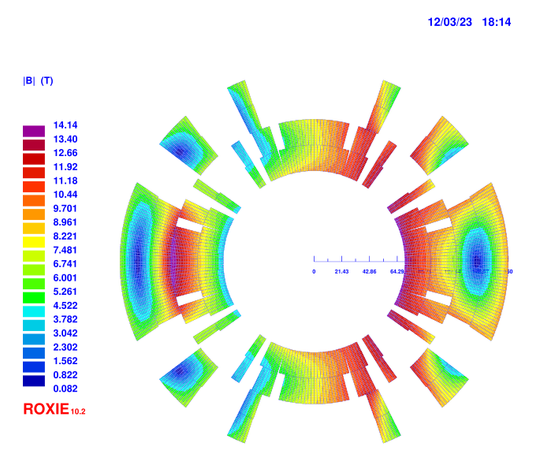
ROXIE Design

Slide 15
Summary
Coax magnet
  field homogeneity ok?
  cryogenics
Main ring magnets
  elliptical cross-section?

