Slide 1
Meson Productions for Hg Jet with Disk Shape
X. Ding
BNL-AAG Meeting
March 15, 2012

Slide 2
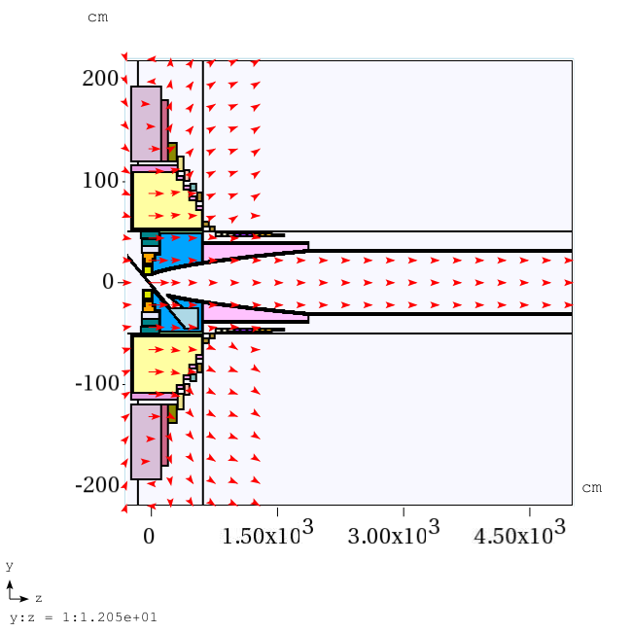
IDS120h Configuration

Slide 3
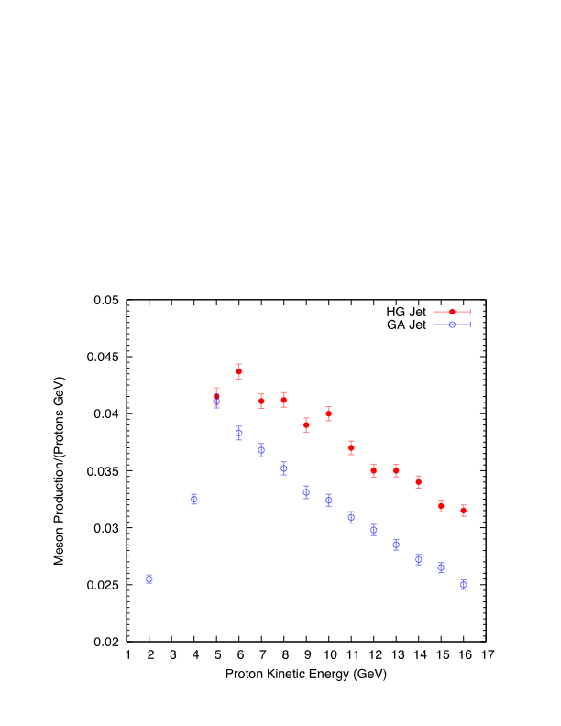
Meson Production with IDS120h
Why the meson productions are lower at KE<5 GeV?

Slide 4
HG Target Geometry
y
x
The mercury jet target geometry. The proton beam and mercury jet cross at z=-37.5 cm.
yz plane
Curve more at low KE
Single particle tracking (entrance and exit point in Hg Jet) for 2,4,8 proton KE with assumed same target parameters (0.404mm/20.6mrad/117mrad):
8 GeV: (-0.143,2.224,-56.475)/(-0.142,-2.23,-18.475); Δz= 38 cm
4 GeV: (-0.246,2.156,-55.988)/(-0.238,-2.129,-19.208); Δz=36.78 cm
2 GeV: (-0.363,1.95,-54.496)/(-0.371,-1.975,-20.323); Δz=34.2 cm
Nuclear Interaction length: HG/14.58 cm

Slide 5
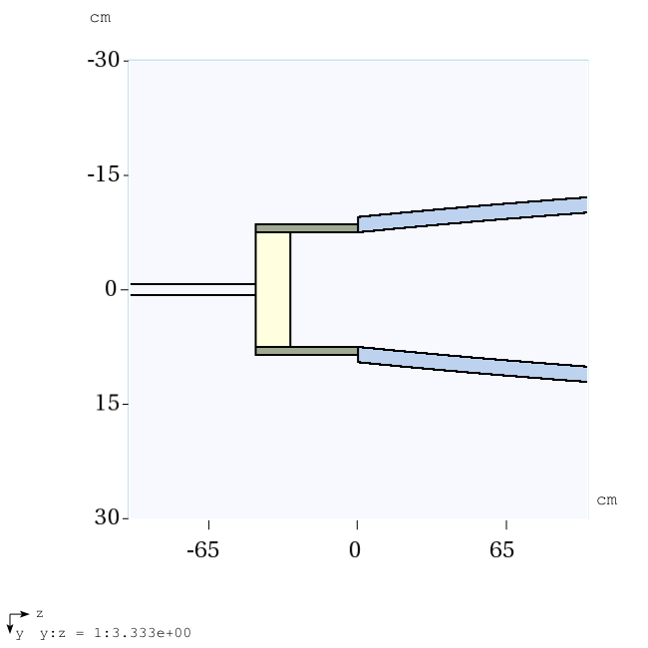
Hg Jet with Disk Shape
Disk:
ϕ=15 cm
Depth: 15/4 cm

Slide 6
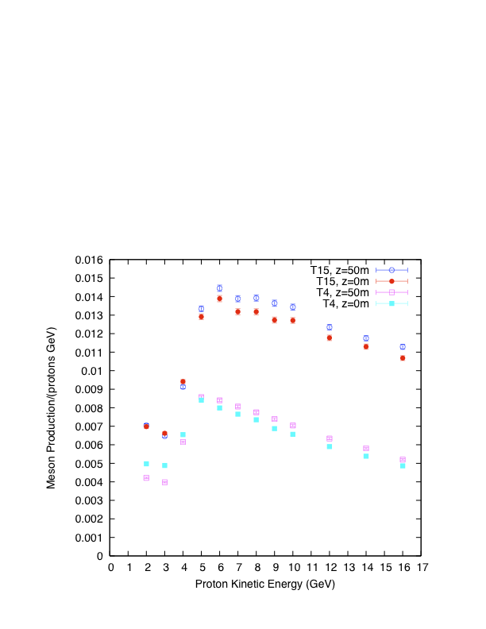
Meson Productions for Hg Jet with Disk Shape

Slide 7
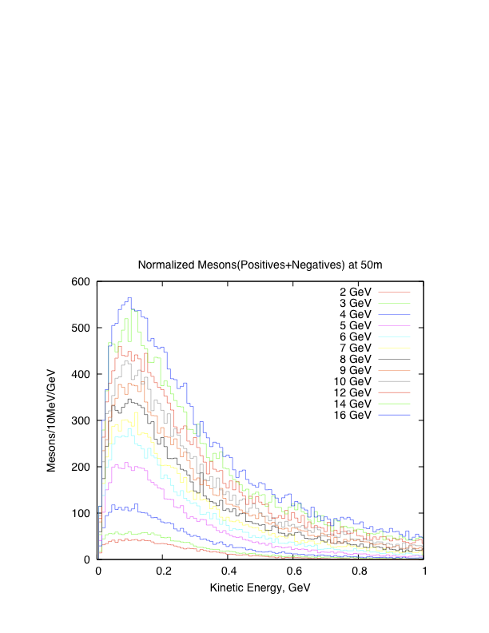
Energy Spectrum

