Slide 1
A Dipole
(without)
Grain Oriented Steel

Slide 2
Overview
Suggestion for a new dipole design
Materials
Simulation results
  achievable fields
  field quality
Power loss

Slide 3
Grain Oriented Steel
Chosen to minimize magnetization losses
  low coercivity
  high saturation field
  (in direction of grains)
Challenges
  measuring material properties
  1D material – not very forgiving in terms of geometrical errors / material inhomogeneities
  change of material properties over time / radiation exposure
  Simulations – convergence problems
Proposal: use different materials
  FeCo (Hiperco 50A)
  6.5% silicon steel (JFE SuperCore)

Slide 4
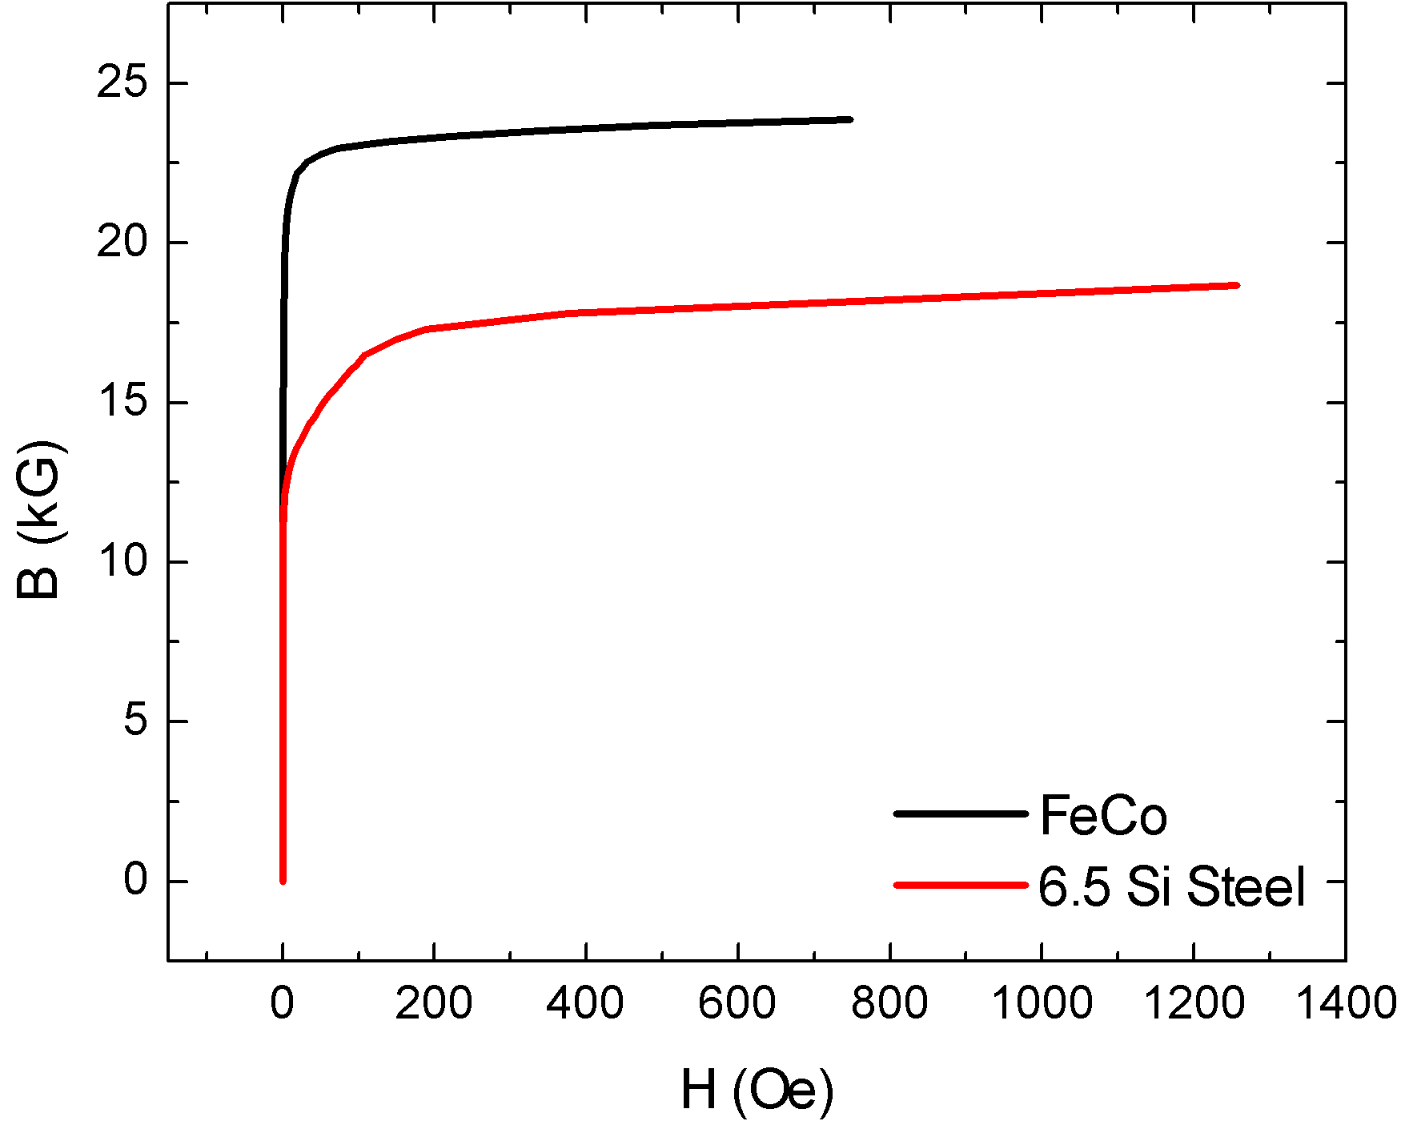
BH Curves
Isotropic
FeCo: saturates at higher B
6.5SiFe: developed for f>50Hz
Limits: 1.1/2.1T
(GO Steel: 1.75T)
FeCo
GO Fe
6.5SiFe

Slide 5
New Dipole Design
Combine both to benefit from respective advantages
  Design yoke so that field around 1.1-1.2T
  Center yoke: FeCo
Geometry: Don Summers EI yoke (‘first magnet’)
Opera 3D
Looked at tapered and non-tapered designs
6.5Si Steel
FeCo

Slide 6
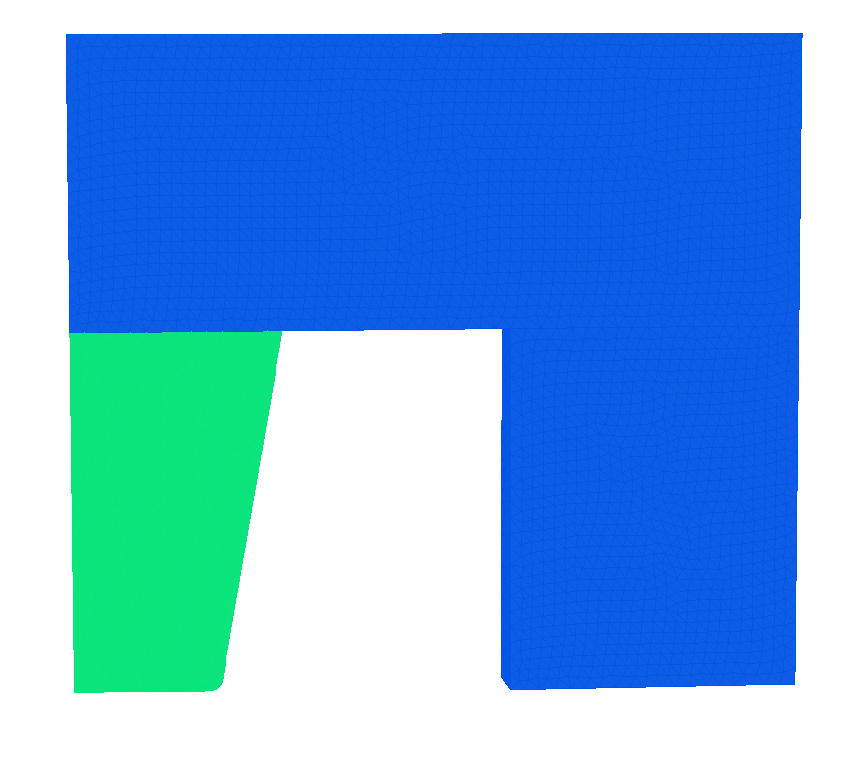
Geometry
100 mm
22 mm
110 mm

Slide 7
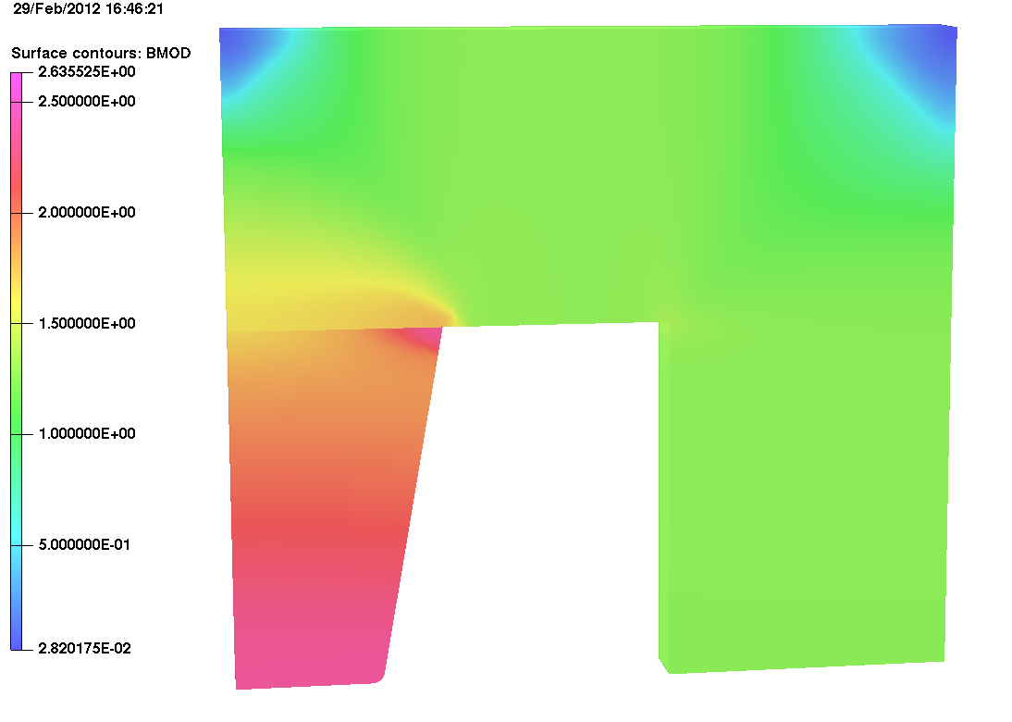
Magnetization

Slide 8
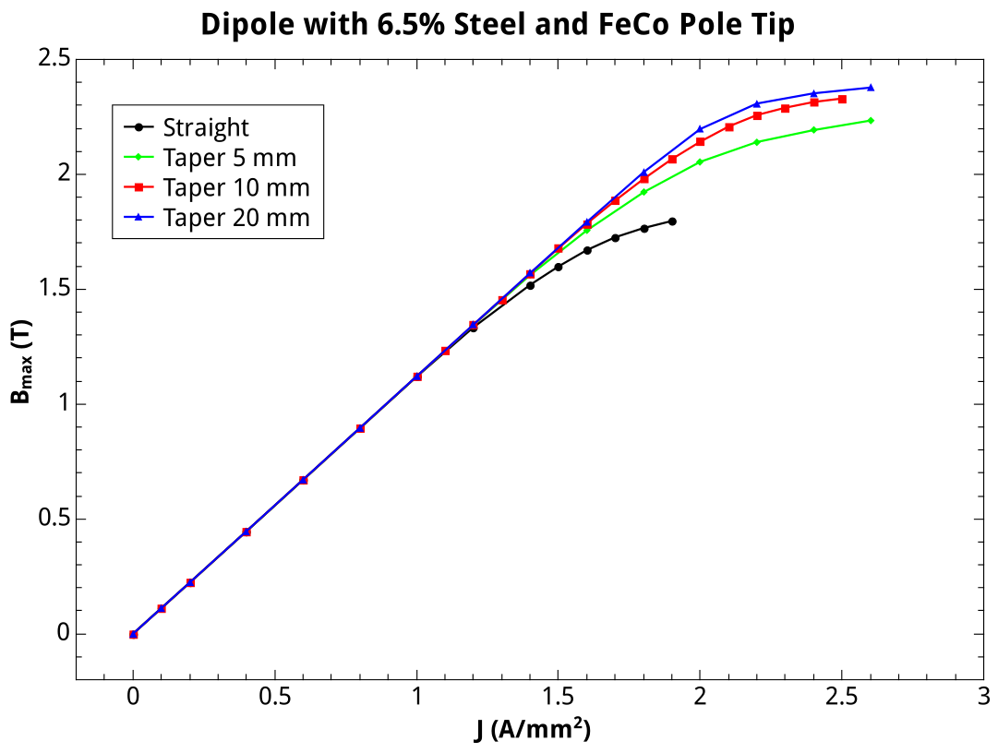
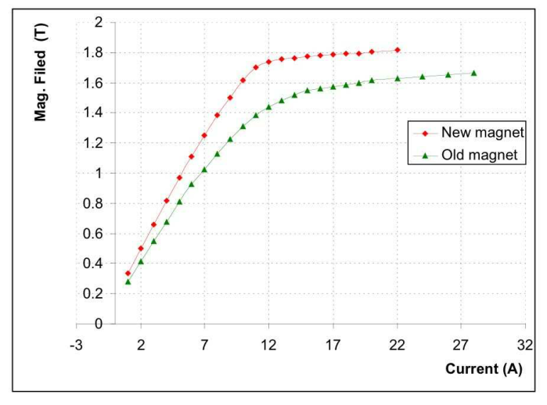
Peak Field
d
From D. Summers: Fast Ramping 750 GeV Muon Synchrotron Dipoles

Slide 9
Field Quality
Evaluate vertical magnetic field on centre plane (y=0)
  from -18 to 18 mm
Fit polynom to field:
Plot polynomial coefficients as function of peak magnetic field in centre
45 mm

Slide 10
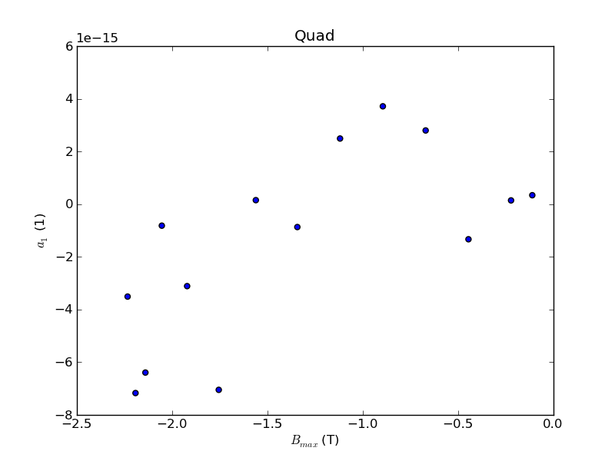
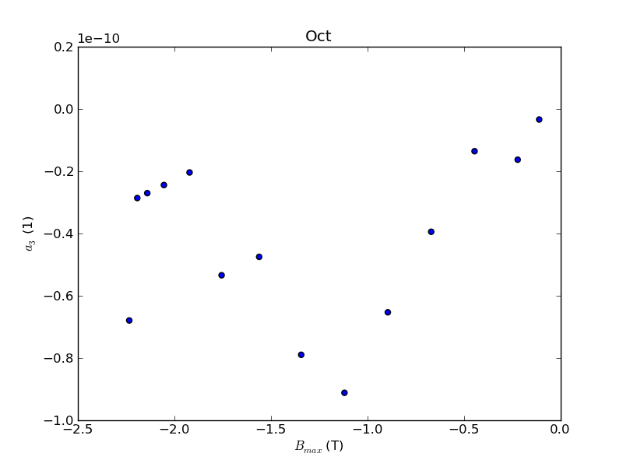
Forbidden Multipoles

Slide 11
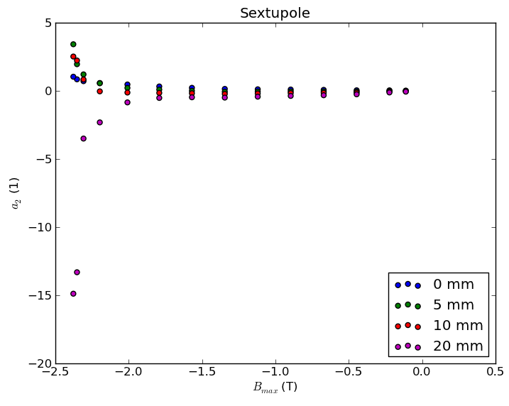
Sextupole

Slide 12
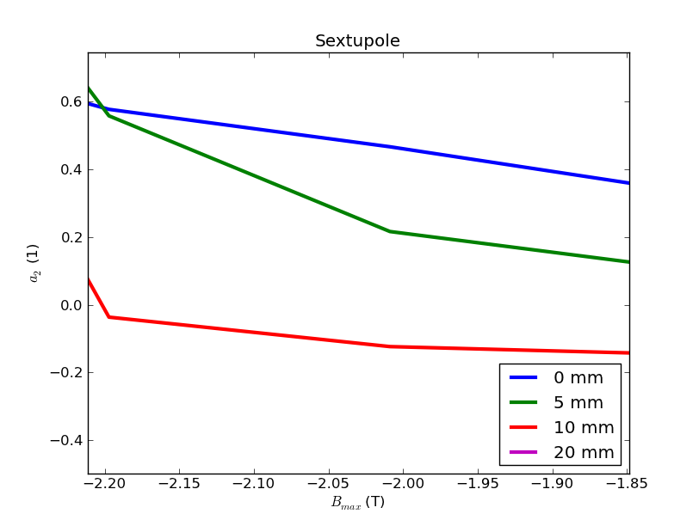
Sextupole

Slide 13
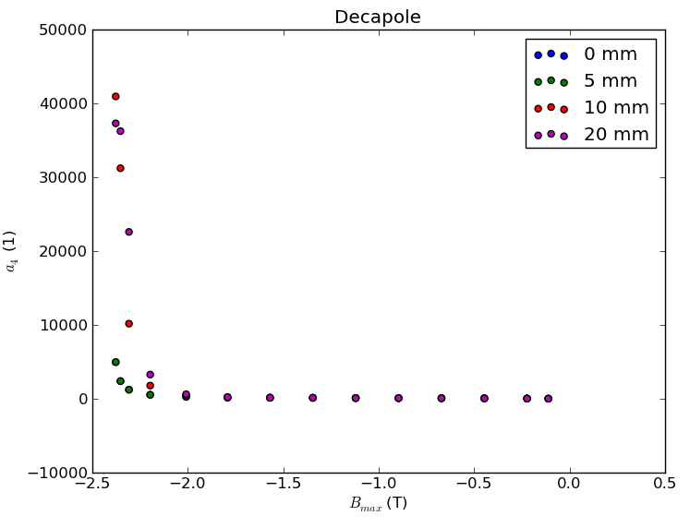
Decapole

Slide 14
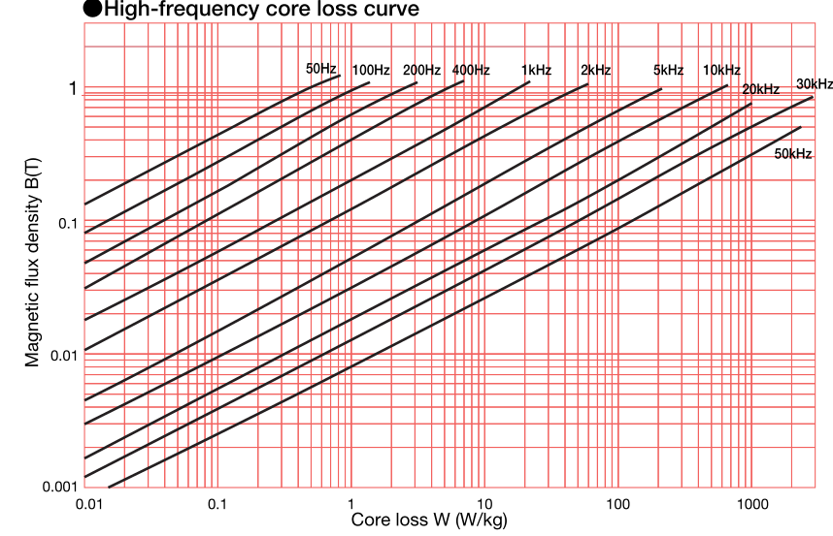
JFE Super Core (0.1 mm sheet)
about 10W/kg

Slide 15
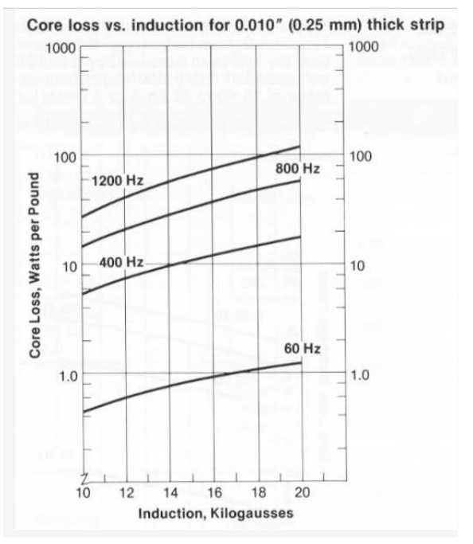
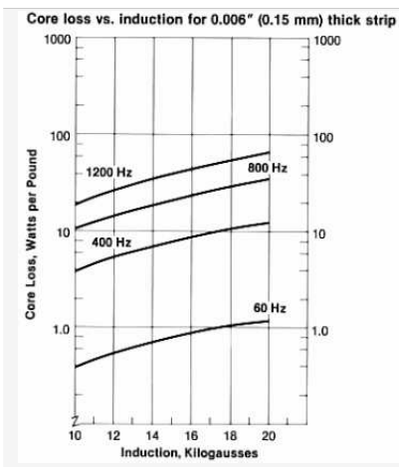
Hiperco 50A
About 20W/lb (44W/kg)

Slide 16
Test Magnet
FeCo (1 m long magnet)
  average field 1.7T
  mass: 45 kg
  power loss: 2kW/m
6.5SiFe
  average field: 1T
  mass: 235 kg
  power loss: 2.35 kW/m
Assumes 400 Hz

Slide 17
Things to do
Epstein frame test
  JFE will provide samples for free (cut to size)
  Hiperco 50A: identified supplier and company for cutting/annealing, waiting for quotation
If successful: test magnet, geometry close to Don’s 2nd magnet (later on: more life size model?)
Magnet design for RCS ring?

Slide 18
Summary
FeCo + 6.5SiFe seems to be good combination
  higher field than GO steel
  better field quality?
Conceptual design of test magnet
Material tests

