Slide 1
Elliptical Dipole

Slide 2
Motivation
Bending magnets in muon collider:
  exposed to decay particles
  a few kW/m
  from short lived muons
Distribution is highly anisotropic
  large peak at the midplane (Mokhov)
One suggestion: open midplane dipoles
  Issue: filed quality
Nikolai Mokhov, in “Brief Overview of the
Collider Ring Magnets Mini-Workshop,
Telluride 2011.

Slide 3
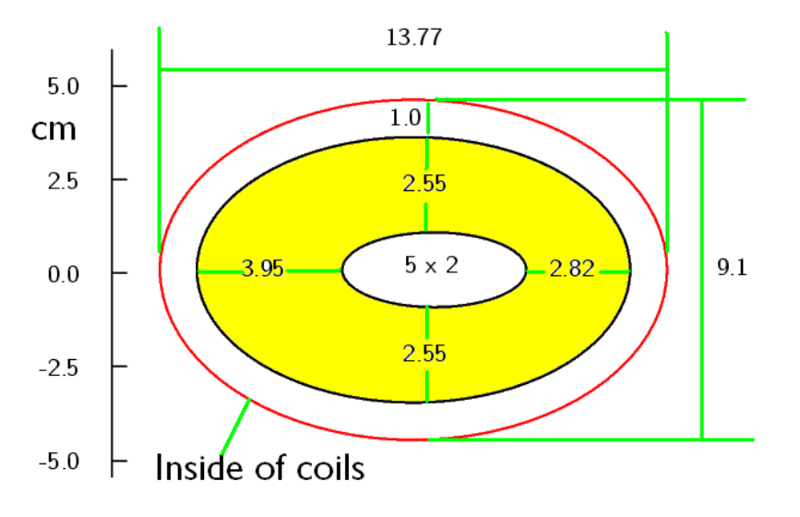
Task
Inside pipe width = 5 cm
Inside pipe height = 2 cm
Tungsten liner
From: Suggested shield & cos theta dipole dimensions R. B. Palmer, 5/26/11

Slide 4
Methodology developed for Integrable Optics Lattice (FNAL)
Task: generate certain vector potential
Singularities
Difficult to approximate with multipole fields
Ideally non-circular aperture – 2 cm horizontal, 4 cm vertical

Slide 5
Vector Potential of Single Line Current
Vector potential at point P due to current I (in z-direction):
Magnetic field:
y
P
R
r
I
a
x

Slide 6
Methodology
Required: desired A_{z} and coil bore
A~I, therefore:
P₂:
Generally:
I₁
P₂
P₁
Beam Aperture
A₁₁=VP @ P₁ for unit current I₁
A₂₁=VP @ P₂ for unit current I₁
A₁₂=VP @ P₁ for unit current I₂

Slide 7
Methodology: Formalism
Same is true for multiple currents and positions P
Formalism:
Linear equation system: Ax=b
I₃
I₄
I₂
I₃
I₁
P₂
P₁
P₃
P₃
P₄
A₁₁, A₁₂, ... are known (can be calculated – unit current I_{m}, calculate Az at P_{n})
b: also known (this is the vector potential we want)
A · x = b

Slide 8
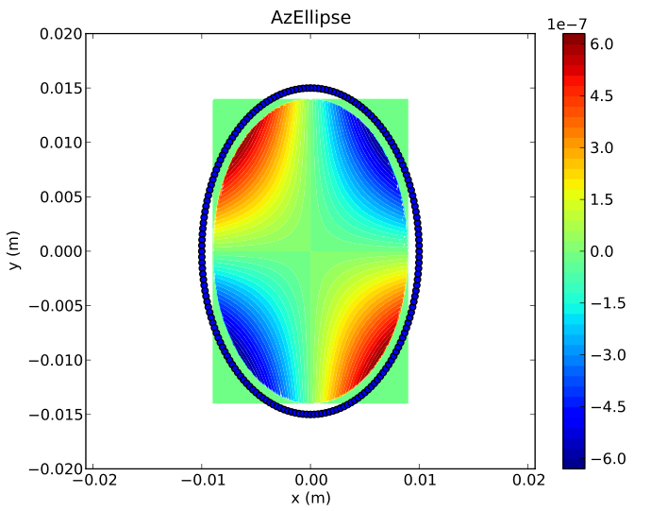
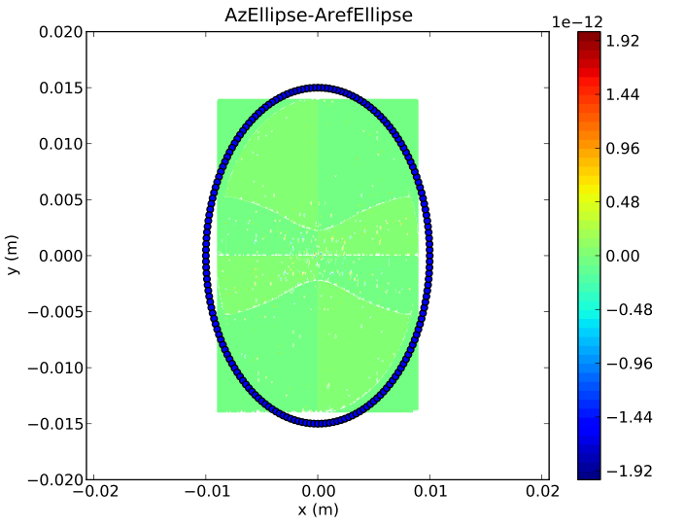
Example: Quadrupole
Current

Slide 9
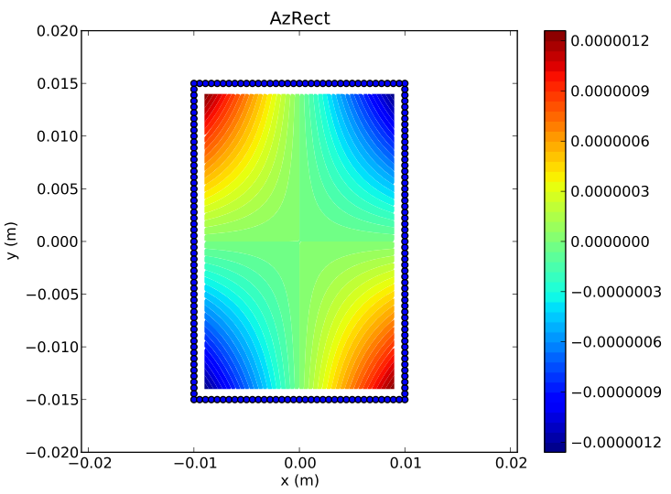
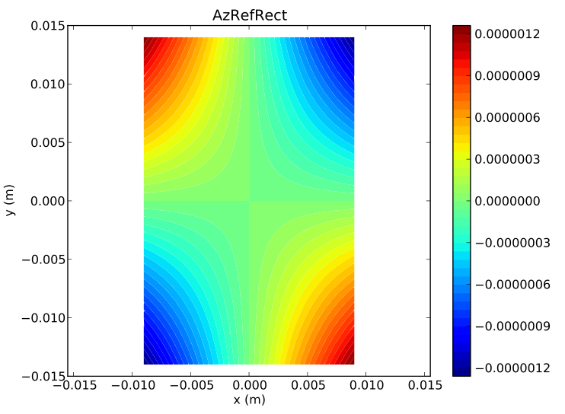
Rectangular Shape
Conductor
Reference Az

Slide 10
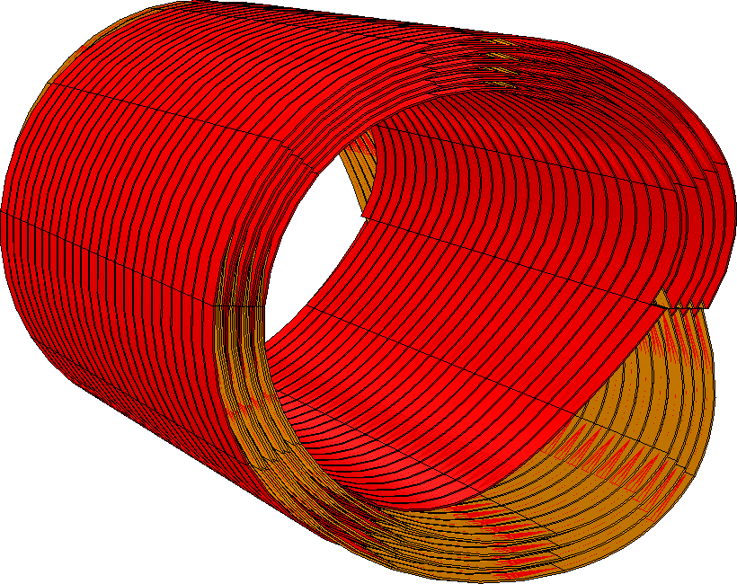
From 2D to 3D
Power each current strand individually
  Very inefficient, clumsy
  Not very elegant
Known current distribution
Helical coil: vector addition of two currents, which always intersect at the correct angle
Vector addition
Notes:
45 s

Slide 11
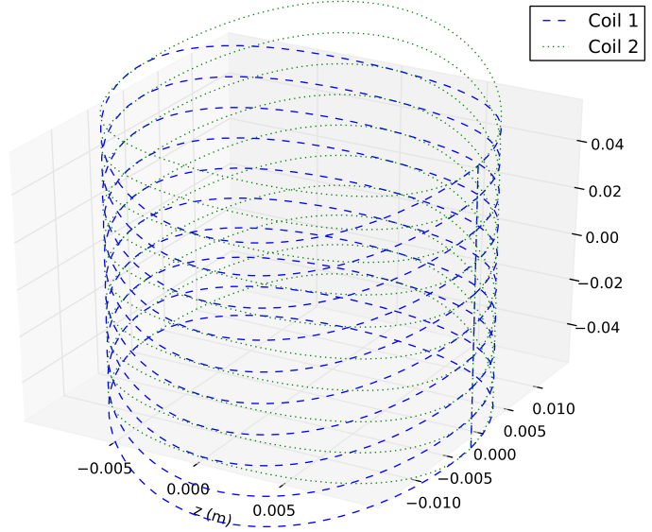
From 2D to 3D
Easy if functional relationship is known (i.e. cos theta)
Here:
  (x,y) position known
  need to determine z
dz=dI
I_{n+1}
I_{n}
I_{n-1}
ds

Slide 12
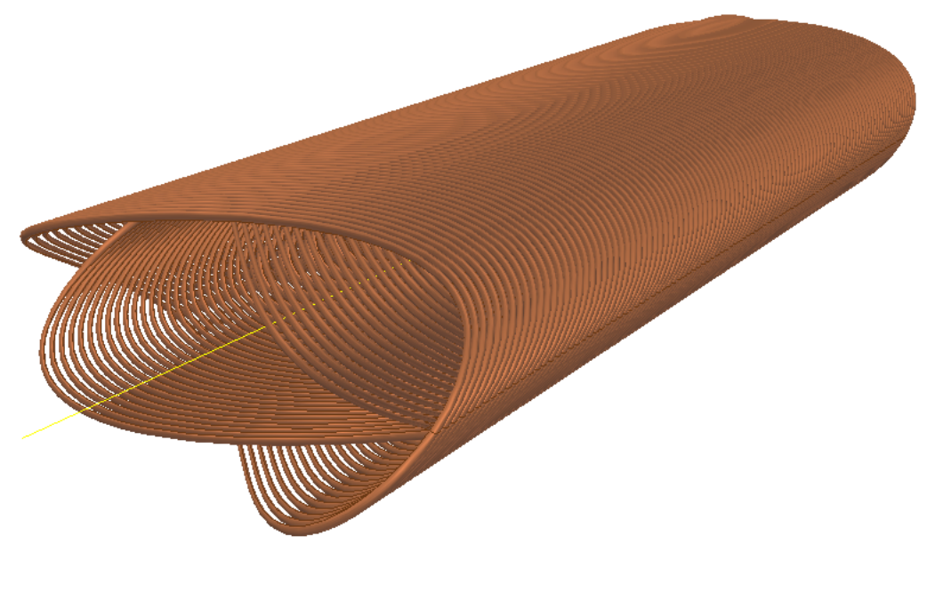
Quadrupole

Slide 13
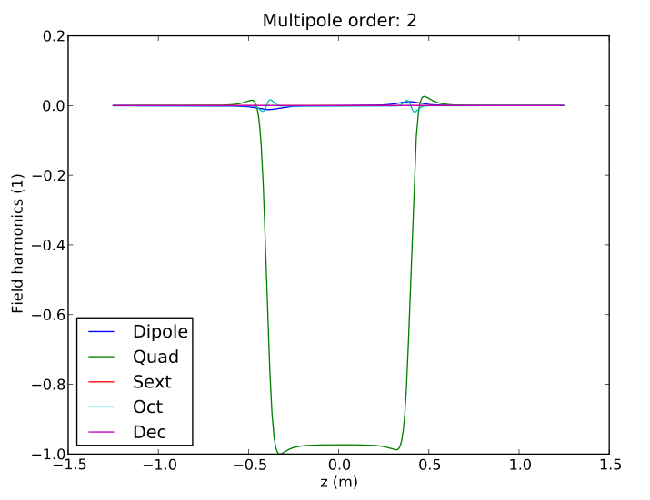
Quadrupole
Calculated for two coils

Slide 14
Task
Inside pipe width = 5 cm
Inside pipe height = 2 cm
From: Suggested shield & cos theta dipole dimensions R. B. Palmer, 5/26/11

Slide 15
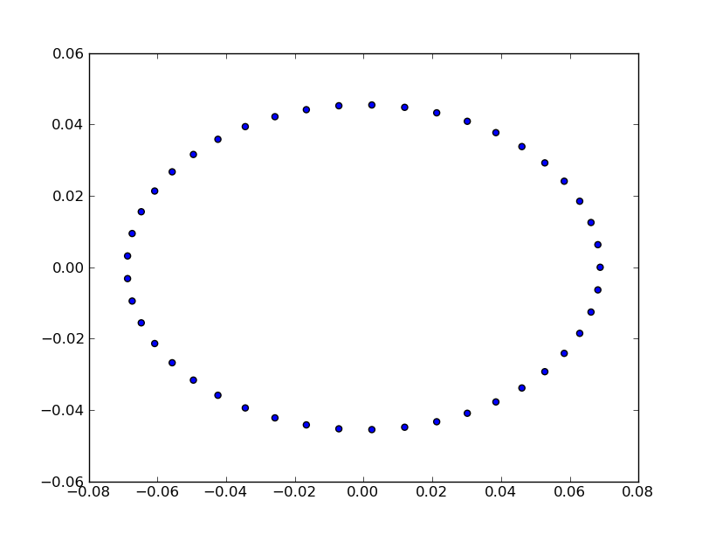
Concept: Elliptical Helical Coil
Task: Find 2D current distribution which generates (almost) pure dipole field
Calculate this for a set
of positions on ellipse
A-axis: 9.1 cm /2
B-axis: 13.77 cm /2
y (m)
x (m)

Slide 16
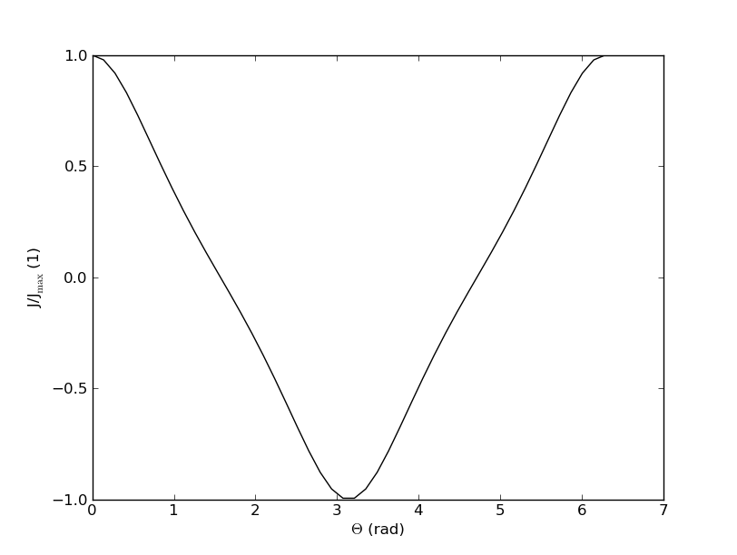
Answer: Current Distribution
Normalized current density vs. azimuthal angle

Slide 17
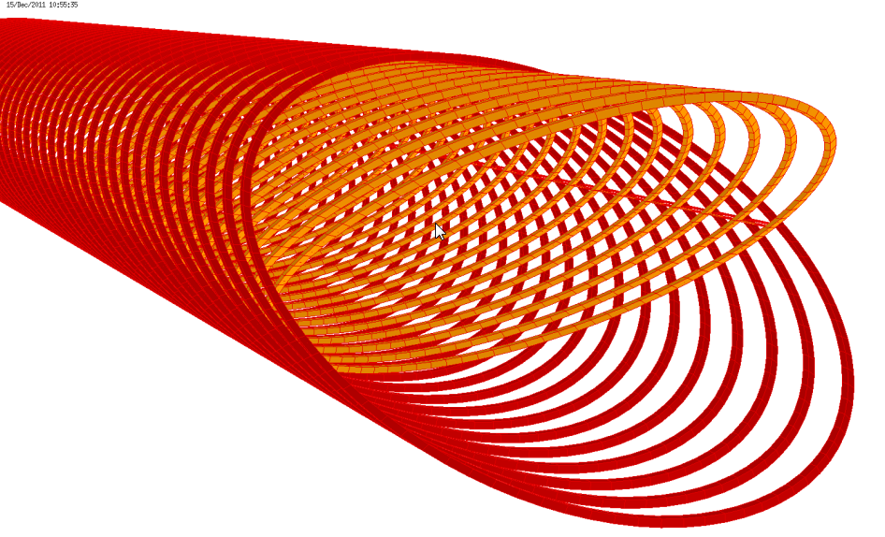
Implementation: Elliptical Helical Coil
40 turns
Spacing: 20 mm
(= length about 0.8 m + “coil ends”)
Single double layer
Current in strand: 10 kA
(=400 kA turns)
Average current density: 10 kA/(20mmx1 mm)=500A/mm²

Slide 18
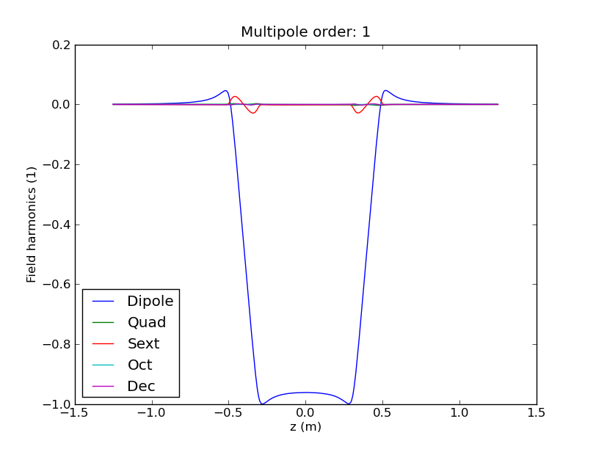
Field Harmonics
Normalized to
Dipole field of 1T
Evaluated for
radius of 25 mm
Well behaved: small sextupole component at coil entrance and exit

Slide 19
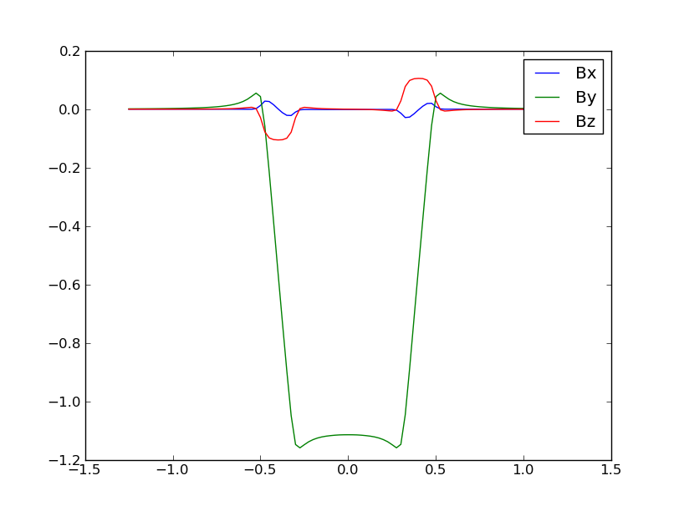
Field along z
10 kA = 1.1T
B (T)
z (m)
All unwanted field components point symmetric to the origin should disappear (e.g. B_{z})
for 4-layer arrangement

Slide 20
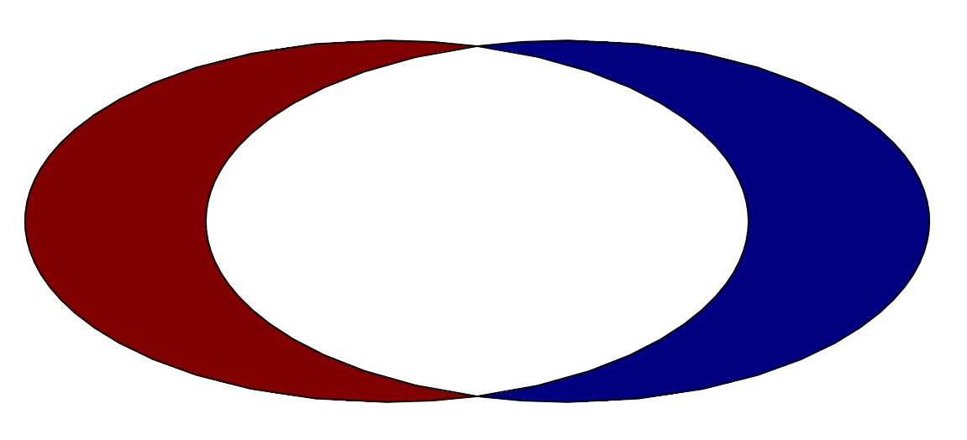
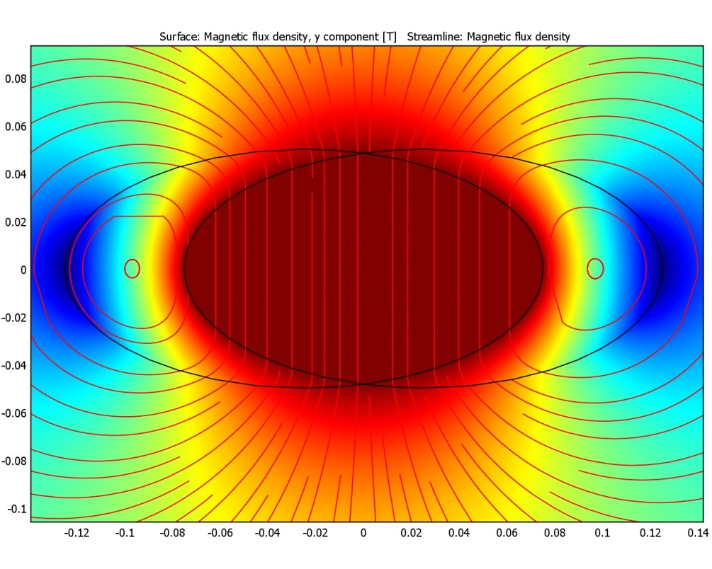
Other Geometries?
Well-known: intersecting ellipses produce dipole field
Worse performance
  Field quality
  Peak field on wire
Less flexible
Coil end problem?
Geometry problem
  Approximation with blocks
Stresses?
J+
J-

Slide 21
Additional Slides

Slide 22
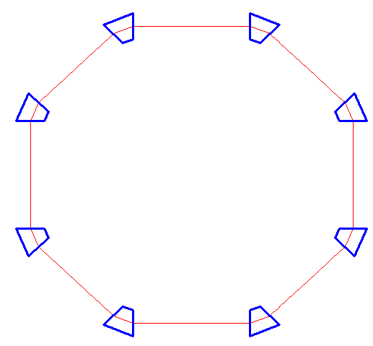
Integrable Optics
Introduce tune shift to prevent instabilities
  Introduces Landau damping
One option for high intensity machines
Key: Non-linear block
  Length 3 m
13 m
Nonlinear
Lens Block
10 cm
5.26
F
F

Slide 23
Required Vector Potential
Singularities
Difficult to approximate with multipole fields
Ideally non-circular aperture – 2 cm horizontal, 4 cm vertical

Slide 24
Integrable Optics - Field

Slide 25
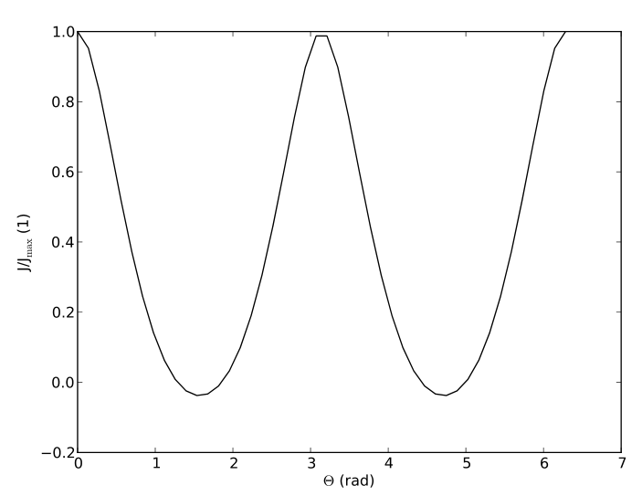
Quadrupole
Gauging

Slide 26
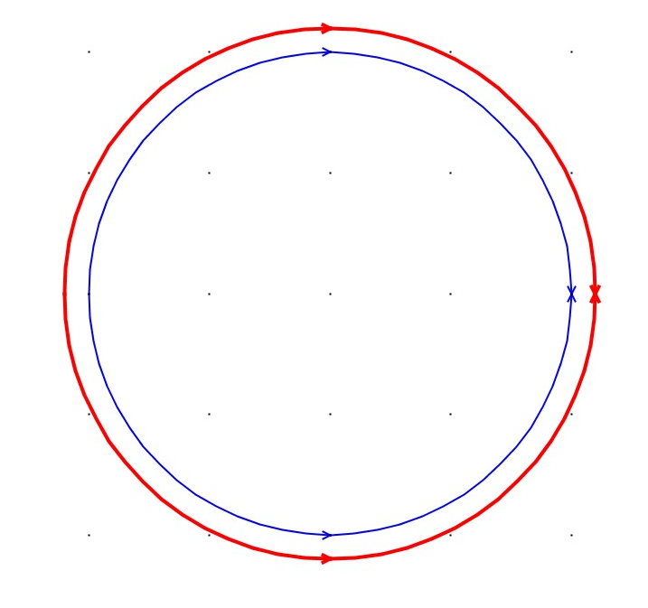
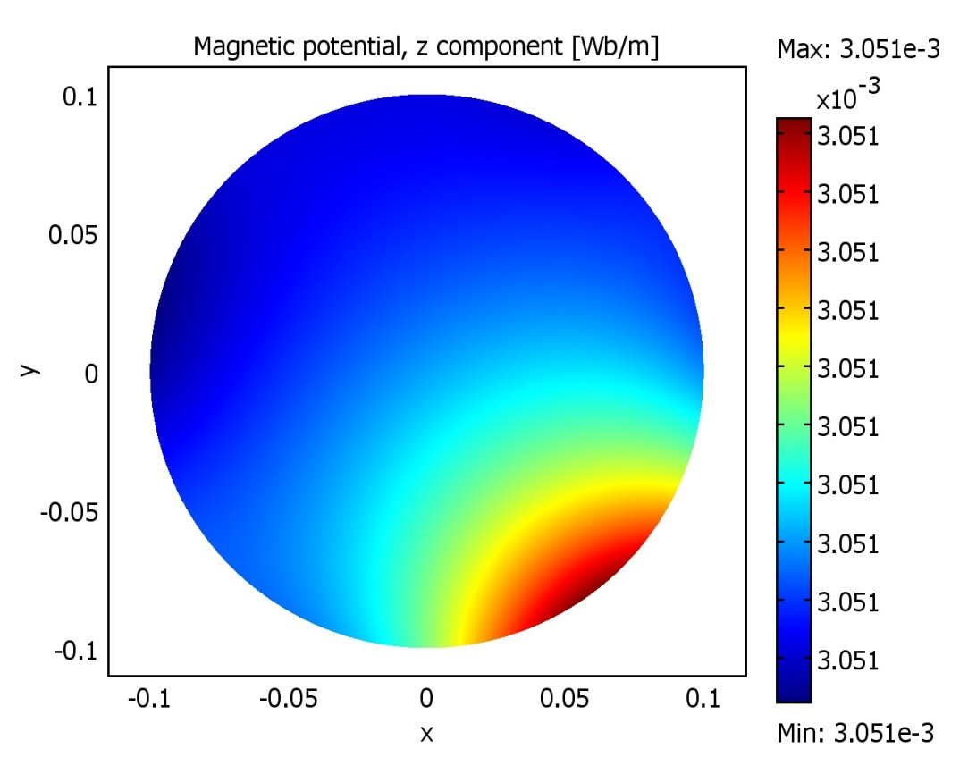
Gauging
Circular coil: constant current in longitudinal direction will cause a uniform vector potential A₀ within this circle
A_{z}(x,y)=A₁(x,y)+A₀
N.b.:
Ergo: changes vector potential but not field
Allows to shift current

Slide 27
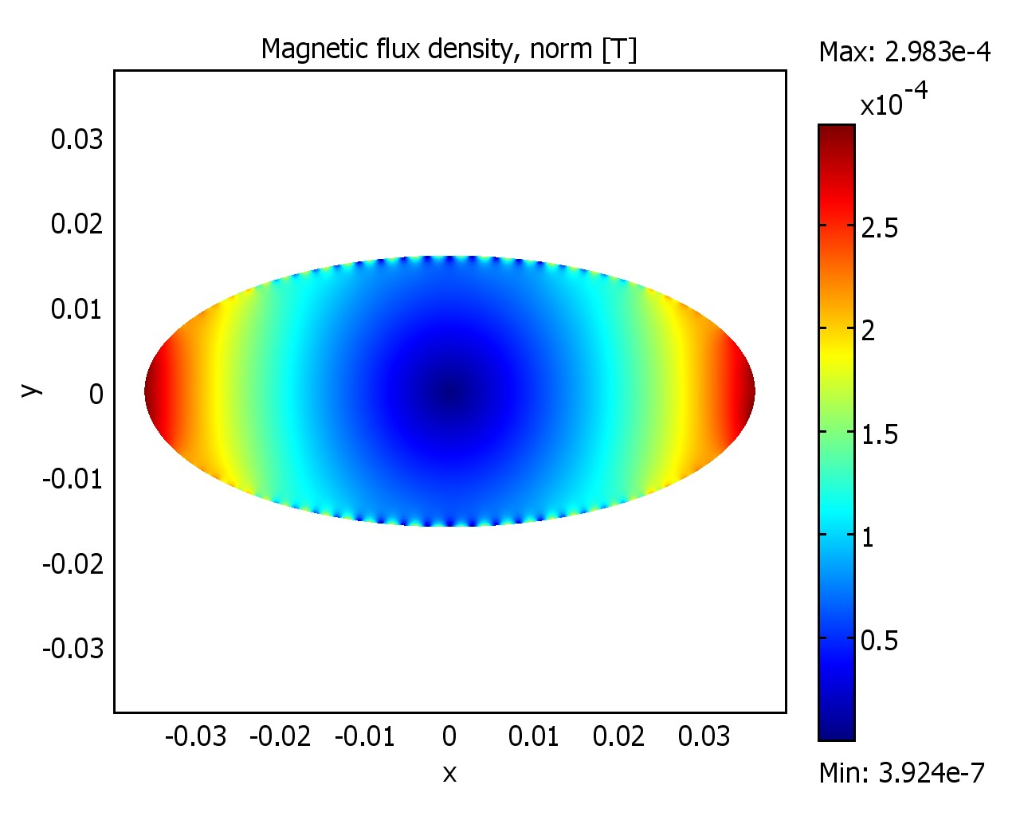
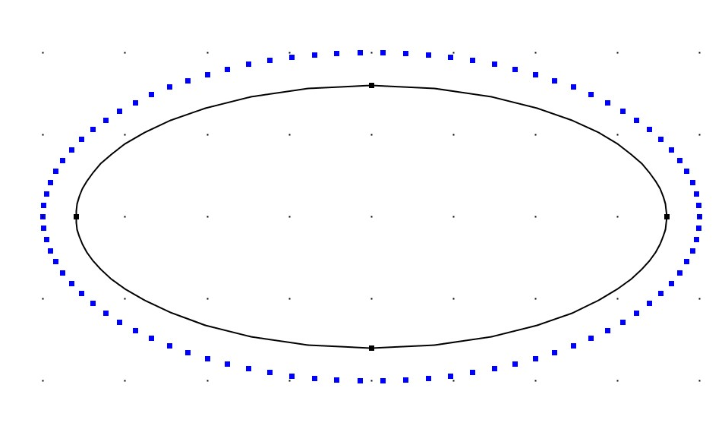
Gauging for elliptical coils
For elliptical coils (or other shapes): some modest variation of A_{z}
Example: quadrupole
Correction per current strand: 2kA
Field: 0.3 mT

Slide 28
Methodology
Required: desired vector potential
  Defined by application
Required: beam aperture
  Defined by application
  (Real coil will be slightly larger)
Az
y
x
Beam Aperture

Slide 29
Methodology (cont.)
Define point P₁ on desired cross-section (known Az)
Define current I₁ (for example on coil cross-section)
A_{z} can be calculated from
I₁
P₁

