Slide 1
A Dipole with Grain Oriented Steel

Slide 2
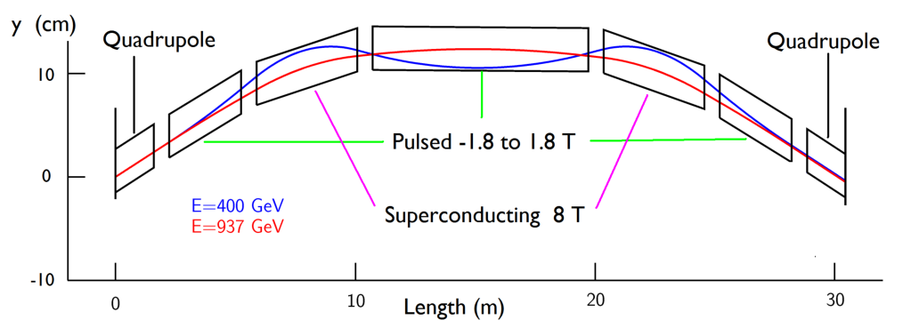
Problem Definition
Muon acceleration: use fast ramping dipoles + superconducting high field magnets
  Rep. rate: 1 kHz (+/-)
  B=-1.8 .. 1.8T
  Uses grain oriented steel
  D.Summers et al., arXiv:0707.0302

Slide 3
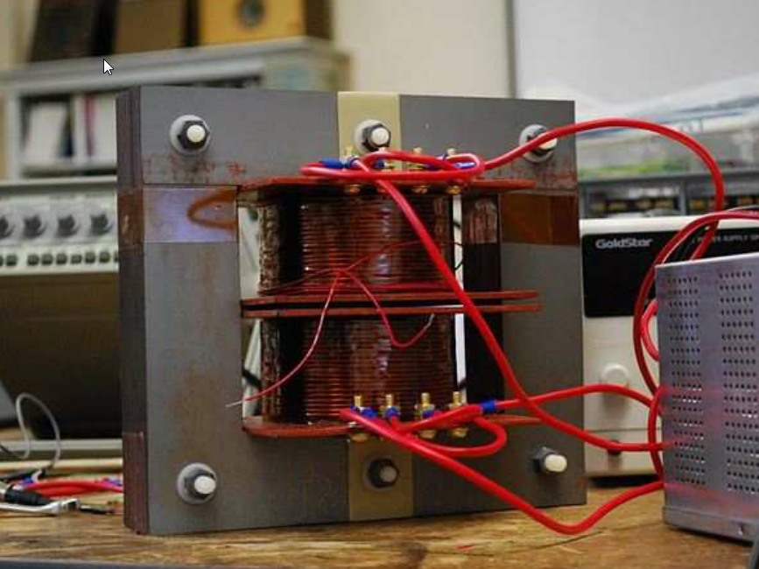
Problem Definition
Prototype Dipole does not perform as expected
1.5T instead of 1.8T
Modelling correct?

Slide 4
FEA Model
Opera 3D
  Magnetostatic simulation
  Explain drop in field
  (unsuitable for estimate on power loss)
Simulation based on modelling approach developed by VF
  Idea: break up internal iteration loop
  Linear elements, exploit symmetry
Included
  Anisotropic steel
  Packing factor 0.98

Slide 5
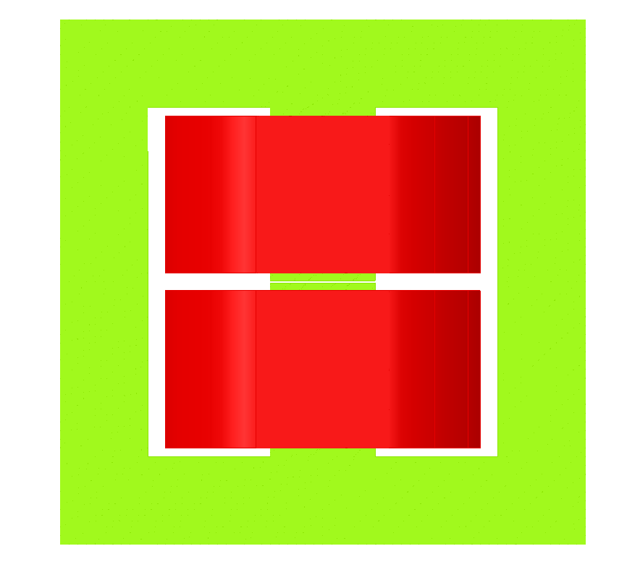
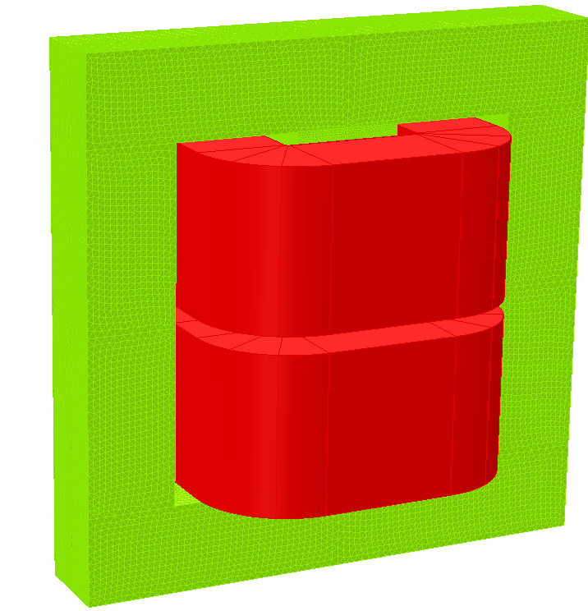
VF Model
Gap: 1.5 mm
t = 50 mm
300 mm
Grain orientation

Slide 6
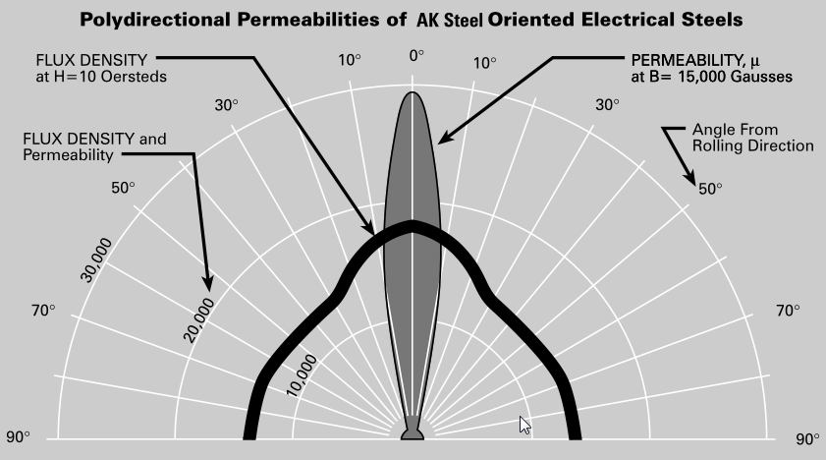
Grain Oriented Steel
Factor 30+?
Data from AK Steel (TRAN-COR)

Slide 7
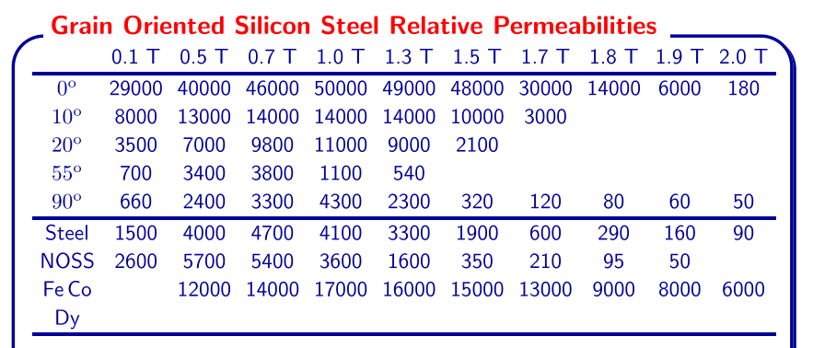
BH Data
Data from: D. Summers. Fast Ramping 750 GeV Muon Synchrotron, Muon Acceleration Program (MAP). 27 Jun - 1 Jul 2011. Telluride, Colorado.

Slide 8
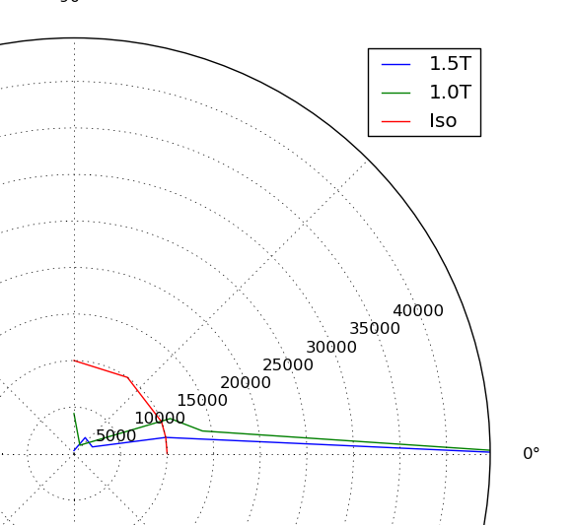
μ_{r}: Polar Plot

Slide 9
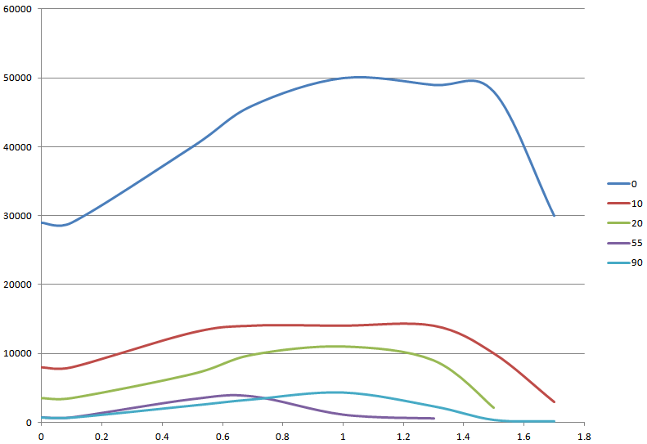
μ_{r} for various angles
Angle
μ_{r}
B (T)

Slide 10
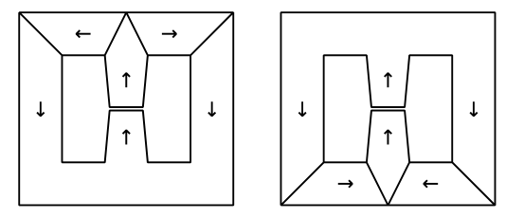
Simulation
BH data implemented in VF simulation
  For 0 and 90 degrees
  (insufficient data points for other angles)
  (functions based on tabular data with 2 or more variables possible)
Simulations: two sheets (+ boundary conditions)
  Magnet geometry as is
  Magnet geometry with ‘mitre’

Slide 11
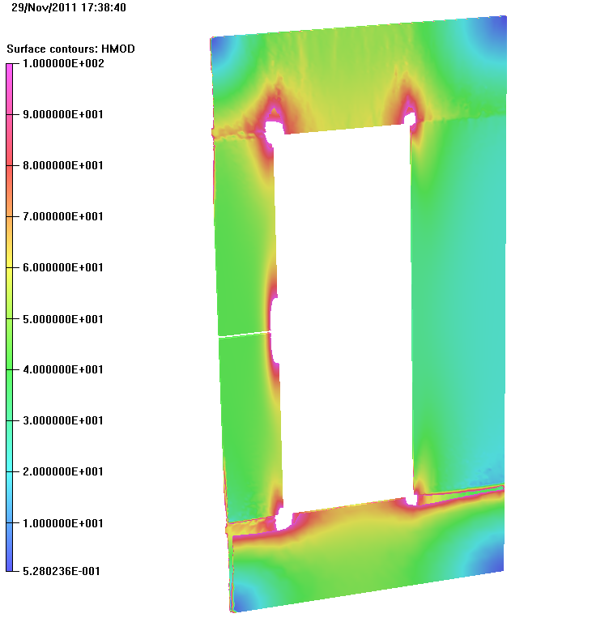
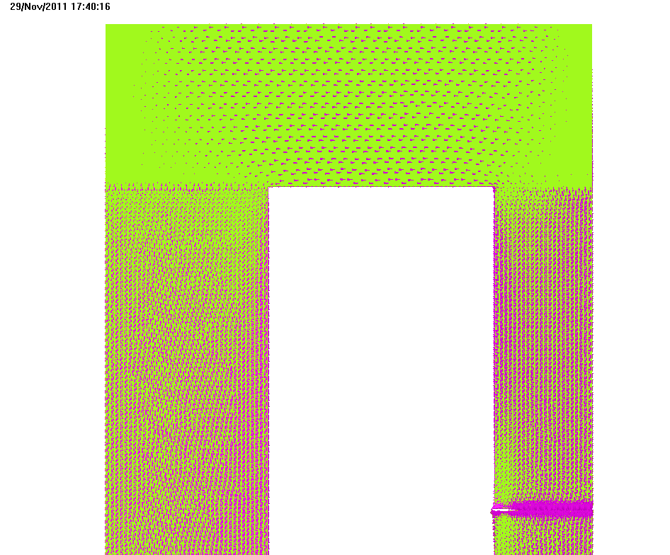
Magnetization and Vector Plot
H is low (mostly < 100 A/m) – mu_r =80..14000

Slide 12
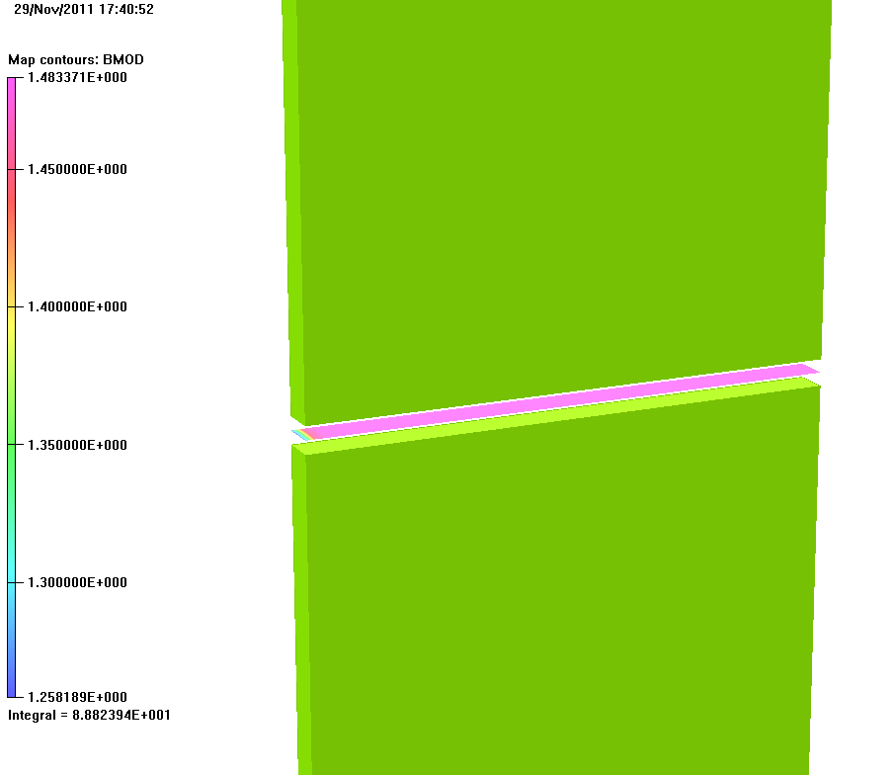
Field in Gap
1.483T
Relatively uniform

Slide 13
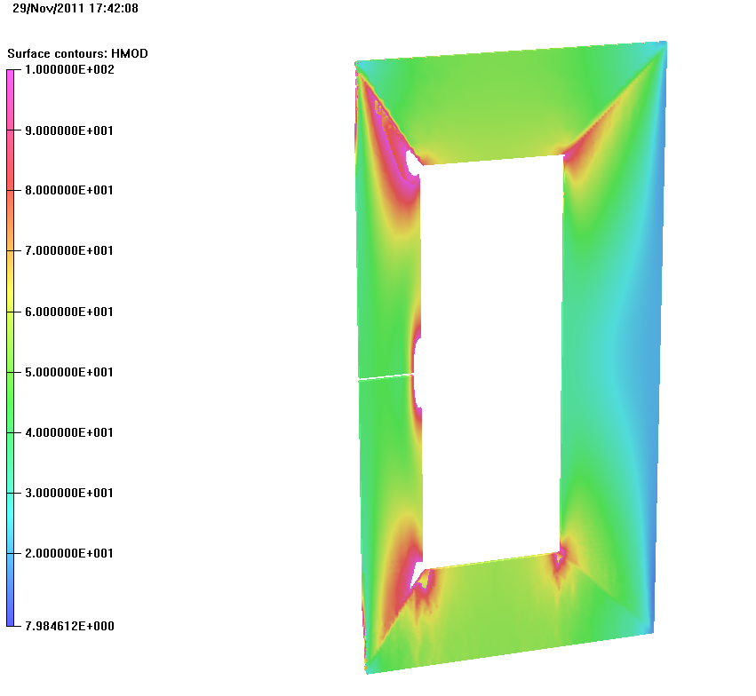
Mitre Geometry
Same as before:
H is relatively low
(<100 A/m)
Mu_r=80..14000

Slide 14
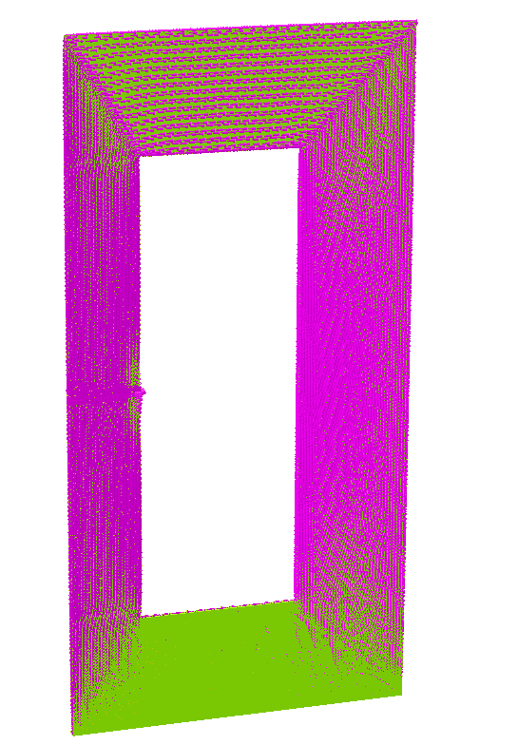
Vector Plot

Slide 15
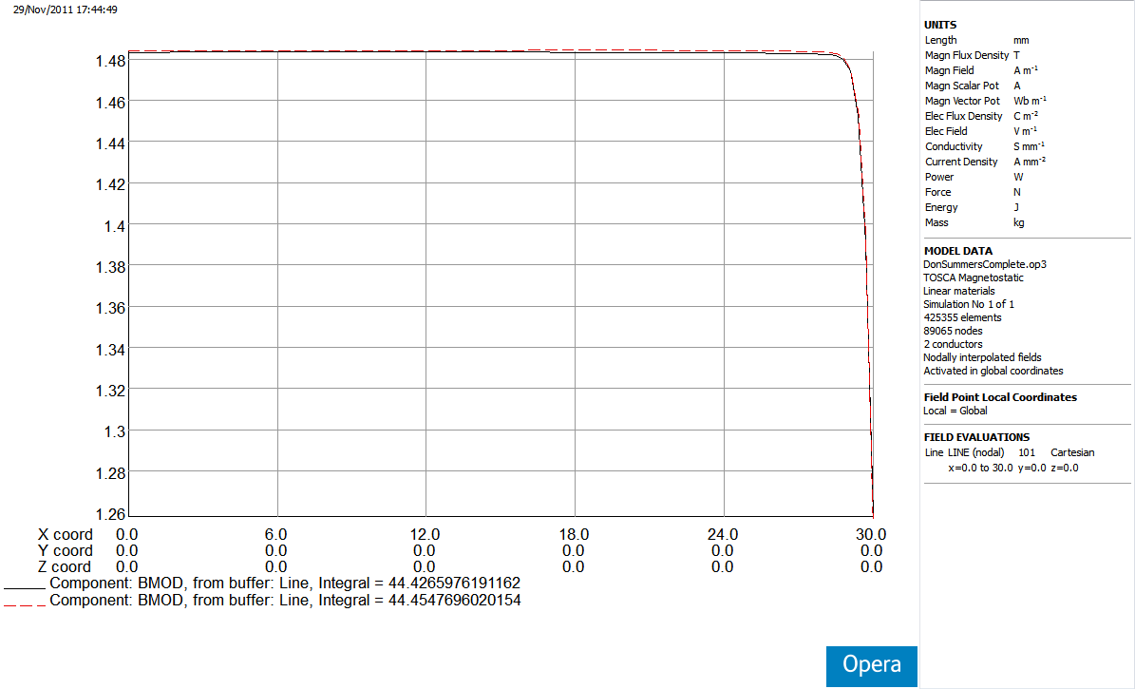
Field in Gap

Slide 16
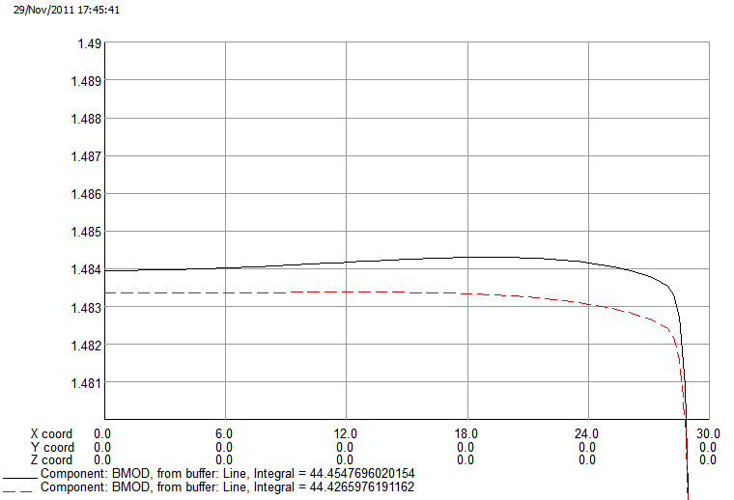
Field in Gap (cont.)
Mitre
Block
B (T)
X (mm)

Slide 17
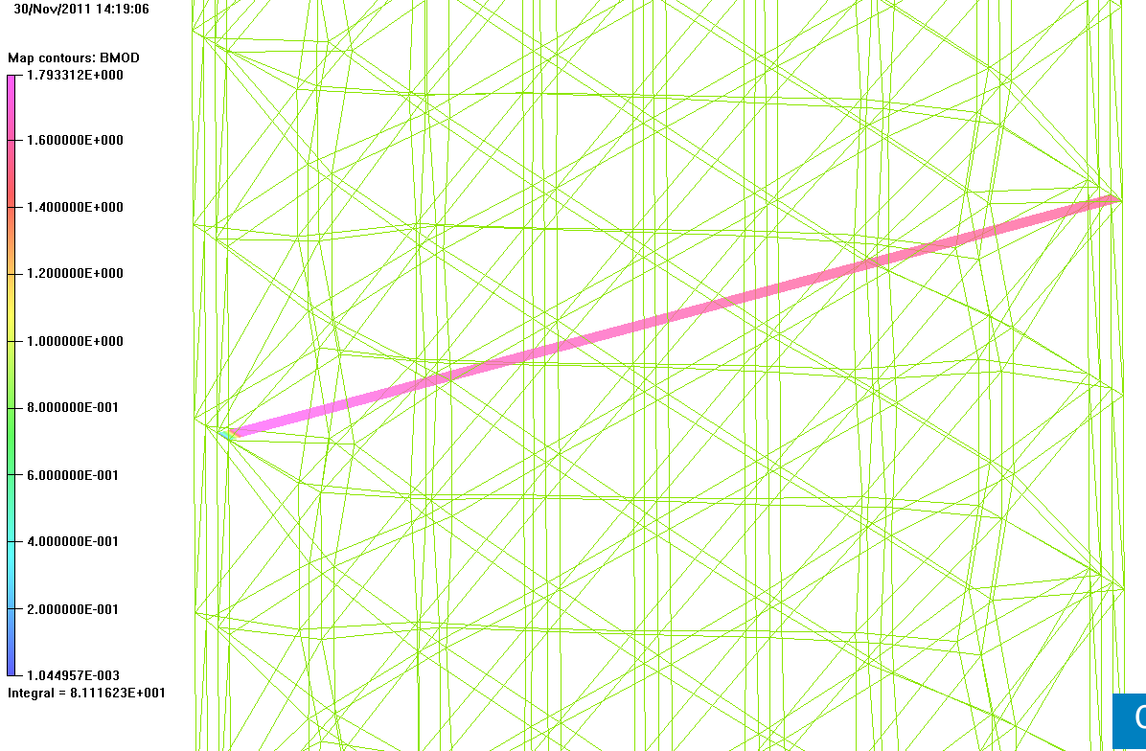
Flux Jump Between Slabs
81 Wb (mitre: 76 Wb)

Slide 18
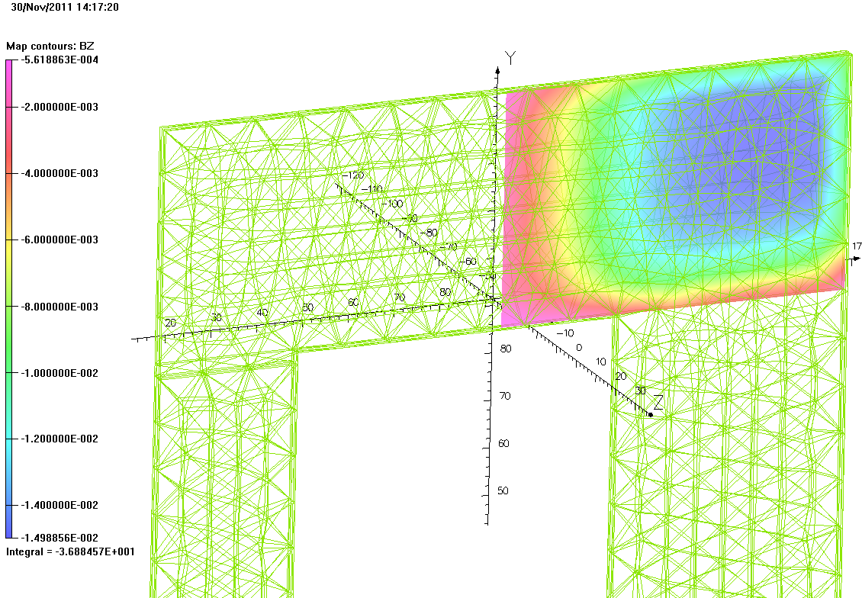
Flux Between Slabs – Initial Geometry
37 Wb

Slide 19
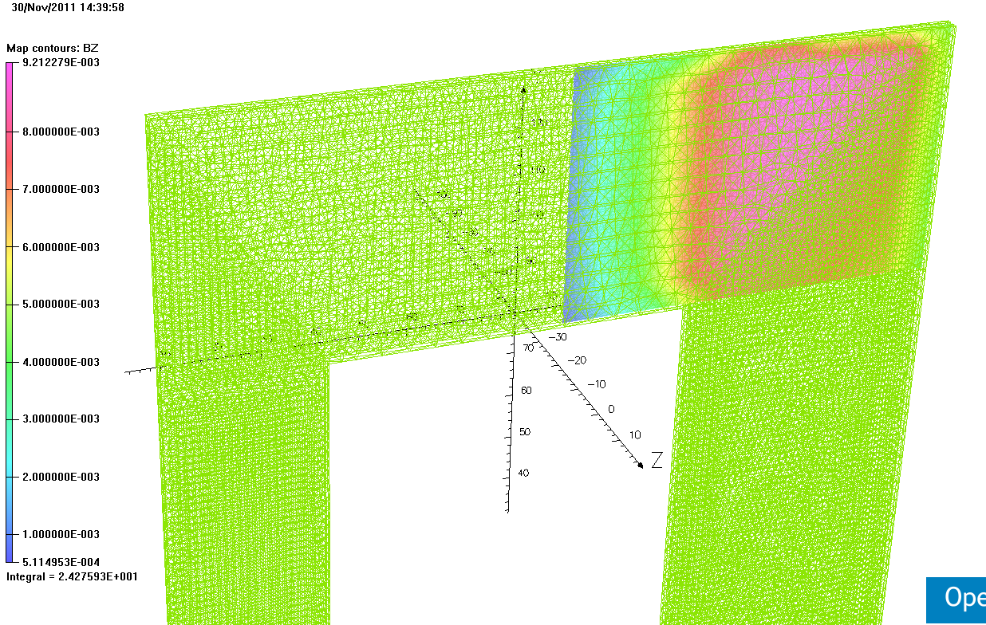
Flux Between Slabs – Mitre
24 Wb

Slide 20
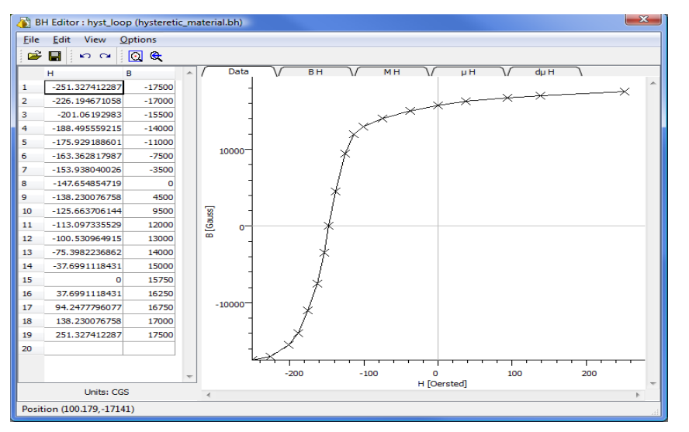
Future?
Estimate power loss
  Hysteresis loop necessary
  Can be implemented in Opera/ELEKTRA

Slide 21
Summary
Previous assumptions too pessimistic – steel is not as anisotropic as feared initially
  Much better performance in general
Simulations can explain why new magnet design (mitre) performs as expected
  It does not explain why the old design did not work as expected…
Next steps?
  More data points on BH curve needed (at more angles)
  Power dissipation: Full magnetization / demagnetization curve required (at different fields)

