Slide 1
Meson Productions for IDS120h (Update)
X. Ding, UCLA
AAG Meeting, Feb. 16, 2012

Slide 2
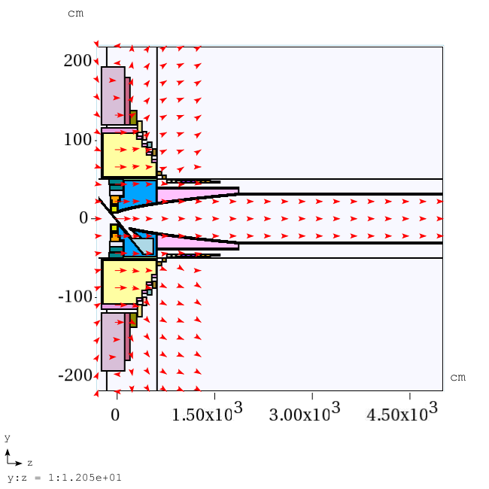
Configuration of IDS120h

Slide 3
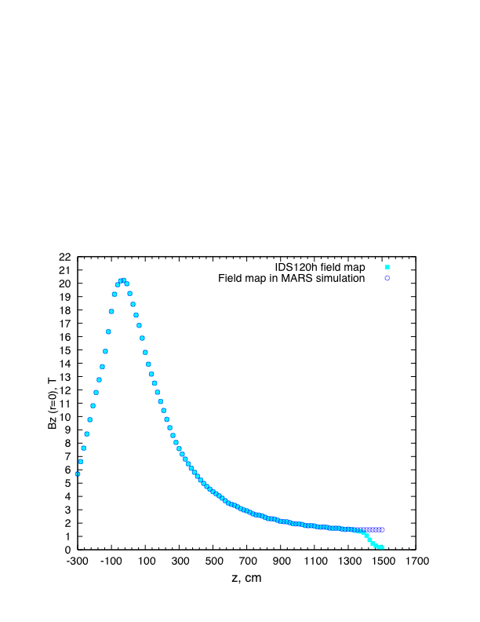
Field Map of IDS120h (Bz at r = 0)

Slide 4
Meson Production Study
The mercury jet target geometry. The proton beam and mercury jet cross at z=-37.5 cm.
IDS120h (Geometry and fieldmap) for HG/GA target
Beam below the HG/GA jet exactly at z=-37.5 cm and project beam back to z=-200cm.
Initial target parameters: target radius of 5 mm, beam angle of 67 mrad at z=-37.5 cm, beam/jet crossing angle of 33 mrad at z=-37.5 cm.
Optimized methods at each cycle (3 runs): 1) Vary jet radius; 2) Vary beam/jet crossing angle while keeping jet fixed - always project beam back to z=-200 cm; 3) Vary jet angle-always keep crossing angle constant-both jet and beam must be rotated about intersection point together and always project beam back to z=-200 cm.

Slide 5
Optimized Target Parameters at z = -37.5 cm
 | HG |  |  | GA
 | Target radius, mm | Crossing angle, mrad | Beam angle, mrad | Target radius, mm | Crossing angle, mrad | Beam angle, mrad
Initial | (5mm, 33mrad, 67mrad) |  |  | (5mm, 33mrad, 67mrad)
1st Cycle | 4.6 | 23 | 120 | 6.7 | 21 | 112
2nd Cycle | 4.15 | 23 | 117 | 5.5 | 17 | 94
3rd Cycle | 4.15 | 21.6 | 120 | 4.9 | 13.2 | 92
4th Cycle | 4.04 | 20.6 | 117 | 4.5 | 13 | 90
5th Cycle |  |  |  | 4.4 | 12.8 | 86
6th Cycle |  |  |  | 4.4 | 13 | 88

Slide 6
Meson Productions at 8 GeV (400,000 events)
 | HG | GA | [N(GA)-N(HG)]/N(HG)
Before optimization (Target radius/beam angle/crossing angle) | 108528 (5mm/67mrad/33mrad, Initial) | 96586 (5mm/67mrad/33mrad, Initial) | -11% (w/t opt)
After optimization (Target radius/beam angle/crossing angle) | 131362 (4.04mm/117mrad/20.6mrad, end of 4th Cycle) | 114401 (4.5mm/90mrad/13mrad, end of 4th Cycle) | -12.9% (opt)
[N(opt)-N(w/t opt)]/N(w/t opt) | +21% | +18.4%

Slide 7
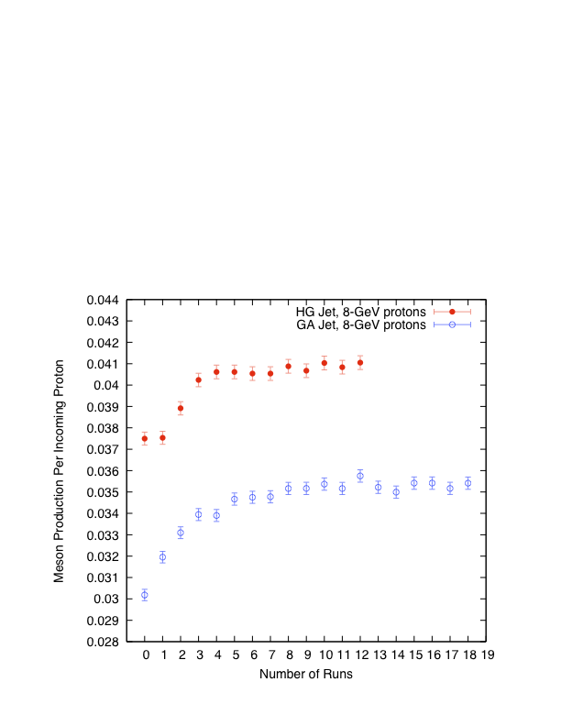
Meson Productions Vs. Run No. (Number of runs: 0-Initial, 1,4,7,10,13,16-optimized target radius, 2,5,8,11,14,17- optimized crossing angle, 3,6,9,12,15,18-optimized beam angle )

Slide 8
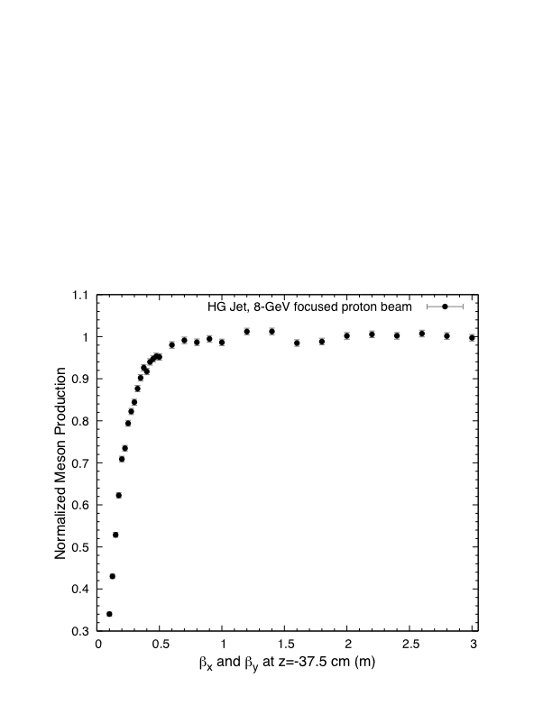
Focused Incident Proton Beam

Slide 9
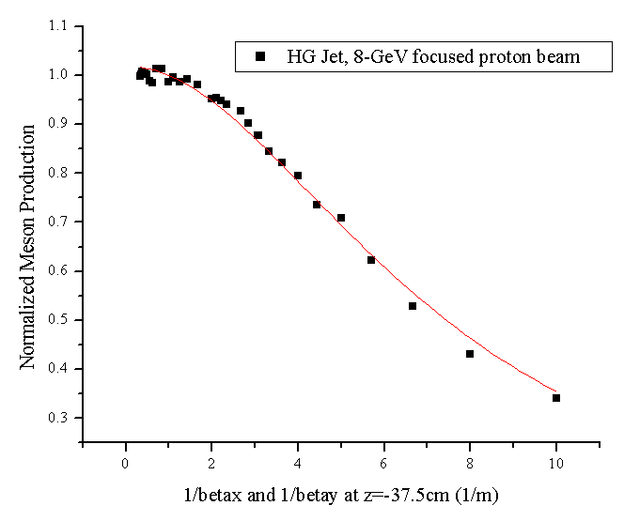
Focused Incident Proton Beam (Cont’d)
Non-Linear Fit
(Growth/sigmoidal, Hill)
Y=N/(1+K2/beta⁻²)
N=1.018
Sqrt(K2)=0.1368
Linear emittance is 4.8 μm with beam radius of 0.12 cm and β* of 0.3 m.

Slide 10
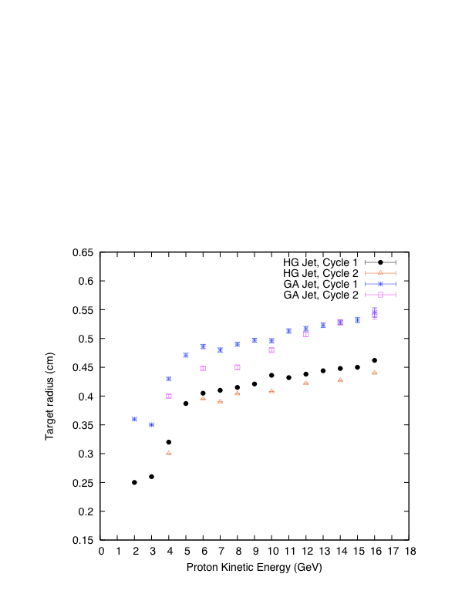
Target Radius vs. KE

Slide 11
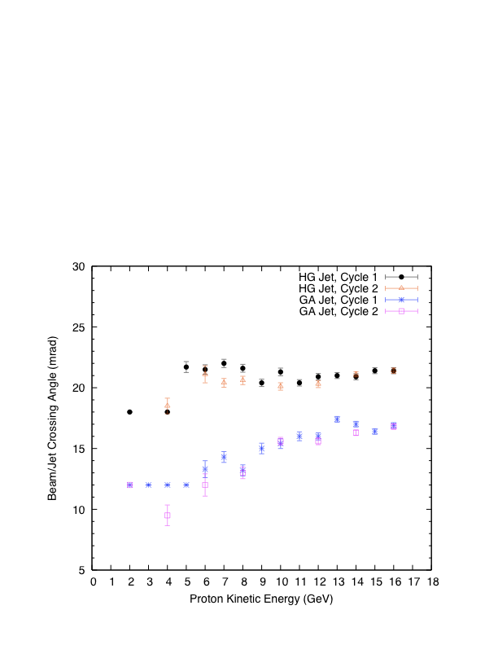
Beam/Jet Crossing Angle vs. KE

Slide 12
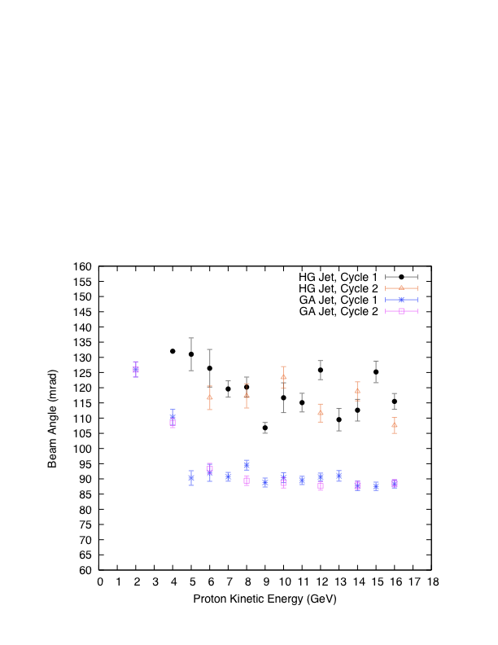
Beam Angle vs. KE

Slide 13
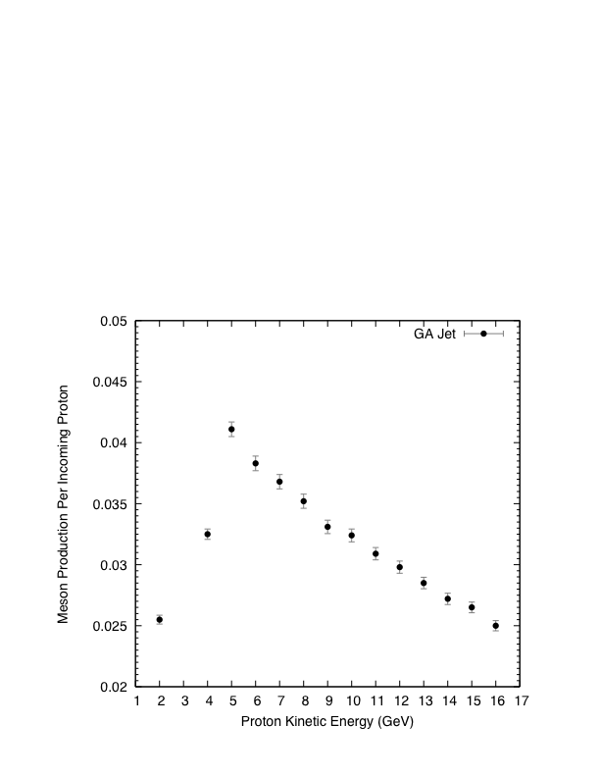
Meson Production vs. KE

